Slide 1


Slide 1
Introducing CLOUD DIAL
The Leading Cloud Dial company in Emerging Markets

Slide 2

FOR YOUR CUSTOMERS
Never wait on calls
One number for life
Delightful experience -
Many ways of
connecting with you

Slide 3

FOR YOUR Employee
Employees have the opportunity to use company resources
Employees have the opportunity to use company resources
Employees have the opportunity to use company resources

Slide 4




Slide 1
We supply our customers world wide , so they can get facilities every where in the world.
We supply our customers world wide , so they can get facilities every where in the world.
We supply our customers world wide , so they can get facilities every where in the world.

Slide 5

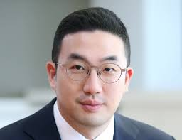
Slide 1
“With the appointment of Koo Kwang-mo as CEO and chairman, LG is being criticized for following the chaebol tradition of keeping corporate management under the control of the founding family.”
Subtitles Goes here
CEO of Cloud Dial

Slide 6


Slide 1
All the employees and customers have the permission to upload work.
1
All the employees and customers have the permission to upload work.
2
All the employees and customers have the permission to upload work.
All the employees and customers have the permission to upload work.
3
All the employees and customers have the permission to upload work.

Slide 7



Slide 1
All the employees and customers have the permission to upload work.
All the employees and customers have the permission to upload work.
Defined Framework
All the employees and customers have the permission to upload work.

Slide 8


Slide 1
“With the appointment of Koo Kwang-mo as CEO and chairman, LG is being criticized for following the chaebol tradition of keeping corporate management under the control of the founding family.”
“With the appointment of Koo Kwang-mo as CEO and chairman, LG is being criticized for following the chaebol tradition of keeping corporate management under the control of the founding family.”
Introducing CLOUD DIAL
The Leading Cloud Dial company in Emerging Markets

Slide 9

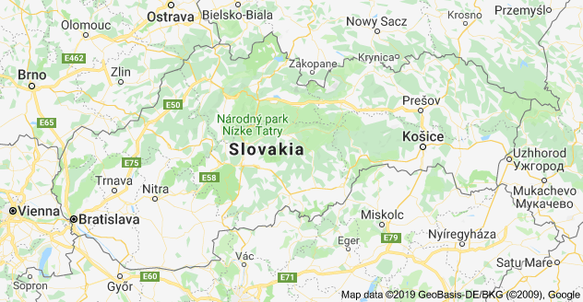


Find us
All the employees and customers have the
permission to upload work. permission to upload work
Slovakia

Slide 10

Slide 10
THANK YOU

