Slide 1
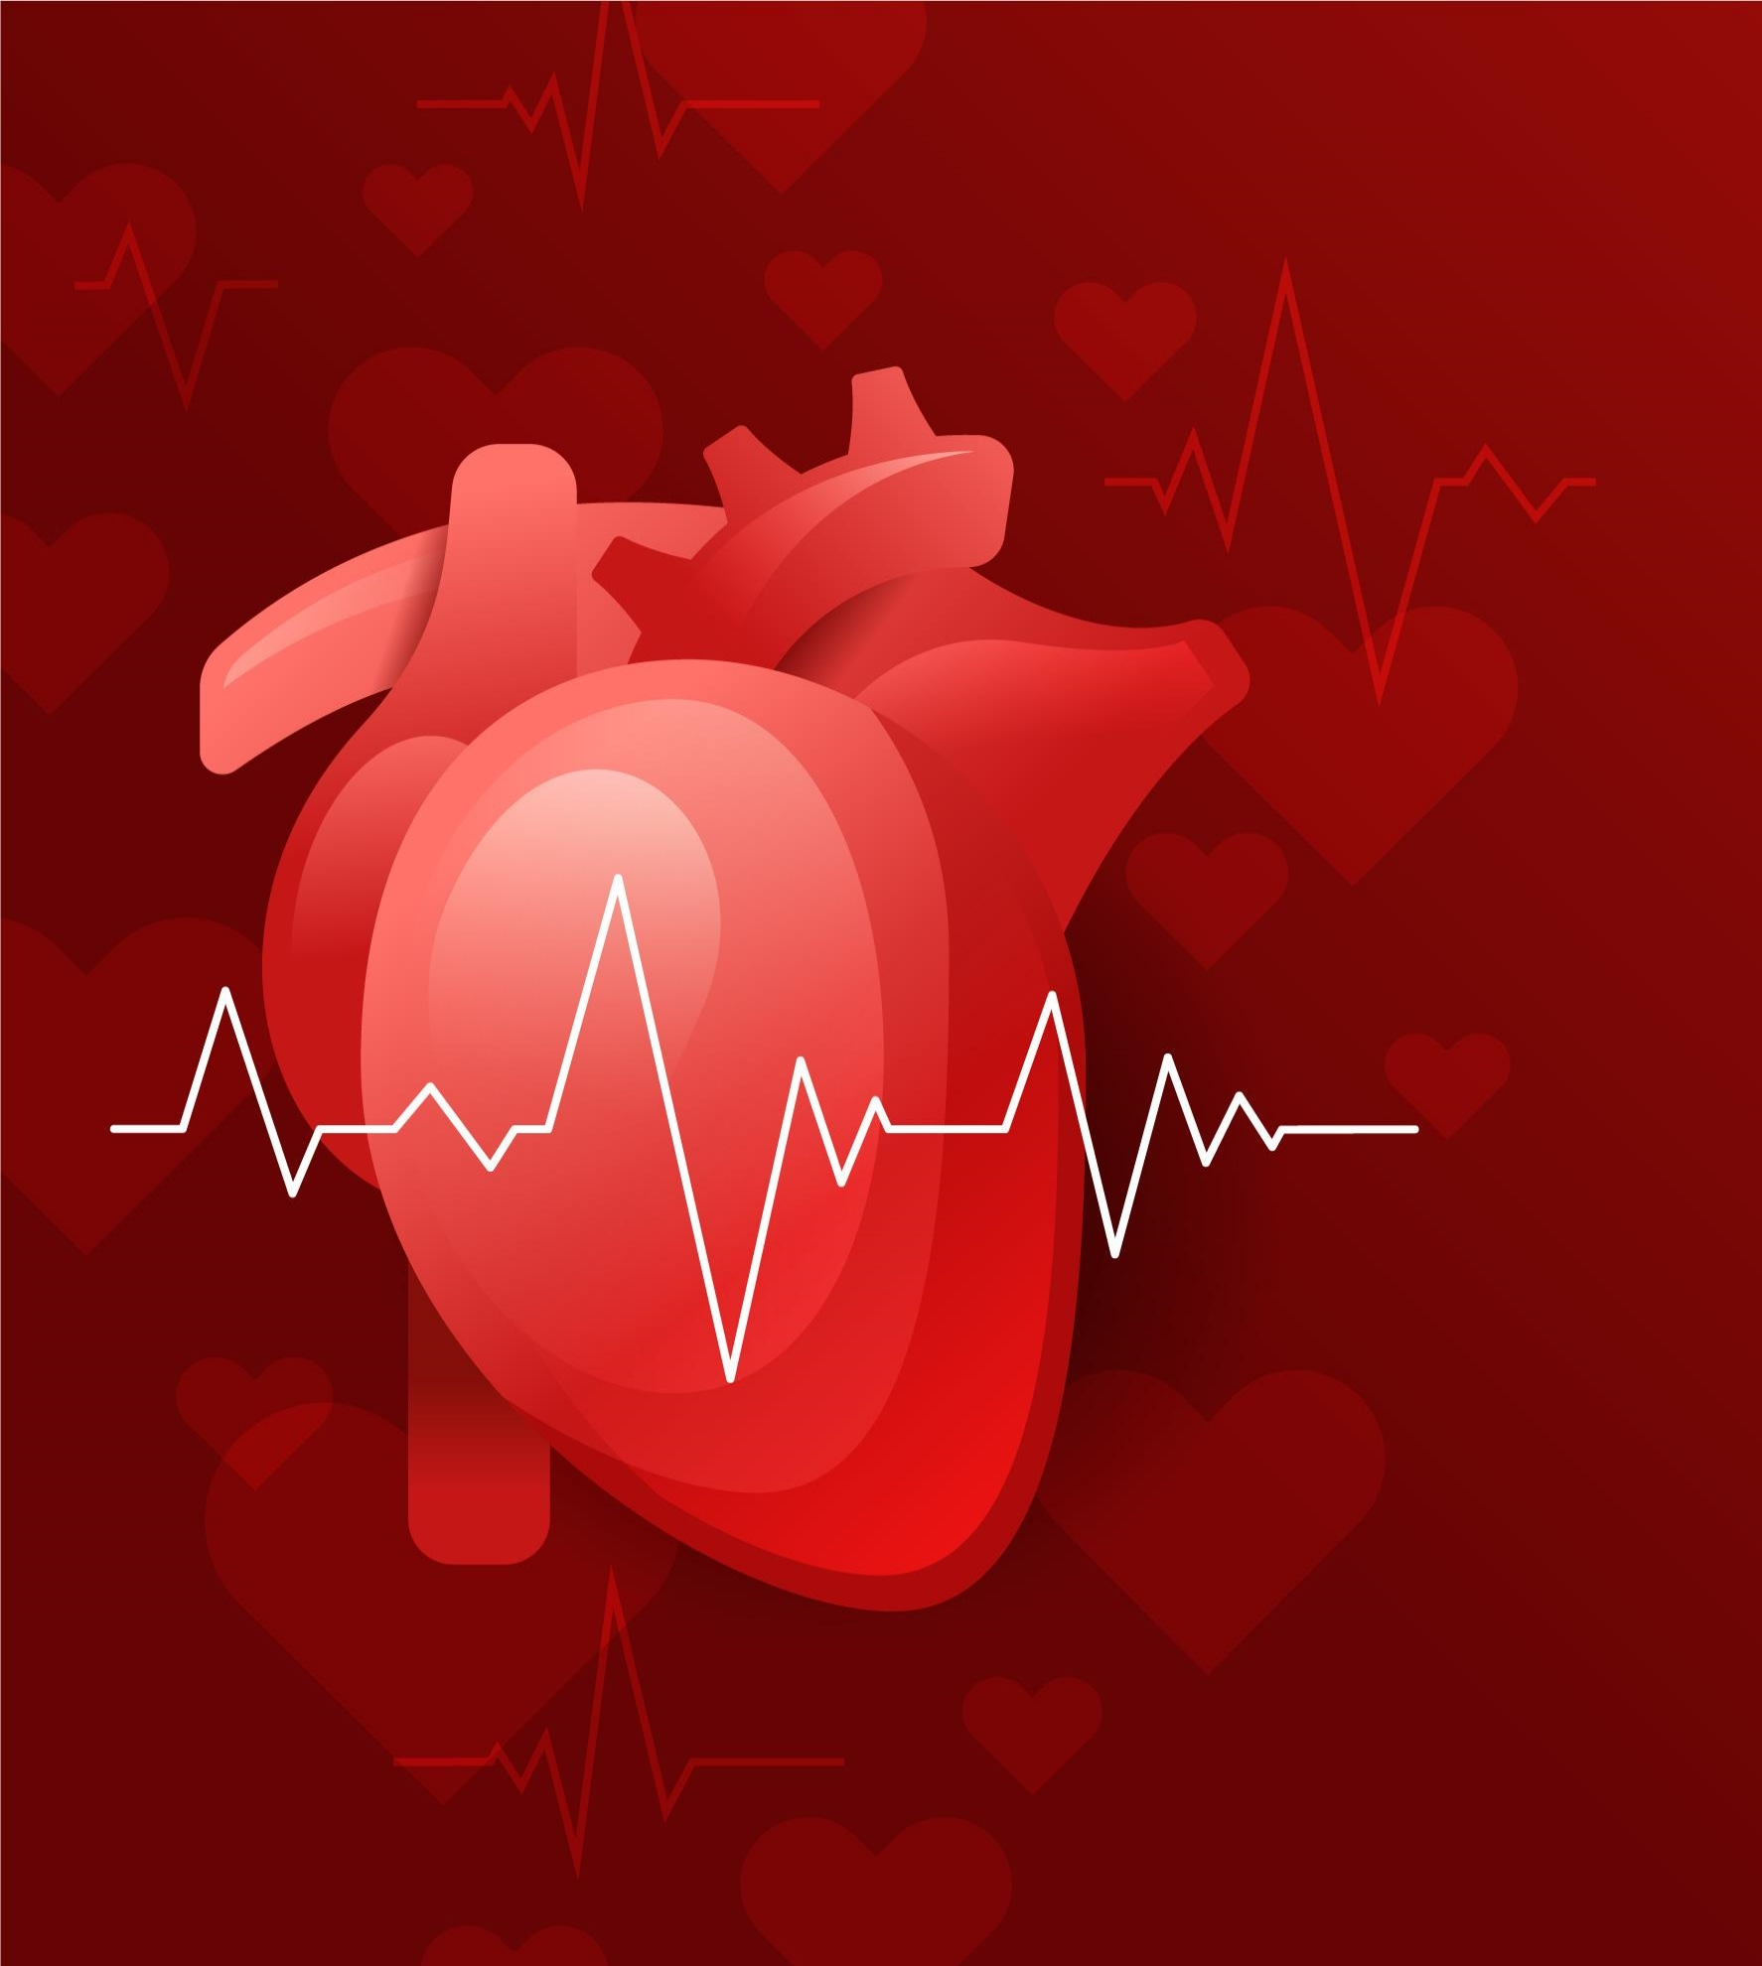
CARADIOLOGY BREAKTHROUGH
Here is where your presentation begins

Slide 2
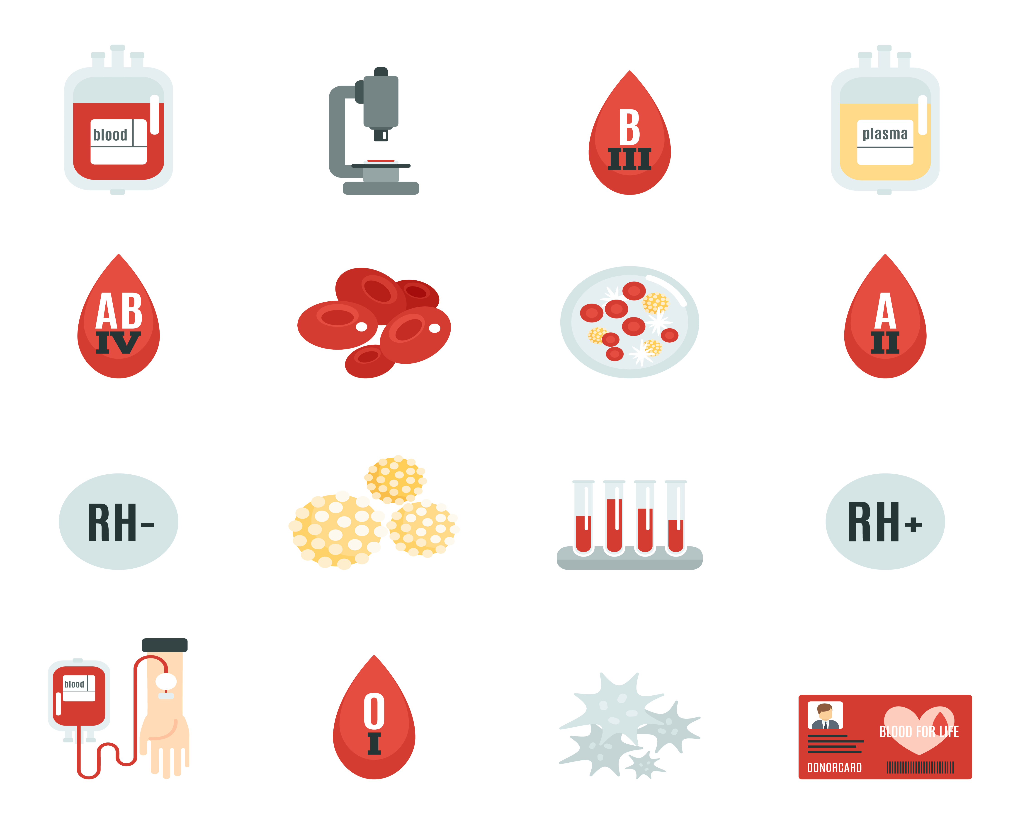
01
02
OBJECTIVES
METHODOLOGY
03
04
RESULTS ANALYSIS
CONCLUSIONS
Here you could describe the topic of the section
Here you could describe the topic of the section
Here you could describe the topic of the section
Here you could describe the topic of the section

Slide 3
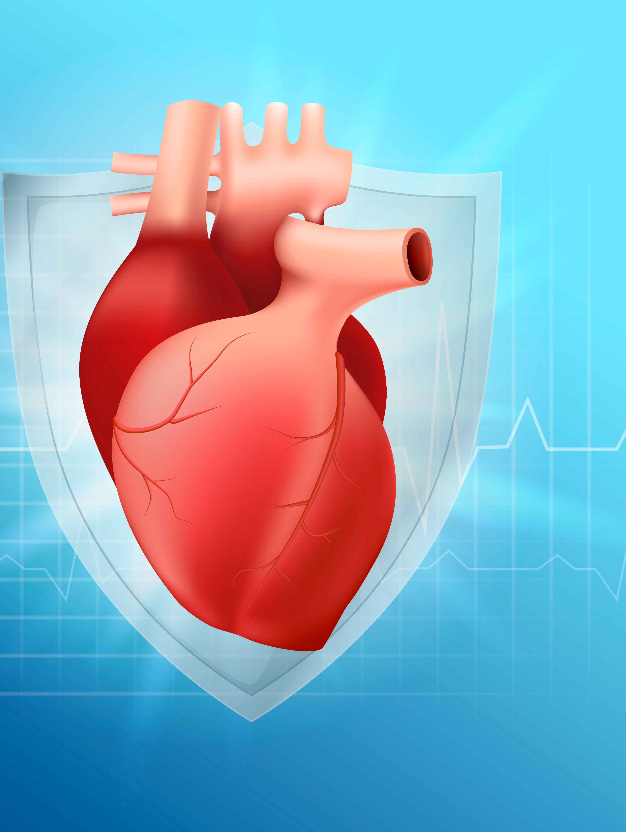
INTRODUCTION
Mercury is the closest planet to the Sun and the smallest one in the Solar System—it’s only a bit larger than our Moon. The planet’s name has nothing to do with the liquid metal since it was named after the Roman messenger god, Mercury

Slide 4
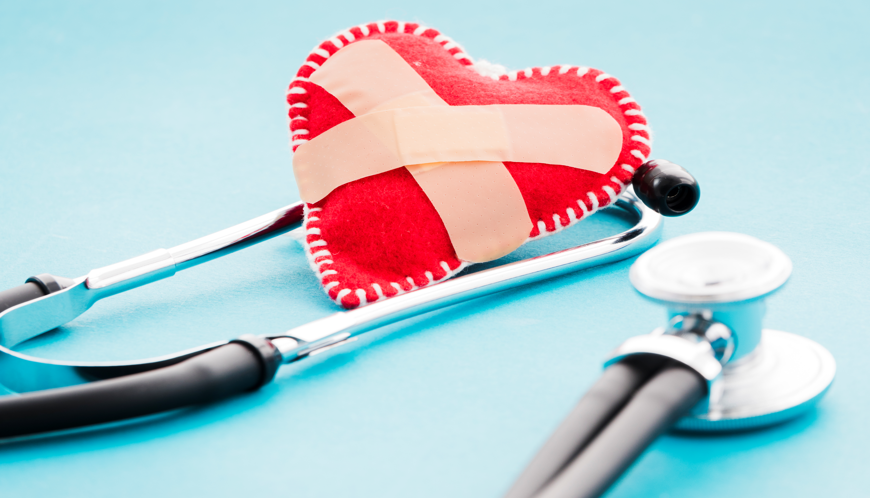
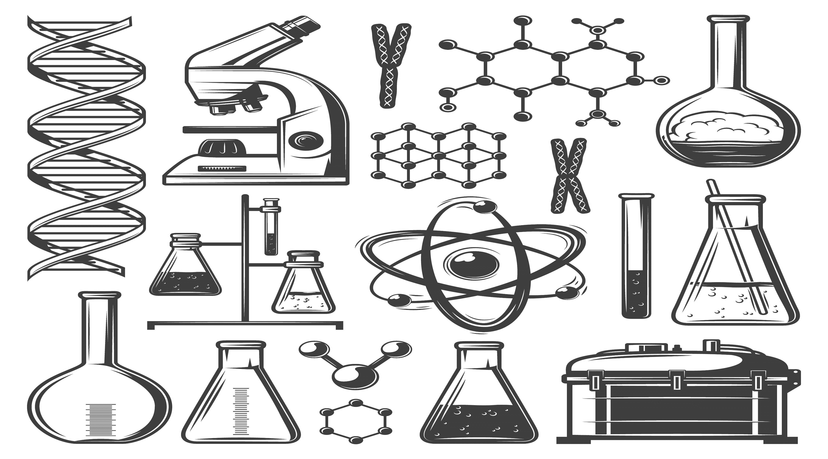
SATURN
MARS
Saturn is composed mostly of hydrogen and helium
Despite being red, Mars is a cold place, not hot. It’s full of iron oxide dust
JUPITER
VENUS
Jupiter is a gas giant and the biggest planet in our Solar System
Venus has a beautiful name, but it’s terribly hot, even hotter than Mercury

Slide 5
GOALS
MERCURY
VENUS
MARS
Mercury is the closest planet to the Sun and the smallest one in the Solar System—it’s only a bit larger than our Moon
Venus has a beautiful name and is the second planet from the Sun. It’s terribly hot and its atmosphere is poisonous
Despite being red, Mars is a cold place, not hot. It’s full of iron oxide dust, which gives the planet its reddish cast

Slide 6
METHODS
MERCURY
JUPITER
VENUS
SATURN
Mercury is the closest planet to the Sun
It’s the biggest planet in our Solar System
Venus has a beautiful name, but it’s terribly hot
It’s composed mostly of hydrogen and helium

Slide 7
CLINICAL TRIAL
PRECLINICAL
PHASE 1
PHASE 2
PHASE 3
Lab Studies
Human Safety
Expanded Safety
Efficacy & Safety

Slide 8
RESEARCH AND PUBLICATIONS
“the second planet from the Sun. It’s terribly hot and its atmosphere is extremely poisonous”
the Sun and the smallest one in the Solar System—it’s only a bit larger than our Moon”
mostly of hydrogen and helium. It’s over 95 times more massive than the Earth”
by VENUS
by MERCURY
by SATURN

Slide 9

REFERENCE
Here you can list your reference websites
Here you can list your reference websites
Here you can list your reference websites
Here you can list your reference websites
Here you can list your reference websites
Here you can list your reference websites
Here you can list your reference websites

Slide 10
FACTORS TO CONSIDER
VENUS
MERCURY
JUPITER
Venus has a beautiful name, but it’s terribly hot
Mercury is the closest planet to the Sun
It’s a gas giant and the biggest planet

Slide 11
TRIAL TIMELINE
EXPERIMENTATION
STEP 2
RESEARCH
STEP 1
Venus has a beautiful name, but it’s terribly hot
Mercury is the closest planet to the Sun
PRECLINICAL
STEP 3
CONCLUSIONS
STEP 5
Neptune is the fourth-largest planet in our Solar System
Despite being red, Mars is a cold place, not hot
RESULTS
STEP 4
The Sun is the star at the center of the Solar System

Slide 12
METHODOLOGY
6 MONTHS
People with common habits
Experimentation time
5%
Confirmation rate
SAMPLE
GOAL
20 - 80 participants
Study the connection between habits and
the disease
RESULTS
POSSIBLE CAUSES
Venus has a beautiful name and is the second planet from the Sun. It’s terribly hot—even hotter than Mercury—and its atmosphere is extremely poisonous
Venus has a beautiful name and is the second planet from the Sun. It’s terribly hot—even hotter than Mercury—and its atmosphere is extremely poisonous

Slide 13
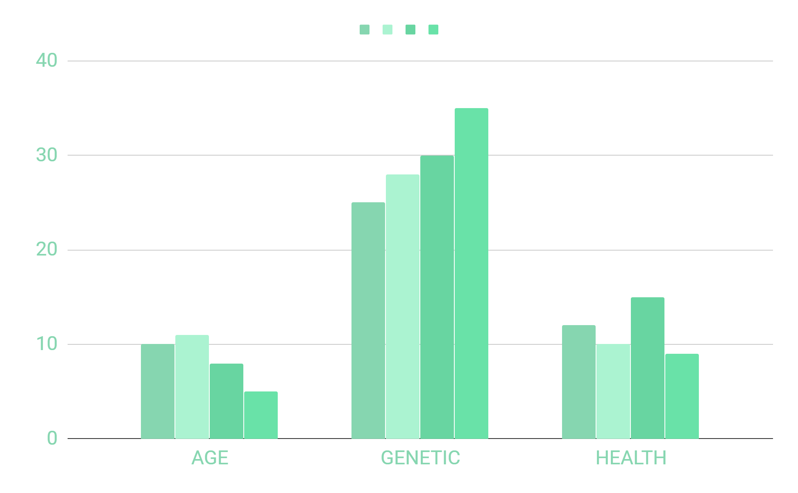
TENDENCY
Mercury is the closest planet to the Sun and the smallest one in the Solar System—it’s only a bit larger than our Moon. The planet’s name has nothing to do with the liquid metal since it was named after the Roman messenger god, Mercury
IF YOU WANT TO MODIFY THESE GRAPHS, CLICK ON THEM, FOLLOW THE LINK, CHANGE THE DATA AND REPLACE THEM

Slide 14
RESULTS
EXPERIMENT A
EXPERIMENT B
 | OUTCOME
TREATMENT | Test 1 | Test 2 | Test 3
Group 1 | 315 | 285 | 600
Group 2 | 210 | 390 | 600
Group 3 | 240 | 165 | 580
 | OUTCOME
TREATMENT | Test 1 | Test 2 | Test 3
Group 1 | 315 | 285 | 600
Group 2 | 210 | 390 | 600
Group 3 | 240 | 165 | 580

Slide 15
RESULTS ANALYSIS
NEPTUNE
SATURN
6%
24%
57%
13%
12%
23%
42%
64%
64%
64%

Slide 16
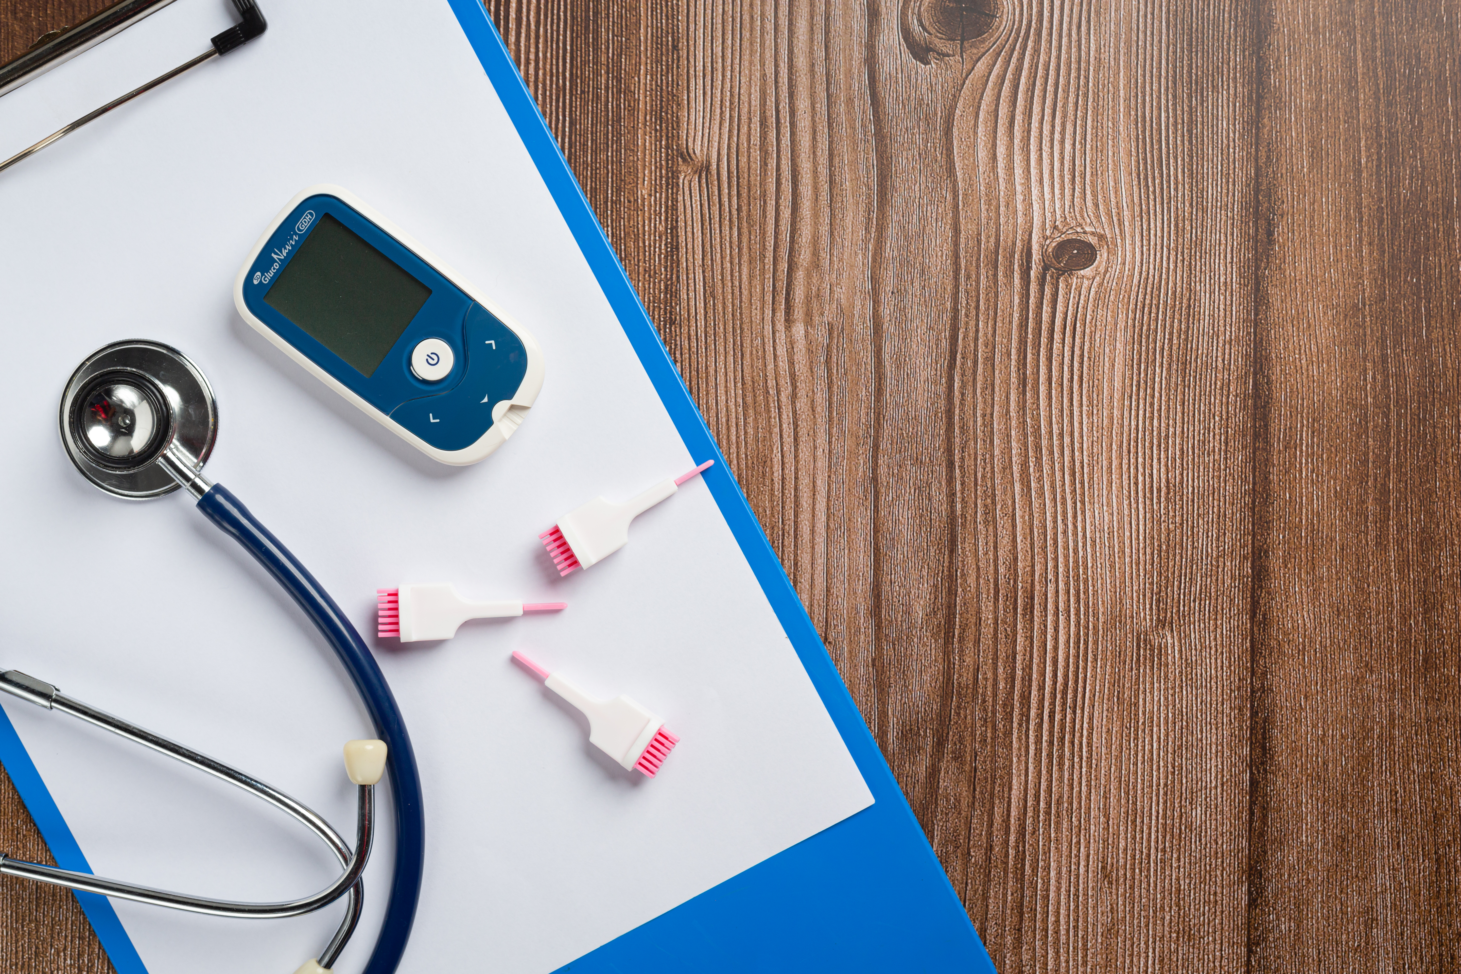
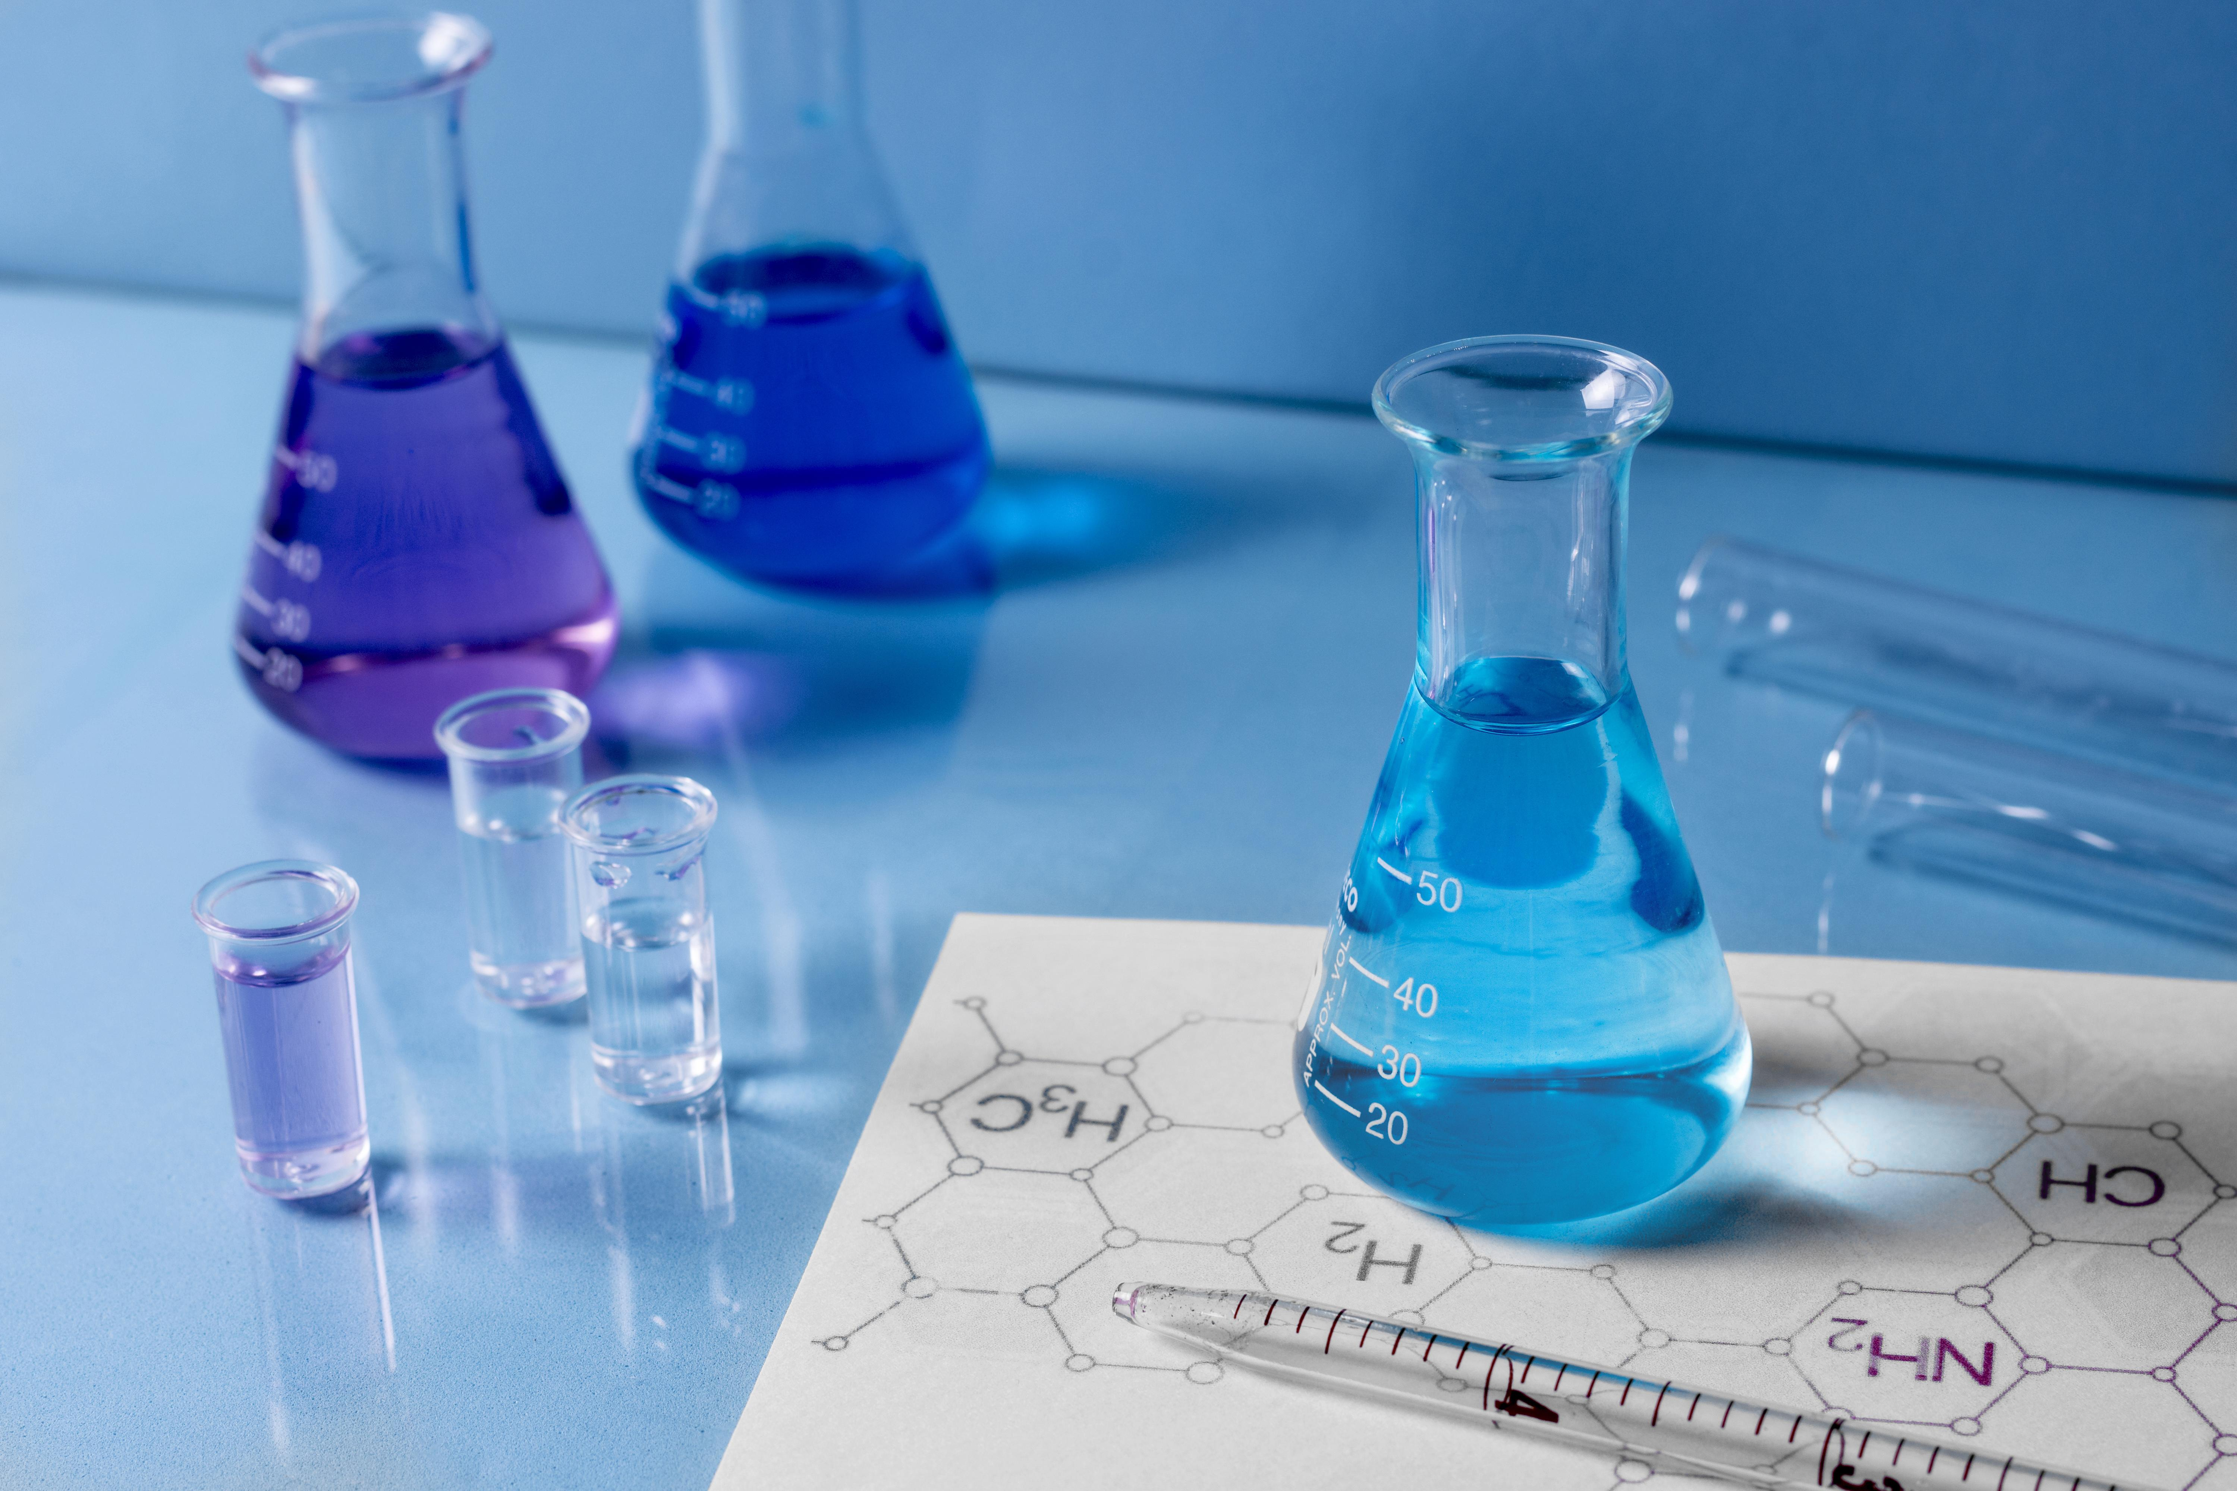
45%
1-5%
GENETIC HERITABILITY
CASES WHERE GENETIC DIFFERENCES WERE IDENTIFIED

Slide 17
CONCLUSIONS
Mercury is the closest planet to the Sun and the smallest one in the Solar System—it’s only a bit larger than our Moon. The planet’s name has nothing to do with the liquid metal since it was named after the Roman messenger god, Mercury

Slide 18
THANKS
Design by
https://www.fiverr.com/users/shaikhzainwork

