Slide 1
Cardiology-Medical
PPT Templates
Insert the Sub Title of Your Presentation

Slide 2
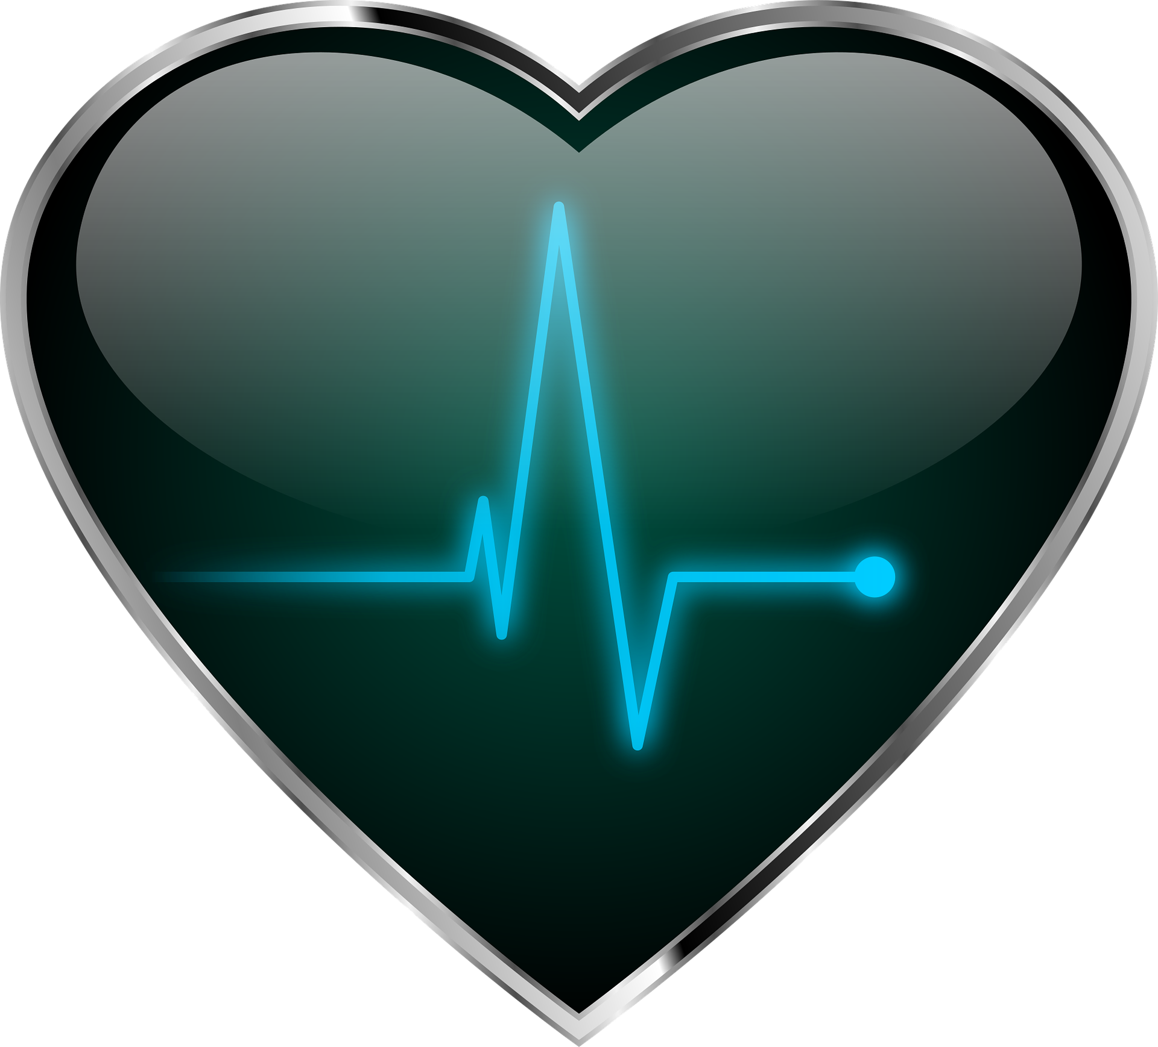
Agenda Style
01
Contents
Get a modern PowerPoint Presentation that is beautifully designed. I hope and I believe that this Template will your Time.
02
Contents
Get a modern PowerPoint Presentation that is beautifully designed. I hope and I believe that this Template will your Time.
03
Contents
Get a modern PowerPoint Presentation that is beautifully designed. I hope and I believe that this Template will your Time.
04
Contents
Get a modern PowerPoint Presentation that is beautifully designed. I hope and I believe that this Template will your Time.

Slide 3
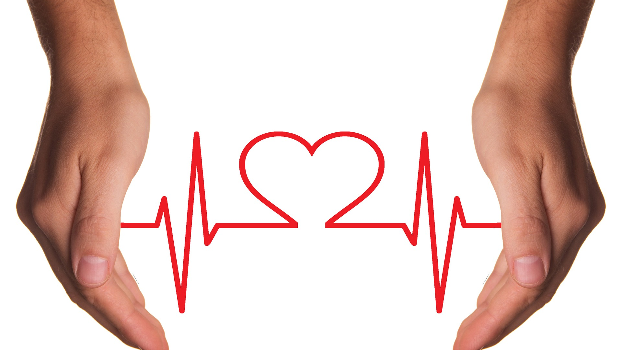
Section Break
Insert the Sub Title of Your Presentation

Slide 4
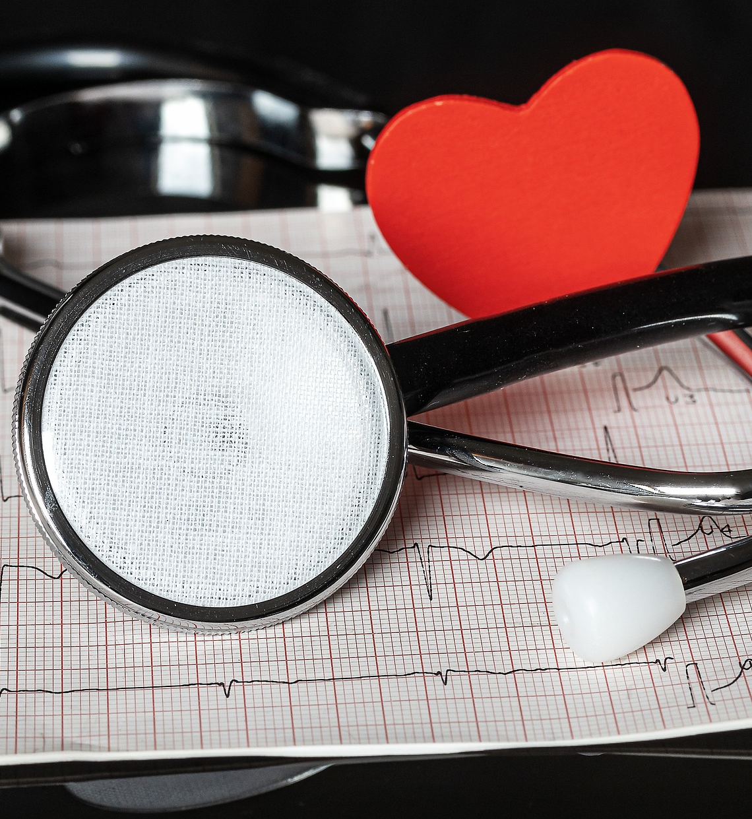



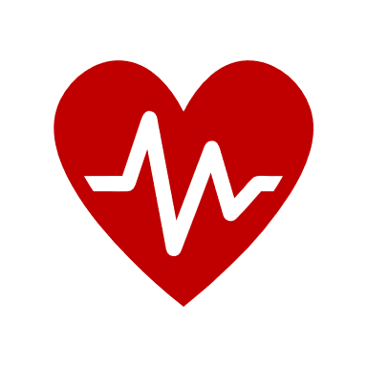
Our Team
Johnson
Ontonia
Jonas
Designation
Designation
Designation
Easy to change colors, photos and Text.
Easy to change colors, photos and Text.
Easy to change colors, photos and Text.
04

Slide 5
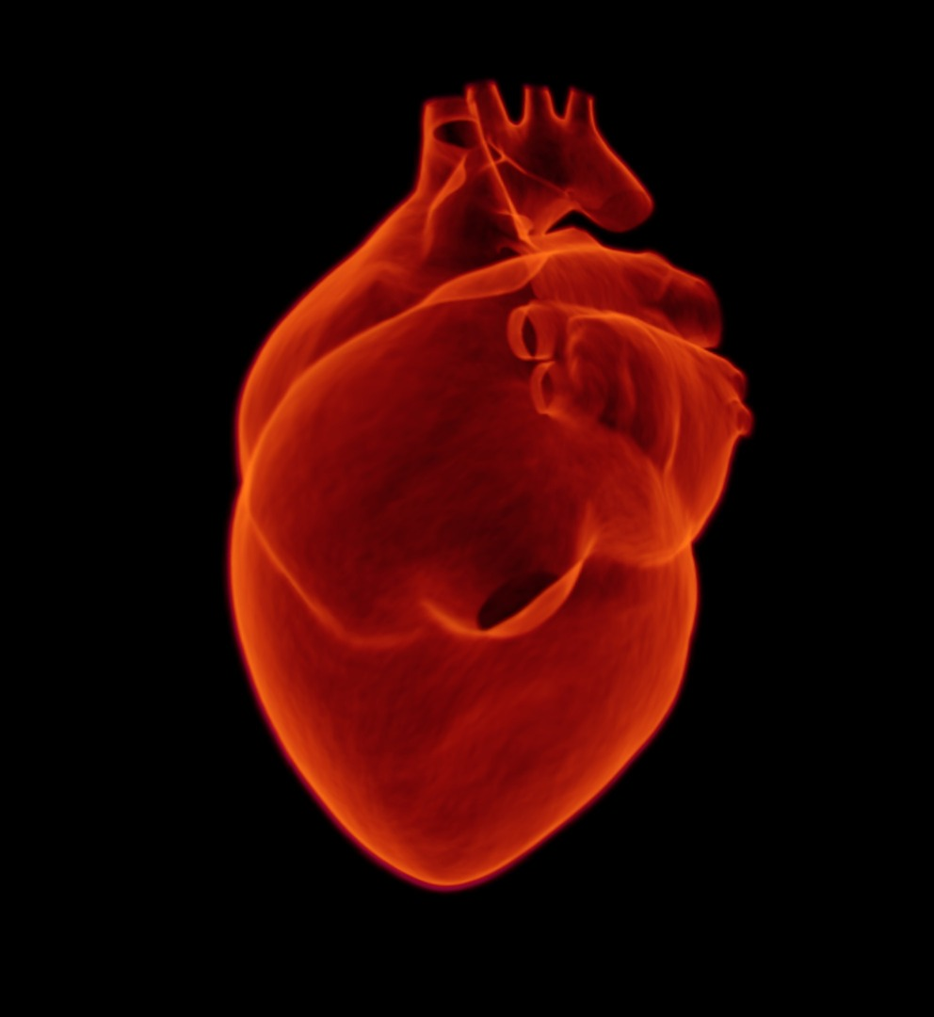
What is cardiology?
Cardiology is the study and treatment of disorders of the heart and the blood vessels. A person with heart disease or cardiovascular disease may be referred to a cardiologist.
05

Slide 6
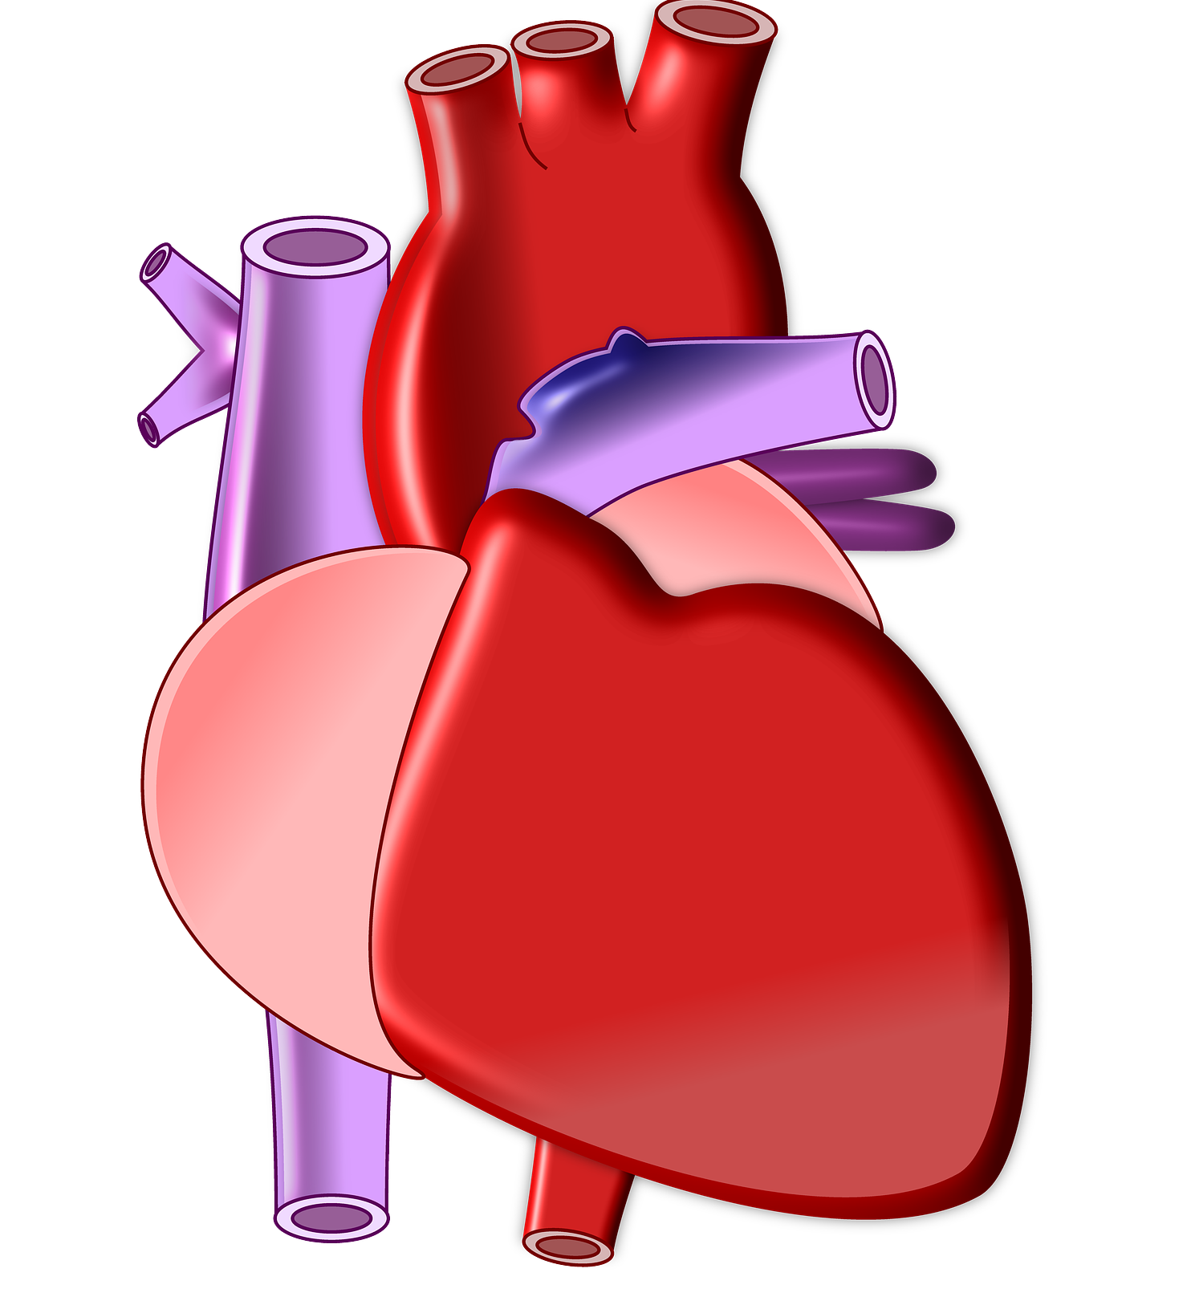
When would I need
a cardiologist?
If a person has symptoms of a heart condition, their physician may refer them to a cardiologist.
Symptoms that can indicate a heart problem include:
shortness of breath
dizziness
chest pains
changes in heart rate or rhythm
high blood pressure
06

Slide 7
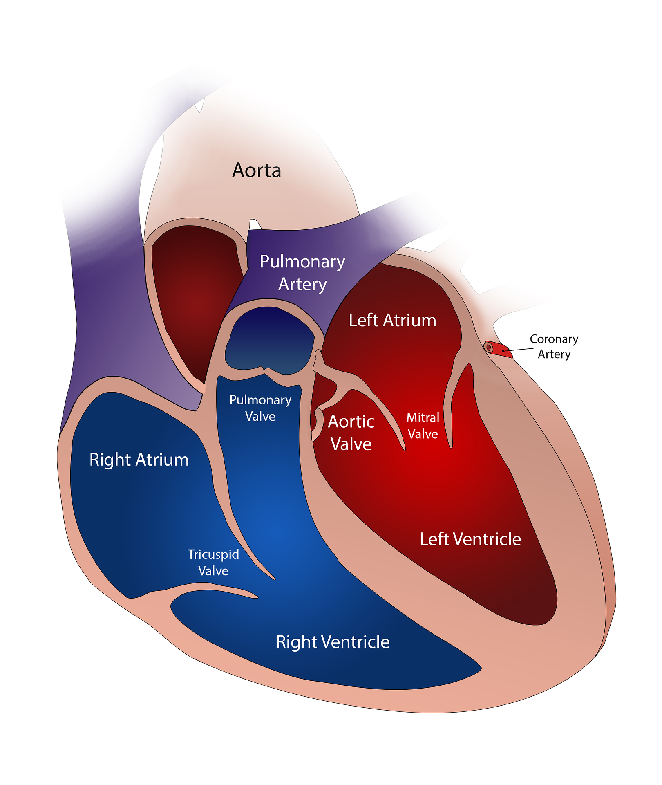
What does
cardiology involve?
A cardiologist will review a patient’s medical history and carry out a physical examination. They may check the person’s weight, heart, lungs, blood pressure, and blood vessels, and carry out some tests. An interventional cardiologist may carry out procedures such as angioplasties, stenting, valvuloplasties, congenital heart defect corrections, and coronary thrombectomies.
07

Slide 8


Tests for Cardiology
Cardiac catheterization
A small tube in or near the heart collects data and may help relieve a blockage.
Electrocardiogram
(ECG or EKG)
An exercise test, or stress test
This records the electrical activity of the heart.
This shows the changes of heart rhythm when resting and exercising.
Ambulatory ECG
Echocardiogram
This records heart rhythms while the person carries out exercise or their regular activities.
This provides an ultrasound picture that shows the structure of the heart chambers.
Nuclear cardiology
Nuclear imaging techniques use radioactive materials to study cardiovascular disorders.
08

Slide 9
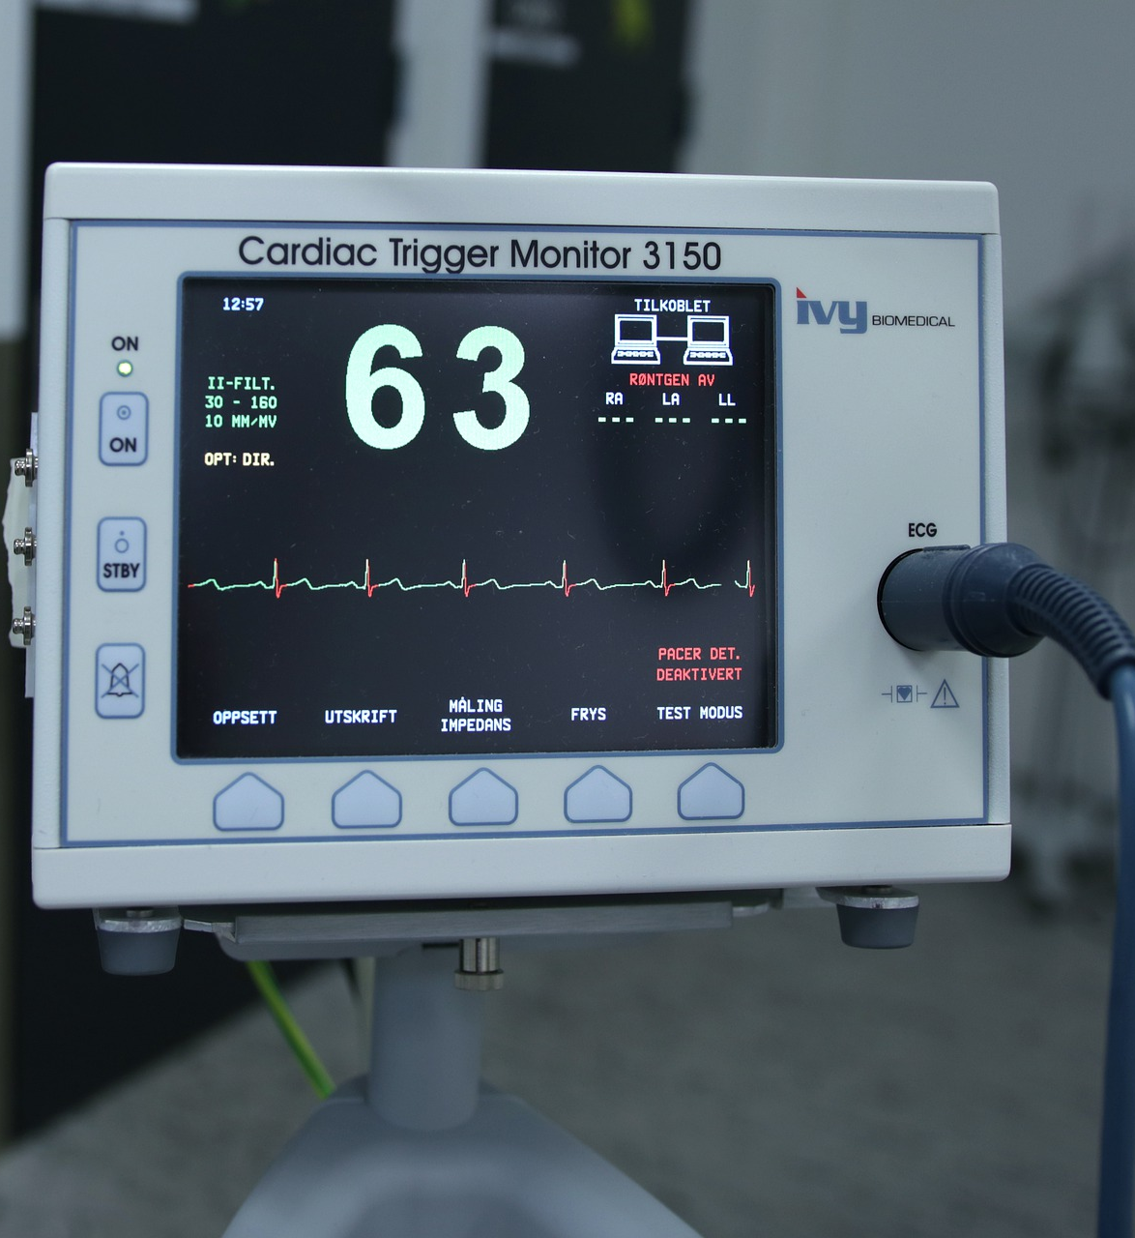
Cardiac
electrophysiology
Cardiac electrophysiology is a subspecialty of cardiology. The physician looks at how electric currents inside the heart muscle tissue work, how the current spreads, and what the pattern of the currents mean.
Electrophysiology study (EPS) of the heart: in this test, a catheter is threaded into a vein at the top of the leg. Guided under fluoroscopy, it makes its way to the heart. The catheter measures the electrical signals within the heart. An EPS of the heart can:
help to show what is causing symptoms
help decide if a patient needs a pacemaker
help decide the best treatment for patients with
arrhythmia, or abnormal heart rhythm
09

Slide 10
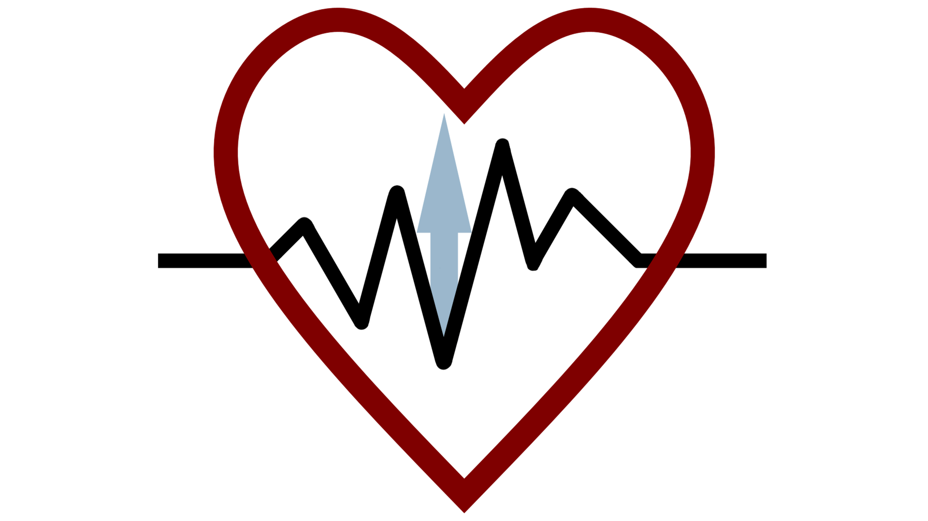
Thank You

