Slide 1

CARDIOLOGY

Slide 2
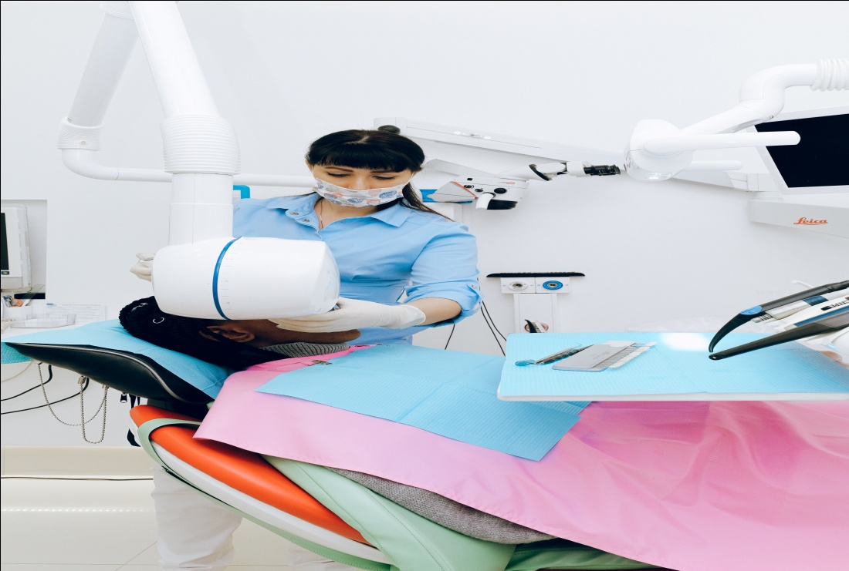
HEADING

Slide 3
SAME STEPS
02
04
06
01
03
05

Slide 4

WELCOME
MESSAGE

Slide 5
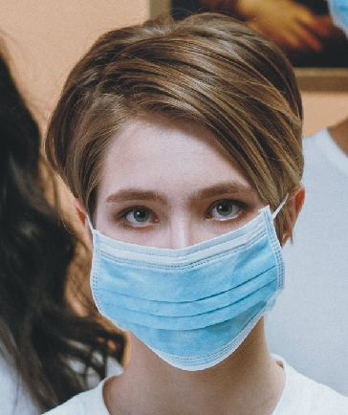

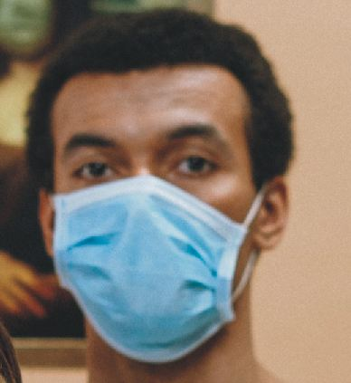
NAME
CREATIVE TEAMS
NAME
NAME

Slide 6

HEADING

Slide 7

INTRODUCING

Slide 8
HEADING
HEADING
HEADING
HEADING

Slide 9
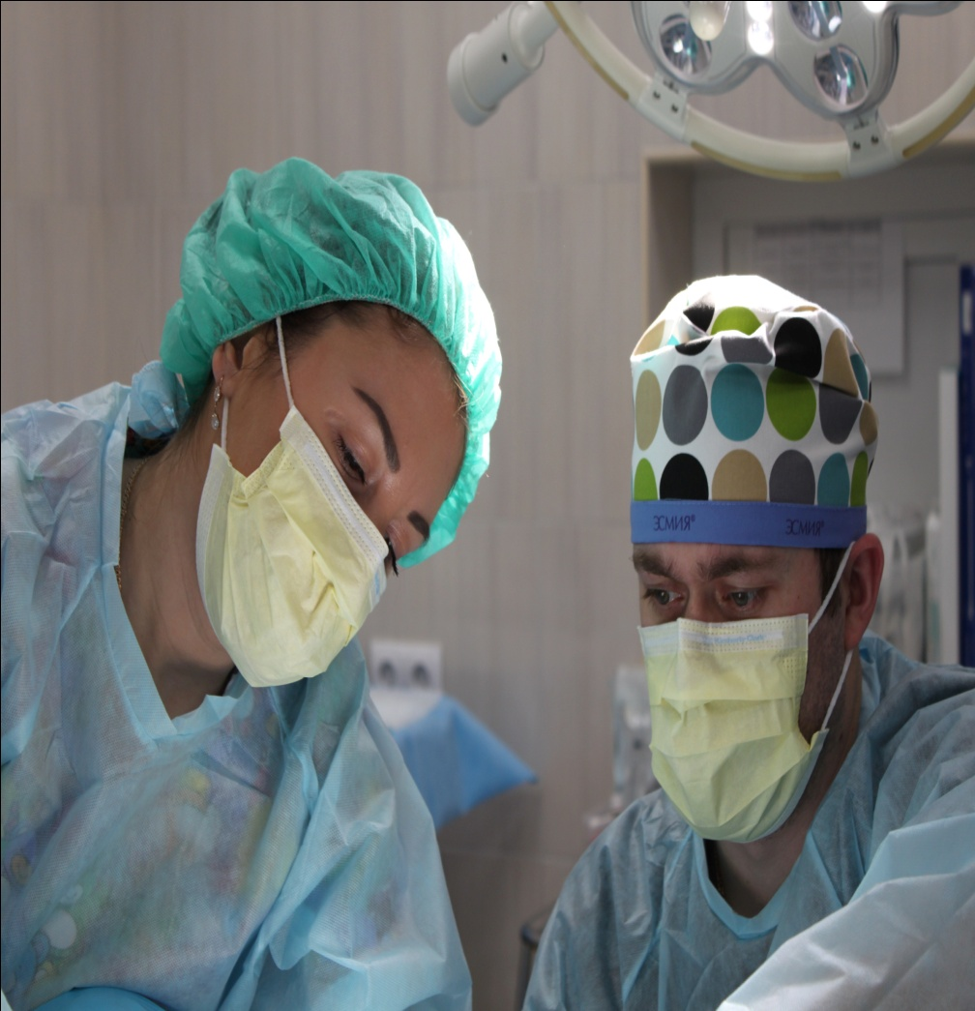
WHAT WE
OFFER

Slide 10

HEADING

Slide 11
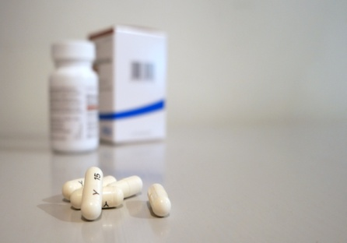

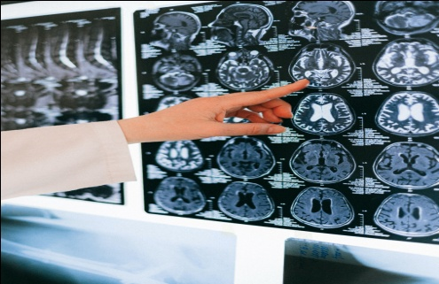

HEADING
HEADING
HEADING
HEADING
HEADING

Slide 12
Y
THANK YOU

