Slide 1
Cardiology-Medical
PPT Templates
Insert the Sub Title of Your Presentation

Slide 2
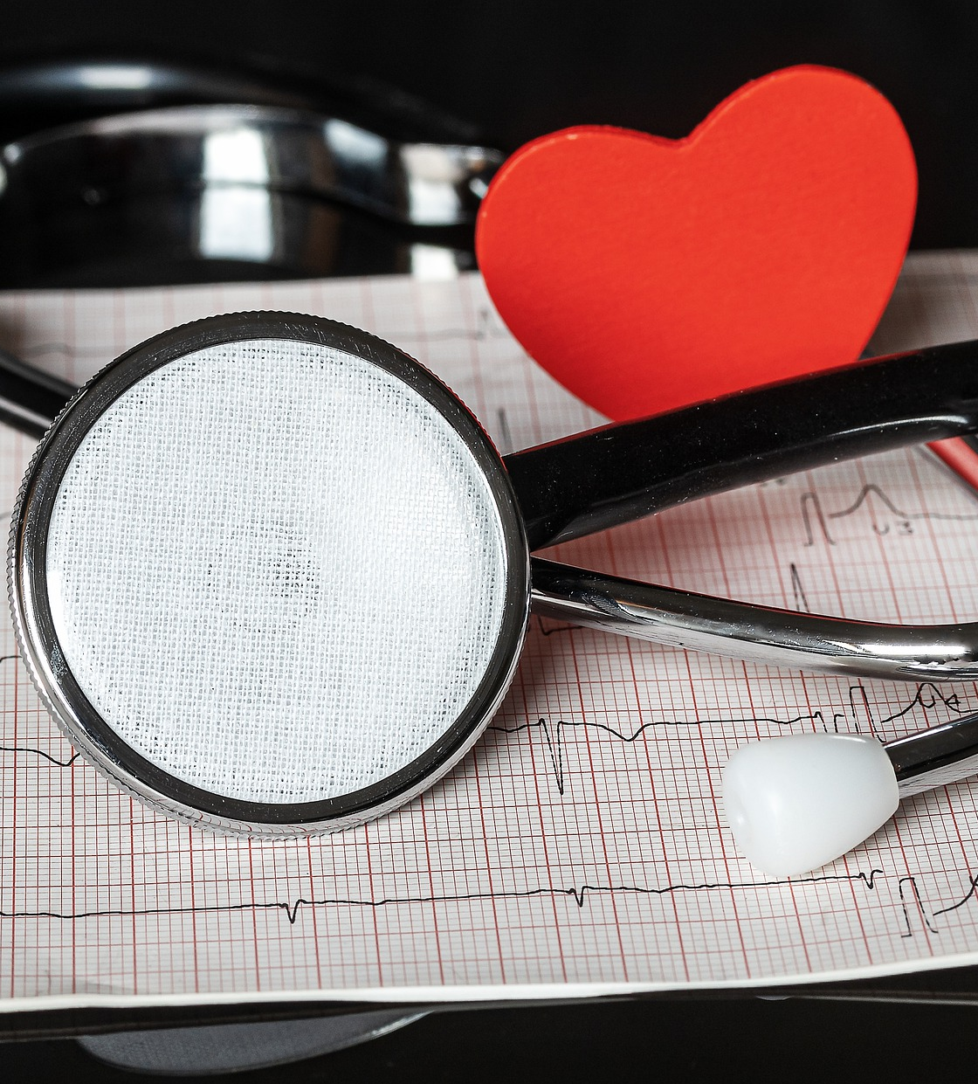
Agenda Style
01
Contents
Get a modern PowerPoint Presentation that is beautifully designed. I hope and I believe that this Template will your Time.
02
Contents
Get a modern PowerPoint Presentation that is beautifully designed. I hope and I believe that this Template will your Time.
03
Contents
Get a modern PowerPoint Presentation that is beautifully designed. I hope and I believe that this Template will your Time.
04
Contents
Get a modern PowerPoint Presentation that is beautifully designed. I hope and I believe that this Template will your Time.

Slide 3
Section Break
Insert the Sub Title of Your Presentation

Slide 4




Our Team
Prof. Dr. Juliana
Prof. Dr. Jona Liana
MBBS, FCPS, FACC (USA)
MBBS, FCPS, FACC (USA)
Cardiology Department
Cardiology Department
Prof. Dr. Flowra
Prof. Dr. Rowsov
MBBS, FCPS, FACC (USA)
MBBS, FCPS, FACC (USA)
Cardiology Department
Cardiology Department
04

Slide 5
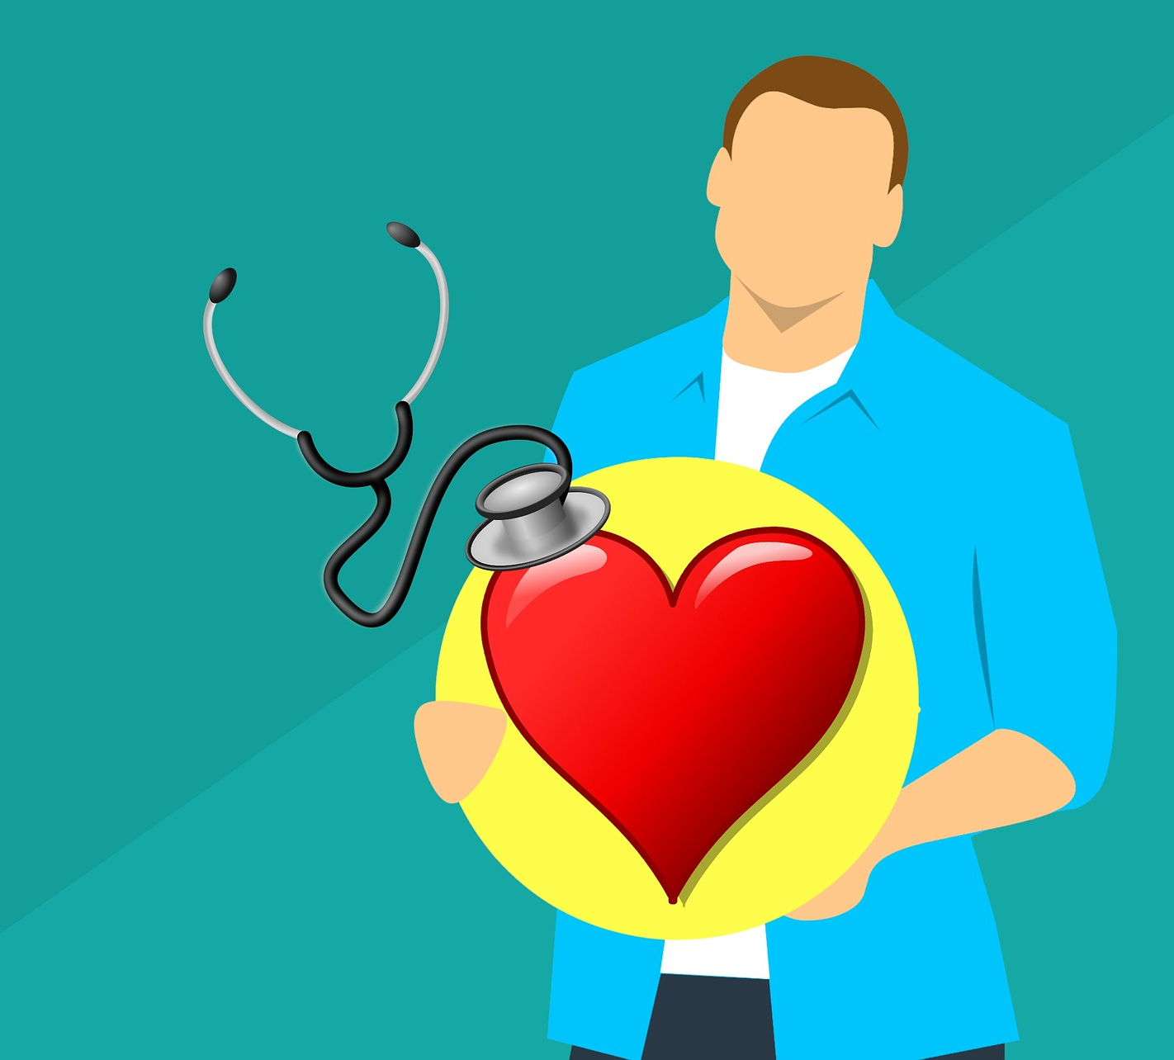
What is
Cardiology
Cardiology is the study and treatment of disorders of the heart and the blood vessels. A person with heart disease or cardiovascular disease may be referred to a cardiologist.
05

Slide 6
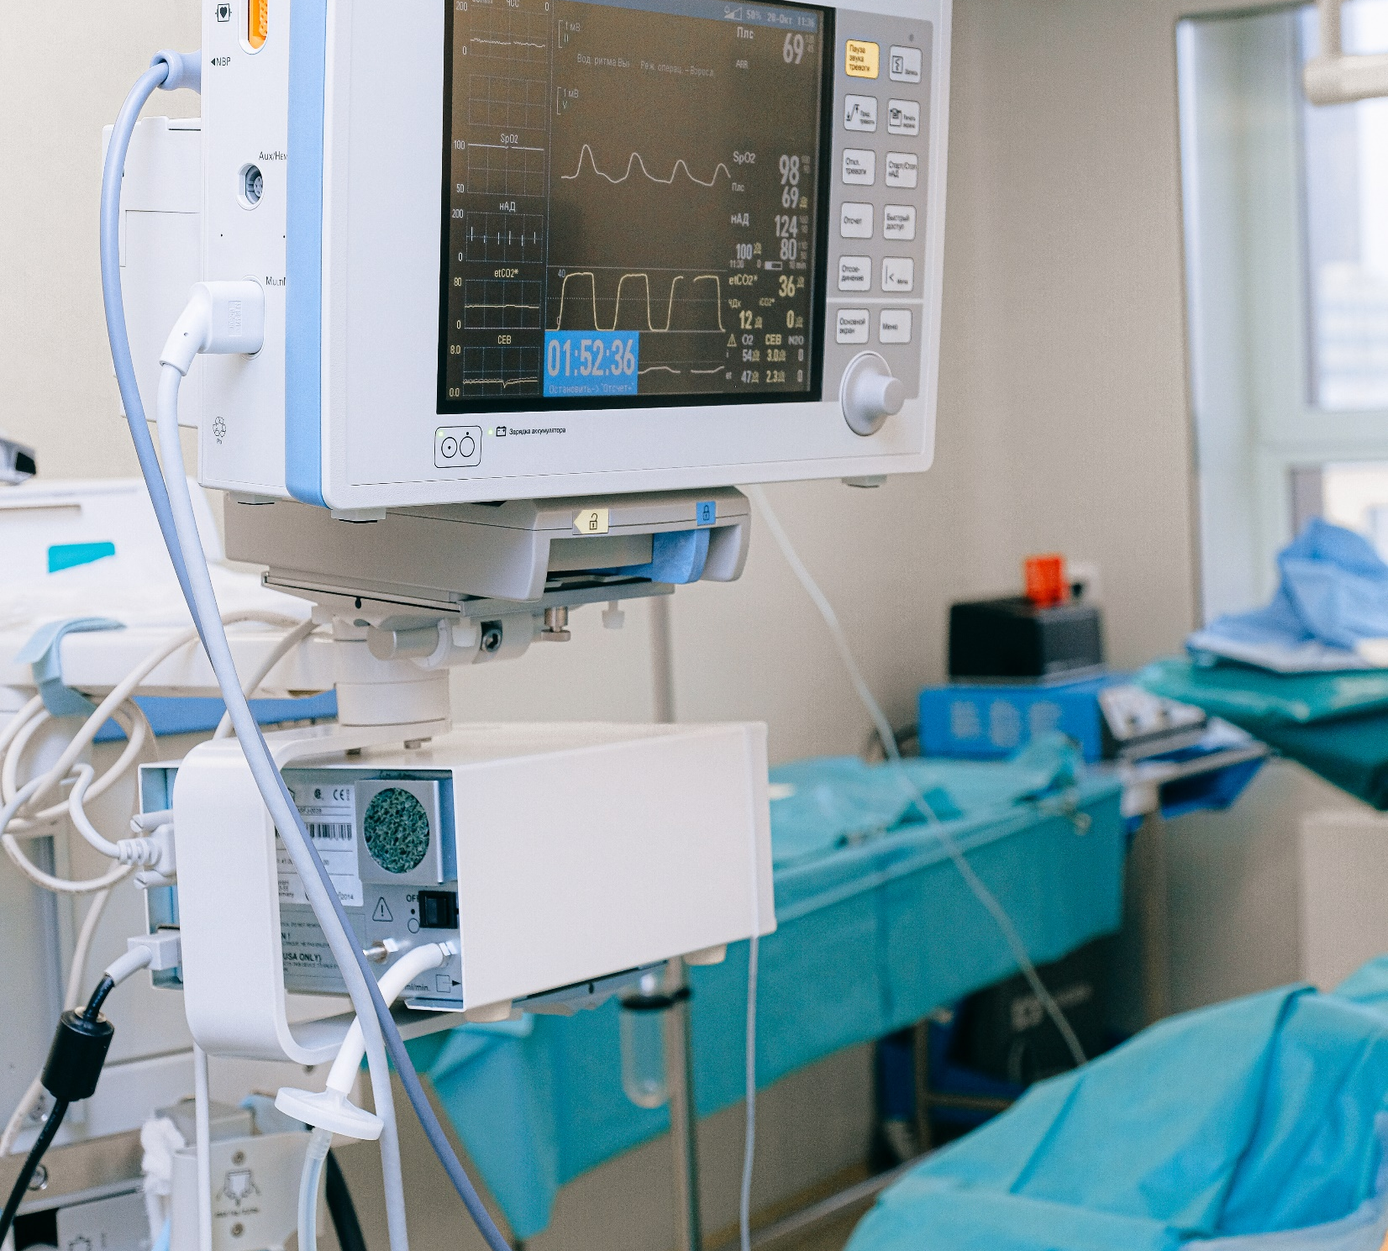
When Would I Need
A Cardiologist?
If a person has symptoms of a heart condition, their physician may refer them to a cardiologist.
Symptoms that can indicate a heart problem include:
shortness of breath
dizziness
chest pains
changes in heart rate or rhythm
high blood pressure
06

Slide 7

What Does
Cardiology Involve?
A cardiologist will review a patient’s medical history and carry out a physical examination. They may check the person’s weight, heart, lungs, blood pressure, and blood vessels, and carry out some tests. An interventional cardiologist may carry out procedures such as angioplasties, stenting, valvuloplasties, congenital heart defect corrections, and coronary thrombectomies.
07

Slide 8
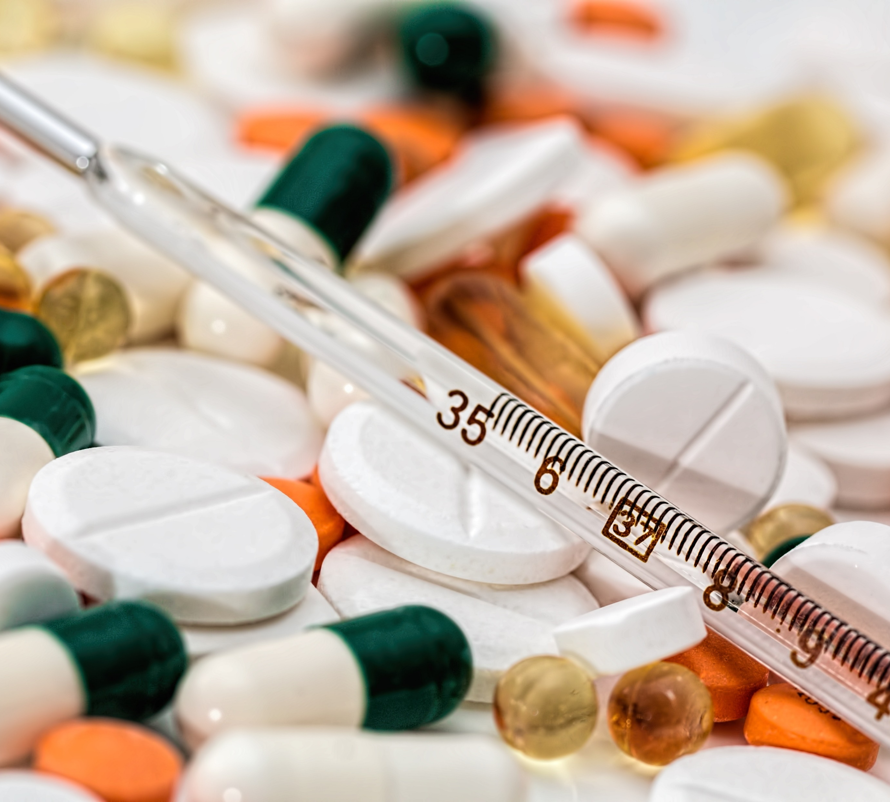
Cardiac
Electrophysiology
Cardiac electrophysiology is a subspecialty of cardiology. The physician looks at how electric currents inside the heart muscle tissue work, how the current spreads, and what the pattern of the currents mean.
Electrophysiology study (EPS) of the heart: in this test, a catheter is threaded into a vein at the top of the leg. Guided under fluoroscopy, it makes its way to the heart. The catheter measures the electrical signals within the heart. An EPS of the heart can:
08

Slide 9
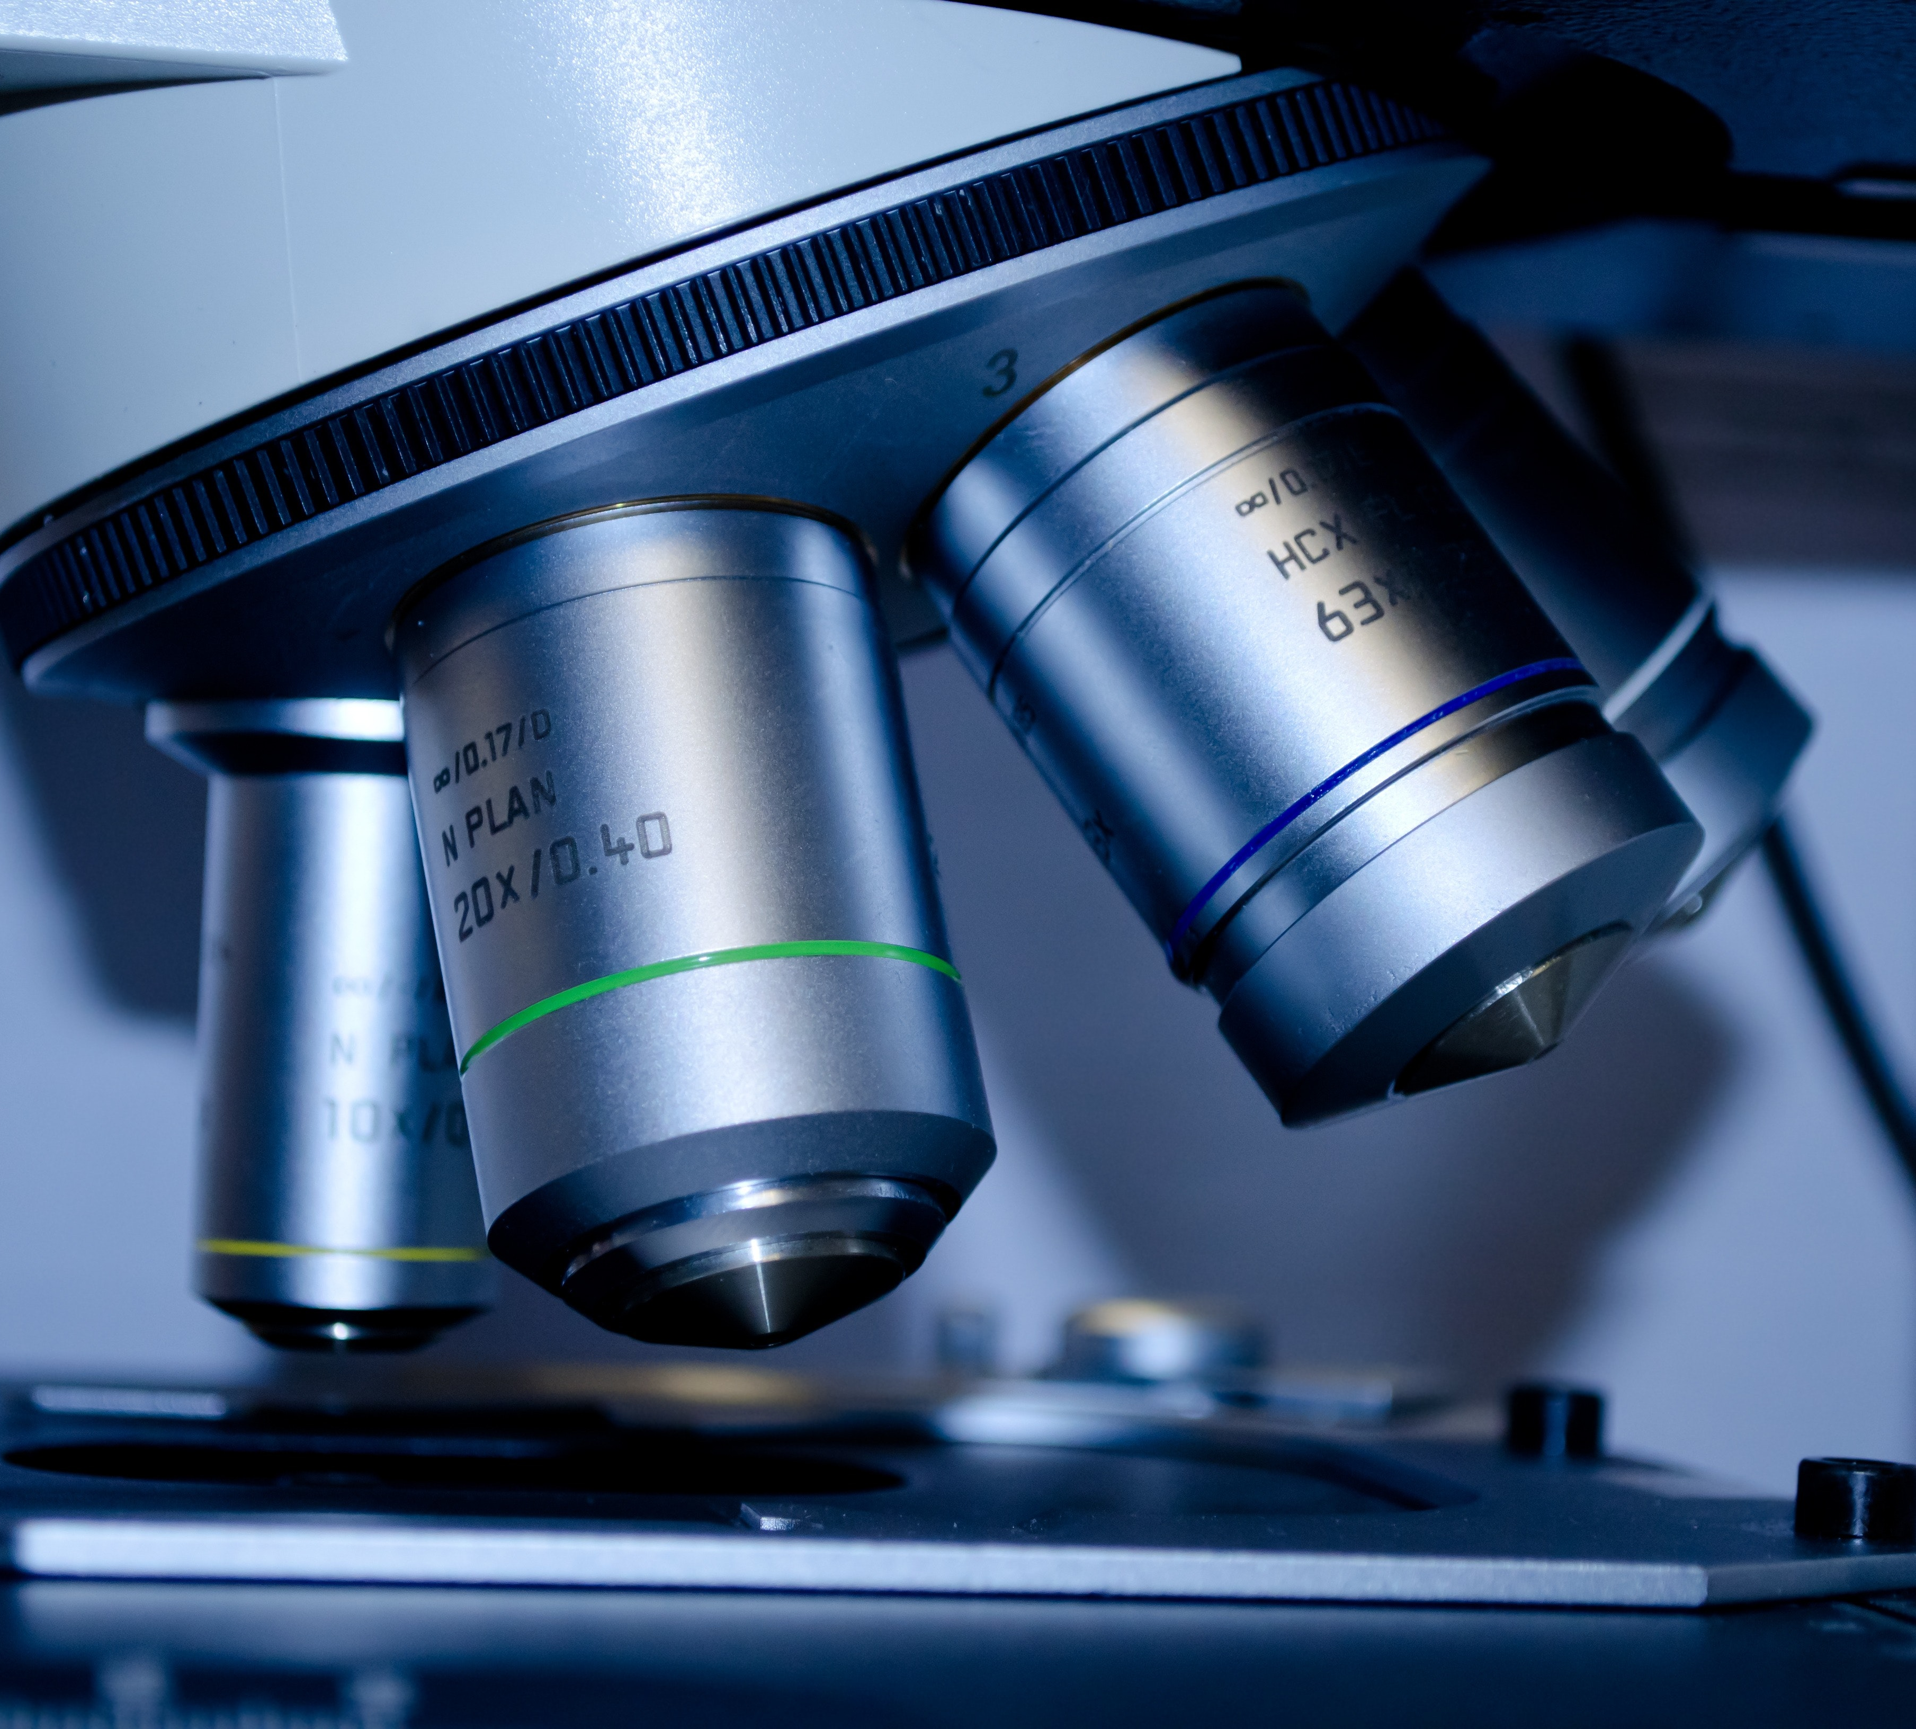
Tests for Cardiology
Electrocardiogram
(ECG or EKG)
This records the electrical activity of the heart.
Ambulatory ECG
This records heart rhythms while the person carries out exercise or their regular activities.
Nuclear imaging techniques use radioactive materials to study cardiovascular disorders.
Nuclear cardiology
A small tube in or near the heart collects data and may help relieve a blockage.
Cardiac catheterization
An exercise test,
or stress test
This shows the changes of heart rhythm when resting and exercising.
Echocardiogram
This provides an ultrasound picture that shows the structure of the heart chambers.
09

Slide 10
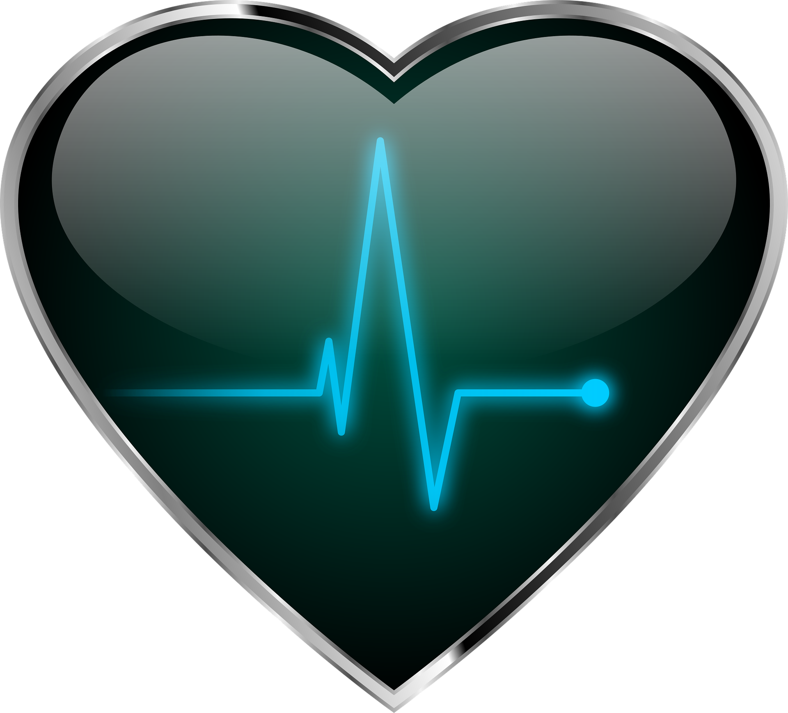
Thank You

