Slide 1

FOLLOW YOUR HEART
HAPPY HEART!

Slide 2

FOLLOW YOUR HEART
BLESS YOUR HEART.
Give Your Heart a Head Start
This American Heart Month, use any one of these 10 quotes on heart health to encourage healthy habits, raise awareness and help your community be healthier and happier.

Slide 3
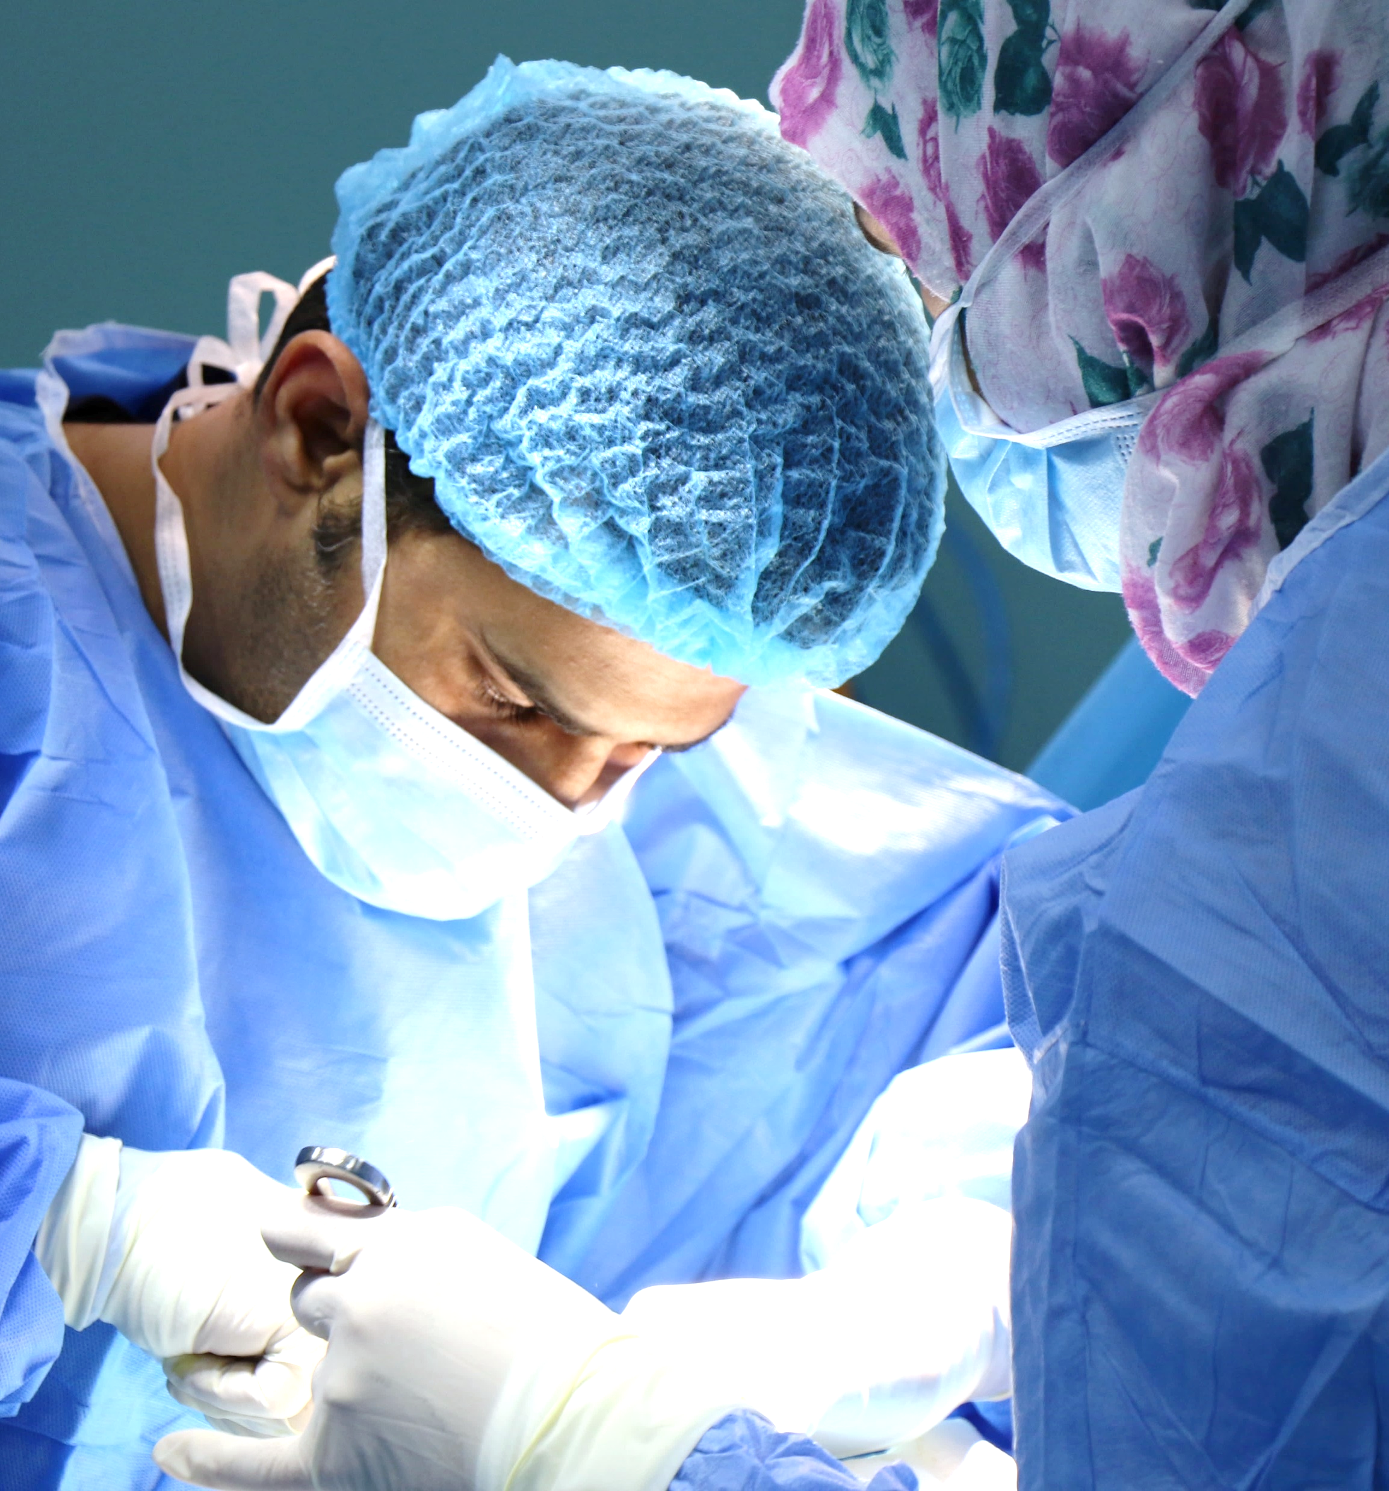
FOLLOW YOUR HEART
BLESS YOUR HEART.
This American Heart Month, use any one of these 10 quotes on heart health to encourage healthy habits, raise awareness and help your community be healthier and happier. This American Heart Month, use any one of these 10 quotes to encourage healthy habits.

Slide 4

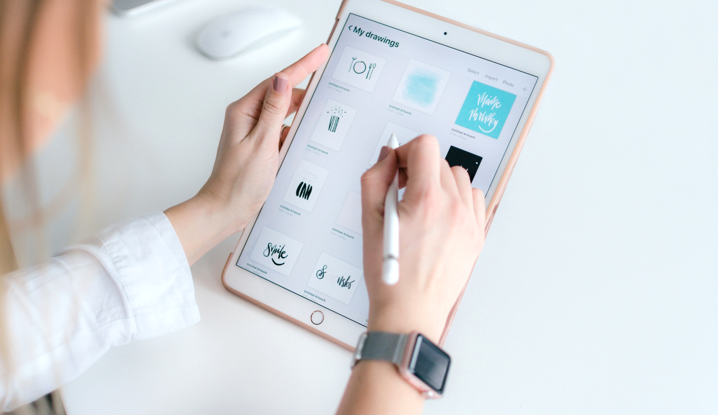
FOLLOW YOUR HEART
We’ve been crafting beautiful presentation & making clients happy for years.

Slide 5
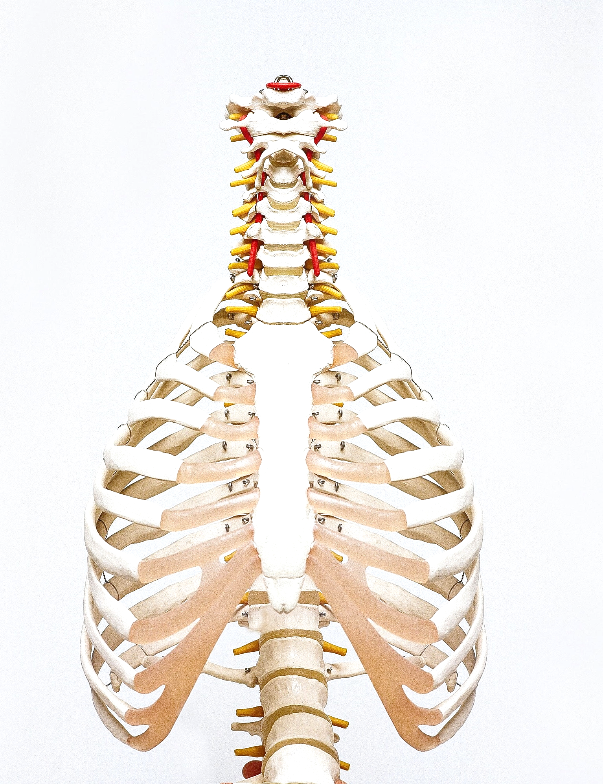
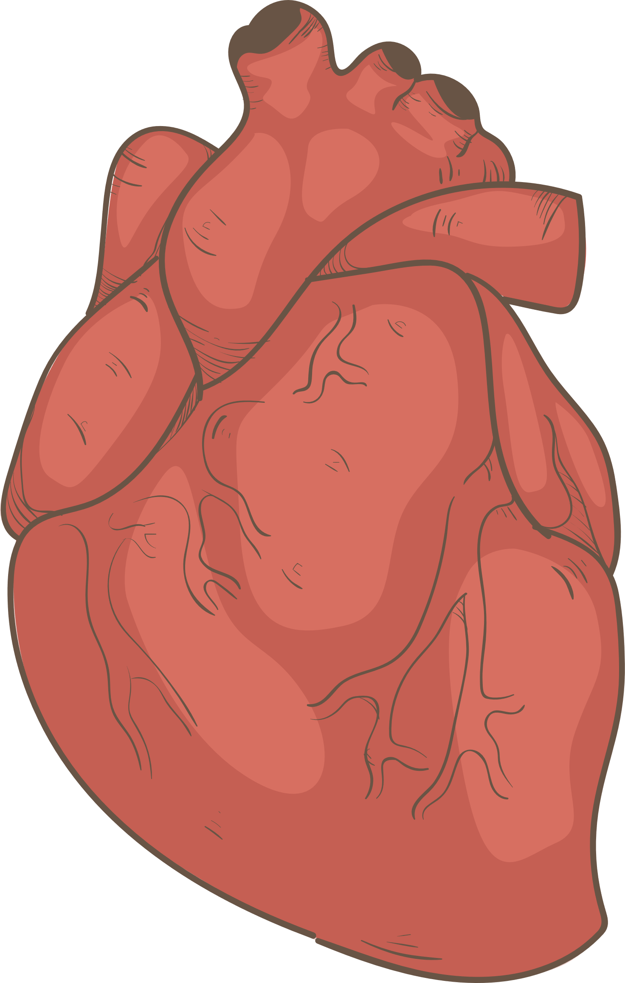
FOLLOW YOUR HEART
BLESS YOUR HEART.
This American Heart Month, use any one of these 10 quotes on heart health to encourage healthy habits, raise awareness and help your community be healthier and happier. This American Heart Month, use any one of these 10 quotes to encourage healthy habits.

Slide 6

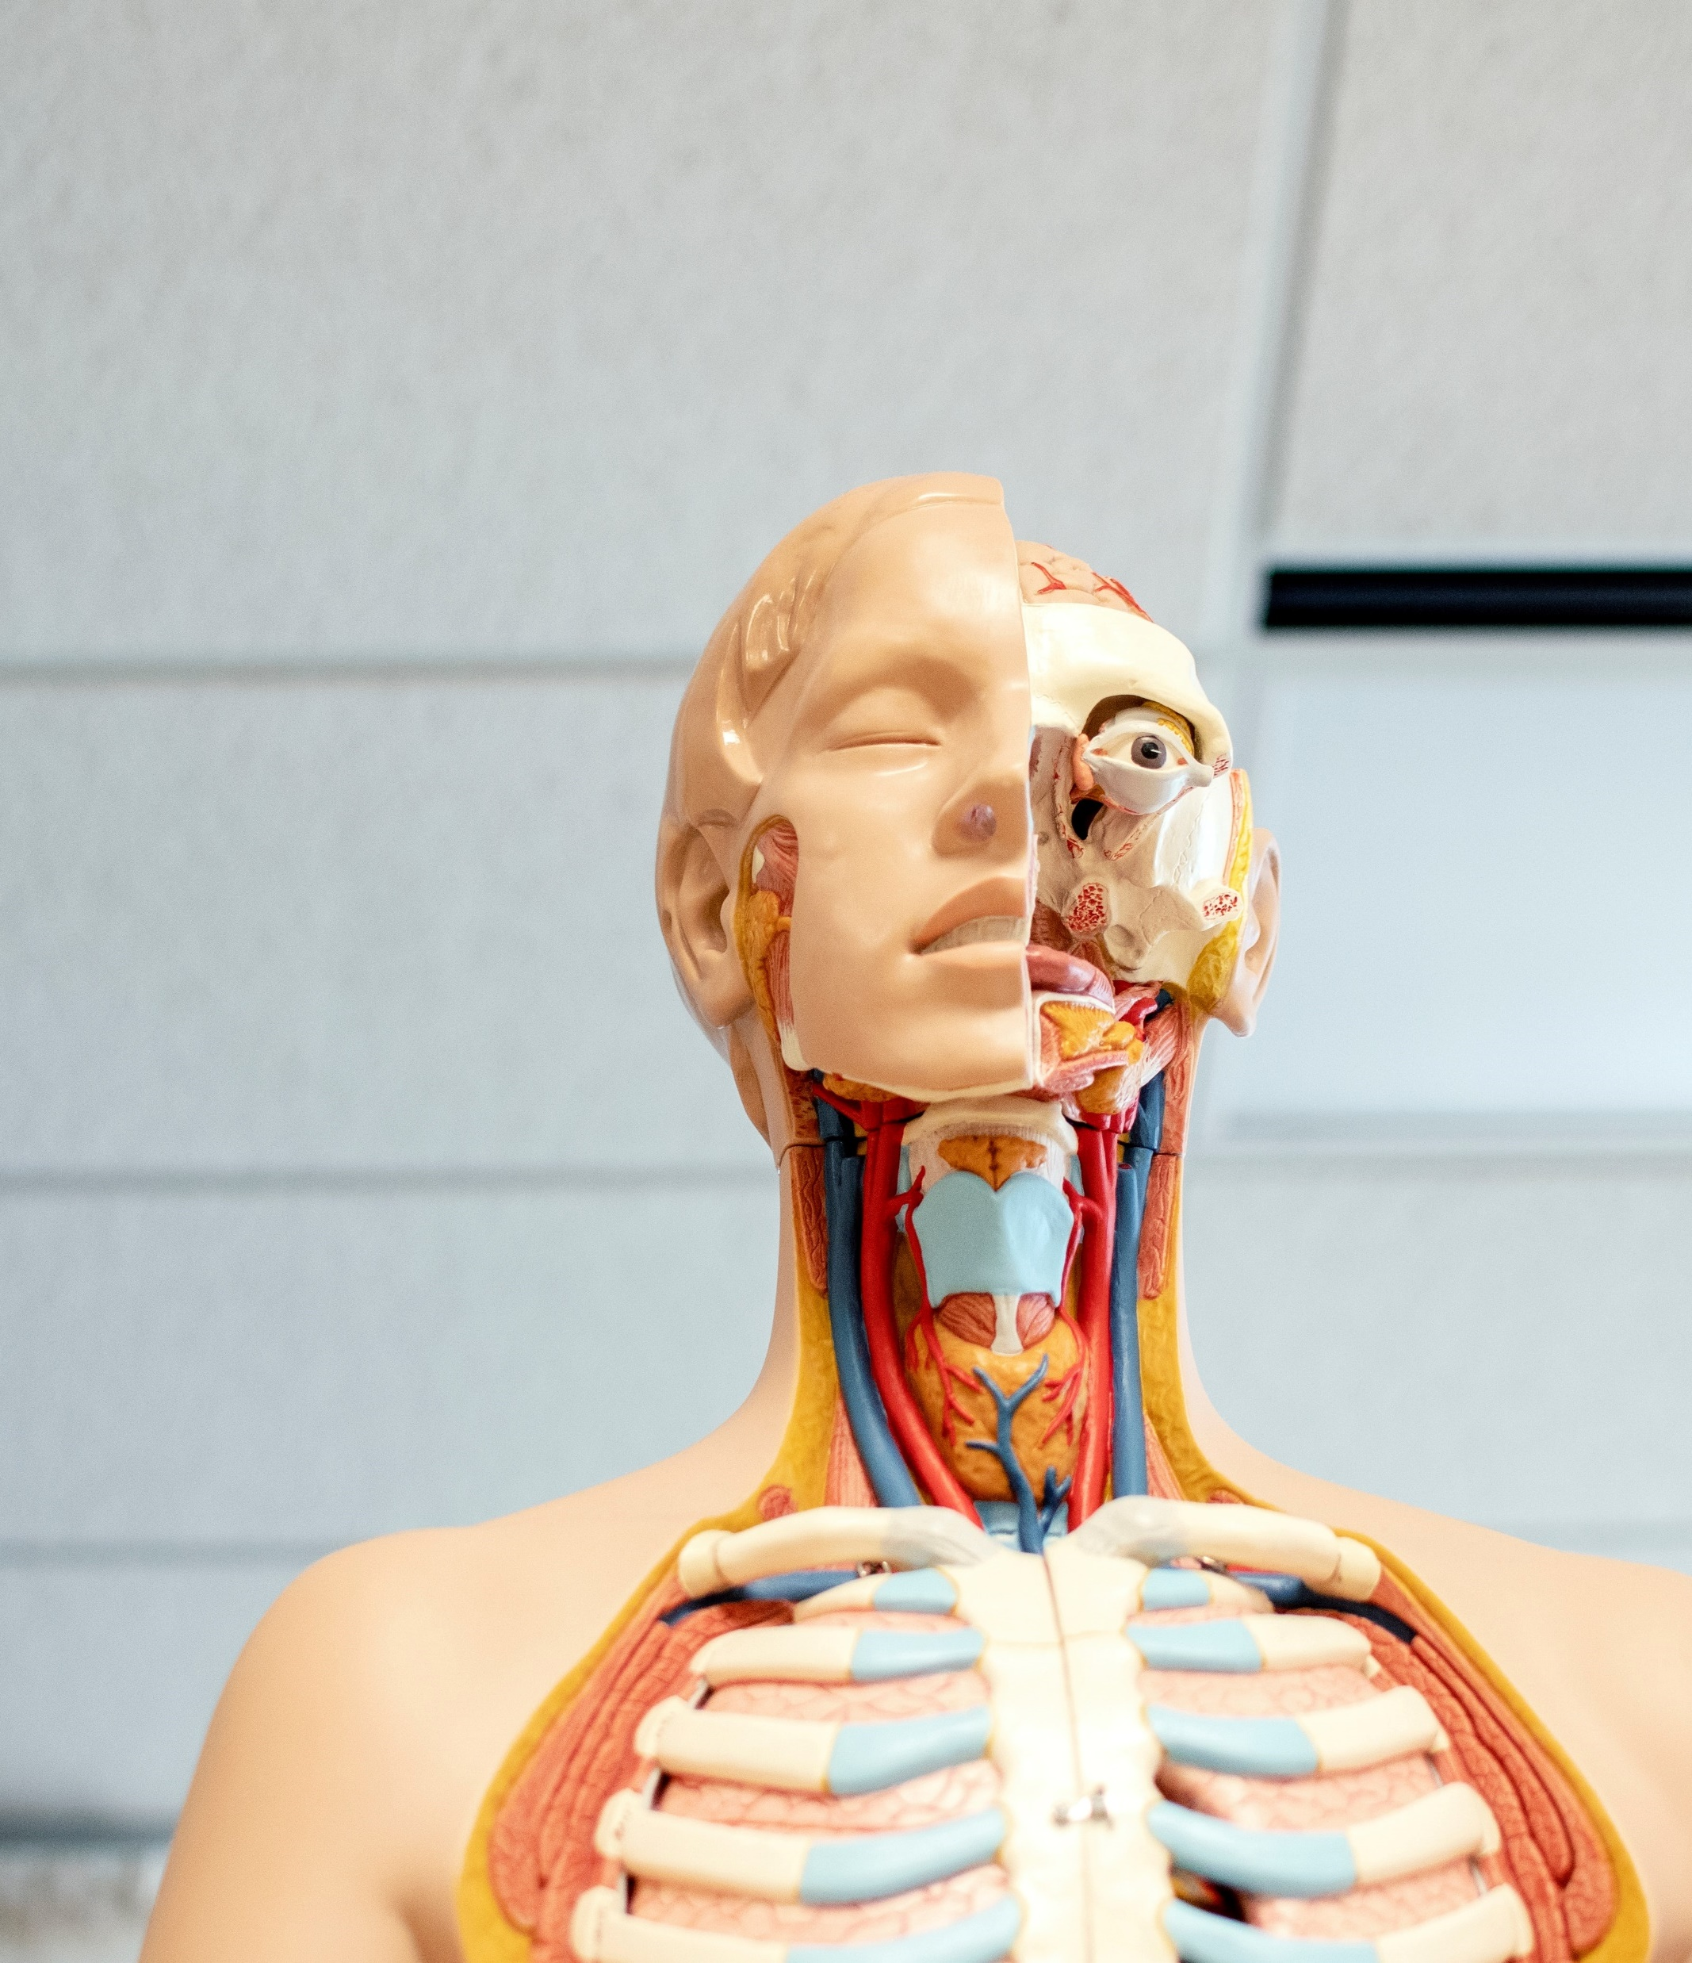
YOUR HEART
raise awareness and help your community
FOLLOW YOUR HEART
BLESS YOUR HEART.
This American Heart Month, use any one of these 10 quotes on heart health to encourage healthy habits, raise awareness and help your community be healthier and happier. This American Heart Month, use any one of these 10 quotes to encourage healthy habits.
WE’RE PUNCTUAL
raise awareness and help your community

Slide 7

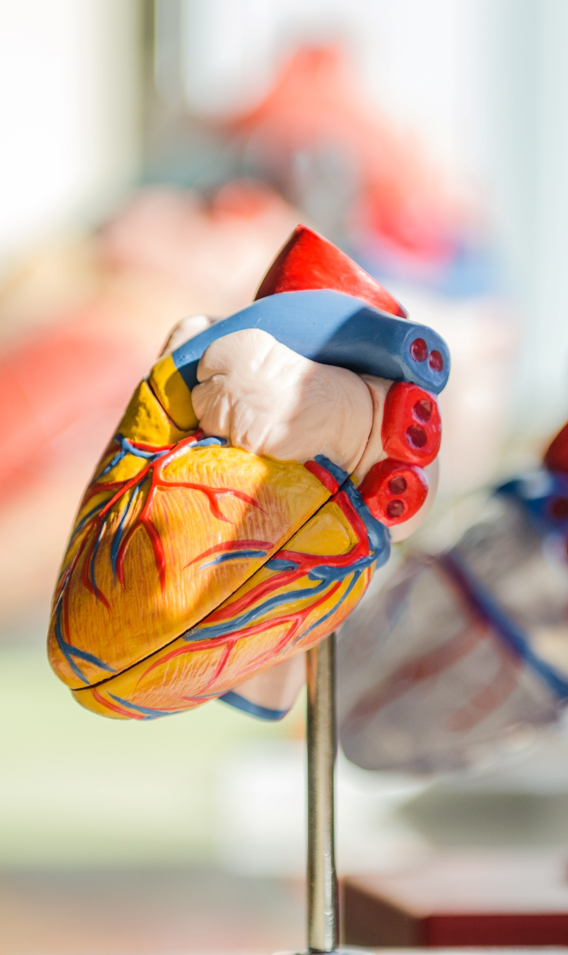

PORTFOLIO 01
Raise awareness and help your community
PORTFOLIO 01
Raise awareness and help your community
PORTFOLIO 01
Raise awareness and help your community
PORTFOLIO 01
Raise awareness and help your community
PORTFOLIO 01
Raise awareness and help your community
PORTFOLIO 01
Raise awareness and help your community

Slide 8
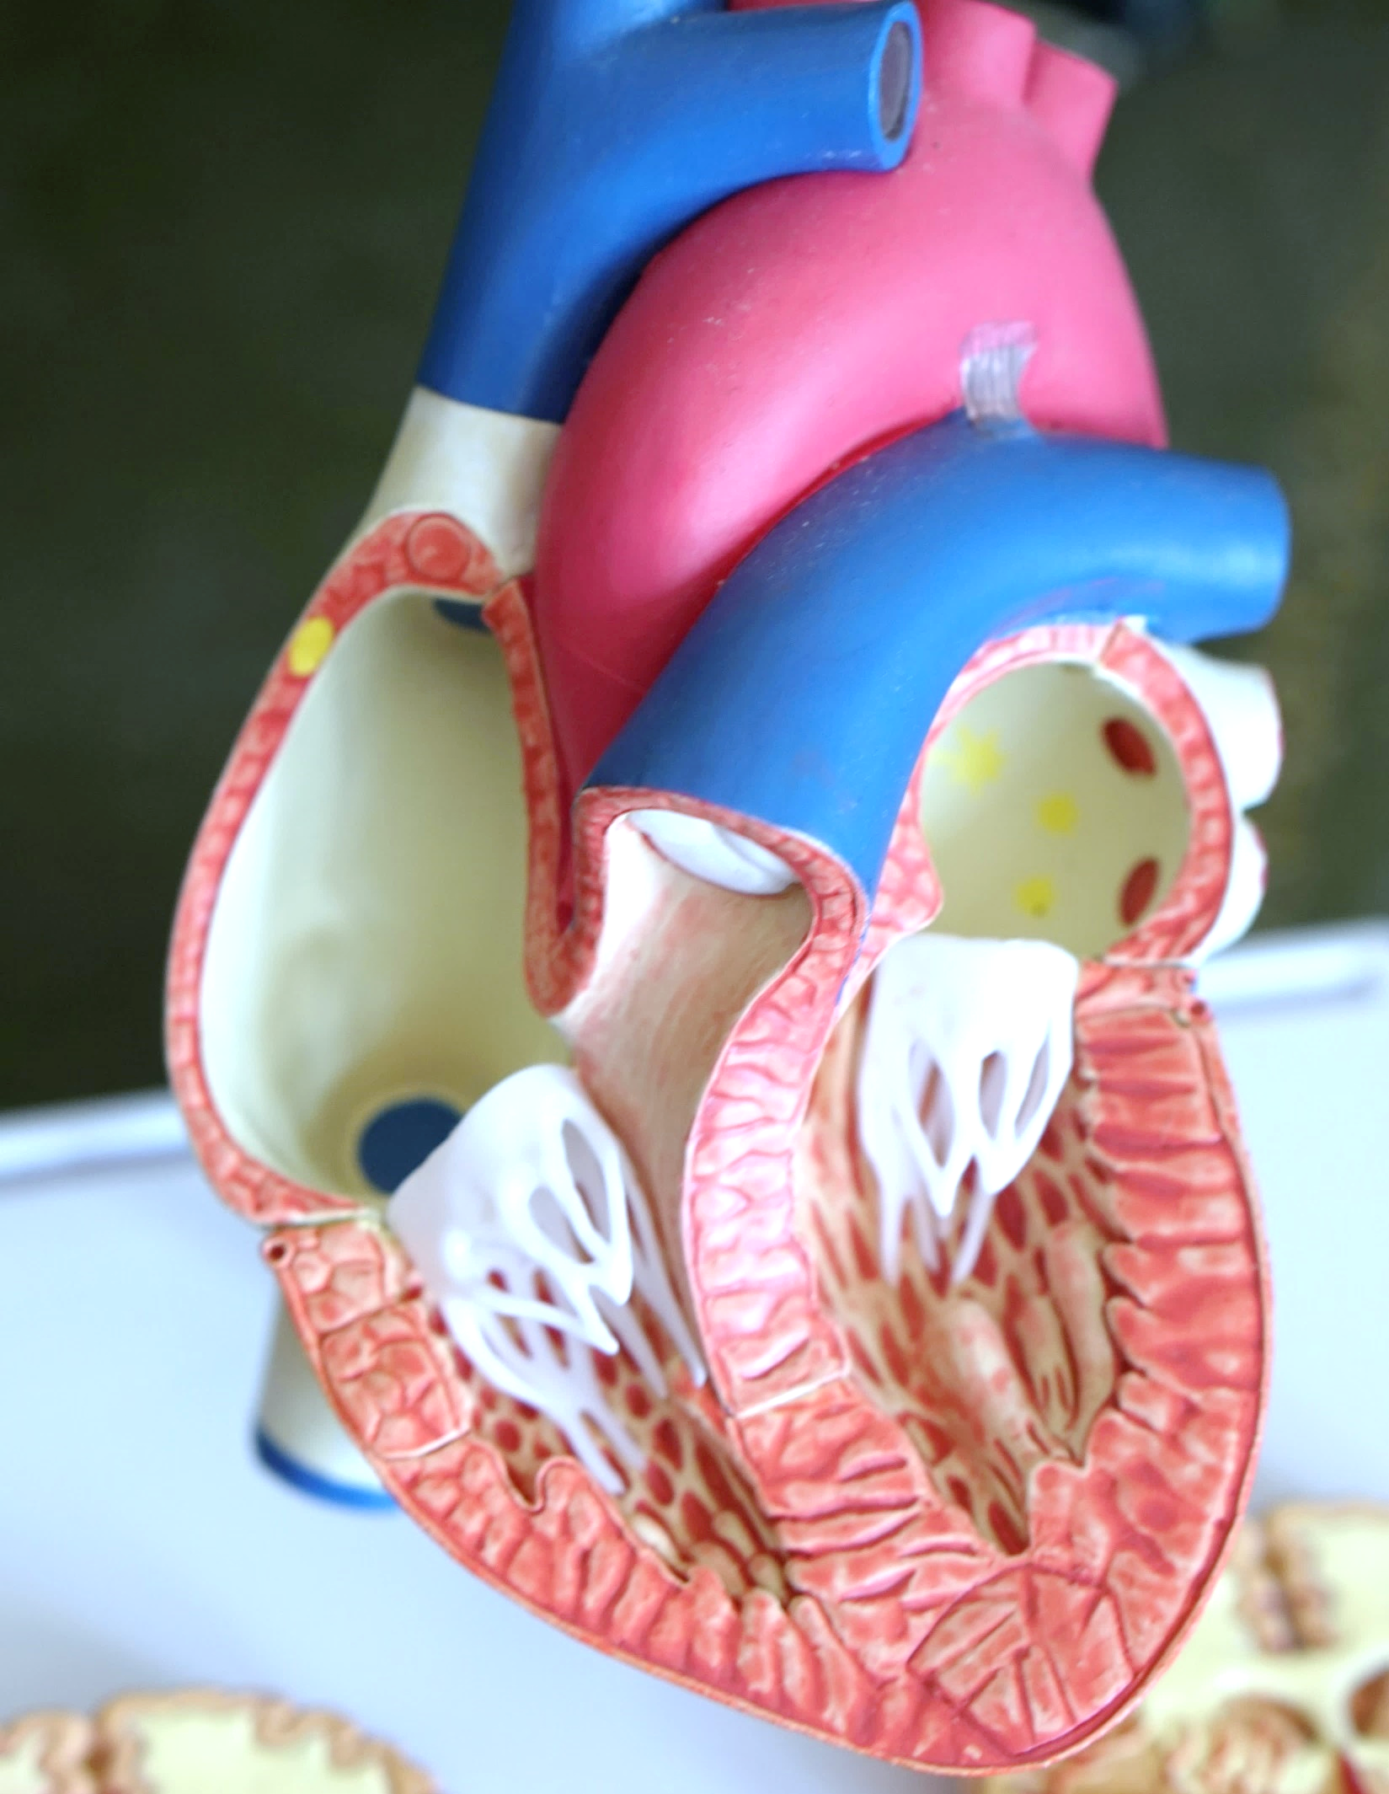

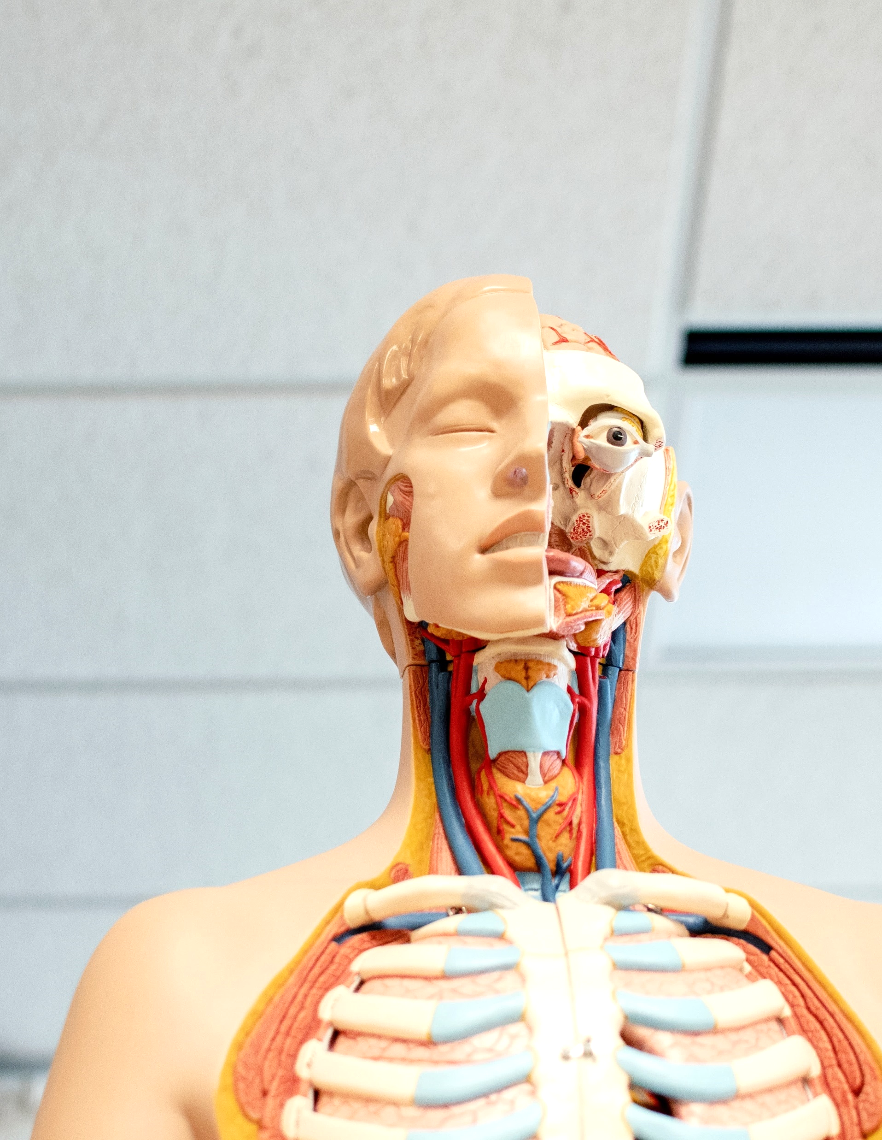
We’ve been crafting beautiful presentation & making clients happy for years.

Slide 9




FOLLOW YOUR HEART
Show Your Heart Some Love
Raise awareness and
help your community.
Raise awareness and
help your community.
Raise awareness and
help your community.
Raise awareness and
help your community.
Number One
Number Two
Number Three
Number Four
Raise awareness and help your community.
Raise awareness and help your community.
Raise awareness and help your community.
Raise awareness and help your community.

Slide 10





FOLLOW YOUR HEART
Show Your Heart Some Love
Raise awareness and help your community.
Raise awareness and help your community.
Raise awareness and help your community.
Raise awareness and help your community.
Raise awareness and help your community.

Slide 11
FOLLOW YOUR HEART
Show Your Heart Some Love
STEP A
STEP B
STEP C
STEP D
A
B
C
D
Show Your Heart Some Love
Show Your Heart Some Love
Show Your Heart Some Love
Show Your Heart Some Love
Steps Data Analysis
Process Steps Information Analysis
Hashtag fashion axe fingerstache, everyday carry shoreditch pinterest umami authentic brooklyn YOLO heirloom keytar waistcoat kickstarter. Kitsy four loko selvage normcore messenger bag put an it stropub.

Slide 12
FOLLOW YOUR HEART
Show Your Heart Some Love
2013
2014
2015
2016
2017
Year 2013
Raise awareness and
help your community.
Year 2014
Raise awareness and
help your community.
Year 2015
Raise awareness and
help your community.
Year 2016
Raise awareness and
help your community.
Year 2017
Raise awareness and
help your community.

Slide 13
FOLLOW YOUR HEART
Show Your Heart Some Love
Number One
Number Two
Number Three
Number Four
Number Five
Synth chartreuse XOXO, tacos brooklyn VHS plaid.
Synth chartreuse XOXO, tacos brooklyn VHS plaid.
Synth chartreuse XOXO, tacos brooklyn VHS plaid.
Synth chartreuse XOXO, tacos brooklyn VHS plaid.
Synth chartreuse XOXO, tacos brooklyn VHS plaid.

Slide 14
FOLLOW YOUR HEART
Show Your Heart Some Love
Analysis 01
Analysis 02
Analysis 03
Show Your Heart Some Love
Hashtag fashion axe fingerstache, everyday carry shoreditch pinterest umami authentic brooklyn YOLO.
Show Your Heart Some Love
Hashtag fashion axe fingerstache, everyday carry shoreditch pinterest umami authentic brooklyn YOLO.
Show Your Heart Some Love
Hashtag fashion axe fingerstache, everyday carry shoreditch pinterest umami authentic brooklyn YOLO.
Analysis 04
Analysis 05
Analysis 06
Show Your Heart Some Love
Hashtag fashion axe fingerstache, everyday carry shoreditch pinterest umami authentic brooklyn YOLO.
Show Your Heart Some Love
Hashtag fashion axe fingerstache, everyday carry shoreditch pinterest umami authentic brooklyn YOLO.
Show Your Heart Some Love
Hashtag fashion axe fingerstache, everyday carry shoreditch pinterest umami authentic brooklyn YOLO.

Slide 15

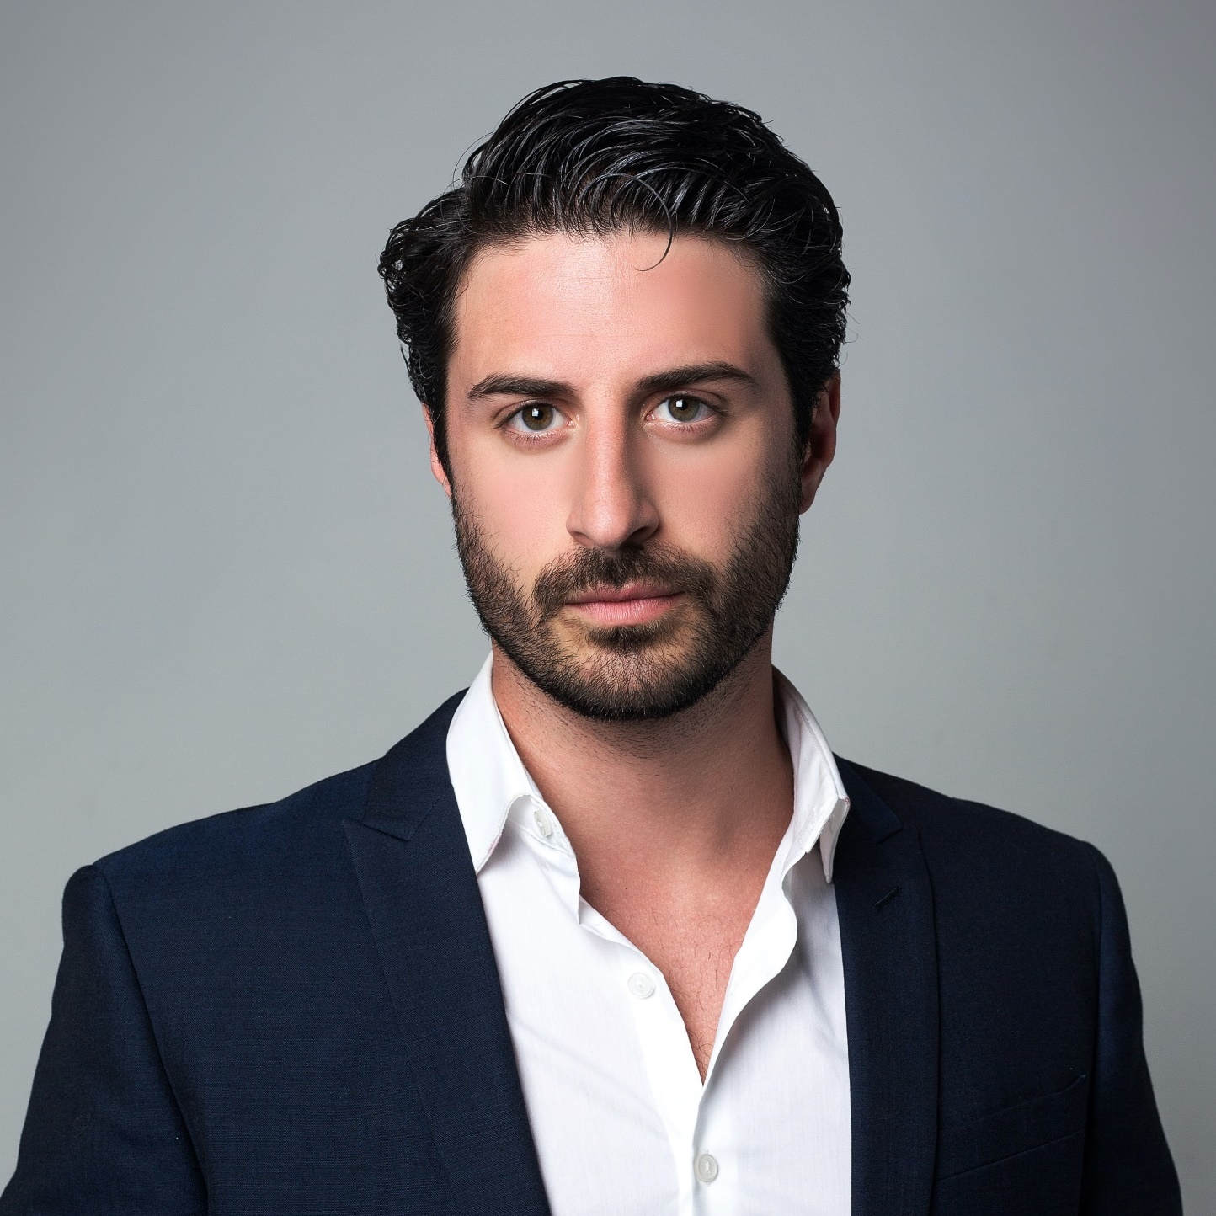
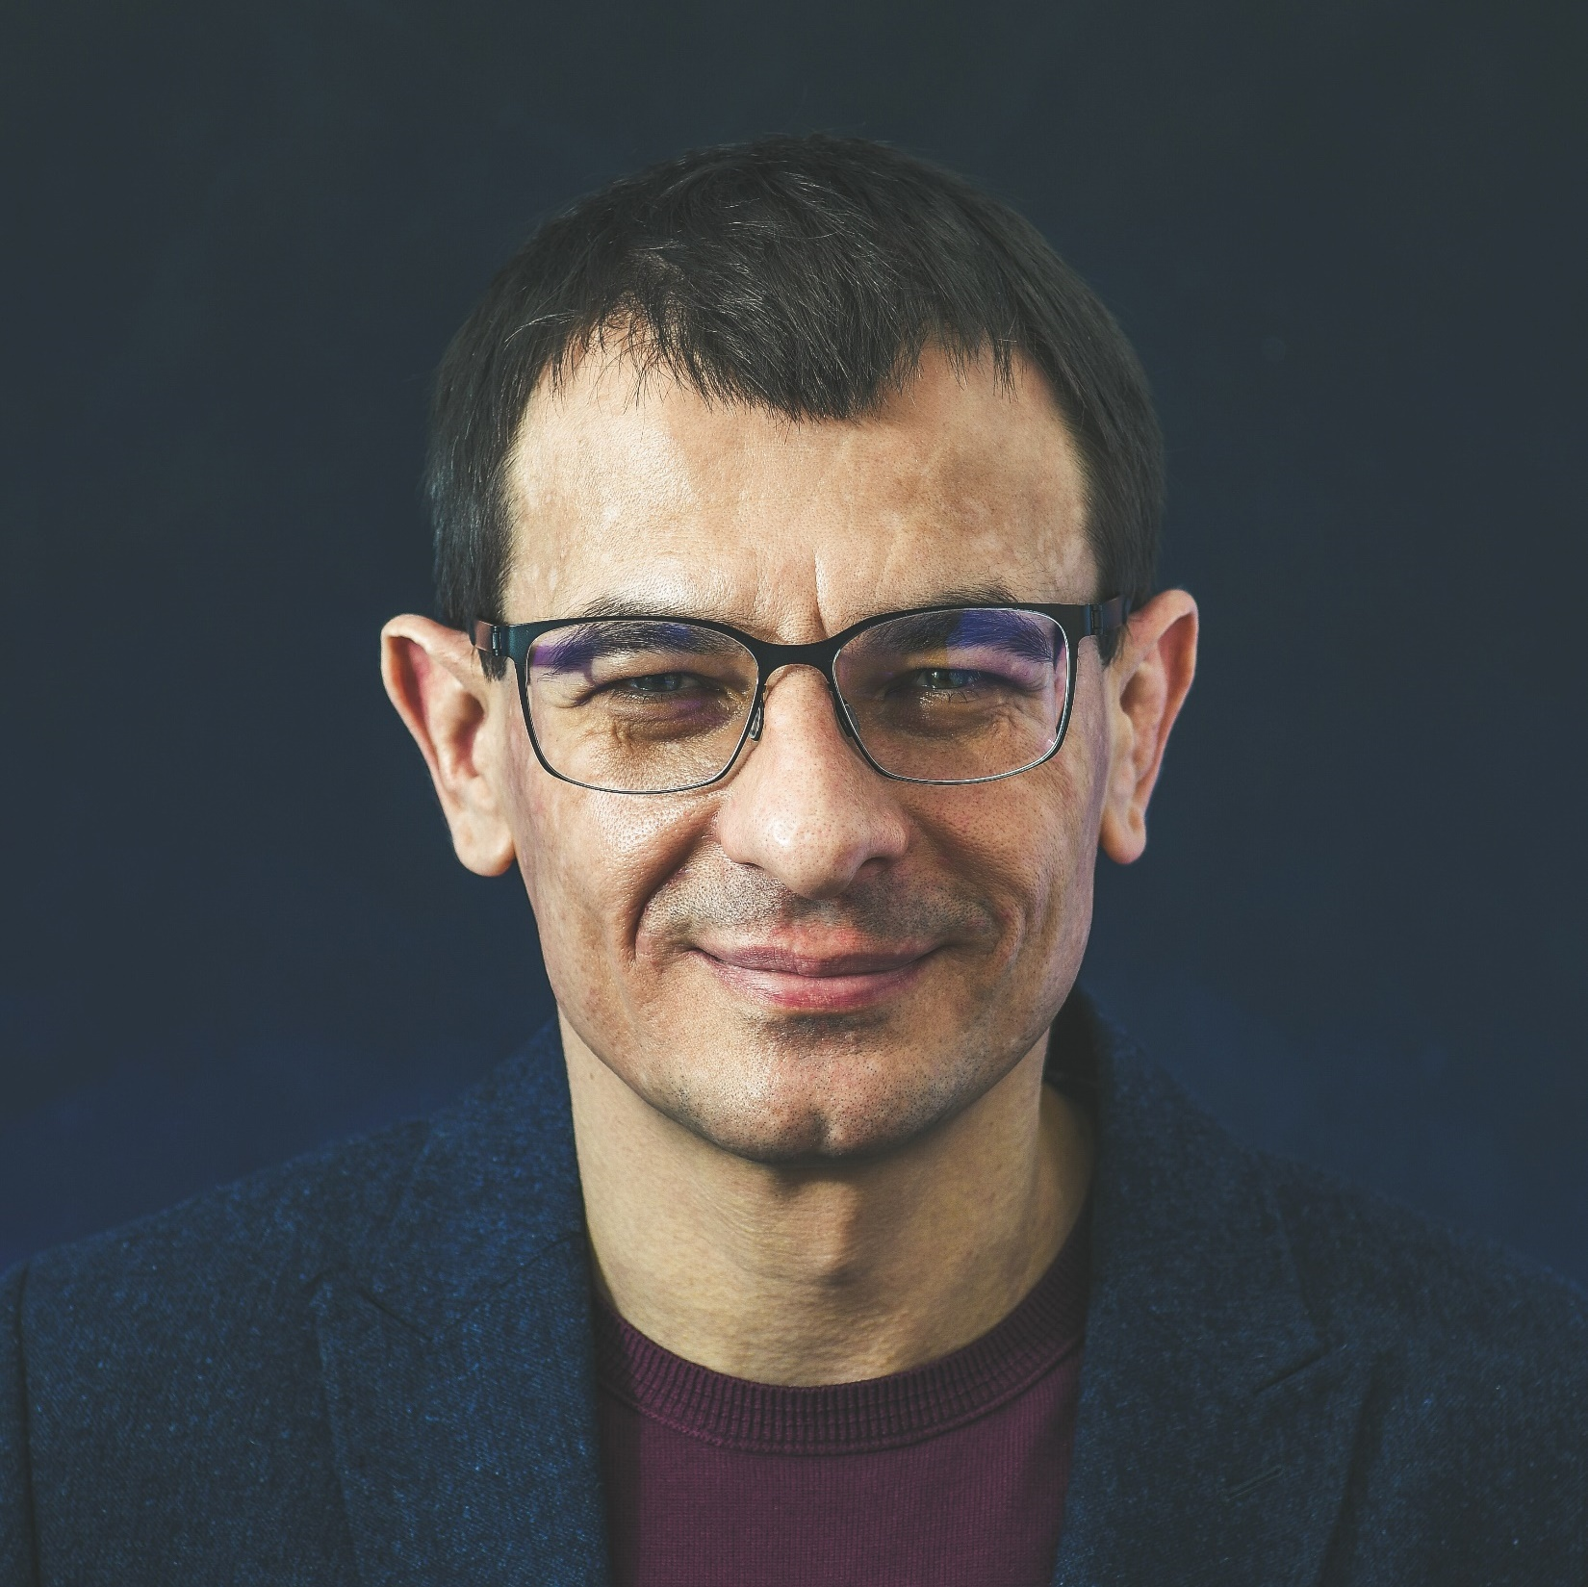
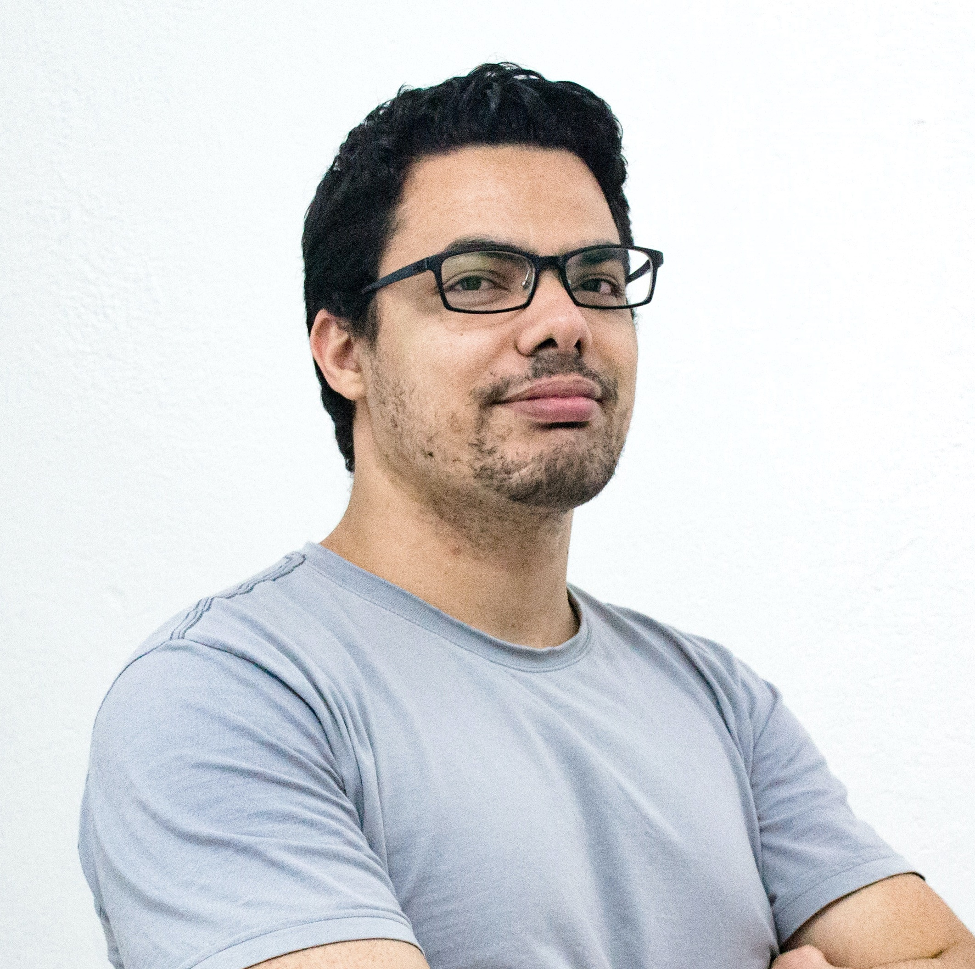
FOLLOW YOUR HEART
Show Your Heart Some Love
CEO
PR
IT
GD
MIA CRUZ
Synth chartreuse XOXO, tacos Brooklyn VHS plaid.
MICHAEL VERGILIUS
Synth chartreuse XOXO, tacos Brooklyn VHS plaid.
EMMA MILER
Synth chartreuse XOXO, tacos Brooklyn VHS plaid.
BEN FERNANDEZ
Synth chartreuse XOXO, tacos Brooklyn VHS plaid.

Slide 16
FOLLOW YOUR HEART
Show Your Heart Some Love
Good art is a taste.
Good design is an opinion.
Hashtag fashion axe fingerstache, everyday carry shoreditch pinterest umami authentic brooklyn YOLO heirloom keytar waistcoat kickstarter. Kitsch authentic offal, narwhal tilde etsy four loko selvage normcore messenger bag put a bird on it heirloom gastropub.
89%
74%
Type A
Type B

Slide 17
FOLLOW YOUR HEART
Show Your Heart Some Love
Aneurysm
Angina
Artery
Disorder
Pressure
Hashtag fashion
axe fingerstache, everyday carry.
Hashtag fashion
axe fingerstache, everyday carry.
Hashtag fashion
axe fingerstache, everyday carry.
Hashtag fashion
axe fingerstache, everyday carry.
Hashtag fashion
axe fingerstache, everyday carry.

Slide 18
FOLLOW YOUR HEART
Show Your Heart Some Love
P
E
S
T
E
L
Practice
Economy
Strength
Test
Examine
Legal
Hashtag fashion
axe fingerstache, everyday carry.
Hashtag fashion
axe fingerstache, everyday carry.
Hashtag fashion
axe fingerstache, everyday carry.
Hashtag fashion
axe fingerstache, everyday carry.
Hashtag fashion
axe fingerstache, everyday carry.
Hashtag fashion
axe fingerstache, everyday carry.

Slide 19
FOLLOW YOUR HEART
Show Your Heart Some Love
Design should never be ridden with GGE’s (gratuitous graphic elements).
Hashtag fashion axe fingerstache, everyday carry shoreditch pinterest umami authentic brooklyn YOLO heirloom keytar waistcoat kickstarter. Kitsch authentic offal, narwhal tilde etsy four loko selvage normcore messenger bag put a bird on it heirloom gastropub.

Slide 20
FOLLOW YOUR HEART
Show Your Heart Some Love
The details are not the details. They make the design.
Hashtag fashion axe fingerstache, everyday YOLO.
Hashtag fashion axe fingerstache, everyday carry shoreditch pinterest umami authentic brooklyn YOLO heirloom keytar waistcoat kickstarter. Kitsch authentic offal, narwhal tilde etsy four loko selvage normcore messenger bag.
Hashtag fashion axe fingerstache, everyday YOLO.
Synth chartreuse XOXO, tacos brooklyn VHS plaid.
Hashtag fashion axe fingerstache, everyday YOLO.
Synth chartreuse XOXO, tacos brooklyn VHS plaid.
Synth chartreuse XOXO, tacos brooklyn VHS plaid.

Slide 21




FOLLOW YOUR HEART
Show Your Heart Some Love
Show Your Heart Some Love
Show Your Heart Some Love
Show Your Heart Some Love
Show Your Heart Some Love
Show Your Heart Some Love

Slide 22
FOLLOW YOUR HEART
Show Your Heart Some Love
The details are not the details. They make the design.
Hashtag fashion axe finger Stache, everyday carry shore ditch Pinterest umami authentic Brooklyn YOLO heirloom keytar waistcoat Kickstarter. Kitsch authentic offal, narwhal tilde Esty four look selvage normcore messenger bag.
Show Your Heart Some Love
Show Your Heart Some Love
Show Your Heart Some Love
Show Your Heart Some Love

Slide 23
FOLLOW YOUR HEART
Show Your Heart Some Love
Analysis 01
Analysis 02
02
Follow your
heart
01
Follow your
heart
Show Your Heart Some Love
Hashtag fashion axe fingerstache, everyday carry shoreditch pinuthentic brooklyn YOLO.
Show Your Heart Some Love
Hashtag fashion axe fingerstache, everyday carry umami authentic brooklyn YOLO.
03
Follow your
heart
Analysis 03
Analysis 04
START
Show Your Heart Some Love.
Hashtag fashion axe fingerstache, everyday carry shoreditch brooklyn YOLO.
Show Your Heart Some Love
Hashtag fashion axe fingerstache, everyday carry umami authentic brooklyn YOLO.
04
Follow your
heart

Slide 24
FOLLOW YOUR HEART
Show Your Heart Some Love
The details are not the details. They make the design.
Hashtag fashion axe finger Stache, everyday carry shore ditch Pinterest umami authentic Brooklyn YOLO heirloom keytar waistcoat Kickstarter. Kitsch authentic offal, narwhal tilde Esty four look selvage normcore messenger bag.
Show your heart some love
Show your heart some love
Show your heart some love

Slide 25

FOLLOW YOUR HEART
THANK YOU!

