Slide 1
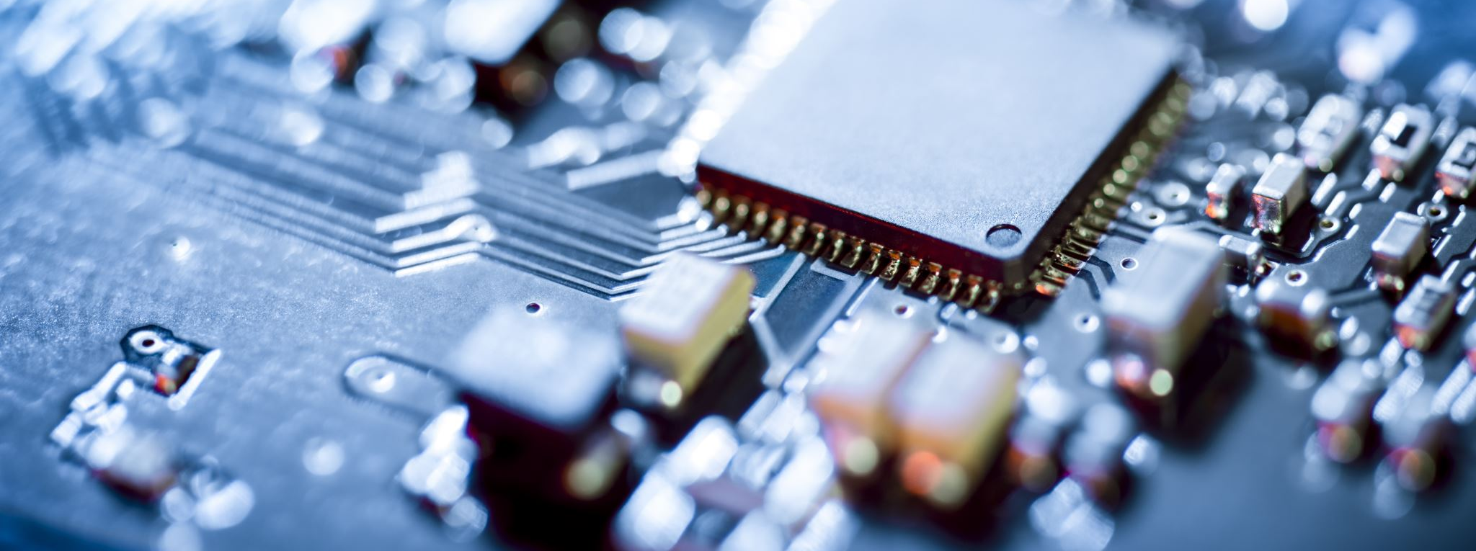
Evolution of Computers

Slide 2
History
The first computer was invented in 1820s by Charlse Babbage. However the first electronic digital computer were developed between 1940 and 1945 in the United States and in the United Kingdom.
In the beginning they were mainly used for arithmetic calculations .
During the first half of the 20th century, many scientific computing needs were met by increasingly sophisticated analog computers , which used a direct mechanical or electrical model of the problem as a basis for computation.
Then digital and Hybrid computers were invented and they are used till this day

Slide 3
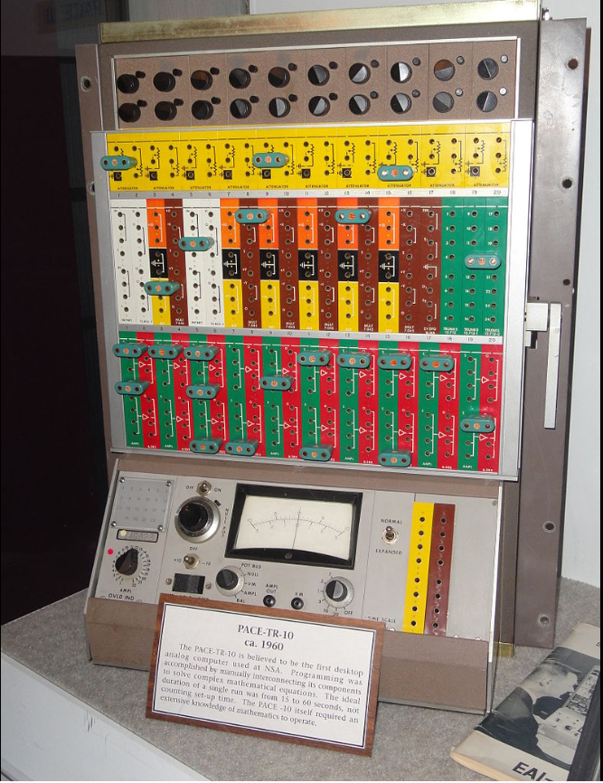
Analog Computers
Computer that uses the continuously changeable aspects of physical phenomena such as electrical, mechanical, or hydraulic quantities to model the problem being solved
Analog computers often have a complicated framework, but they have,
at their core, a set of key components which perform the calculations,
which the operator manipulates through the computer's framework.
Key hydraulic components might include pipes, valves and containers.
In the 1950s to 1970s, digital computers based on first vacuum tubes,
transistors, integrated circuits and then micro-processors
became more economical and precise.
Extraordinarily fast

Slide 4

Digital Computers
Digital electronic computer is a computer machine which is both an electronic computer and a digital computer Examples of a digital electronic computers include the IBM PC, the Apple Macintosh as well as modern smartphones.
A digital computer can perform its operations in the decimal system, in binary, in ternary or in other numeral systems
A digital electronic computer is not necessarily a transistorized
computer.
Digital computers are inherently best described by
discrete mathematics, while analog computers are most
commonly associated with continuous mathematics.

Slide 5
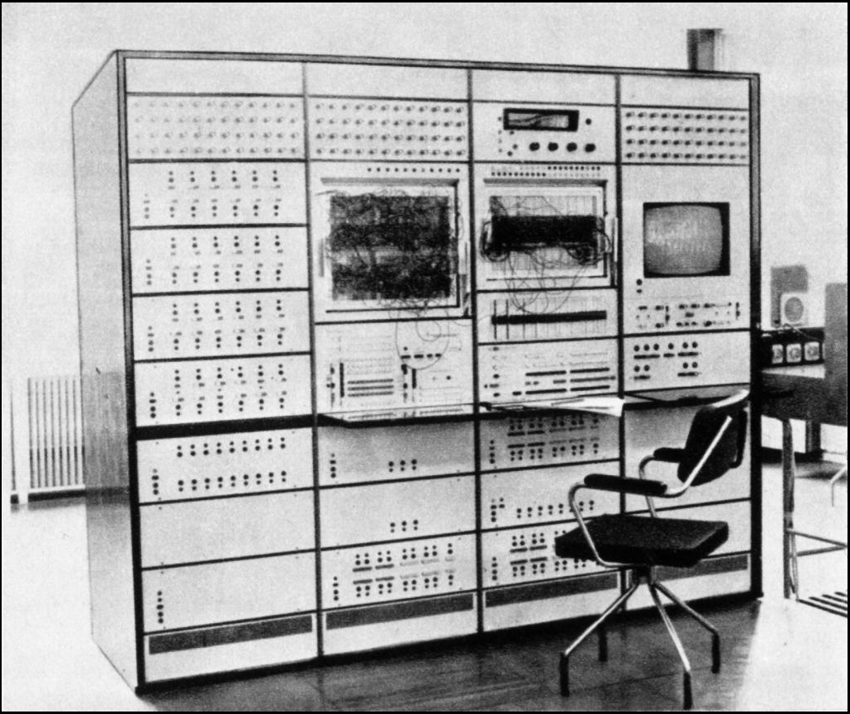
Hybrid Computers
Hybrid Computers are computers that exhibit features of analog computers and digital computers.
Digital computers are very precise in calculating math equations
Analog computers execute the operations at a very high speed
The mix between the speed of the analog computers and
the precision of the Digital computers .
In the figure on the right is the first Hybrid computer created

Slide 6

Evolution of Operating System of the Computers
Serial Processing
Simple Batch Systems
Multiprogram Batch Systems
Time Sharing Systems

Slide 7
Serial Processing
late 1940s to mid-1950s
No operating system
Machines run from a console with display lights, toggle switches, input device, and printer
Challenges include:
Scheduling: using a sign-up sheets
Setup time:
loading compiler and source program into memory
saving the object program
loading and linking object program and common functions

Slide 8
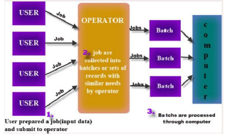
Simple Batch Systems
Early computers were extremely expensive–Important to maximize processor utilization
Mid-1950s : Batch OS (1rst OS of any kind!!)
Use of Monitor i.e. Software that controls the sequence of events–
Batch jobs together–each program returns control to monitor when finished.

Slide 9
Multiprogram Batch Systems
CPU is often idle–Even with automatic job sequencing.–I/O devices are slow compared to the CPU.
There are several issues :
which job should sit in memory
which CPU pick up
How to manage memory
What happens to the job which is suspended

Slide 10
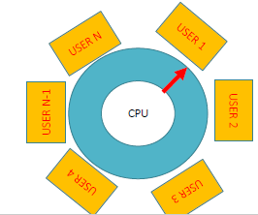
Time sharing systems
Provide user interaction with the computer system.
more than one user interacting with the system at the same time!!
Time sharing systems use:
Multiprogramming
Memory management scheme

Slide 11
THANK YOU !

