Slide 1
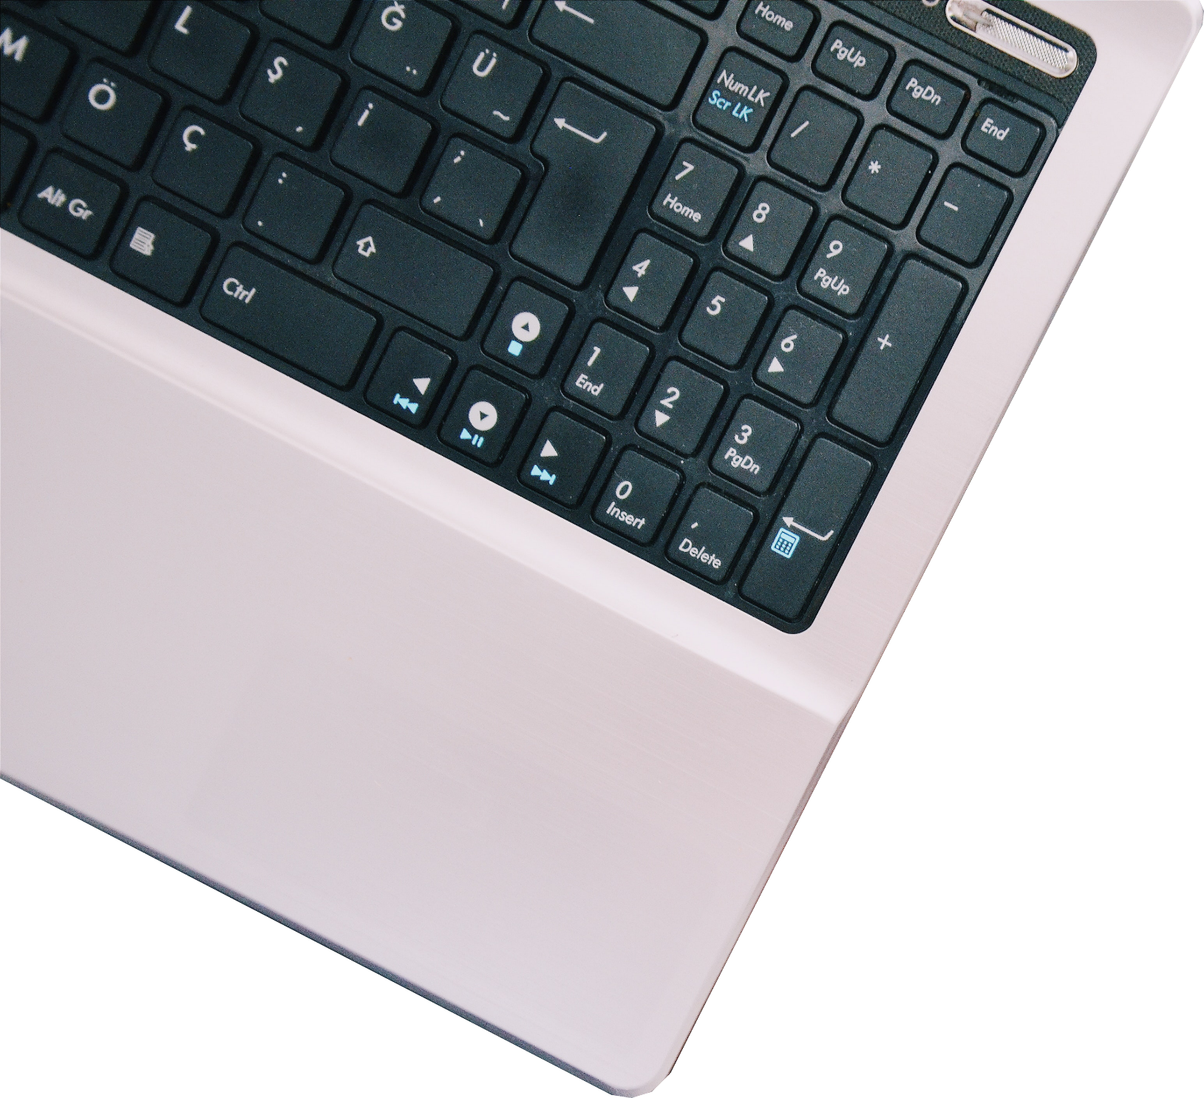
COMPUTERS
“Computers are like Old Testament gods; lots of rules and no mercy.”

Slide 2
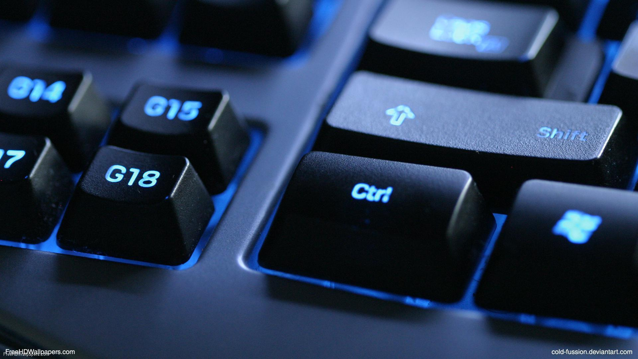
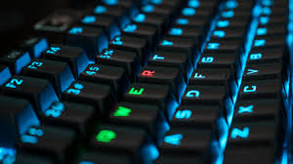
WHAT IS A COMPUTER?
A computer is an electronic device, operating under the control of instructions stored in its own memory.
Collects
Processing
Produces
(Input)
(Output)

Slide 3
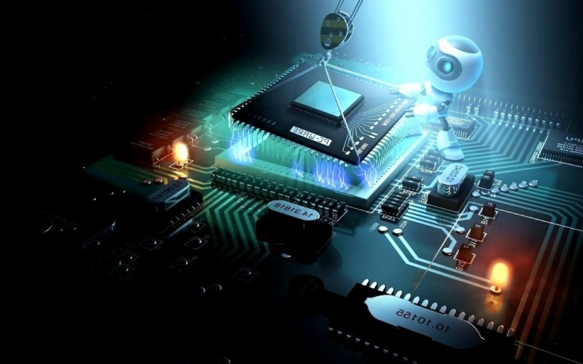
CHARACTERISTICS OF COMPUTER
Speed: Computer is very fast and accurate device.
Accuracy: Computer results are highly accurate.
Memory: Computers have a large amount of memory to hold a very large amount of data or information.

Slide 4
CHARACTERISTICS OF COMPUTER
Diligence: Computer is free from problems like lack of concentration and confusions & tiredness.
Versatility: We can perform different types of tasks on computer.
Power of Remembrance: Unlike humans, computer can store things for unlimited period of time.

Slide 5
Input Device: Allows you to enter data and instructions into a computer.
Output Device: Hardware component that conveys information to one or more people.
System Unit: Case that contains the electronic components of the computer that are used to process data.
Storage Device: Holds data, instructions, and information for future use.
Communications Device: Enables a computer to send and receive data, instructions, and information to and from one or more computers or mobile devices
THE COMPONENTS OF A COMPUTER
POWER OF CREATIVITY

Slide 6
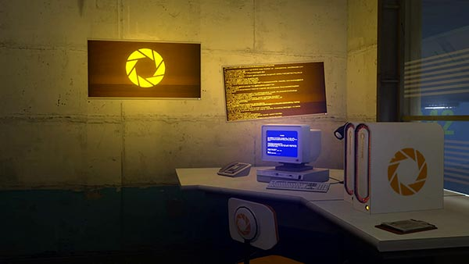
ADVANTAGES
DISADVANTAGES
Speed
Reliability
Consistency
Storage
Communications
Health Risks
Violation of Privacy
Public Safety
Impact on Labor Force
Impact on Environment

Slide 7
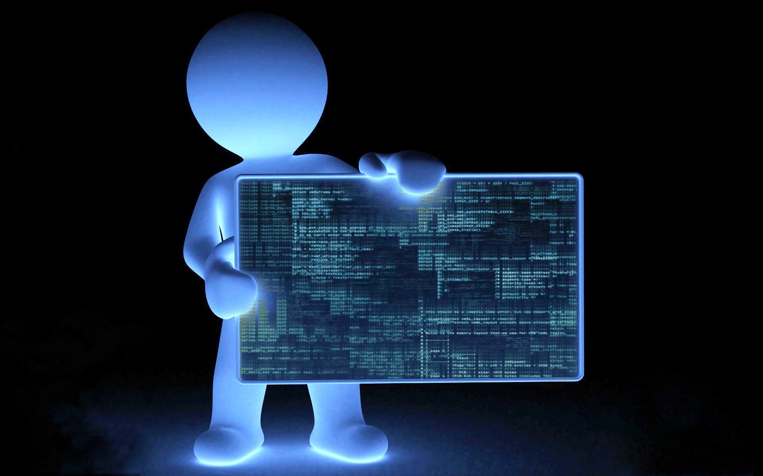




A network is a collection of computers and devices connected together, often wirelessly, via communications devices and transmission media
NETWORKS AND THE INTERNET

Slide 8
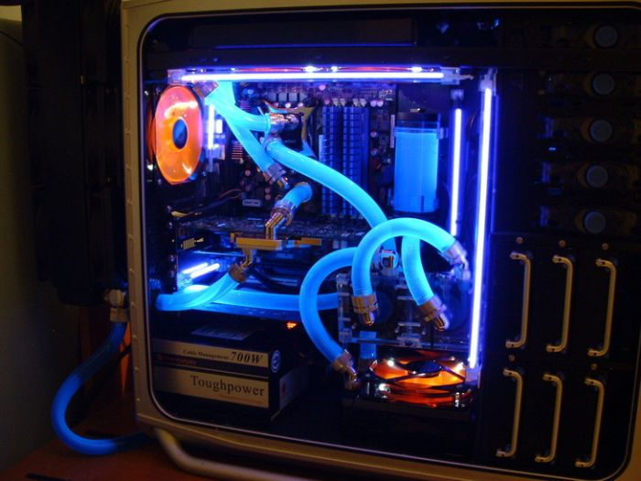
COMPUTER SOFTWARE
Software, also called a program, tells the computer what tasks to perform and how to perform them
Desktop or web app
I
B
C
G
H
A
D
E
F

Slide 9
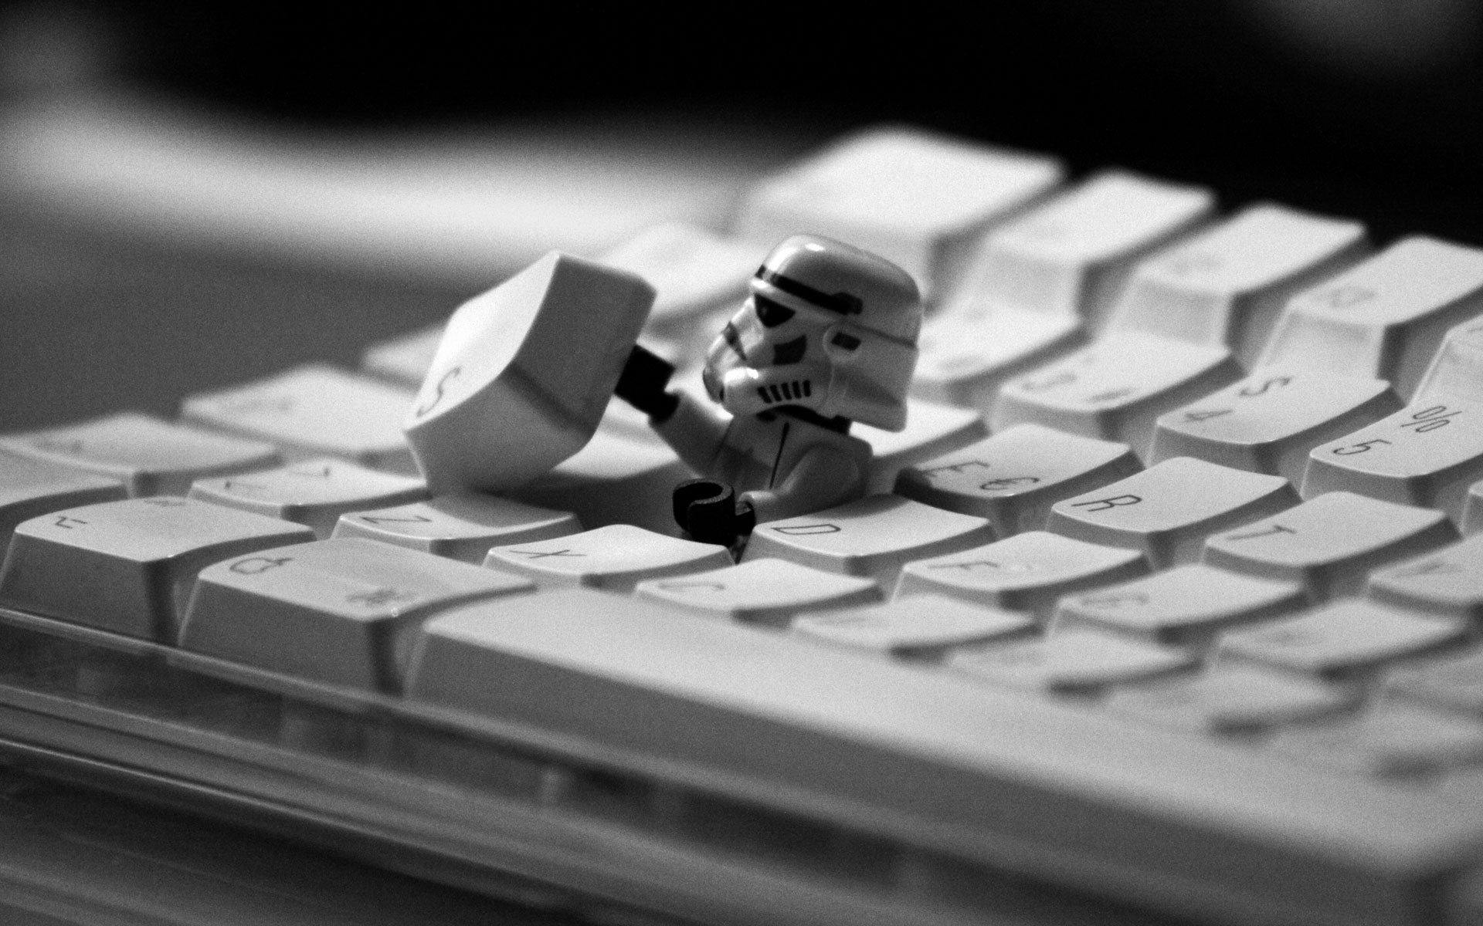
Personal
Computer
Mobile Computers and mobile devices
Game consoles
CATEGORIES OF COMPUTERS
Servers
Mainframes
Supercomputers
Embedded computers
Notes:
To myself I am only a child playing on the beach, while vast oceans of truth lie undiscovered before me.

Slide 10
COMPUTER APPLICATIONS IN SOCIETY
Science
Publishing
Travel
Manufacturing

