Slide 1

CORPORATE
POWERPOINT TEMPLATE
WHO ARE CRAZY ENOUGH TO THINK THEY CAN CHANGE THE WORLD, ARE THE ONES THAT DO.

Slide 2

CORPORATE
POWERPOINT TEMPLATE
WHO ARE CRAZY ENOUGH TO THINK THEY CAN CHANGE THE WORLD, ARE THE ONES THAT DO.

Slide 3

CORPORATE
POWERPOINT TEMPLATE
WHO ARE CRAZY ENOUGH TO THINK THEY CAN CHANGE THE WORLD, ARE THE ONES THAT DO.

Slide 4
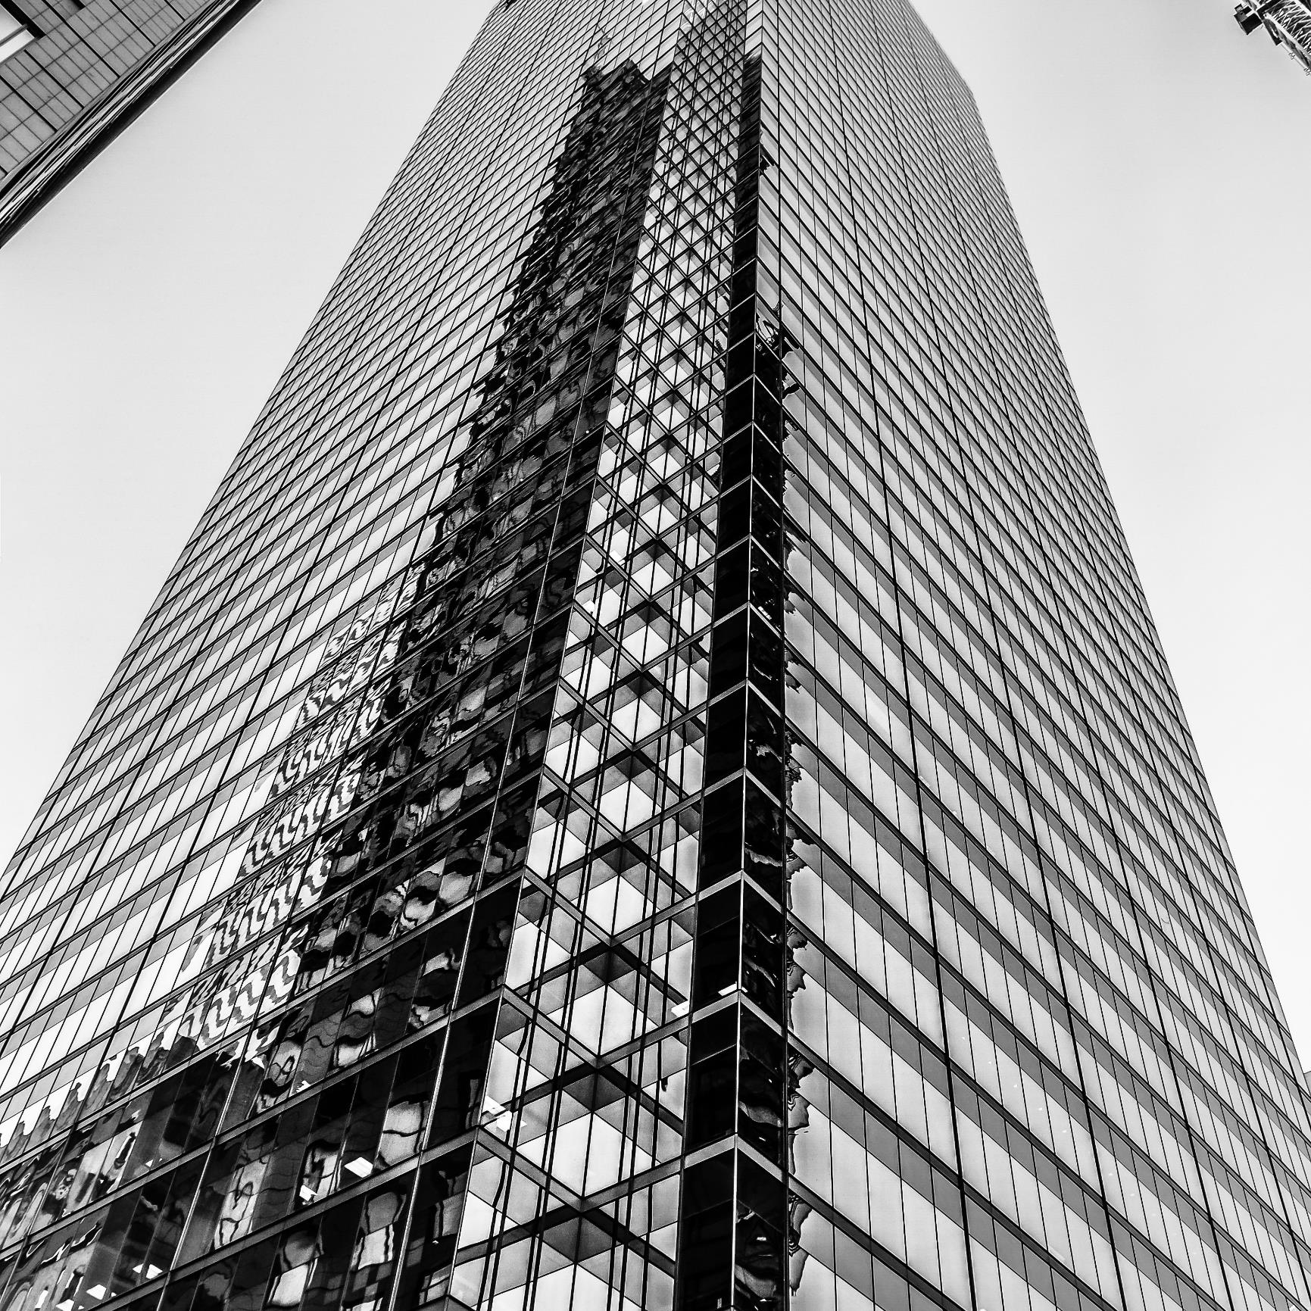
ABOUT
CORPORATE
WHO ARE CRAZY ENOUGH TO THINK THEY CAN CHANGE THE WORLD, ARE THE ONES THAT DO.
USER EXPERIENCE
It hadn't properly registered with Arthur that the council wanted to knock down his house and build an bypass instead.
USER EXPERIENCE
It hadn't properly registered with Arthur that the council wanted to knock down his house and build an bypass instead.

Slide 5

ABOUT CORPORATE
WHO ARE CRAZY ENOUGH TO THINK THEY CAN CHANGE THE WORLD, ARE THE ONES THAT DO.
Watch this slideshow about fibromyalgia (fibrositis) with pictures about this chronic condition that causes pain and stiffness of the tendons, muscles, and joints. Watch this slideshow about. Watch this slideshow about fibromyalgia.
Watch this slideshow about fibromyalgia (fibrositis) with pictures about this chronic condition that causes pain and stiffness of the tendons, muscles, and joints. Watch this slideshow about. Watch this slideshow about fibromyalgia.

Slide 6

ABOUT CORPORATE
USER EXPERIENCE
USER EXPERIENCE
USER EXPERIENCE
It hadn't properly registered with Arthur that the council wanted to knock down his house and build an bypass instead.
It hadn't properly registered with Arthur that the council wanted to knock down his house and build an bypass instead.
It hadn't properly registered with Arthur that the council wanted to knock down his house and build an bypass instead.

Slide 7

OUR SERVICES
USER
EXPERIENCE
USER
EXPERIENCE
USER
EXPERIENCE
USER
EXPERIENCE
Watch this slideshow for a about fibromyalgia with pictures about this chronic condition
Watch this slideshow for a about fibromyalgia with pictures about this chronic condition
Watch this slideshow for a about fibromyalgia with pictures about this chronic condition
Watch this slideshow for a about fibromyalgia with pictures about this chronic condition

Slide 8

IT HADN'T REGISTERED WITH ARTHUR THAT THE COUNCIL WANTED TO KNOCK DOWN HIS HOUSE AND BUILD AN BYPASS INSTEAD.

Slide 9

IT HADN'T PROPERLY REGISTERED WITH ARTHUR
THAT THE COUNCIL WANTED TO KNOCK DOWN HIS HOUSE AND BUILD AN BYPASS INSTEAD.

Slide 10

Find out where the people are going and buy the land before they get there. To be successful in real estate, you must always and consistently put your clients' best interests first. When you do, your personal needs will be realized beyond your greatest expectations.
RON STARK
CEO & CO-FOUNDER

Slide 11

WATCH THIS SLIDESHOW ABOUT CONDITION THAT CAUSES PAIN AND STIFFNESS OF THE TENDONS
USER EXPERIENCE
USER EXPERIENCE
USER EXPERIENCE
Watch this slideshow about fibromyalgia (fibrositis) with pictures about this chronic condition that causes pain and stiffness of the tendons, muscles, and joints. Watch this slideshow about.
Watch this slideshow about fibromyalgia (fibrositis) with pictures about this chronic condition that causes pain and stiffness of the tendons, muscles, and joints. Watch this slideshow about.
Watch this slideshow about fibromyalgia (fibrositis) with pictures about this chronic condition that causes pain and stiffness of the tendons, muscles, and joints. Watch this slideshow about.

Slide 12

BUYERS DECIDE IN THE FIRST EIGHT SECONDS OF SEEING A HOME IF THEY’RE INTERESTED IN BUYING IT.

Slide 13


IT HADN'T PROPERLY REGISTERED WITH ARTHUR
THAT THE COUNCIL WANTED TO KNOCK DOWN HIS HOUSE AND BUILD AN BYPASS INSTEAD.

Slide 14

IT HADN'T PROPERLY REGISTERED WITH ARTHUR
THAT THE COUNCIL WANTED TO KNOCK DOWN HIS HOUSE AND BUILD AN BYPASS INSTEAD.

Slide 15


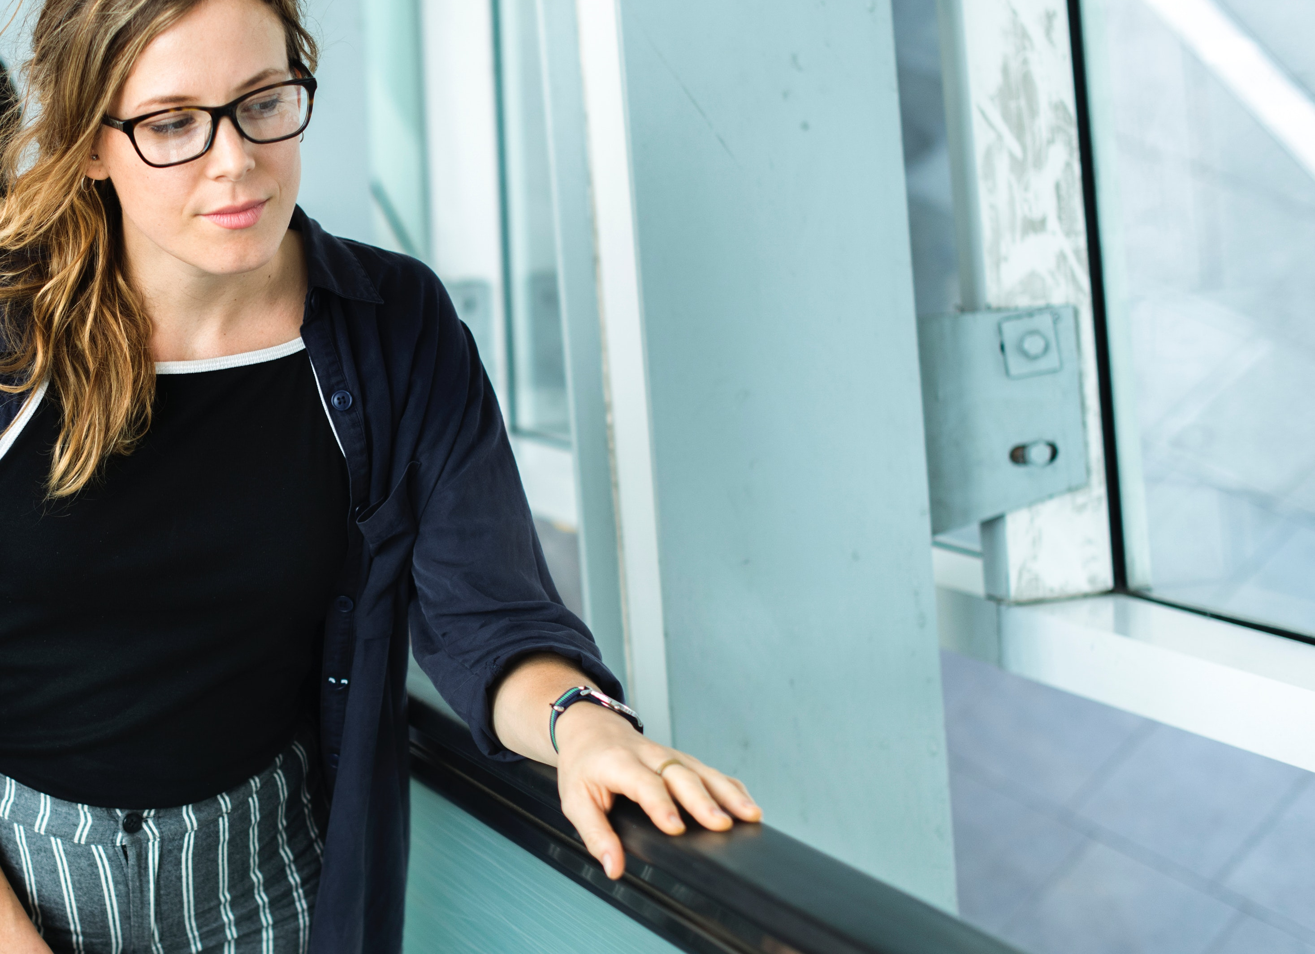


PROJECT PORTFOLIO
WHO ARE CRAZY ENOUGH TO THINK THEY CAN CHANGE THE WORLD, ARE THE ONES THAT DO.

Slide 16
PROJECT PORTFOLIO
WHO ARE CRAZY ENOUGH TO THINK THEY CAN CHANGE THE WORLD, ARE THE ONES THAT DO.
IT HADN'T REGISTERED WITH ARTHUR THAT THE COUNCIL WANTED TO KNOCK DOWN HIS HOUSE AND BUILD AN BYPASS INSTEAD.

Slide 17
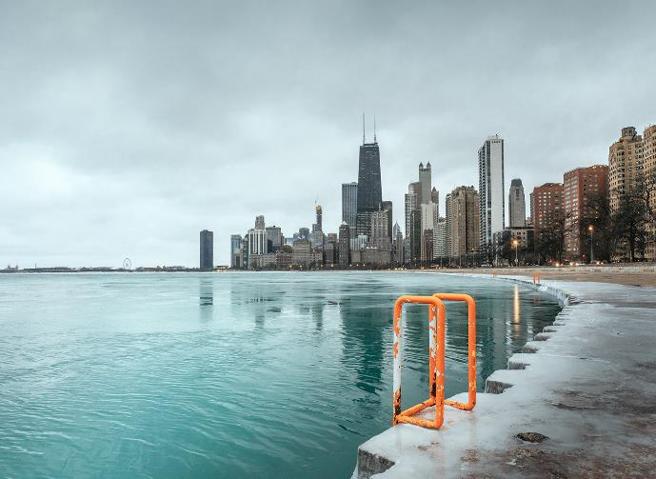
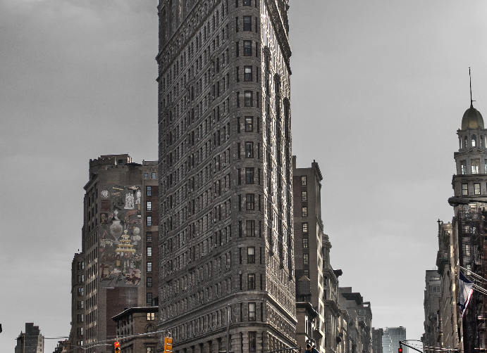


PROJECT PORTFOLIO
WHO ARE CRAZY ENOUGH TO THINK THEY CAN CHANGE THE WORLD, ARE THE ONES THAT DO.
PROJECT PORTFOLIO
PROJECT PORTFOLIO
PROJECT PORTFOLIO
PROJECT PORTFOLIO

Slide 18
PROJECT PORTFOLIO
WHO ARE CRAZY ENOUGH TO THINK THEY CAN CHANGE THE WORLD, ARE THE ONES THAT DO.
USER EXPERIENCE
It hadn't properly registered with Arthur that the council wanted to knock down his house and build an bypass instead.
USER EXPERIENCE
It hadn't properly registered with Arthur that the council wanted to knock down his house and build an bypass instead.
PROJECT PORTFOLIO
PROJECT PORTFOLIO
USER EXPERIENCE
It hadn't properly registered with Arthur that the council wanted to knock down his house and build an bypass instead.

Slide 19



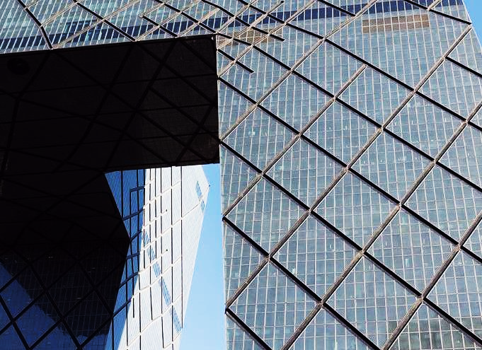
PROJECT PORTFOLIO
WHO ARE CRAZY ENOUGH TO THINK THEY CAN CHANGE THE WORLD, ARE THE ONES THAT DO.
PROJECT PORTFOLIO
PROJECT PORTFOLIO
PROJECT PORTFOLIO
PROJECT PORTFOLIO
PROJECT PORTFOLIO
PROJECT PORTFOLIO
PROJECT PORTFOLIO
PROJECT PORTFOLIO

Slide 20
PROJECT PORTFOLIO
WHO ARE CRAZY ENOUGH TO THINK THEY CAN CHANGE THE WORLD, ARE THE ONES THAT DO.
USER EXPERIENCE
It hadn't properly registered with Arthur that the council wanted to knock down his house and build an bypass instead.
PROJECT PORTFOLIO
PROJECT PORTFOLIO
USER EXPERIENCE
It hadn't properly registered with Arthur that the council wanted to knock down his house and build an bypass instead.
USER EXPERIENCE
PROJECT PORTFOLIO
PROJECT PORTFOLIO
It hadn't properly registered with Arthur that the council wanted to knock down his house and build an bypass instead.

Slide 21
PROJECT PORTFOLIO
WHO ARE CRAZY ENOUGH TO THINK THEY CAN CHANGE THE WORLD, ARE THE ONES THAT DO.
USER EXPERIENCE
USER EXPERIENCE
It hadn't properly registered with Arthur that the council wanted to knock down his house and build an bypass instead.
It hadn't properly registered with Arthur that the council wanted to knock down his house and build an bypass instead.
USER EXPERIENCE
USER EXPERIENCE
It hadn't properly registered with Arthur that the council wanted to knock down his house and build an bypass instead.
It hadn't properly registered with Arthur that the council wanted to knock down his house and build an bypass instead.
USER EXPERIENCE
USER EXPERIENCE
It hadn't properly registered with Arthur that the council wanted to knock down his house.
It hadn't properly registered with Arthur that the council wanted to knock down his house.

Slide 22
PROJECT PORTFOLIO
WHO ARE CRAZY ENOUGH TO THINK THEY CAN CHANGE THE WORLD, ARE THE ONES THAT DO.
USER EXPERIENCE
USER EXPERIENCE
It hadn't properly registered with Arthur that the council wanted to knock down his house and build an bypass instead.
It hadn't properly registered with Arthur that the council wanted to knock down his house and build an bypass instead.
USER EXPERIENCE
USER EXPERIENCE
It hadn't properly registered with Arthur that the council wanted to knock down his house and build an bypass instead.
It hadn't properly registered with Arthur that the council wanted to knock down his house and build an bypass instead.
USER EXPERIENCE
USER EXPERIENCE
It hadn't properly registered with Arthur that the council wanted to knock down his house and build an bypass instead.
It hadn't properly registered with Arthur that the council wanted to knock down his house and build an bypass instead.

Slide 23
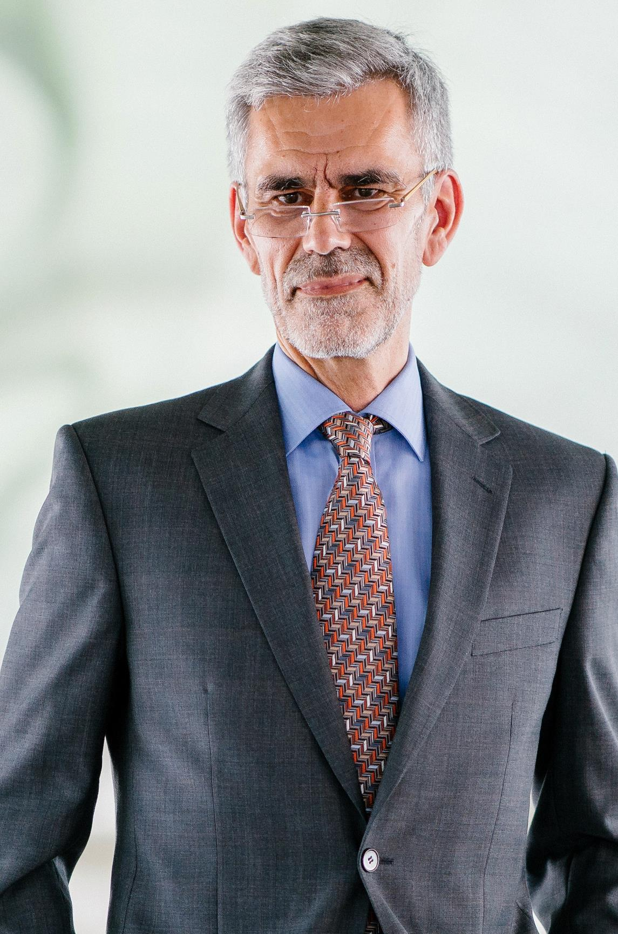
MR. WALTON
CEO
Watch this slideshow about fibromyalgia (fibrositis) with pictures about this chronic condition that causes pain and stiffness of the tendons, muscles, and joints. Watch this slideshow about. Watch this slideshow about fibromyalgia (fibrositis) with pictures. Watch this slideshow about fibromyalgia (fibrositis) with pictures about this chronic condition.
Experience
Expertise
Education
Success Rate

Slide 24


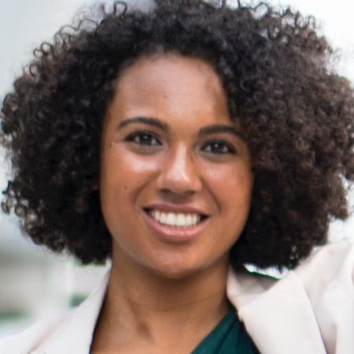
OUR TEAM
DOMINICK NORMAN
PATTI HAMILTON
MELISSA SHAW
CEO
CEO
CEO
Watch this slideshow about fibromyalgia (fibrositis) with pictures about this chronic condition that causes pain and stiffness of the tendons.
Watch this slideshow about fibromyalgia (fibrositis) with pictures about this chronic condition that causes pain and stiffness of the tendons.
Watch this slideshow about fibromyalgia (fibrositis) with pictures about this chronic condition that causes pain and stiffness of the tendons.

Slide 25
OUR TEAM
DOMINICK NORMAN
PATTI HAMILTON
MELISSA SHAW
CEO
CEO
CEO
Watch this slideshow about fibromyalgia (fibrositis) with pictures about this chronic condition that causes pain and stiffness of the tendons.
Watch this slideshow about fibromyalgia (fibrositis) with pictures about this chronic condition that causes pain and stiffness of the tendons.
Watch this slideshow about fibromyalgia (fibrositis) with pictures about this chronic condition that causes pain and stiffness of the tendons.

Slide 26
BIZZ INFOGRAPHICS
USER EXPERIENCE
It hadn't properly registered with Arthur that the council wanted to knock down his house and build an bypass instead.
USER EXPERIENCE
It hadn't properly registered with Arthur that the council wanted to knock down his house and build an bypass instead.
USER EXPERIENCE
It hadn't properly registered with Arthur that the council wanted to knock down his house and build an bypass instead.

Slide 27
BIZZ INFOGRAPHICS
USER EXPERIENCE
It hadn't properly registered with Arthur that the council wanted to knock down his house and build an bypass instead.
USER EXPERIENCE
It hadn't properly registered with Arthur that the council wanted to knock down his house and build an bypass instead.
USER EXPERIENCE
It hadn't properly registered with Arthur that the council wanted to knock down his house and build an bypass instead.

Slide 28
BIZZ INFOGRAPHICS
USER EXPERIENCE
It hadn't properly registered with Arthur that the council wanted to knock down his house and build an bypass instead.
USER EXPERIENCE
It hadn't properly registered with Arthur that the council wanted to knock down his house and build an bypass instead.
USER EXPERIENCE
It hadn't properly registered with Arthur that the council wanted to knock down his house and build an bypass instead.

Slide 29
BIZZ INFOGRAPHICS
USER EXPERIENCE
It hadn't properly registered with Arthur that the council wanted to knock down his house and build an bypass instead.
USER EXPERIENCE
It hadn't properly registered with Arthur that the council wanted to knock down his house and build an bypass instead.
USER EXPERIENCE
It hadn't properly registered with Arthur that the council wanted to knock down his house and build an bypass instead.

Slide 30
BIZZ INFOGRAPHICS
USER EXPERIENCE
It hadn't properly registered with Arthur that the council wanted to knock down his house and build an bypass instead.
USER EXPERIENCE
It hadn't properly registered with Arthur that the council wanted to knock down his house and build an bypass instead.
USER EXPERIENCE
It hadn't properly registered with Arthur that the council wanted to knock down his house and build an bypass instead.

Slide 31
BIZZ INFOGRAPHICS
USER EXPERIENCE
It hadn't properly registered with Arthur that the council wanted to knock down his house and build an bypass instead.
USER EXPERIENCE
It hadn't properly registered with Arthur that the council wanted to knock down his house and build an bypass instead.
USER EXPERIENCE
It hadn't properly registered with Arthur that the council wanted to knock down his house and build an bypass instead.

Slide 32
BIZZ INFOGRAPHICS
USER EXPERIENCE
It hadn't properly registered with Arthur that the council wanted to knock down his house and build an bypass instead.
USER EXPERIENCE
It hadn't properly registered with Arthur that the council wanted to knock down his house and build an bypass instead.
USER EXPERIENCE
It hadn't properly registered with Arthur that the council wanted to knock down his house and build an bypass instead.

Slide 33
BIZZ INFOGRAPHICS
USER EXPERIENCE
BIZZ INFO
GRAPHIC
It hadn't properly registered with Arthur that the council wanted to knock down his house and build an bypass instead.
USER EXPERIENCE
It hadn't properly registered with Arthur that the council wanted to knock down his house and build an bypass instead.
USER EXPERIENCE
It hadn't properly registered with Arthur that the council wanted to knock down his house and build an bypass instead.

Slide 34
BIZZ INFOGRAPHICS
USER EXPERIENCE
It hadn't properly registered with Arthur that the council wanted to knock down his house and build an bypass instead.
USER EXPERIENCE
It hadn't properly registered with Arthur that the council wanted to knock down his house and build an bypass instead.
USER EXPERIENCE
It hadn't properly registered with Arthur that the council wanted to knock down his house and build an bypass instead.

Slide 35
KEY FACTORS
YOUR TITLE HERE
Watch this slideshow about fibromyalgia (fibrositis) with pictures about this chronic condition that causes pain and stiffness of the tendons.
YOUR TITLE HERE
Watch this slideshow about fibromyalgia (fibrositis) with pictures about this chronic condition that causes pain and stiffness of the tendons.
YOUR TITLE HERE
Watch this slideshow about fibromyalgia (fibrositis) with pictures about this chronic condition that causes pain and stiffness of the tendons. Watch this slideshow about fibromyalgia.
WE DEVELOP
BUSINESS!

Slide 36
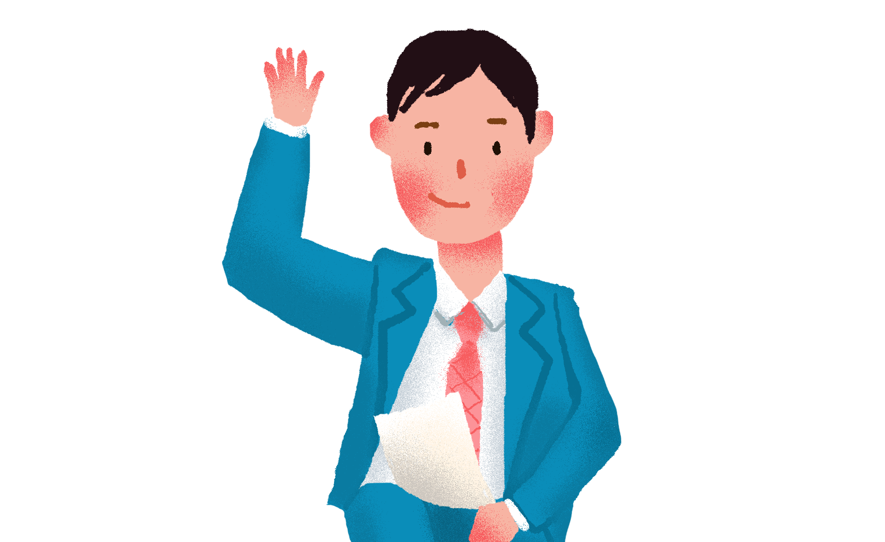
KEY FACTORS
IMPERISHABLE ASSET
IMPERISHABLE ASSET
Watch this slideshow about fibromyalgia (fibrositis) with pictures about this chronic condition that causes pain and stiffness.
Watch this slideshow about fibromyalgia (fibrositis) with pictures about this chronic condition that cause.
IMPERISHABLE ASSET
IMPERISHABLE ASSET
Watch this slideshow about fibromyalgia (fibrositis) with pictures about this chronic condition that cause.
Watch this slideshow about fibromyalgia (fibrositis) with pictures about this chronic condition that cause.
IMPERISHABLE ASSET
IMPERISHABLE ASSET
Watch this slideshow about fibromyalgia (fibrositis) with pictures about this chronic condition that causes pain and stiffness.
Watch this slideshow about fibromyalgia (fibrositis) with pictures about this chronic condition that causes pain and stiffness.

Slide 37
KEY FACTORS
67%
75%
43%
92%
USER EXPERIENCE
USER EXPERIENCE
USER EXPERIENCE
USER EXPERIENCE
It hadn't properly registered with Arthur that the council wanted to knock down his house and build an bypass instead.
It hadn't properly registered with Arthur that the council wanted to knock down his house and build an bypass instead.
It hadn't properly registered with Arthur that the council wanted to knock down his house and build an bypass instead.
It hadn't properly registered with Arthur that the council wanted to knock down his house and build an bypass instead.

Slide 38
KEY FACTORS
USER EXPERIENCE
USER EXPERIENCE
It hadn't properly registered with Arthur that the council wanted to knock down his house and build an bypass instead.
It hadn't properly registered with Arthur that the council wanted to knock down his house and build an bypass instead.
USER EXPERIENCE
USER EXPERIENCE
It hadn't properly registered with Arthur that the council wanted to knock down his house and build an bypass instead.
It hadn't properly registered with Arthur that the council wanted to knock down his house and build an bypass instead.
USER EXPERIENCE
USER EXPERIENCE
It hadn't properly registered with Arthur that the council wanted to knock down his house and build an bypass instead.
It hadn't properly registered with Arthur that the council wanted to knock down his house and build an bypass instead.

Slide 39
PRICING CHART
ECONOMIC
POPULAR
BUSINESS
BRILLAND
$99
$199
$299
$399
First Feature
Second Feature
Third Feature
Fourth Feature
First Feature
Second Feature
Third Feature
Fourth Feature
Fifth Feature
First Feature
Second Feature
Third Feature
Fourth Feature
Fifth Feature
First Feature
Second Feature
Third Feature
Fourth Feature
Fifth Feature
REQUEST OFFER
REQUEST OFFER
REQUEST OFFER
REQUEST OFFER

Slide 40
FINANCIAL PROJECTIONS
Medical Cost | $13,000.00 | $13,000.00 | $13,000.00
Medical Cost | $13,000.00 | $13,000.00 | $13,000.00
Medical Cost | $13,000.00 | $13,000.00 | $13,000.00
Medical Cost | $13,000.00 | $13,000.00 | $13,000.00
Medical Cost | $13,000.00 | $13,000.00 | $13,000.00
TOTAL | $13,000.00 | $13,000.00 | $13,000.00

Slide 41
FINANCIAL PROJECTIONS

Slide 42
WORLD MAP
THE BEST INVESTMENT ON EARTH IS EARTH.
50%
+0.16 (2.16%)
Good Feedback
30%
+0.16 (2.16%)
Good Feedback

Slide 43
UNITED STATES MAP
USER EXPERIENCE
It hadn't properly registered with Arthur that the council wanted to knock down his house and build an bypass instead.
USER EXPERIENCE
It hadn't properly registered with Arthur that the council wanted to knock down his house and build an bypass instead.
50%
+0.16 (2.16%)
Good Feedback
30%
+0.16 (2.16%)
Good Feedback
USER EXPERIENCE
It hadn't properly registered with Arthur that the council wanted to knock down his house and build an bypass instead.

Slide 44
EUROPE MAP
50%
+0.16 (2.16%)
Good Feedback
30%
+0.16 (2.16%)
Good Feedback
USER EXPERIENCE
It hadn't properly registered with Arthur that the council wanted to knock down his house and build an bypass instead.
USER EXPERIENCE
It hadn't properly registered with Arthur that the council wanted to knock down his house and build an bypass instead.

Slide 45
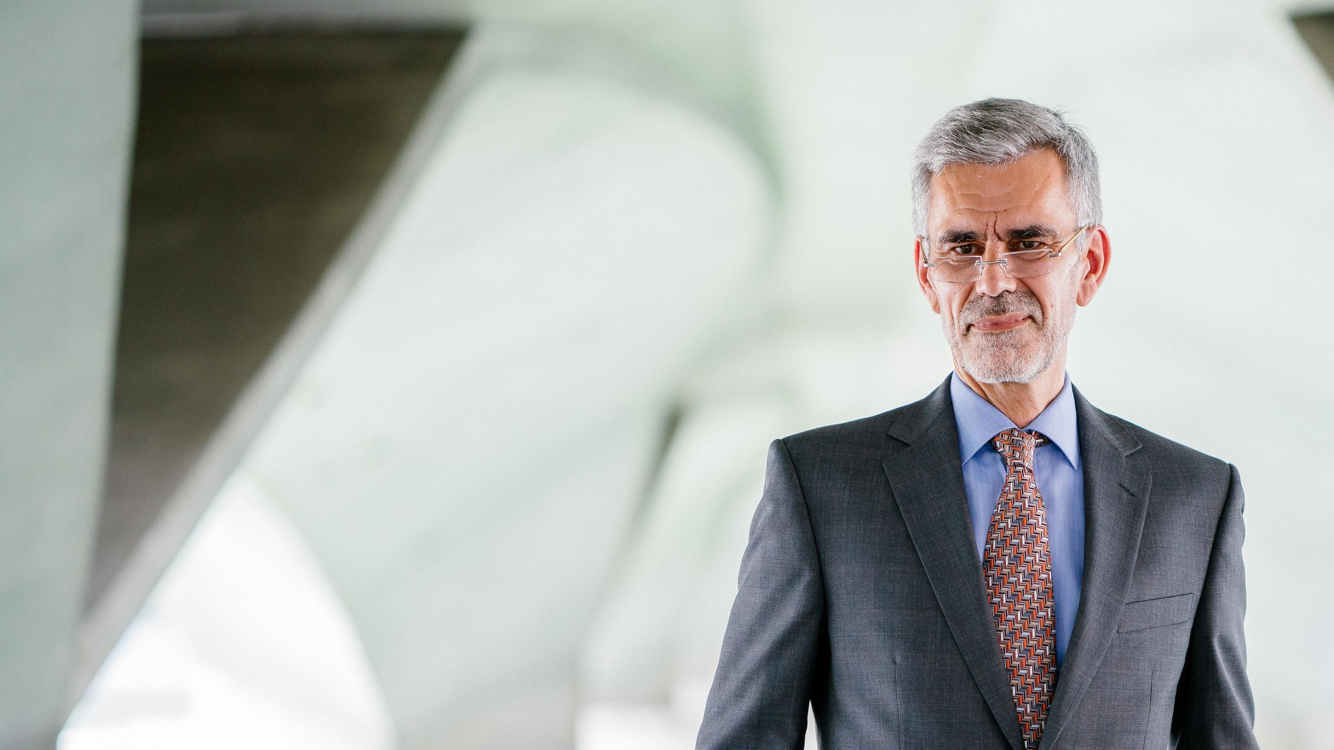
TALK
TO US
+8801824989751
youremail@gmail.com
4383 Greenridge Ln, Kannapolis, NC, 28081

Slide 46

TALK TO US
+8801824989751
youremail@gmail.com
4383 Greenridge Ln, Kannapolis, NC, 28081

Slide 47

GET IN TOUCH
+8801824989751
youremail@gmail.com
4383 Greenridge Ln, Kannapolis, NC, 28081

