Slide 1
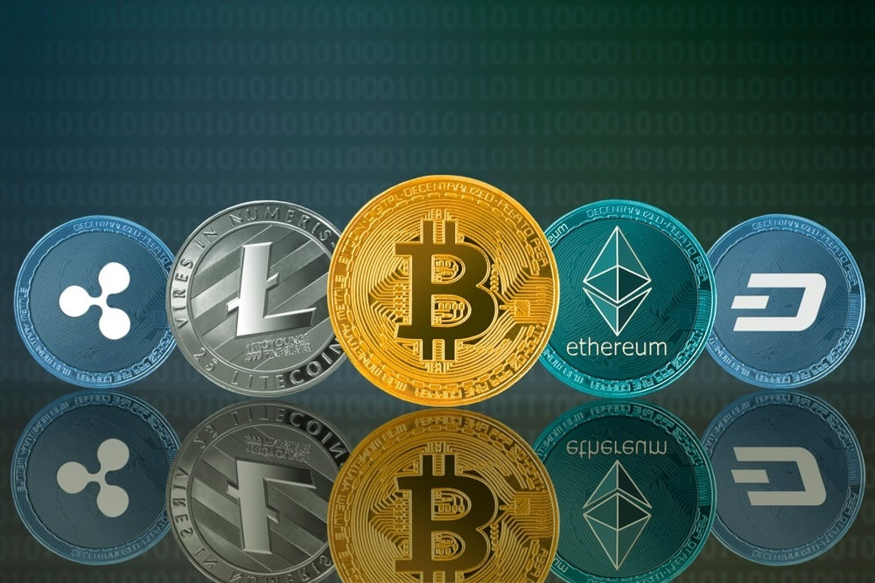
CRYPTOCURRENCY
“Crypto is money 2.0, a huge huge huge deal.”

Slide 2
\
WHAT IS CRYPTOCURRENCY?
A cryptocurrency (or crypto currency) is a
digital asset designed to work as a medium of exchange using cryptography to secure the transactions and to control the creation of additional units of the currency.

Slide 3

CONVENTIONAL VS DIGITAL CURRENCY
 | Flat or conventional currency | Cryptocurrency
Type | Real | Virtual
Intermediates | Yes | No (peer-to-peer)
Portability | Yes (except heavy cash) | Highly portable
Durable | Moderate | Highly durable
Acceptance | National | Global (throughout the Internet)

Slide 4
CONVENTIONAL VS DIGITAL CURRENCY
 | Flat or conventional currency | Cryptocurrency
Secure ( cannot be counterfeited) | Moderate | High
Scarce (Predictable Supply) | Low | High
Sovereign (Government Issued) | Yes | No
Decentralized | No | Yes
Smart (Programmable) | No | Yes

Slide 5
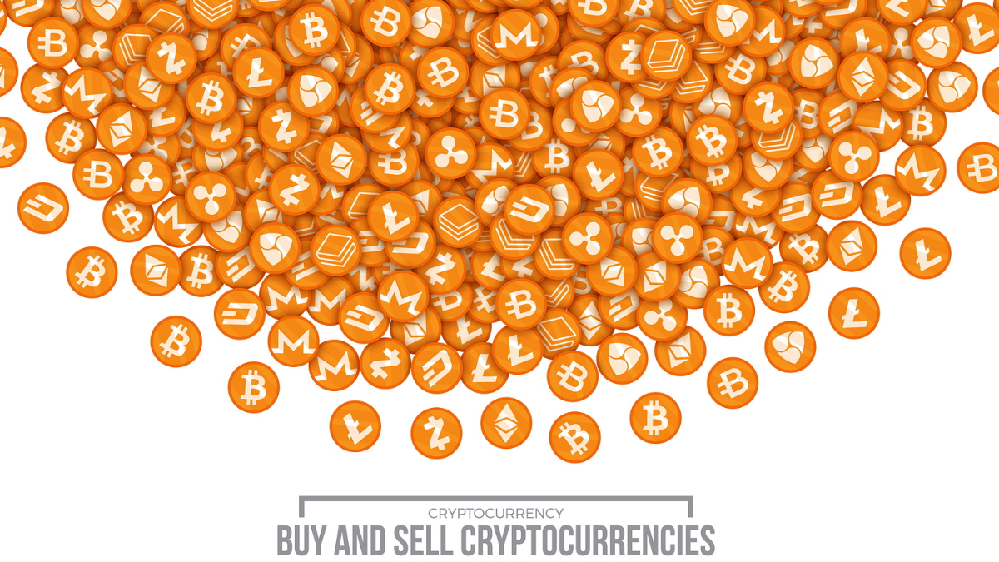
Fast, Safe and chea.
Ease of use and highly portable.
Untraceable.
Transparent and neutral.
Decentralized nature.
Active involvement of users.
Fewer risks for merchants.
Freedom to transact.
Low inflation and collapse risk.
WHY USE CRYPTOCURRENCY?

Slide 6
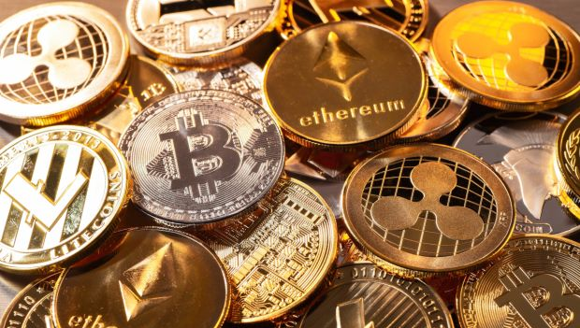







RISKS
Hackers. Cryptocurrencies are targets for highly sophisticated hackers, who have been able to breach advanced security systems.
•Fewer protections. If you trust someone else to hold your
cryptocurrencies and something goes wrong, that company may not offer you the kind of help you expect from a bank or debit or credit card provider.
•Cost. Cryptocurrencies can cost consumers much more to use than credit cards or even regular cash, often due to price volatility.
•Scams. Fraudsters are taking advantage of the hype surrounding virtual currencies to cheat people with fake opportunities.
•Lack of Transparency. The anonymous nature of cryptocurrencies make transparency and accountability difficult for consumers seeking to ensure the safety of their investments.

Slide 7
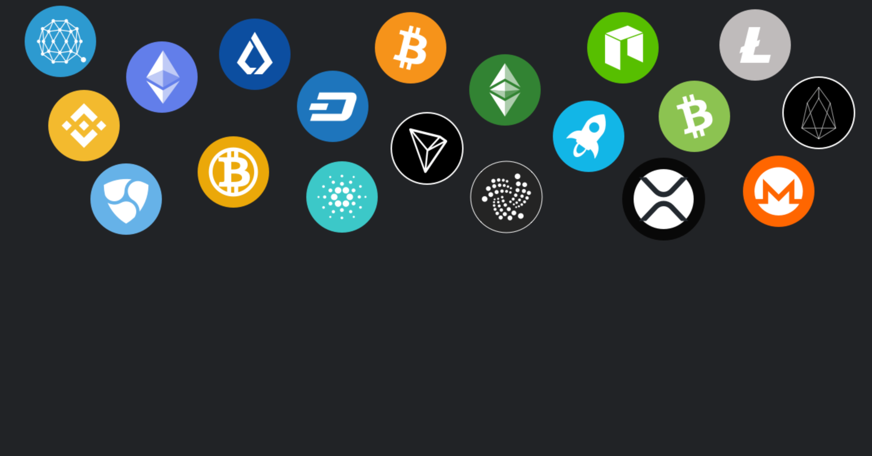
Bitcoin
Litecoin
Novacoin
Peercoin
Namecoin
TYPES OF CRYPTOCURRENCY

Slide 8
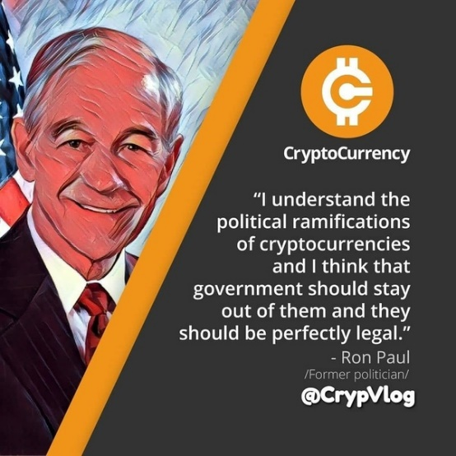

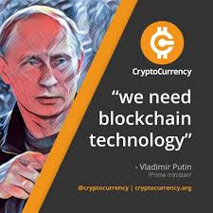

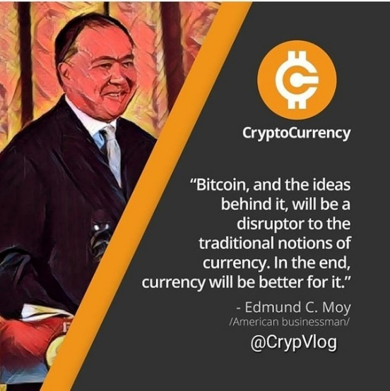
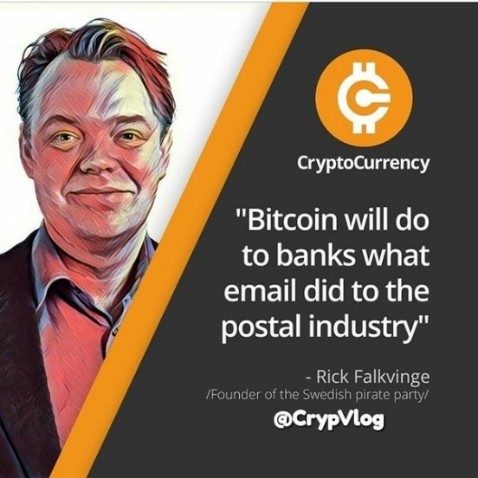
OPEN OUT ON CRYPTOCURRENCY

Slide 9
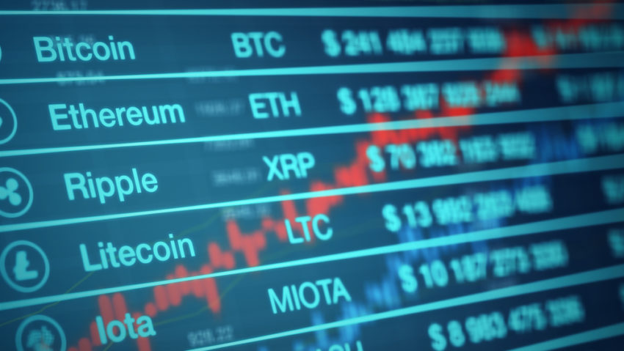
Distributed ledger technology.
Mining.
Mining hardware.
Mining Software.
Blockchain.
Bitcoin Wallets
BITCOIN TECHNOLOGY

Slide 10
CONCLUSION
Cryptocurrency is an impressive technical achievement, but it remains a monetary experiment. Even if cryptocurrencies survive, they may not fully displace fiat currencies. As I have tried to show in this presentation, they provide an interesting new perspective from which to view economic questions surrounding currency governance, the characteristics of money, the political economy of financial intermediaries, and the nature of currency competition.

