Slide 1
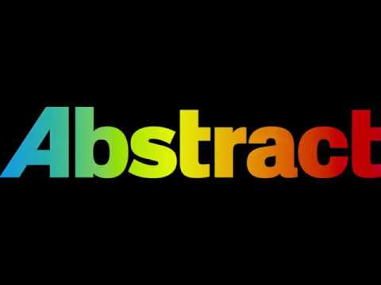
ABSTRACT
“People like abstract art because it makes them feel clever”

Slide 2
WHAT IS ABSTRACT OF RESEARCH PAPER?
An abstract summarizes, usually in one paragraph of 300 words or less, the major aspects of the entire paper in a prescribed sequence that includes: 1) the overall purpose of the study and the research problem(s) you investigated; 2) the basic design of the study; 3) major findings or trends found as a result of your analysis; and, 4) a brief summary of your interpretations and conclusions.

Slide 3

WHAT IS THE DIFFERENCE BETWEEN AN ABSTRACT AND A SUMMARY?
Its a short note that express the contents of the work. One basic difference: An abstract is always at the beginning of a academic paper. A conclusion is always at the end. A summary could be anywhere, even separate from the paper itself, so it's a bit more slippery.

Slide 4

HOW DO YOU SUMMARIZE AN ABSTRACT?
Read the abstract. Abstracts are short paragraphs written by the author to summarize research articles.
Understand the context of the research.
Skip to the conclusion.
Identify the main argument or position of the article.
Scan the argument.
Take notes while you read.

Slide 5
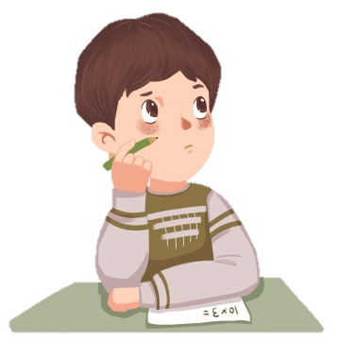
HOW DO YOU TEST FOR ABSTRACT THINKING?
Generally, abstract reasoning tests measure non-verbal abilities. You must, through logical and abstract reasoning, extract rules, analogies and structures which you subsequently use to find a correct answer among a set of possible options.

Slide 6

DO ABSTRACT OBJECTS EXIST?
An abstract object is an object that does not exist at any particular time or place, but rather exists as a type of thing—i.e., an idea, or abstraction. The term abstract object is said to have been coined by Willard Van Orman Quine. The study of abstract objects is called abstract object theory.

Slide 7

SHOULD I WRITE MY ABSTRACT LAST?
According to the APA style manual, an abstract should be between 150 to 250 words. If you are writing your paper for a psychology course, your professor may have specific word requirements, so be sure to ask. The abstract should also be written as only one paragraph with no indentation.

Slide 8

HOW LONG SHOULD AN ABSTRACT BE HARVARD?
Abstracts also serve as a summary of the research so the paper can be categorized and searched by subject and keywords. Generally, abstracts are limited to 200 to 300 words, but the exact word limit will be stated by the publication, conference, or organization requesting the abstract.

Slide 9

SHOULD ABSTRACT HAVE REFERENCES?
It is not entirely unreasonable to include a citation in an abstract, if the reason you are citing it is because your paper is a major extension, rebuttal, or counterpoint to the cited article. In that case, however, you do have the responsibility of providing the reference within the body of the abstract.

Slide 10
WHAT MAKES A GOOD ABSTRACT?
A good informative abstract acts as a surrogate for the work itself. That is, the researcher presents and explains all the main arguments and the important results and evidence in the paper.
Thank You

