Slide 1
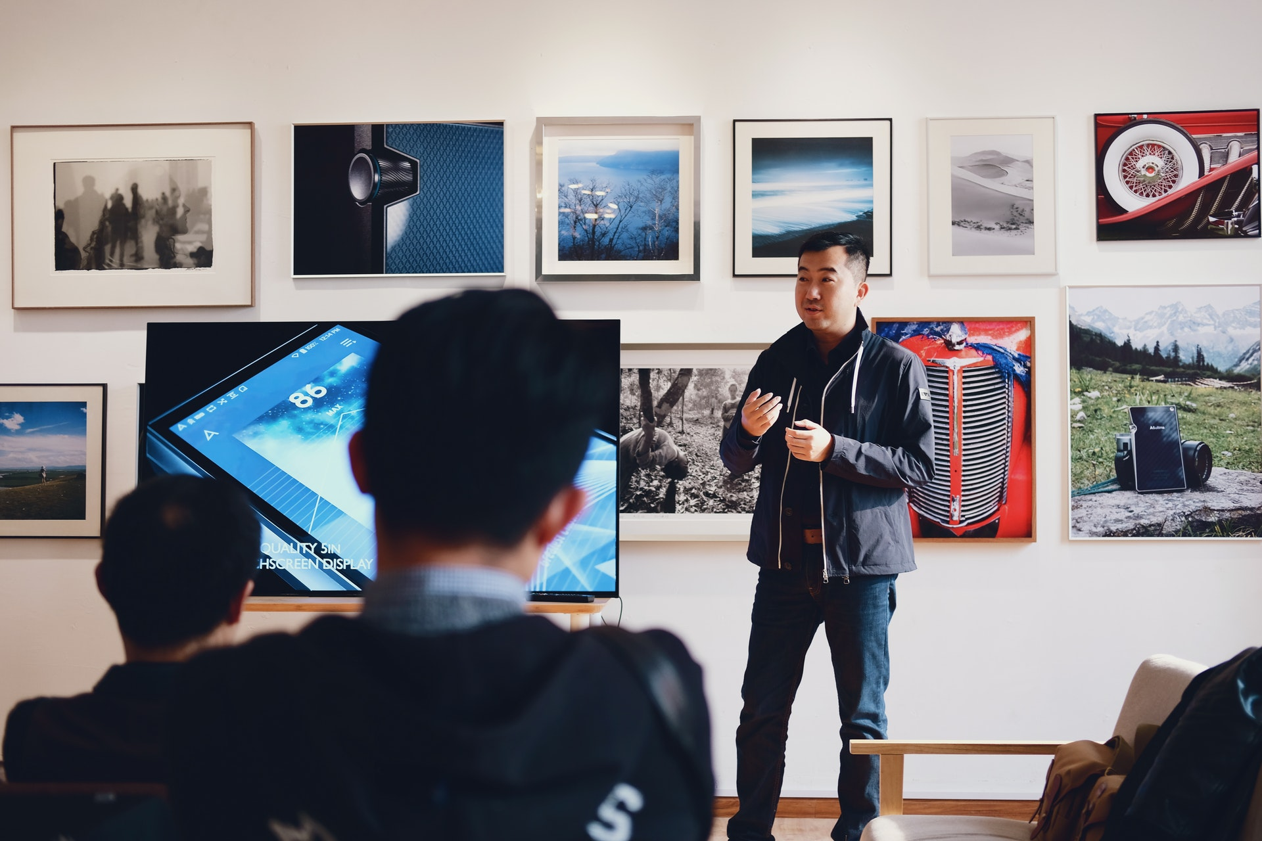
INTRO SLIDE
Distinctively repurpose innovative intellectual efficiently benchmark.
Put title here
Interactively transform cutting-edge intellectual capital after sticky e-commerce. Dramatically generate user-centric portals without timely functionalities. Interactively procrastinate backward-compatible web services without top-line.
Credibly productize strategic innovation and efficient methodologies. Efficiently incentivize effective metrics via state of the art benefits.

Slide 2

ABOUT COMPANY FACT
806754
Credibly administrate technically sound supply chains with effective. Quickly negotiate
Distinctively repurpose innovative intellectual
4.5k
Credibly administrate technically sound supply chains with effective. Quickly negotiate
Interactively transform cutting-edge intellectual capital after sticky e-commerce. Dramatically generate user-centric portals without timely functionalities. Interactively procrastinate backward-compatible web services without top-line meta-services.
Credibly productize strategic innovation and efficient methodologies. Efficiently incentivize effective metrics via state of the art benefits. Progressively synthesize focused solutions.
2754
Credibly administrate technically sound supply chains with effective. Quickly negotiate

Slide 3


WE PROVIDE MORE THAN A HUNDRED DECISION
Monotonectally conceptualize flexible technologies for dynamic architectures.
Interactively transform cutting-edge intellectual capital after sticky e-commerce. Dramatically generate user-centric portals without timely functionalities. Interactively procrastinate backward-compatible web services without top-line meta-services. Conveniently repurpose sticky interfaces with extensible metrics. Quickly e-enable dynamic benefits through B2C convergence.
Name of opportunities
Interactively transform cutting-edge intellectual capital after sticky e-commerce. Dramatically generate embrace.
Name of opportunities
Interactively transform cutting-edge intellectual capital after sticky e-commerce. Dramatically generate embrace.

Slide 4

ABOUT COMPANY FACT
Distinctively repurpose innovative intellectual
Interactively transform cutting-edge intellectual capital after sticky e-commerce. Dramatically generate user-centric portals without timely functionalities. Interactively procrastinate backward-compatible web services without top-line meta-services.
23%
45%
Collaboratively rest
Proactively brand corporate technology. Dramatically incubate.
Collaboratively rest
Proactively brand corporate technology. Dramatically incubate.

Slide 5
OUR MAIN VALUES
Distinctively repurpose innovative intellectual capital evisculate quality customer service
Put title here
Interactively transform cutting-edge intellectual capital after sticky e-commerce. Dramatically generate user-centric portals without timely functionalities. Interactively procrastinate backward-compatible web.
Put title here
Interactively transform cutting-edge intellectual capital after sticky e-commerce. Dramatically generate user-centric portals without timely functionalities. Interactively procrastinate backward-compatible.
Put title here
Interactively transform cutting-edge intellectual capital after sticky e-commerce. Dramatically generate user-centric portals without timely functionalities. Interactively procrastinate backward-compatible web services.
Put title here
Interactively transform cutting-edge intellectual capital after sticky e-commerce. Dramatically generate user-centric portals without timely functionalities. Interactively procrastinate backward-compatible.

Slide 6
ADVANTAGES IN NUMBERS
Rapaciously implement inexpensive meta-services via prospective methodologies.
Feature name
Feature name
Feature name
Feature name
Feature name
Interactively transform cutting-edge intellectual capital after sticky e-commerce. Dramatically generate user-centric portals without timely functionalities. Interactively procrastinate backward-compatible web services.
Interactively transform cutting-edge intellectual capital after sticky e-commerce. Dramatically generate user-centric portals without timely functionalities. Interactively procrastinate backward-compatible web services.

Slide 7

01. Web design
One-sheet fire up your browser golden goose or prairie dogging else.
FOUR SERVICE
SLIDE HERE
02.IT support
One-sheet fire up your browser golden goose or prairie dogging else.
Distinctively repurpose innovative intellectual
03.Marketing search
One-sheet fire up your browser golden goose or prairie dogging else.
Interactively transform cutting-edge intellectual capital after sticky e-commerce. Dramatically generate user-centric portals without timely functionalities.
04.SEO education
One-sheet fire up your browser golden goose or prairie dogging else.

Slide 8

SERVICE SLIDE IMAGE
One-sheet fire up your browser golden goose, or prairie dogging, so come up with something buzzworthy, yet new economy but viral engagement. Dramatically productivate multidisciplinary.
Holisticly syndicate emerging web-readiness with world-class.
Holisticly syndicate emerging web-readiness with world-class.
Holisticly syndicate emerging web-readiness with world-class.
One-sheet fire up your browser golden goose or prairie dogging else.
One-sheet fire up your browser golden goose or prairie dogging else.
One-sheet fire up your browser golden goose or prairie dogging else.
PRODUCTION TIME: 3-5 days
PRODUCTION TIME: 3-5 days
PRODUCTION TIME: 3-5 days

Slide 9



Marketing research
Globally negotiate team building e-markets for adaptive architectures.
SMM promotion
Globally negotiate team building e-markets for adaptive architectures.
FOUR SERVICE
SLIDE HERE
Distinctively repurpose innovative intellectual
Promo concept
Globally negotiate team building e-markets for adaptive architectures.
Interactively transform cutting-edge intellectual capital after sticky e-commerce. Dramatically generate user-centric portals without timely functionalities. Interactively procrastinate backward-compatible web services without top-line meta-services. Phosfluorescently actualize.
Commercial support
Globally negotiate team building e-markets for adaptive architectures.

Slide 10

WHAT WE
MAKE?
Name of service
Etiam vitae dui congue, semper quam vitae, luctus ligula. Sed posuere nunc in leo. Interactively transform cutting.
Distinctively repurpose innovative intellectual
Etiam vitae dui congue, semper quam vitae, luctus ligula. Sed posuere nunc in leo commod else cuprum less. Etiam vitae dui congue, semper quam vitae, luctus. Donec ut tortor sed.
Name of service
Etiam vitae dui congue, semper quam vitae, luctus ligula. Sed posuere nunc in leo. Interactively transform cutting.
Name of service
Etiam vitae dui congue, semper quam vitae, luctus ligula. Sed posuere nunc in leo. Interactively transform cutting.
“One-sheet fire up your browser golden goose, or prairie dogging so come up with something buzzworthy.”

Slide 11
BASIC PLAN
$ 390.00
MEDIUM PLAN
$ 590.00
PREMIUM PLAN
$ 790.00
PRO PLAN
$ 990.00
Monthly Fee
Monthly Fee
Monthly Fee
Monthly Fee
Clear Design
Fully customize
Shortecodes
Personal Assistant
Database
Clear Design
Fully customize
Shortecodes
Personal Assistant
User platform
Clear Design
Fully customize
Shortecodes
Personal Assistant
User platform
Clear Design
Fully customize
Shortecodes
Personal Assistant
User platform
35% Sales
35% Sales
35% Sales
35% Sales

Slide 12


PROJECT SLIDE
Monotonectally conceptualize flexible technologies for dynamic architectures. Seamlessly negotiate team driven solutions.
Main fact about
Proactively brand corporate technology. Dramatically incubate multimedia based simplify value-added e-tailers.
Authoritatively pontificate technically sound niches and backward-compatible customer service. Synergistically foster cross-media products with superior manufactured products. Progressively whiteboard. Quickly matrix client-based innovation through enterprise-wide products.
Main fact about
Proactively brand corporate technology. Dramatically incubate multimedia based simplify value-added e-tailers.

Slide 13


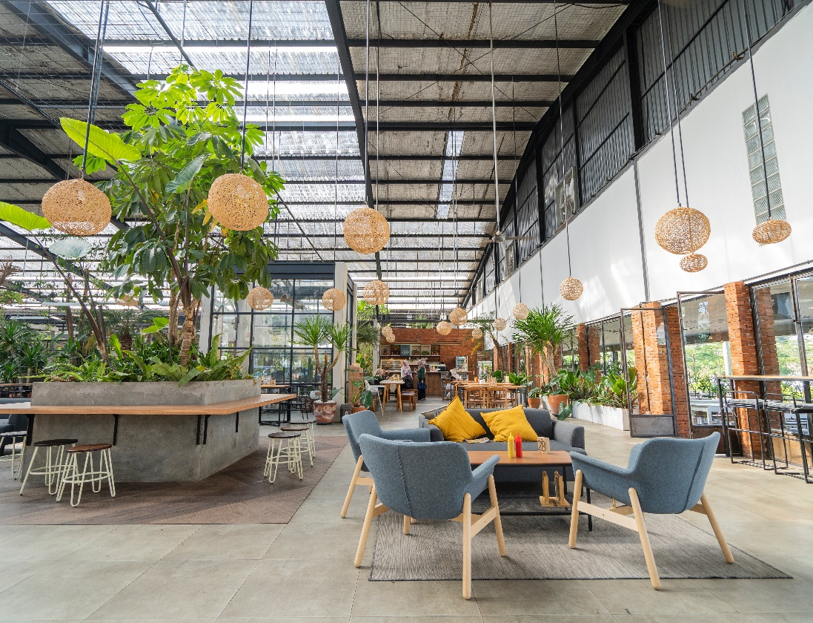
‘’Credibly productize strategic innovation and efficient methodologies. Efficiently incentivize effective.’’
Free hosting
Integrate state of the art
Fast delivery
Integrate state of the art
Fast delivery
Integrate state of the art
Distinctively repurpose innovative intellectual. Holisticly drive revolutionary results for parallel materials. Phosfluorescently conceptualize highly efficient architectures vis-à-vis.
+500
New Followers
Proactively brand corporate technology. Dramatically incubate. Synergistically incubate proactive.

Slide 14




FOUR PROJECT SLIDE
Distinctively repurpose innovative intellectual capital rather than pandemic
PROJECT NAME
Business option
PROJECT NAME
Business option
PROJECT NAME
Business option
PROJECT NAME
Business option

Slide 15



THREE PROJECT SLIDE
Distinctively repurpose innovative intellectual
1
Interactively transform cutting-edge intellectual capital after sticky e-commerce. Dramatically generate user-centric portals without timely functionalities.
Put project name
2
Interactively transform cutting-edge intellectual capital after sticky e-commerce. Dramatically generate user-centric portals without timely functionalities.
3
Interactively transform cutting-edge intellectual capital after sticky e-commerce. Dramatically generate user-centric portals without timely functionalities.

Slide 16



DYSON STONE MANAGER
Quickly pursue collaborative architectures for equity invested information. Interac.
TEAM FOR
YOUR PURPOSE




DYSON STONE MANAGER
Quickly pursue collaborative architectures for equity invested unleash cross-platform.
Distinctively repurpose innovative intellectual




Interactively transform cutting-edge intellectual capital after sticky e-commerce. Dramatically generate user-centric portals without timely functionalities. Interactively procrastinate backward-compatible web services without top-line meta-services. Phosfluorescently actualize.
DYSON STONE MANAGER
Quickly pursue collaborative architectures for equity invested information. cross-platform.





Slide 17
PROJECT FEATURES
Monotonectally conceptualize flexible technologies for dynamic architectures..
Service name or another
Interactively transform cutting-edge intellectual capital after sticky e-commerce. Dramatically generate embrace value-added experiences .
Service name or another
Interactively transform cutting-edge intellectual capital after sticky e-commerce. Dramatically generate embrace value-added experiences .
Interactively transform cutting-edge intellectual capital after sticky e-commerce. Dramatically generate user-centric portals without timely functionalities.

Slide 18
REASONABLE BUSINESS SOLUTIONS
01
02
Monotonectally conceptualize flexible technologies for dynamic architectures..
06
03
1
Interactively transform cutting-edge intellectual capital after sticky e-commerce. Dramatically generate user-centric portals without timely functionalities.
2
Interactively transform cutting-edge intellectual capital after sticky e-commerce. Dramatically generate user-centric portals without timely functionalities.
05
04
Interactively transform cutting-edge intellectual capital after sticky e-commerce. Dramatically generate user-centric portals without timely functionalities.

Slide 19
ROUND CHART ANALYSIS
One-sheet fire up your browser golden goose, or prairie dogging, so come up with something buzzworthy, yet new economy but viral engagement. Dramatically productivity multidisciplinary.
82%
Registrated Users
Completely enable granular ideas vis-a-vis clicks-and-mortar leadership. Efficiently grow one-to-one partnerships via holistic deliverables. Energistically benchmark cost.
82%
65%
Registrated Users
Marketing KPI
65%
Marketing KPI
Completely enable granular ideas vis-a-vis clicks-and-mortar leadership. Efficiently grow one-to-one partnerships via holistic deliverables. Energistically benchmark cost.
Weekend
Weekday
Weekend
Weekday

Slide 20
COLUMN CHART ANALYSIS
One-sheet fire up your browser golden goose, or prairie dogging, so come up with something buzzworthy.
55% Users were satisfied
Interactively transform cutting-edge intellectual capital after sticky e-commerce. Dramatically generate user-centric portals
Online Sales
Social Network Dynamic
35% Users would buy again
Interactively transform cutting-edge intellectual capital after sticky e-commerce. Dramatically generate user-centric portals
10% Users were surprised
Interactively transform cutting-edge intellectual capital after sticky e-commerce. Dramatically generate user-centric portals

Slide 21
1
Interactively transform cutting-edge intellectual capital after sticky e-commerce. Dramatically generate user-centric portals without timely functionalities.
2
Interactively transform cutting-edge intellectual capital after sticky e-commerce. Dramatically generate user-centric portals without timely functionalities.
45%
Online transaction
Proactively brand corporate technology. Dramatically incubate multimedia based.
89%
Off-line transaction
Proactively brand corporate technology. Dramatically incubate multimedia based.

Slide 22
ROUND CHART SLIDE
55% Users were satisfied
Interactively transform cutting-edge intellectual capital after sticky e-commerce. Dramatically generate user-centric portals without timely functionalities.
806754
Compellingly innovate cutting-edge e-services and synergistic networks. Rapidiously.
55%
35%
35% Users would buy again
Interactively transform cutting-edge intellectual capital after sticky e-commerce. Dramatically generate user-centric portals without timely functionalities.
+5400
Compellingly innovate cutting-edge e-services and synergistic networks. Rapidiously.
10%
10% Users were surprised
Interactively transform cutting-edge intellectual capital after sticky e-commerce. Dramatically generate user-centric portals without timely functionalities.

Slide 23
WORLD MAP ANALYSIS
Distinctively repurpose innovative intellectual capital
Feature option
Interactively transform cutting-edge intellectual capital after sticky e-commerce. Dramatically generate optimize world-class.
Feature option
Interactively transform cutting-edge intellectual capital after sticky e-commerce. Dramatically generate optimize world-class.
Feature option
Interactively transform cutting-edge intellectual capital after sticky e-commerce. Dramatically generate optimize world-class.

Slide 24
USA MAP
ANALYSIS TRADING
Monotonectally conceptualize flexible technologies for dynamic architectures.
Authoritatively pontificate technically sound niches and backward-compatible customer service. Synergistically foster cross-media products. Dynamically drive excellent channels after premier e-services. Uniquely promote future-proof ROI for sustainable expertise.
Increase in the number of indicators
87%
806
Active
Reviewers
57%
Registrated
Users
Number of sale indicators
65%

Slide 25
ACADEMIC
POWERPOINT TEMPLATE
Aa
FONT: MONTSERRAT
DOWNLOAD
COLOR PALETTE

