Slide 1
Important point for Career

Slide 2
Points in Maze Show Your Position in Getting Job
Start of Career
Under Skilled
Perfect for Job but did not got interview call
You see the job with great hours and perfect pay but its not in your field of interest.
Interview with company you want but don’t get the job.
Finally dream job with handsome pay and great hours.

Slide 3
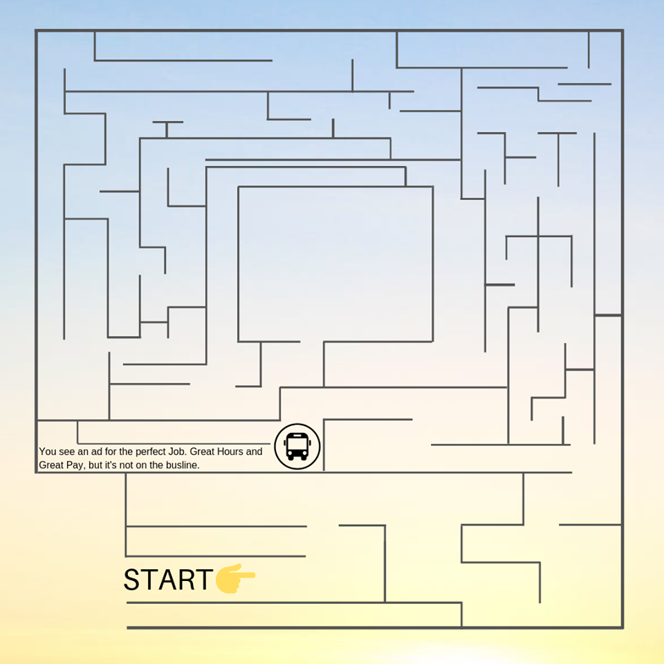
Getting Job is like Maze Game

Slide 4

Start of Career

Slide 5

Under Skilled

Slide 6

Interview Call

Slide 7

Job Without Interest:

Slide 8

Job Rejection:

Slide 9

Dream Job:
REACHED

Slide 10
Points in Maze Show Your Position in Getting Job
Start of Career
Under Skilled
Perfect for Job but did not got interview call
You see the job with great hours and perfect pay but its not in your field of interest.
Interview with company you want but don’t get the job.
Finally dream job with handsome pay and great hours.

Slide 11
THANKS

