Slide 1




Education,
Without education, we are in a horrible and deadly danger of taking educated people seriously.

Slide 2
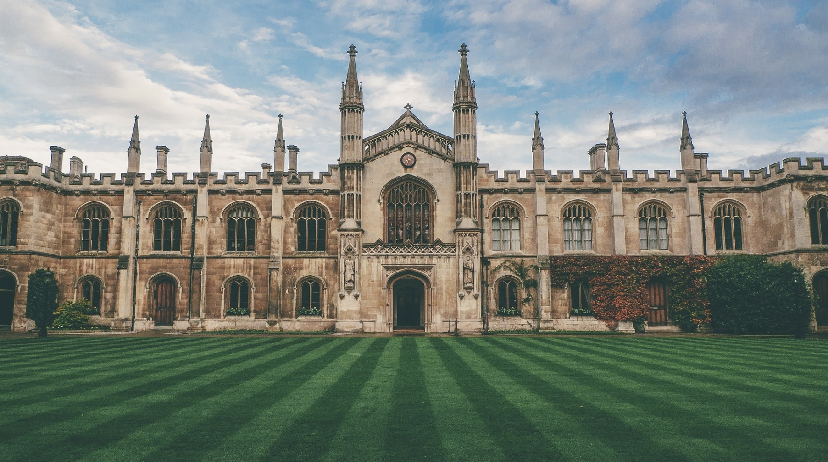
Educational Institute,
An educational institution is a place where people of different ages gain an education. Examples of some institutions are preschools, primary schools, colleges, universities.

Slide 3

Teacher,
A teacher (also called a school teacher or, in some contexts, an educator) is a person who helps others to acquire knowledge, competence or virtue.
Informally the role of teacher may be taken on by anyone (e.g. when showing a colleague how to perform a specific task).

Slide 4
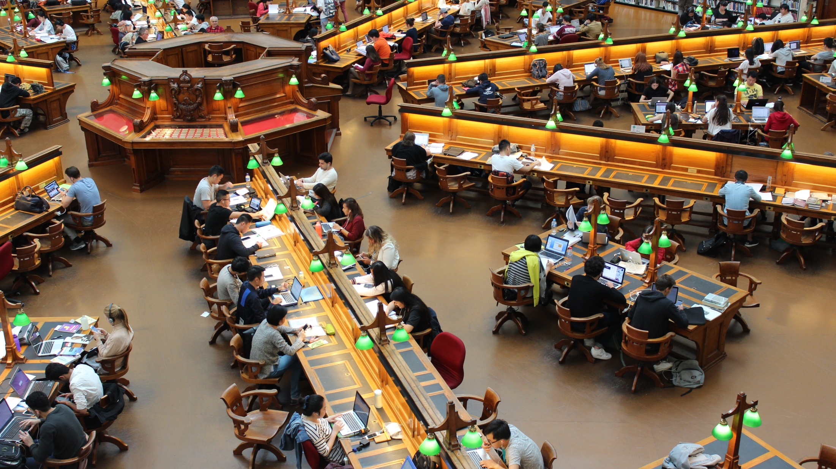
Classroom,
A classroom is a learning space, a room in which both children and adults learn. Classrooms are found in educational institutions of all kinds, ranging from preschools to universities. The classroom provides a space where learning can take place uninterrupted by outside distractions.

Slide 5

Early Childhood Education,
When children are young, they are learning sponges. Every new experience, every word they learn, every behavior they adopt, is an investment in a more fruitful future.
You can never have a greater impression on a person than when they are in their early childhood years.

Slide 6

Primary Education,
Primary Education is the initial stage of education and has as its basic aim to create, establish and offer opportunities to all children, regardless of age, gender or country of origin, to achieve a balanced cognitive, emotional and psychomotor development.

Slide 7

Secondary Education.
Secondary education typically takes place after six years of primary education and is followed by higher education, vocational education or employment. Like primary education, in most countries secondary education is compulsory, at least until the age of 16.

Slide 8
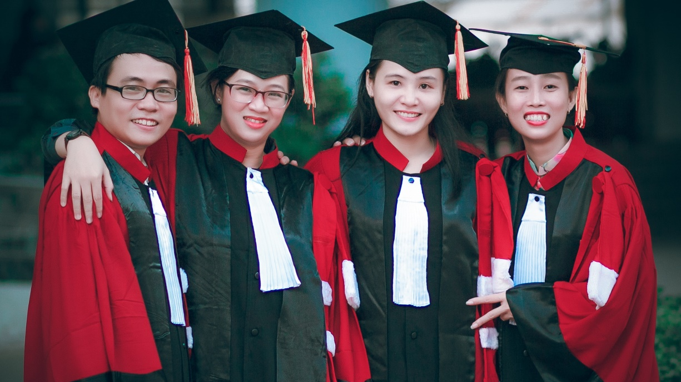
Higher Education,
Higher education is tertiary education leading to award of an academic degree. Higher education, also called post-secondary education, third-level or tertiary education, is an optional final stage of formal learning that occurs after completion of secondary education.

Slide 9

Group Study,
A study group is a small group of people who regularly meet to discuss shared fields of study. These groups can be found in a school or college/university
setting, within companies, occasionally primary/junior school and sometimes middle school. Professional advancement organizations also may encourage study groups.

Slide 10
Online Study.
Online Education is when you take courses online instead of in a physical classroom. If your schedule makes it hard to attend classes, if you prefer studying at your own pace or if you live far from campus, online Education might be for you.

Slide 11
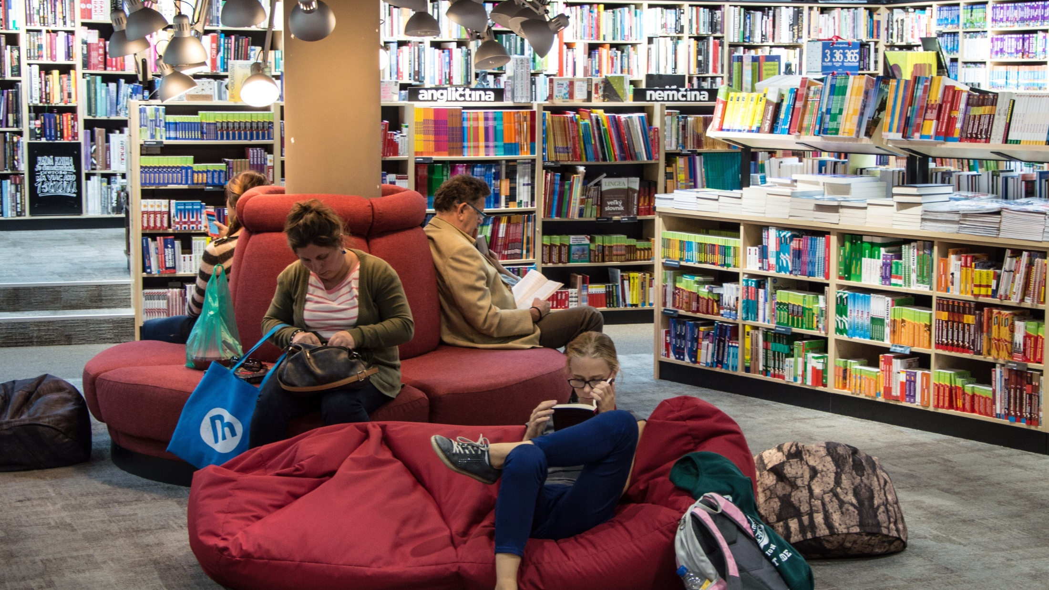
Library,
A library is a curated collection of sources of information and similar resources, selected by experts and made accessible to a defined community for reference or borrowing. It provides physical or digital access to material, and may be a physical location or a virtual space, or both. A library's collection can include books, periodicals, newspapers, Etc.

Slide 12
Education,
Education is the most powerful weapon which you can use to change the world.
― Nelson Mandela

