Slide 1
COLLEGE
AND
SUCCESS

Slide 2
INTRODUCTION
6.7% of the world have a bachelor degree
32% of billionaires don’t

Slide 3
Problem
90 % People always relate success to education

Slide 4
Need
Our main need is to define word success correctly
Stop relating both success and education to each other

Slide 5

.
For me, education means a lot. But it doesn't mean that holding a book and going to a school or a
College makes you educated

Slide 6
Need
Some basic knowledge
We don't really need formal education to be successful.
Successful person learns from experience and his personality would play a more important role.

Slide 7

Satisfaction
Propose motivational speeches
Constructing annual events
Gathering successful people from around the world without degree to share their stories to:
  Motivate
  Inspire people to use their creativity
  Think out of the box

Slide 8
ACTIONS WE SHOULD TAKE
COLLEGE SHOULD START TEACH STUDENTS HOW TO USE THEIR MINDS PRACTICALLY
READ MORE AND OPEN YOUR MIND
FIND WHAT YOU LOVE AND DEVELOP IT

Slide 9
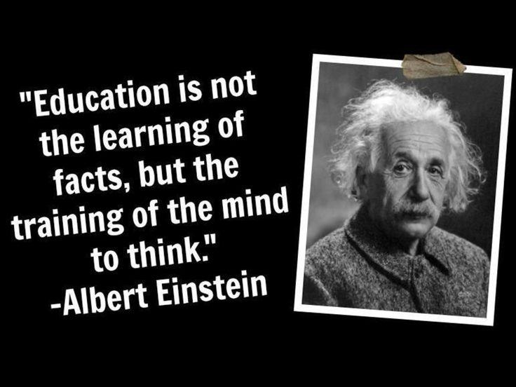
ALBERT EINSTEIN
DOES HATING MATH MAKE YOU STUPID?
FOCUS ON WHAT YOU LOVE TO REACH THE REAL SUCCESS

Slide 10
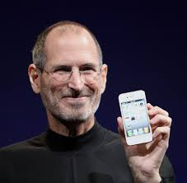
STEVE JOBS
SIMPLICITY IS THE REAL WAY OF SUCCESS
COLLEGE’ GPA DOESN’T DEFINE YOU
EDUCATION IS NOT JUST THE SCHOOL AND COLLEGE

Slide 11
CONCLUSION
A college degree doesn’t automatically mean success

Slide 12
“Don’t let a bad grade define who you are or what you become.”
-Annonymous

Slide 13
Thanks!
Any questions?

