Slide 1
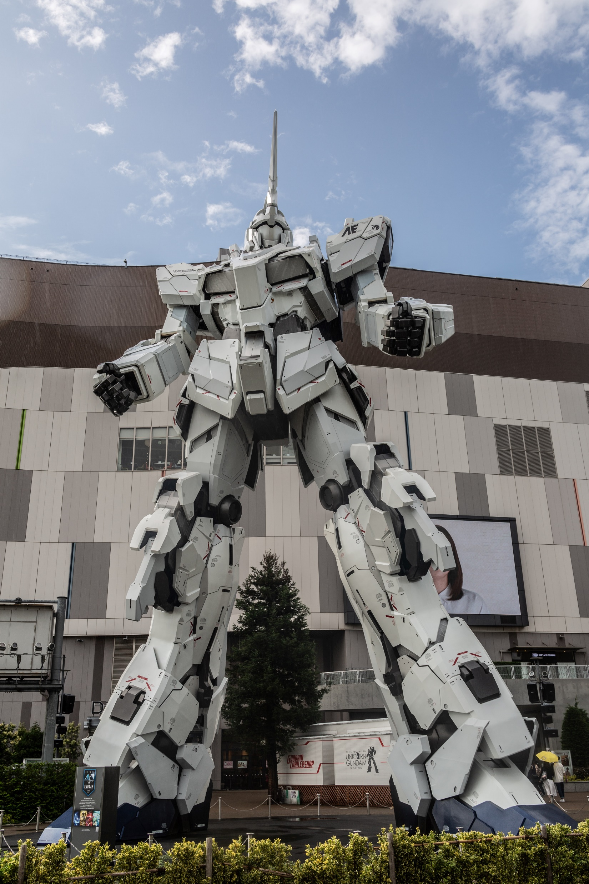
ONLINE COURSE
QUIZ EXAM ON
GENERAL
KNOWLEDGE

Slide 2




Topics
Technology
QUIZ EXAM
Literature
Sports

Slide 3

About Quiz Exam
A quiz is a form of game or mind sport in which players attempt to answer questions correctly. It is a game to test knowledge about a certain subject. In some countries, a quiz is also a brief assessment used in education and similar fields to measure growth in knowledge, abilities, and/or skills.

Slide 4
Quiz Questions on Technology
1. What is the meaning of VPN ?
a) Virtual Private Network b) Virtual PC Network c) Valuable Private Network
2. What is the meaning of RAM ?
a) Read Access Memory b) Random Access Memory c) Random Acquired Memory
3. What is the meaning of ROM ?
a) Read Only Memory b) Random Access Memory c) Random Only Memory
4. What is the meaning of USB ?
a) Universal Base Series b) Universal Serial Bus c) Uninstall Bus Series

Slide 5
Quiz Questions on Technology
5. In which decade was the American Institute of Electrical Engineers (AIEE) founded?
a) 1850s b) 1880s c) 1930s
6. What is part of a database that holds only one type of information?
a) Report b) Field c) Record
7. OS computer abbreviation usually means ?
a) Order of Significance b) Open Software c) Operating System
8. .MOV extension refers usually to what kind of file?
a) Image file b) Animation/movie file c) MS Office document

Slide 6
Quiz Questions on Literature
1. Tweedledum and Tweedledee are two characters of which Children’s book?
a) Alice in Wonderland b) Alice in land c) Jhon in Wonderland
2. Who is the author of The Origin Of Species?
a) Jhony b) Darwin c) Jhon & Darwin
3. People of which religion consider ‘The Bhagavad Gita’ as their sacred text?
a) Hinduism b) Jewes c) Islam
4. Who invented the character, Robinson Crusoe?
a) Daniel Robin b) Kerel Defoe c) Daniel Defoe

Slide 7
Quiz Questions on Literature
5. Shakespeare’s four greatest tragedies are Macbeth, Othello, Hamlet and __________?
a) King Lear b) King Earther c) John Lear
6. Name the mega-selling writer who has written “Deception Point”?
a) Dan Brown b) Dan Ruso c) Daniel
7. By what name was Shakespeare’s mother known before her marriage?
a) Mark Arden b) Mary Arden c) Arden Bob
8. Mention the exact number of sonnets written by William Shakespeare?
a) 154 b) 164 c) 158

Slide 8
Quiz Questions on Sports
1. Chukker and Mallet terms are associated with the game of -
a) Water Polo b) Tennis c) Polo
2. Wembly is a famous football stadium in -
a) Dallas b) London c) Barcelona
3. Who became the first cricketer to violate ICC's 'saliva ban' rule?
a) Jofra Archer b) Dom Sibley c) Stuart Broad
4. Where the Winter Olympic Games 2022 will be organized?
a) Pyeong Chang, South Korea b) Vancouver, Canada c) Beijing, China

Slide 9
Quiz Questions on Sports
5. Who among the following Tennis Player has won the US Open Men's Title 2020?
a) Roger Federer b) Rafael Nadal c) Dominic Thiem
6. Who among the following Tennis Player has won the US Open Women's Single Title 2020?
a) Naomi Osaka b) Victoria Azarenka c) Aryna Sabalenka
7. Which nation will host Asian Boxing Championships 2020?
a) India b) China c) Malaysia
8. Which India Cricketer got Laureus Sporting Moment honour?
a) M. S. Dhoni b) Sachin Tendulkar c) Virat Kohli

Slide 10

THANK YOU

