Slide 1

EDUCATION
“Education is the most powerful weapon which you can use to change the world”

Slide 2
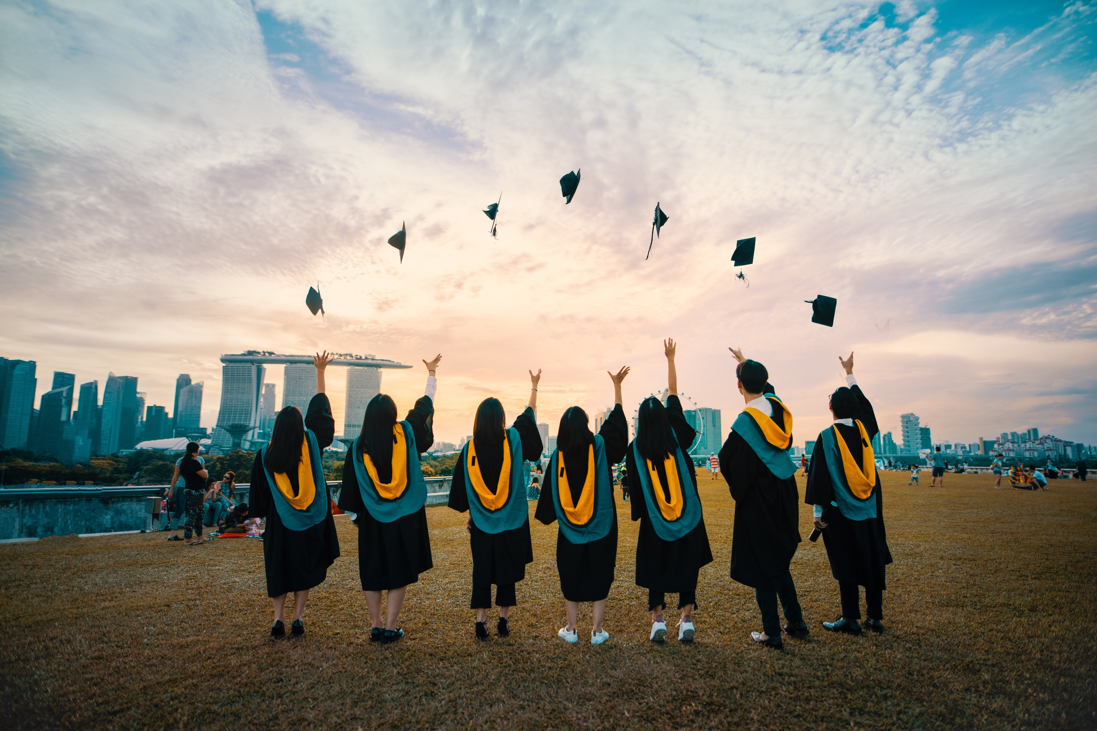
What is Education?
Education is nothing but studying different kinds of subjects to gain knowledge and understanding and trying to apply it in daily life.
Education is not only gaining book knowledge but also can be learnt practically. Education doesn’t mean to just go to schools and colleges daily and attend exams, it is meant for gathering knowledge and relating it to our lives.
Straightforwardly, we can say, “education is the passage to progress”.

Slide 3
Origin of Education Word
Latin
Latin
Educare
Edutio
Education
English
Educate

Slide 4
Types of Education
Formal
Formal education or formal learning usually takes place in the premises of school, where a person may learn basic, academic, or trade skills.
1
Informal
Informal education may be a parent teaching a child how to prepare a meal or ride a bicycle.
2
Non-formal
Non-formal education includes adult basic education, adult literacy education or school equivalency preparation.
3

Slide 5
Types of Education
Formal Education
Learning in a classroom
School grading/certification, college, and university degrees
Planned education of different subjects having a proper syllabus acquired by attending the institution.
Informal Education
Teaching the child some basics such as numeric characters.
Someone learning his/her mother tongue
A spontaneous type of learning, “if a person standing in a bank learns about opening and maintaining the account at the bank from someone.”
Non-formal Education
Boy Scouts and Girls Guides develop some sports program such as swimming comes under the nonformal education.
Community-based adult education courses.
Free courses for adult education developed by some organization.

Slide 6
Importance of Education in Our Lives:
To gain respect from society, one should be educated.
To lead a happy and prosperous life, one needs to study and obtain a great job to be successful in life.
It helps in earning money and fulfilling the basic needs of life.
education will help to gain reputation by being in a great position.
It can help you grow in career and fulfil their dreams.
Every human being needs oxygen to survive in the world. Education is as important as this because education gives people the knowledge and skills they require.

Slide 7
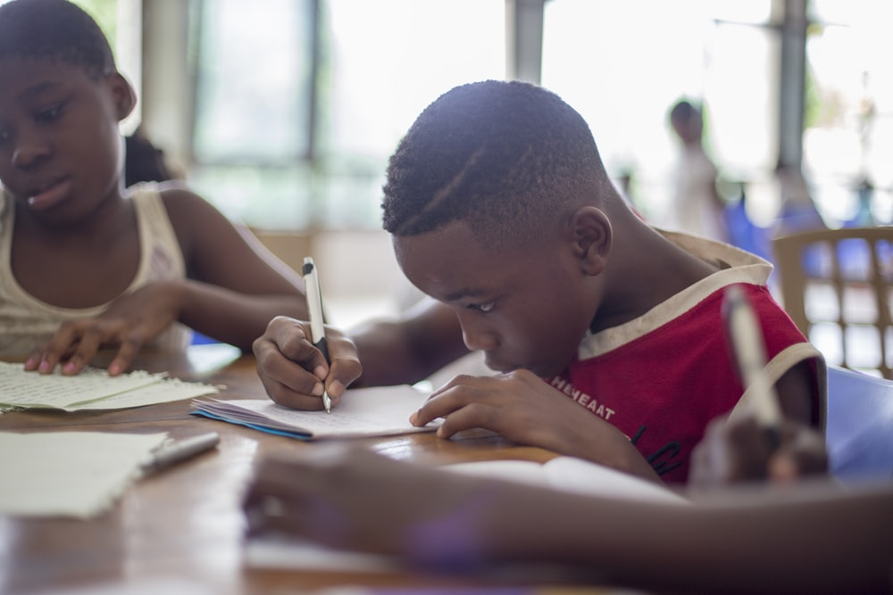

Why Education is Important for Children?
Education is important for children because they are the future of the world and they should be updated with current affairs. They are the pillars of the nation, to develop a country and the world the future should be secure and the children are the weapons to build the nation with all their knowledge and education.
Education is necessary at the childhood stage, this is the period where it provides them a chance to develop mentally, physically and develop social awareness in them.

Slide 8
Why Education is Important to Society?
For a modern society, education is very important. Education these days is important as the population is increasing, the needs of people are raising. Hence there are many firms where they require a huge number of employees to develop, so to bring productivity one should be able to gain knowledge and develop healthy competition.
Also, these days women should be equally educated along with men and promote women empowerment. Education is the best platform for them to prove themselves that they are equal to men in society.

Slide 9
Why Education is Important for a Country?
People will become better citizens with education
You will get to know the importance of voting only through education.
It will help you to get a job.
People can know the difference between good and bad.
Will work hard to grow and develop themselves.
Help in creating a better society to live in
Becoming a respectable law-abiding citizen of the country.
Education will support mothers who are single or alone
Raise the children rightly as they are the future of the country

Slide 10
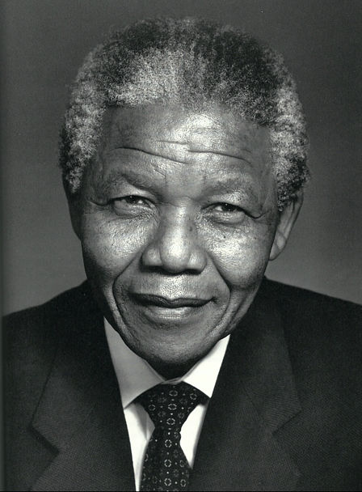
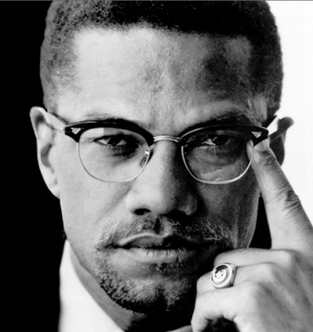
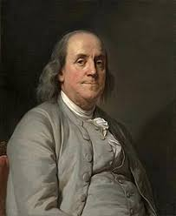
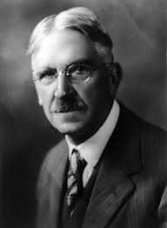
Important Quotes about Education
Education is the most powerful weapon which you can use to change the world.
-Nelson Mandela
Education is the passport to the future, for tomorrow belongs to those who prepare for it today. -Malcolm X
An investment in knowledge pays the best interest.
-Benjamin Franklin
Education is not preparation for life; education is life itself.
-John Dewey

