Slide 1


Growth and Scalability
Joe Black

Slide 2

-Marc Andreesen
"product/market fit means being in a good market with a Product that can satisfy that market"
“Andreessen has always been a multi-stage investment firm, but really the opportunity here is for [me] to be the first focused late-stage investor there and to work with the early-stage team and complement their experience,” George told TechCrunch.

Slide 3

Your Title Goes Here
At a16z, George will invest across industries, offering up his knowledge of late-stageeconomics, valuations and Underwriting to a16z’s large team of investors.
George is the firm’s 15th general partner and at least the Fourth high-level addition to the team in the last year, including Katie Haun, who joined in June to lead a16z’s
cryptocurrency investment effort.

Slide 4

Digital inclusion is about for example access to affordable broadband and devices, digital literacy – having the rights skills to use the internet, and digital enablement – being able to use technology that improves quality of life.

Slide 5
Your Title Goes Here
The aim of the workshop is to gather good practices and expert opinion of our members and civil societyorganisations
specaialised in digital rights on the role of new technologies in the accessibility and delivery of services.
On this basis, we will work towards identifying our focus and define our scope of work in this area.

Slide 6

Assistive technology for people with disabilities to perform activities they otherwise would not be able to do; digital skills to empower citizens and carers to fight social exclusion through education, and promote participation of disadvantaged people in public, social and economic activities through social inclusion projects.

Slide 7
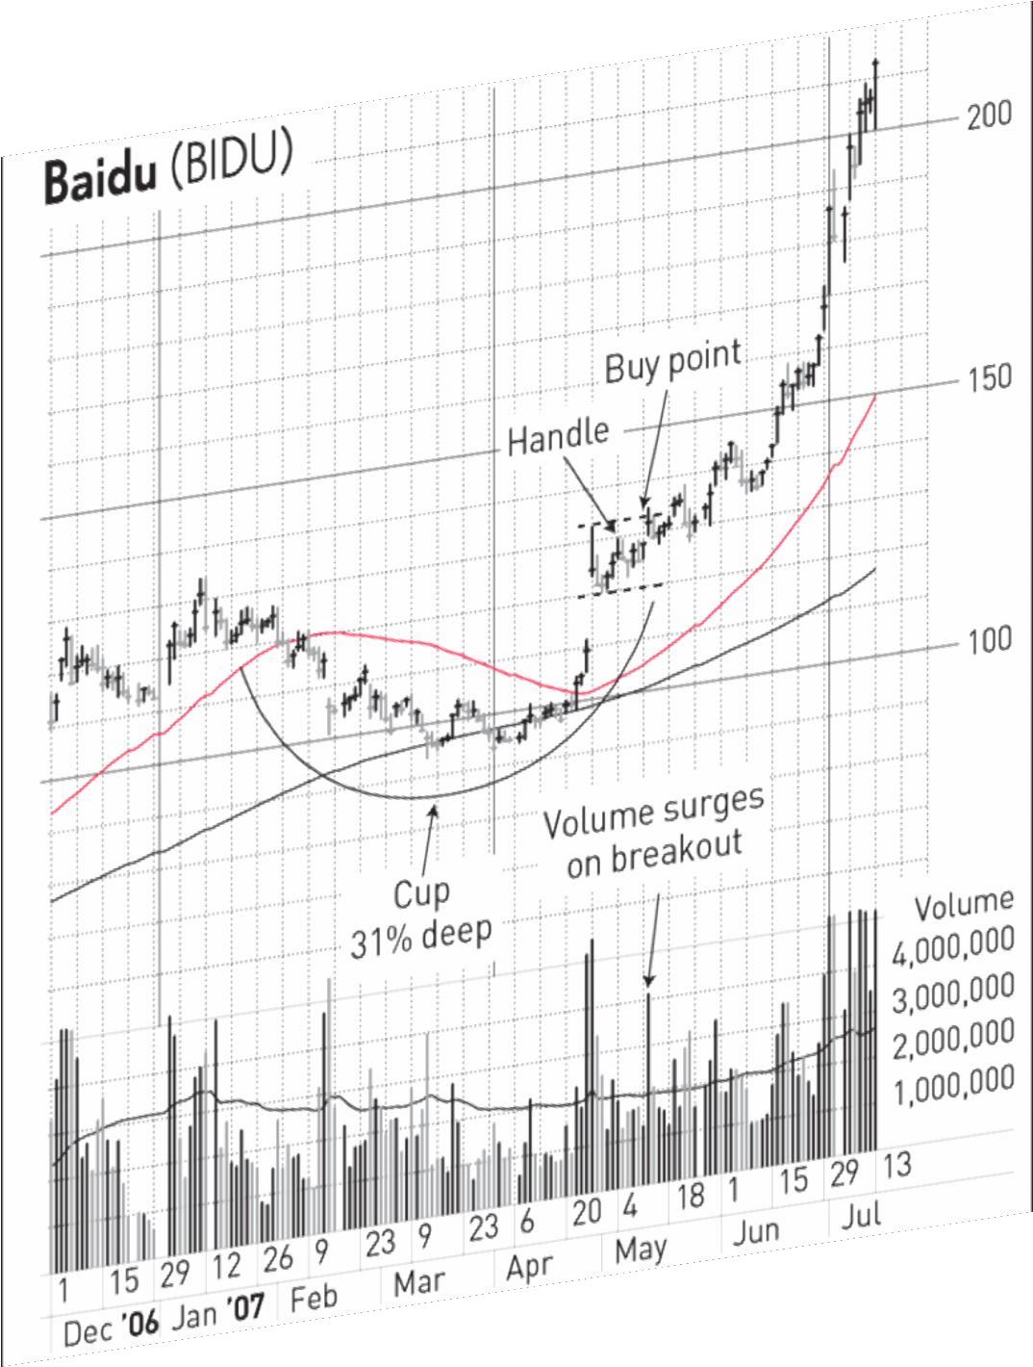
The cup should form smoothly, Withoutmajor price declines on the left side.Sharp gains on the right side aren't necessarily good, either. You might Think that the opposite of a panic- driven exit would be a good thing.

Slide 8

Your Title Goes Here
Kick off NeoCon 2016 with fellow alumni In
the Windy City. Enjoy refreshments, mingle with
old friends and faculty and network with SCAD industry partners.

Slide 9

Moloko Business Meet Up
March 30
3.30 PM
Neatworking Event
Institute of Modern Art
2320 W Chicago Ave, Chicago

Slide 10
The question we ought to ask ourselves every singla day is,
"How does each new user/customer we worked so hard for lead to more new users/customers?"

