Slide 1
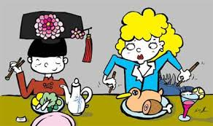

Slide 2
CULTURE SHOCK

Slide 3
General Definition of Culture
The ideas, customs, and social behavior of a particular people or society.

Slide 4
General Definition of Shock
A sudden upsetting or surprising event or experience.

Slide 5
Confusion, discomfort, disorientation, and uncertainty experienced when suddenly subjected to an unfamiliar environment/culture.
According to the Oxford Dictionary

Slide 6
Culture Shock
Symptoms
Five Stages
How to Cope
Page of Content

Slide 7
Symptoms of Culture Shock
Physical
Emotional
Insecurity
Homesickness
Isolation
Idealization of home culture
Confusion
Headaches
Insomnia
Loss of appetite

Slide 8
Five Stages of Culture Shock

Slide 9
The Honeymoon Stage
New experience -- Euphoria

Slide 10
2. The Distress Stage
Experiences no longer feel new.
The realization that familiar support systems are not easily accessible anymore.

Slide 11
3. Reintegration Stage
General dislike of the culture, language, and food.
Onset of aggression
The idealization of life “back home”.

Slide 12
4. Autonomy Stage
(Emergence Stage)
Acceptance starts.
Increase of confidence and appreciation.

Slide 13
5. Independence Stage
Embracing the new culture.
Feeling at home.

Slide 14
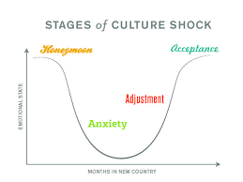

Slide 15

How to Cope with Culture Shock

Slide 16
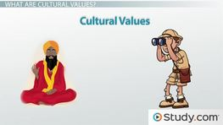
Before you go...
Research cultural norms, politics and entire history of the host country.
Seek advice from other people about the country and its tradition.

Slide 17
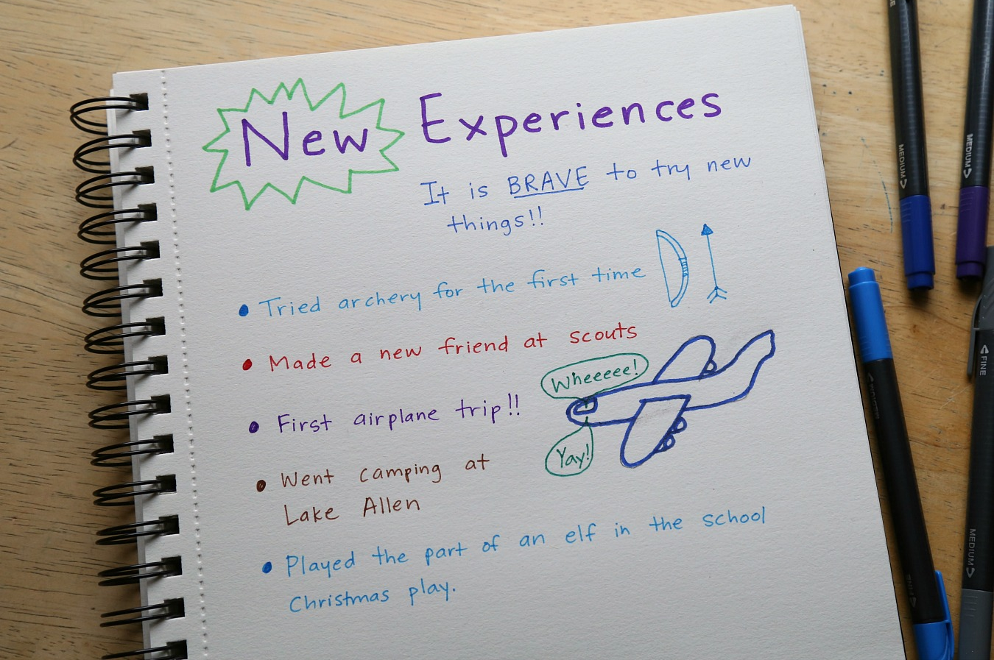
Once you arrive...
Once settled, start a daily journal, recording entries of your encounters and experiences..

Slide 18
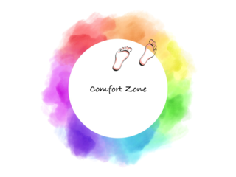
Push yourself to...
Although leaving the comfort zone can be irritating, pushing through it is part of the process.

Slide 19
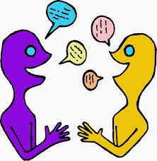
Participate..
Practice the language.
Make friends.

Slide 20

Ask for help..
A fellow student, professor, counsellor, or host parent to talk help through difficulties as they arise.

Slide 21

Get involved...
In an enjoyable activity that helps you meet people and get used to the environment.

Slide 22
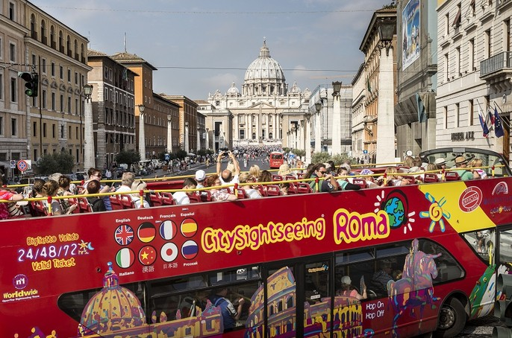
Plan...
Tours and participate in sports and recreational activities.

Slide 23
Summing up...

Slide 24
References
"Coping With Culture Shock". International Student Exchange Programs, 2018, https://www.isepstudyabroad.org/while-you-are-abroad/adjusting-to-a-different-culture.
"Culture | Definition Of Culture In English By Oxford Dictionaries". Oxford Dictionaries | English, 2018, https://en.oxforddictionaries.com/definition/culture.
Limited, Communicaid. "What Is Culture Shock?". Communicaid.Com, 2018, https://www.communicaid.com/cross-cultural-training/blog/what-is-culture-shock/.
Swallow, Deborah. "The Classic 5 Stage Culture Shock Model « Dr Deborah Swallow – Global Cultural Diversity..". Deborahswallow.Com, 2018, http://www.deborahswallow.com/2010/05/15/the-classic-5-stage-culture-shock-model/.
"What Is Culture Shock? Definition And Meaning". Businessdictionary.Com, 2018, http://www.businessdictionary.com/definition/culture-shock.html.

Slide 25
THANK YOU

