Slide 1
B Y A H M E D K A M A L
B U S I N E S S P L A N
F a l l 2 0 1 7 – C a p s t o n e , N Y U S P S , I N T G 1 - G C 0 0 0 0 - 000

Slide 2

Executive Summary
Jwelix intends to offer handmade custom and fashion jewelry made purely with a combination of sand, silver and natural gemstones in the Dubai’s e- commerce market as from June 2017. The business intends to target expatriates within the city; more specifically South Asian and Western expatriates. The unique thing about Jwelix is that it will be selling from award winning emerging jewelry designers
only.
Ahmed Akmal

Slide 3

Industry Analysis
The business is expected to be a success given the opportunities available.
Most stores have concentrated on women jewelry hence neglecting the men sector.
MEN’S
COSTUMES

Slide 4
Industry Analysis
There is an increasing demand for men’s costume and fashion jewelry, and Jwelix is priming itself to fulfill this need as backed by evidence gathered by the designers at the Dubai Jewelry awards show where men’s intent to
JWELIX INTENTION
purchase
Enquiries were 61%
Compared to Women’s of 39%
&

Slide 5
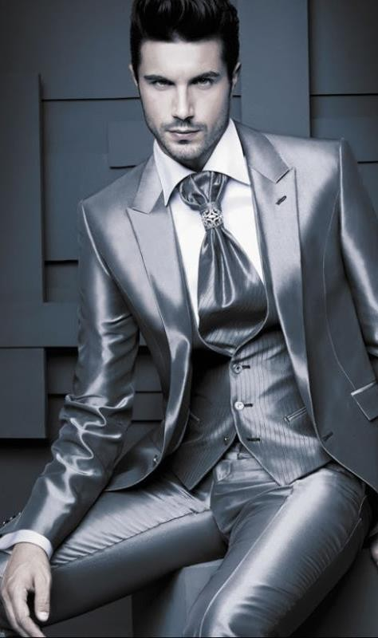
TARGET AUDIENCE
EXPATRIATES IN DUBAI
The business will be targeting expatriates in Dubai, international buyers, Jewelry lovers who are design oriented who like customized one of a kind jewelry.
The segments of the expatriates that the business will focus more are expats from high level income earners. Nationally focusing on South Asian and Western countries includes both men and women.
Involves
Consumers between
21-35 yrs
& Consumers over
35 yrs
WHY?
This decision has been arrived at due to varied demographics and psychographic data that indicates expatriates would make for a favorable target market.

Slide 6

70%
TARGET AUDIENCE
Health & Medical
allowance is
While Global average is 52%
More than 65% of expats in Dubai think that they are earning more than they would be earning back home (Derived from Go-gulf, 2016).
Accommodation allowance is
60%
The benefits in UAE that are received by expats also seem to be high compared to global average figures.
While Global average stands at
33%
Annual trips to home allowance is
67%
Compared to Global average that
stands at 33%
(Derived from Go-gulf, 2016)

Slide 7

MARKET
SIZE
I n 2 0 1 6 , t h e v a l u e o f e - c o m m e r c e i n U A E w a s e s t i m a t e d t o b e a r o u n d
US $ 2 . 8
billion
B y 2 0 1 8 , e x p e c t e d m a r k e t g r o w t h t o
US $ 10
billion
D u b a i a l o n e a c c o u n t s f o r
46%
o n l i n e s h o p p e r s i n U A E .

Slide 8


VALUE
Jwelix embraces a value proposition that reads:
“A Unique Artistic Award-winning Handmade Jewelry.”

Slide 9
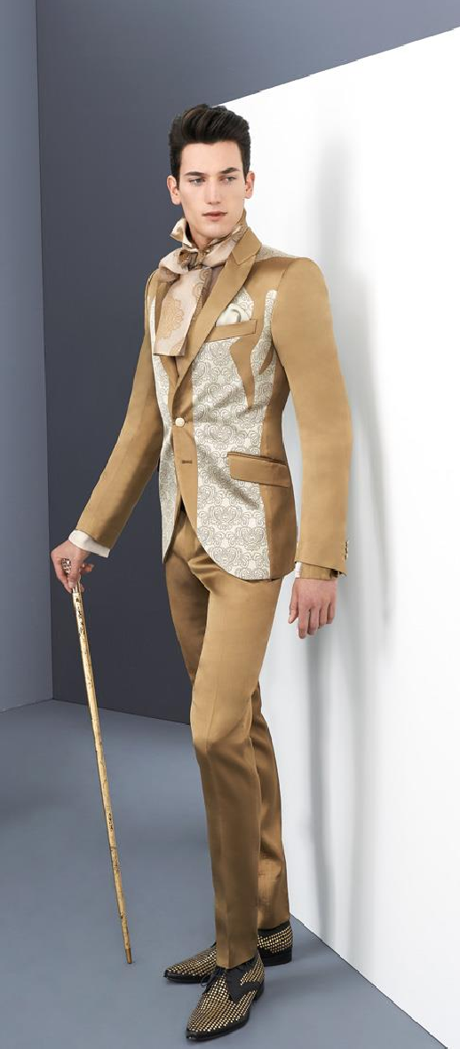
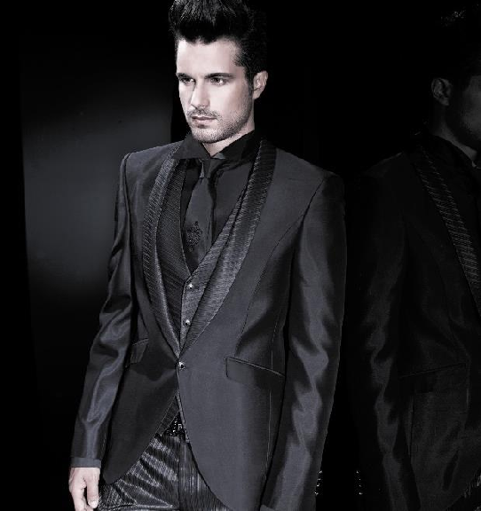
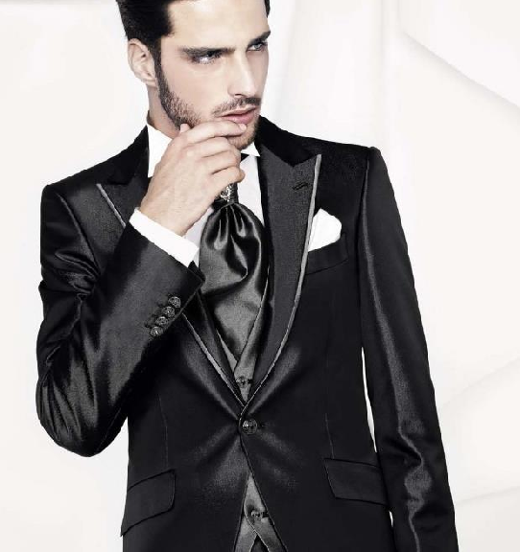
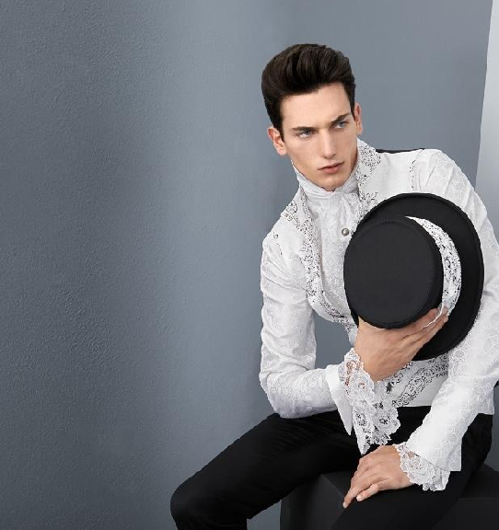
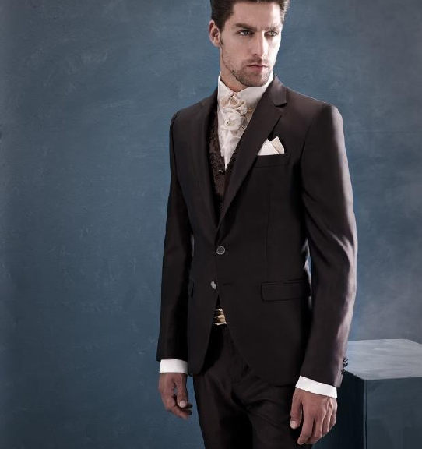
C O M P E T I T I V E A D V A N T A G E
MAJOR:
Namshi.com & Souq.com
STRENGTH:
Early Market Entry acquiring a favorable market share
WEAKNESS:
ADVANTAGE:
Cheaper
Concentrating more on Women Jewelry at the Expense of Men’s Jewelry
No Handmade Jewelry
No Award-Winners Designed Jewerly
But Jwelix stands by the Notion of Uniqueness in designs and made up of sellers who have gained popularity in the hearts of jewelry lovers in Dubai.

Slide 10
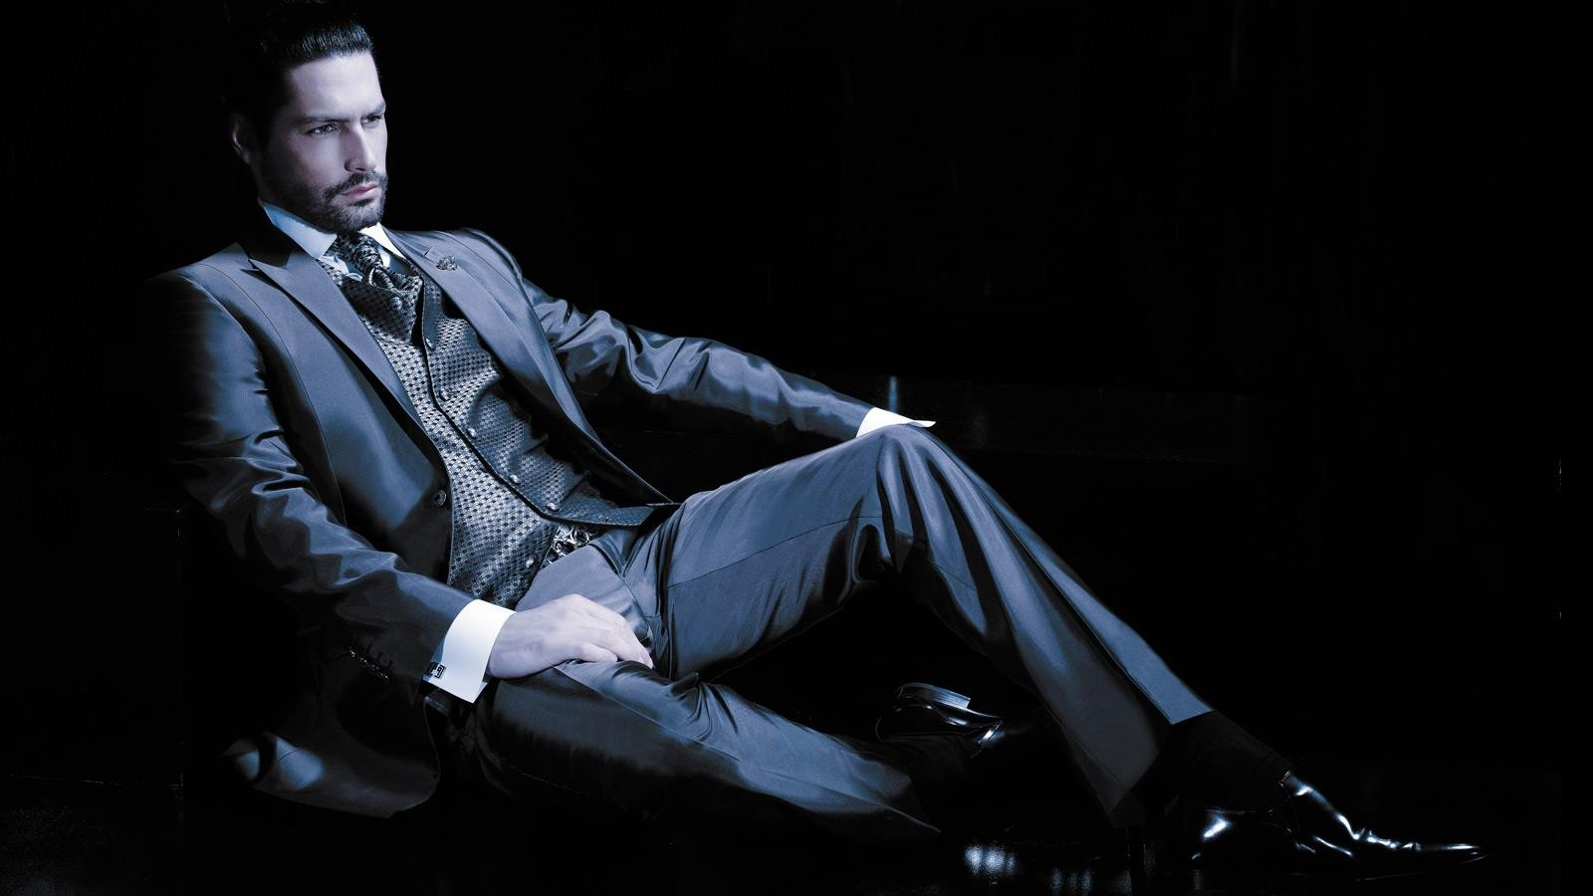
BUSINESS MODEL
The business will involve designers who were featured in 2016 Dubai magazines and won the jewelry designer awards. These designers will not be expected to sell their products through any other stream, but only through Jwelix.
1
2
Providing high-quality products at lower prices compared to competitors.
The main idea of the business is that the jewelry featured are hand made, made of sand, silver and natural gemstones.
3

Slide 11
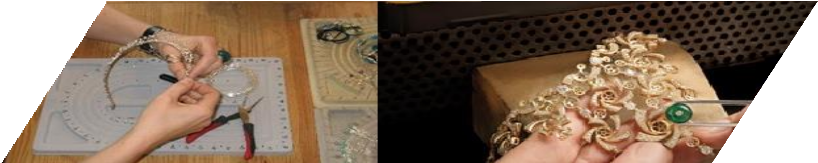
PRODUCT
Jwelix has partnered with Marjan Shakeri, Harshmi Sheth and The ‘Unknownmaker’ to deliver award winning jewelry to
consumers in Dubai.
The jewelry is made purely of Sand, silver and natural gemstones only. It is also hand made to perfection by our designers who have spent valuable time in each and every detail of the product.
The jewelry have stood out from the crowd being the award winners in the Jewelry design awards show in Dubai (2016), Thailand (2015) and Muscat (2016) for the uniqueness and pureness of the individual efforts that went through the crafting. The designs are purely an artistic element featured which was crafted with the imaginations of our designers. They were drawn up in paper for several years, and made in the right time.

