Slide 1


Slide 2
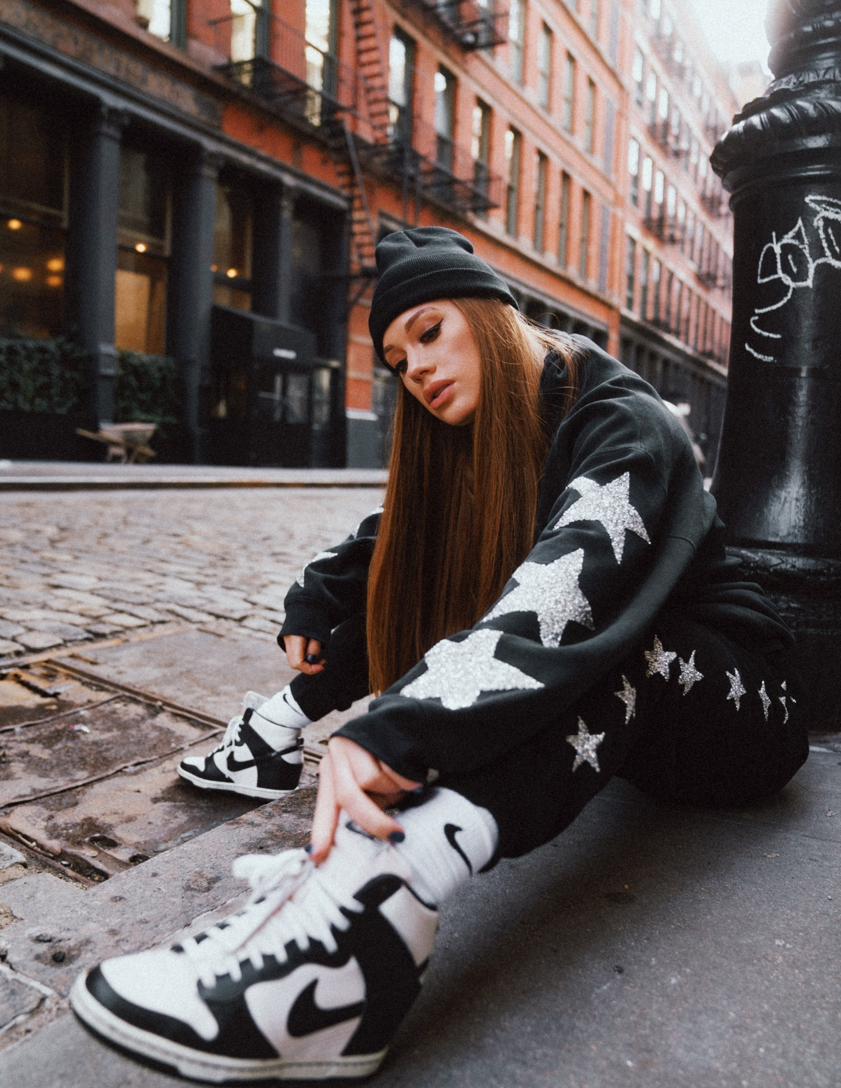
DENIS Street Fashion
FOUNDER
123.456.789
A GENERAL DIRECTION IN WHICH SOMETHING IS DEVELOPING OR CHANGING.

Slide 3

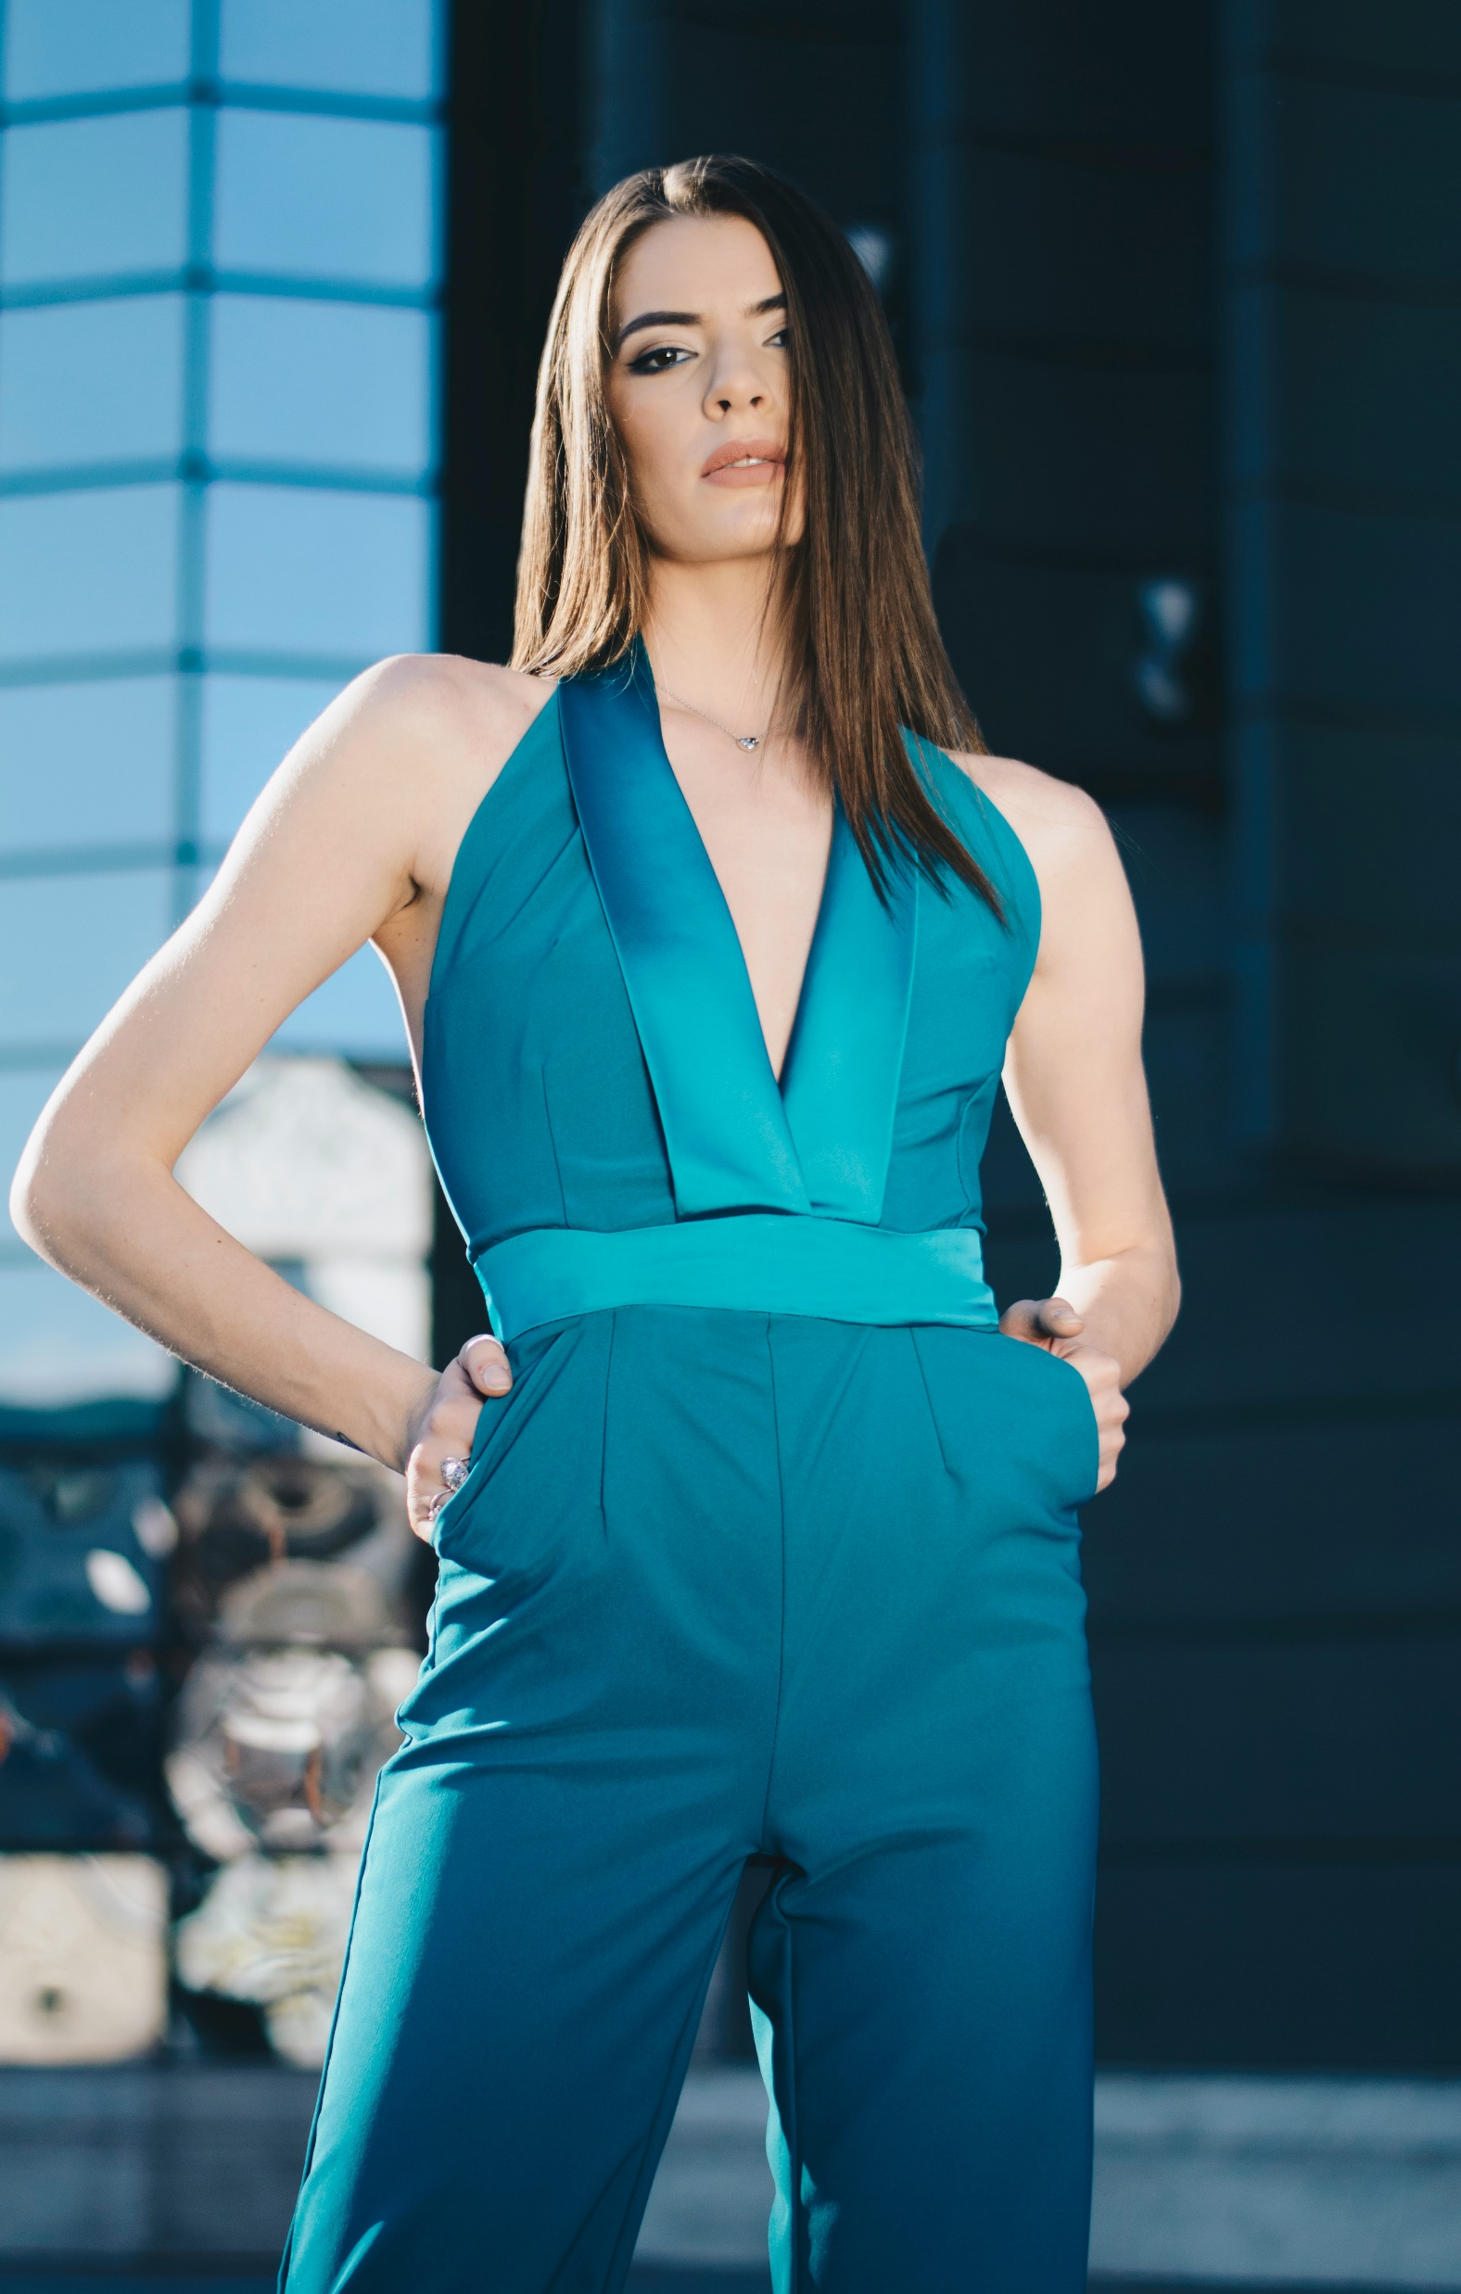
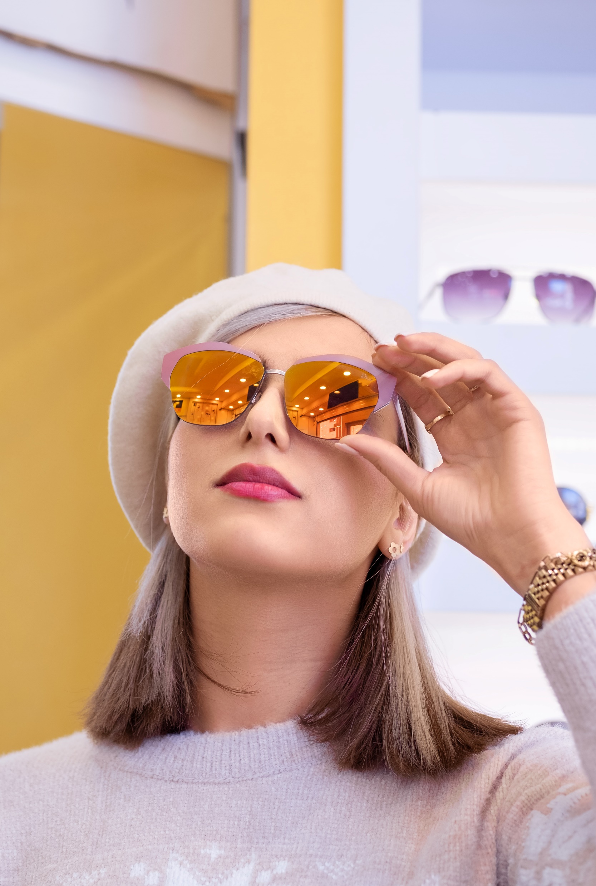
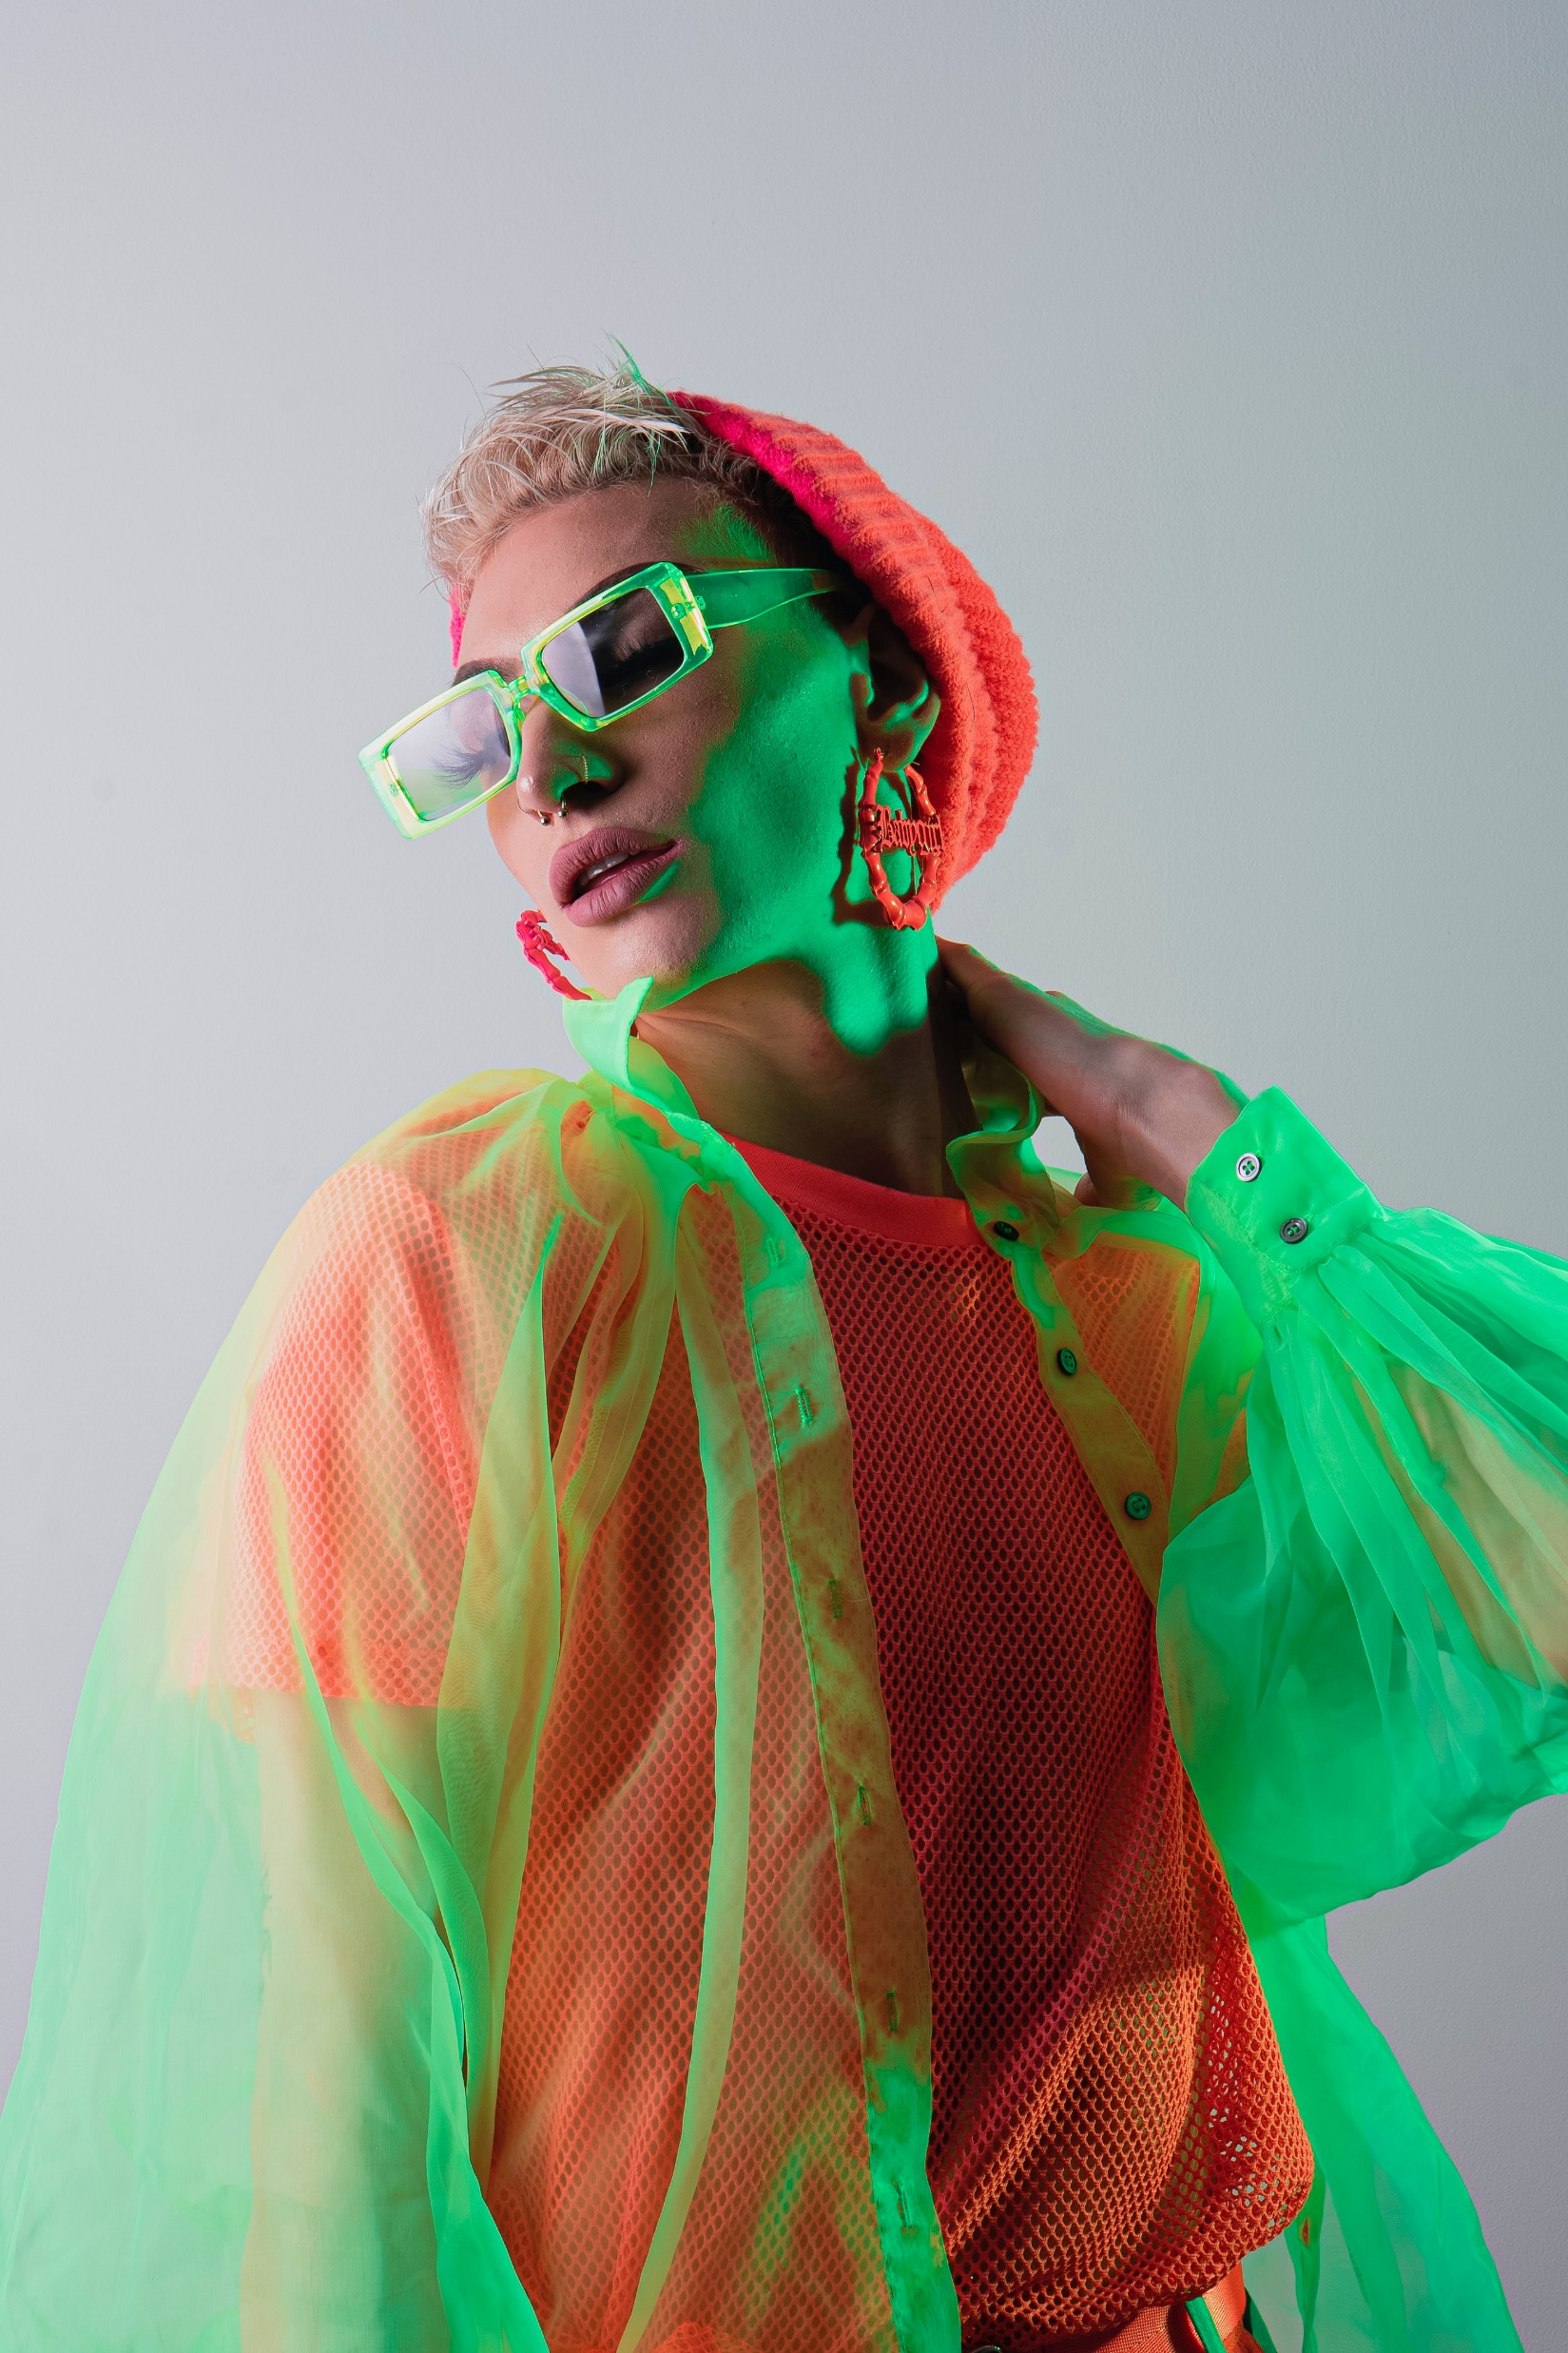

STARTING
NEW TREND

Slide 4
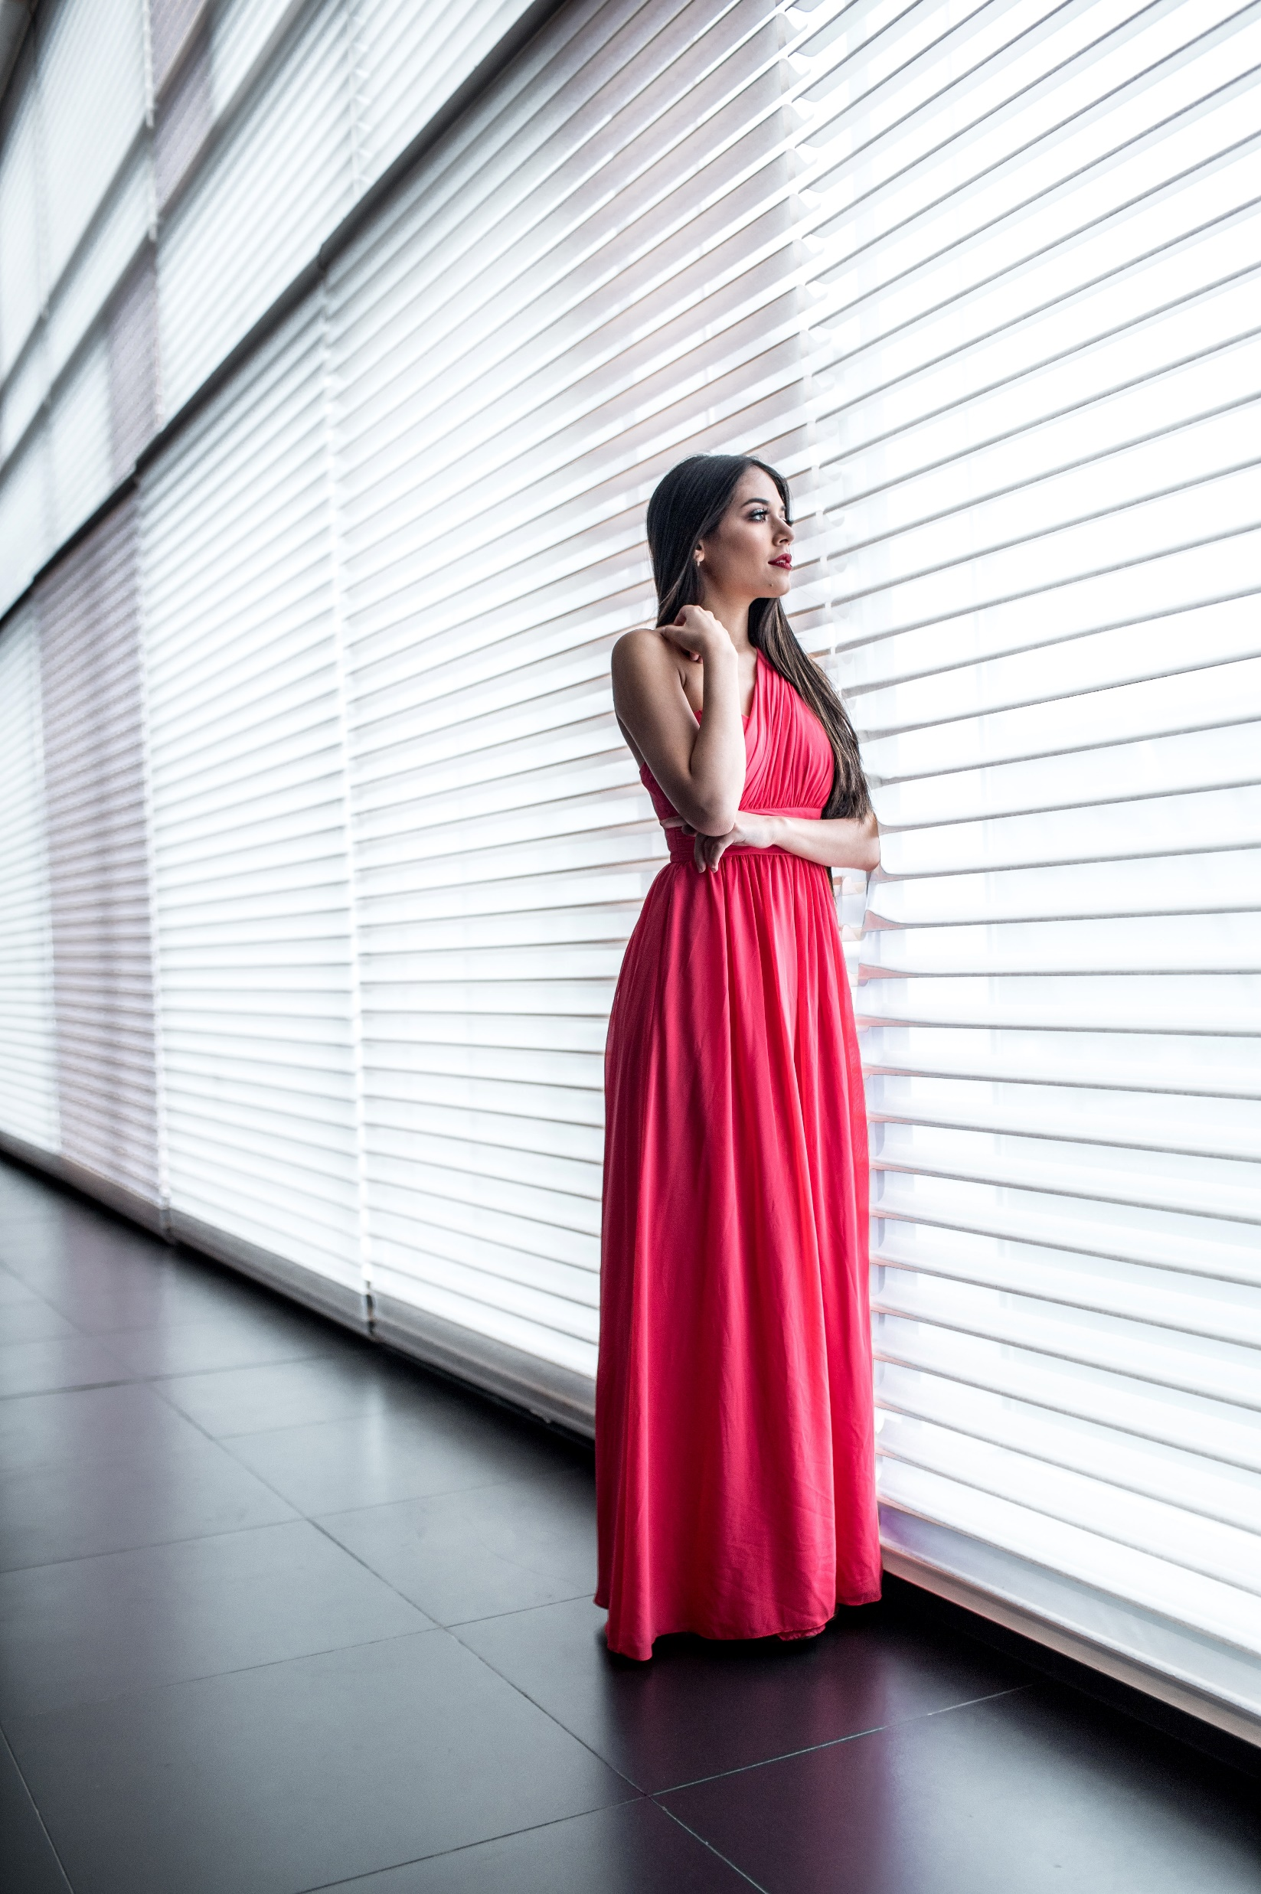
16/08/2021
Nearly all of the people interviewed believed that their mental illness had cost them previous job opportunities.
Street Fashion
Clothes That Matters.
The image of the ‘tortured artist’ is a familiar characterisation that asserts that the most creative among us are bound to be touched by mental affliction.

Slide 5

Clothes Matter.
Planning
In Pacifict Place Indor
Saturday
08:00PM
These employees scored lower on objective job performance evaluations than their peers.
Saturday
09:00PM
Saturday
08:00PM

Slide 6
Jeff Kaylisky
Designer
Tortured artist’ is a familiar characterization
The image of the ‘tortured artist’ is a familiar characterisation that asserts that the most creative among us are bound to be touched by mental affliction.

Slide 7

Our Designer
Design to enhance everyday life.
The image of the ‘tortured artist’ is a familiar characterization that asserts that the most creative among us are bound to be touched by mental affliction.

Slide 8
Let’s Learn
How To Make It Happen
Influence behavior
Ultimately shape
A research project I conducted on the meaning of the clothes associated with a high street brand,
“There is much to support the view that it is clothes that wear us, and not we, them; we may make them.

Slide 9
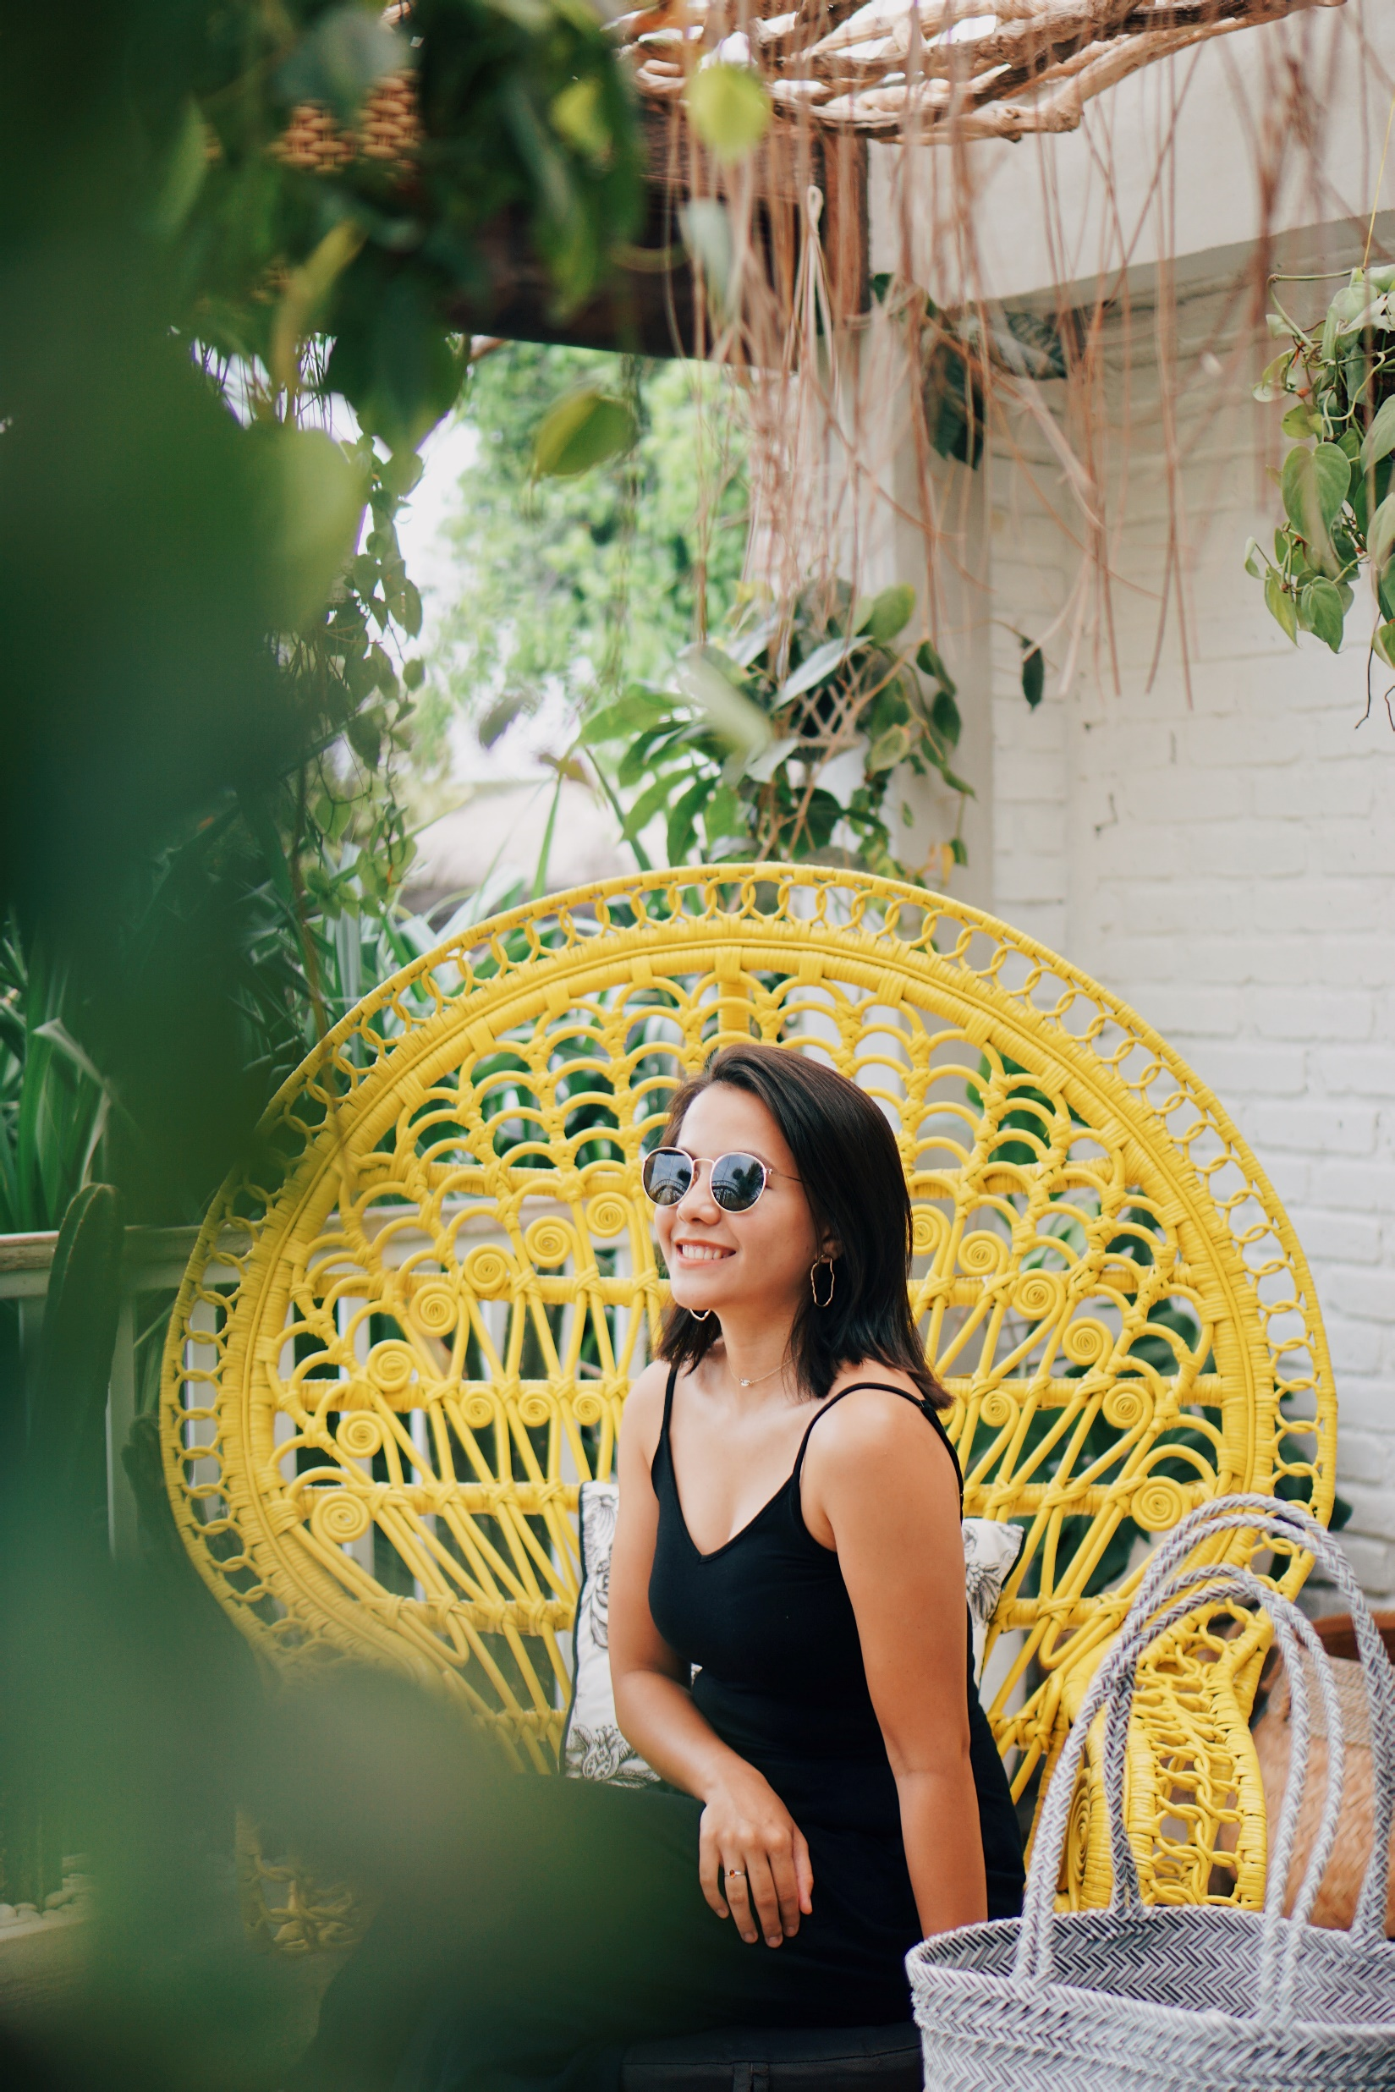
A presentation template created with attentive detail to provide a new experience for users. Hopefully this presentation can help you and bring good luck to you. each of our slides is designed to make it easy for you to deliver every point of your presentation.
POTRAIT

Slide 10

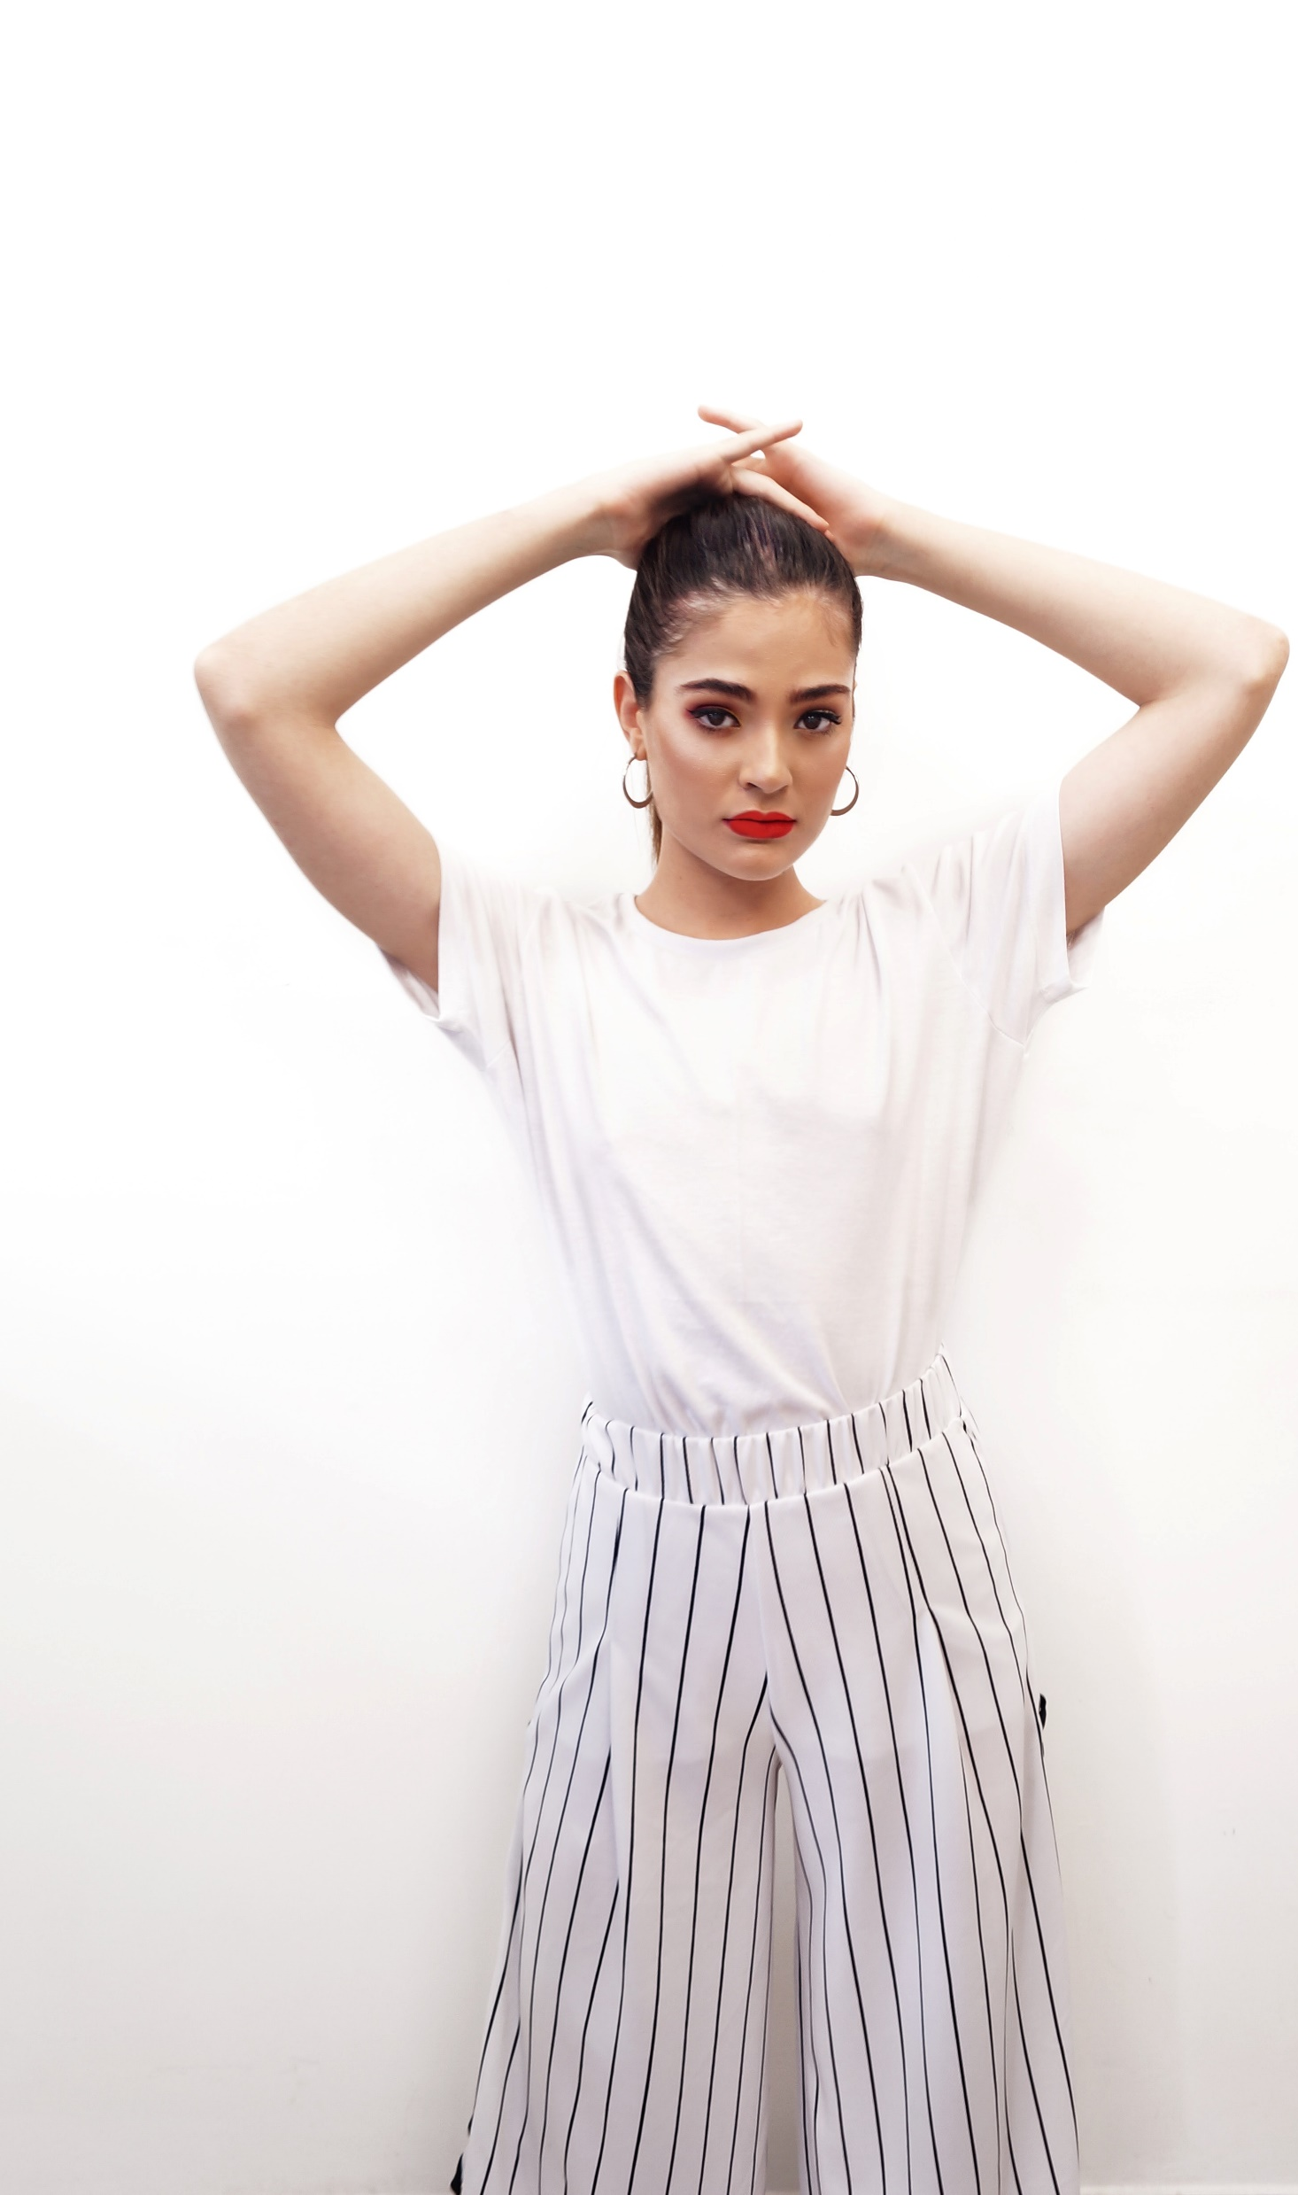
Wear Moments.
Design to enhance everyday life.
The image of the ‘tortured artist’ is a familiar characterization that asserts that the most creative among us are bound to be touched by mental affliction.

Slide 11
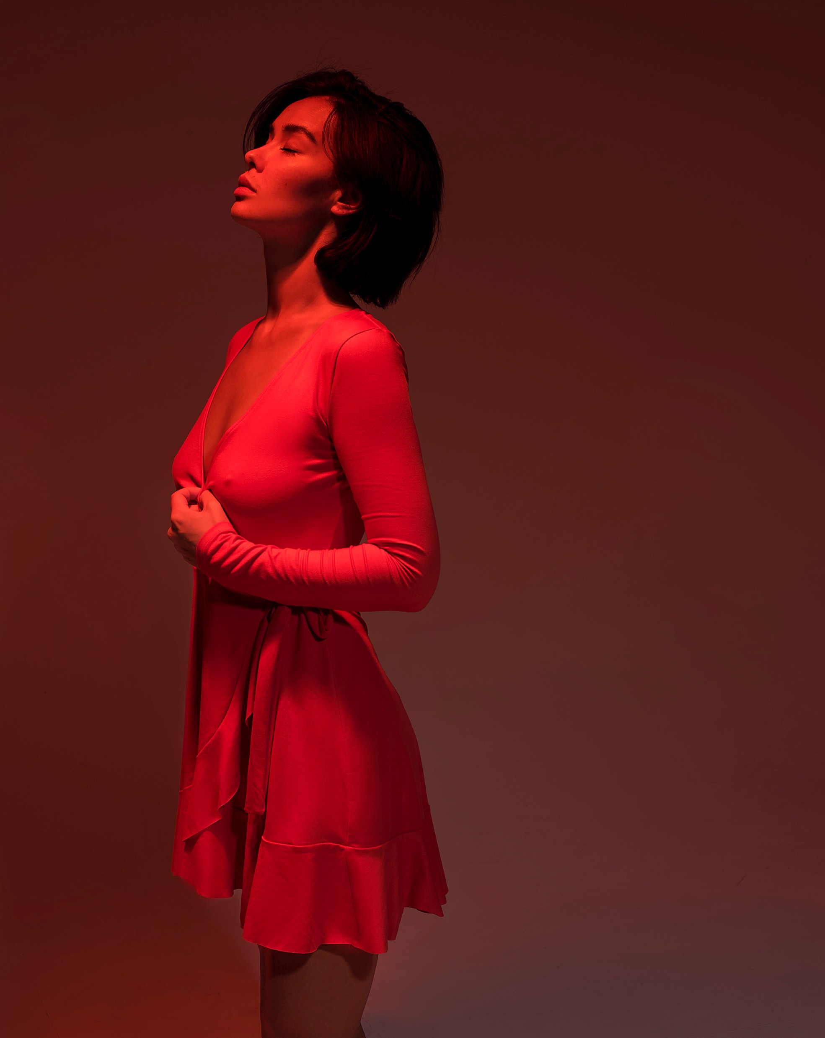

Clothes
that matters.
Design to enhance everyday life.
Intrigued by current political affairs around the conduct of american police officers towards black men, researchers at a canadian university conducted a study, in which students wore police-style uniforms.

Slide 12
Wear Moments.
Design to enhance everyday life.
The image of the ‘tortured artist’ is a familiar characterization that asserts that the most creative among us are bound to be touched by mental affliction.

Slide 13

Fashion is Trending.
Design to enhance everyday life.
The image of the ‘tortured artist’ is a familiar characterization that asserts that the most creative among us are bound to be touched by mental affliction.

Slide 14
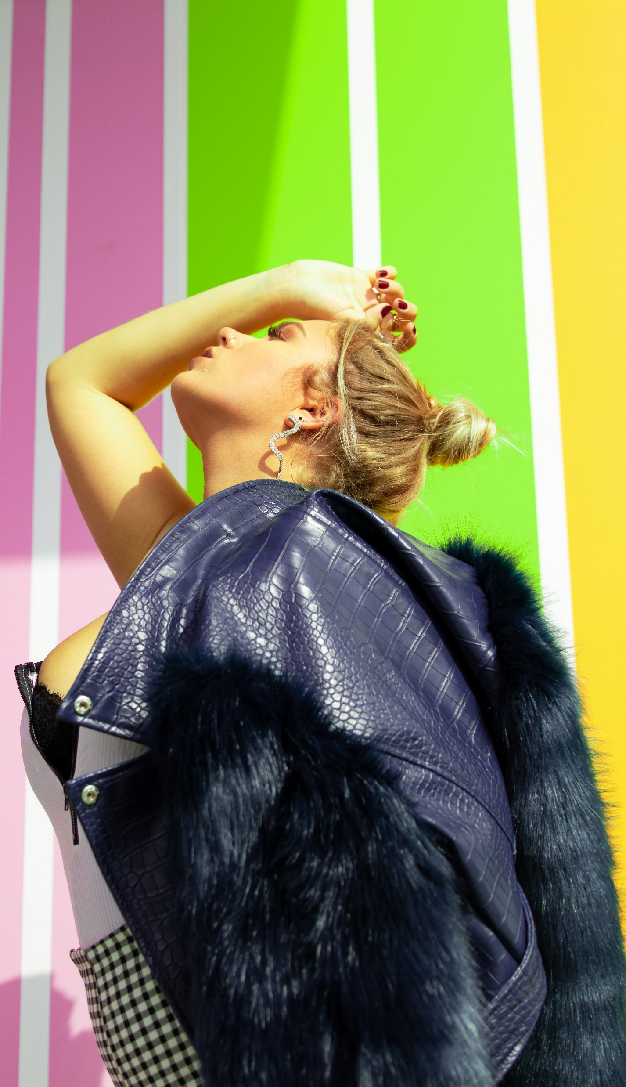
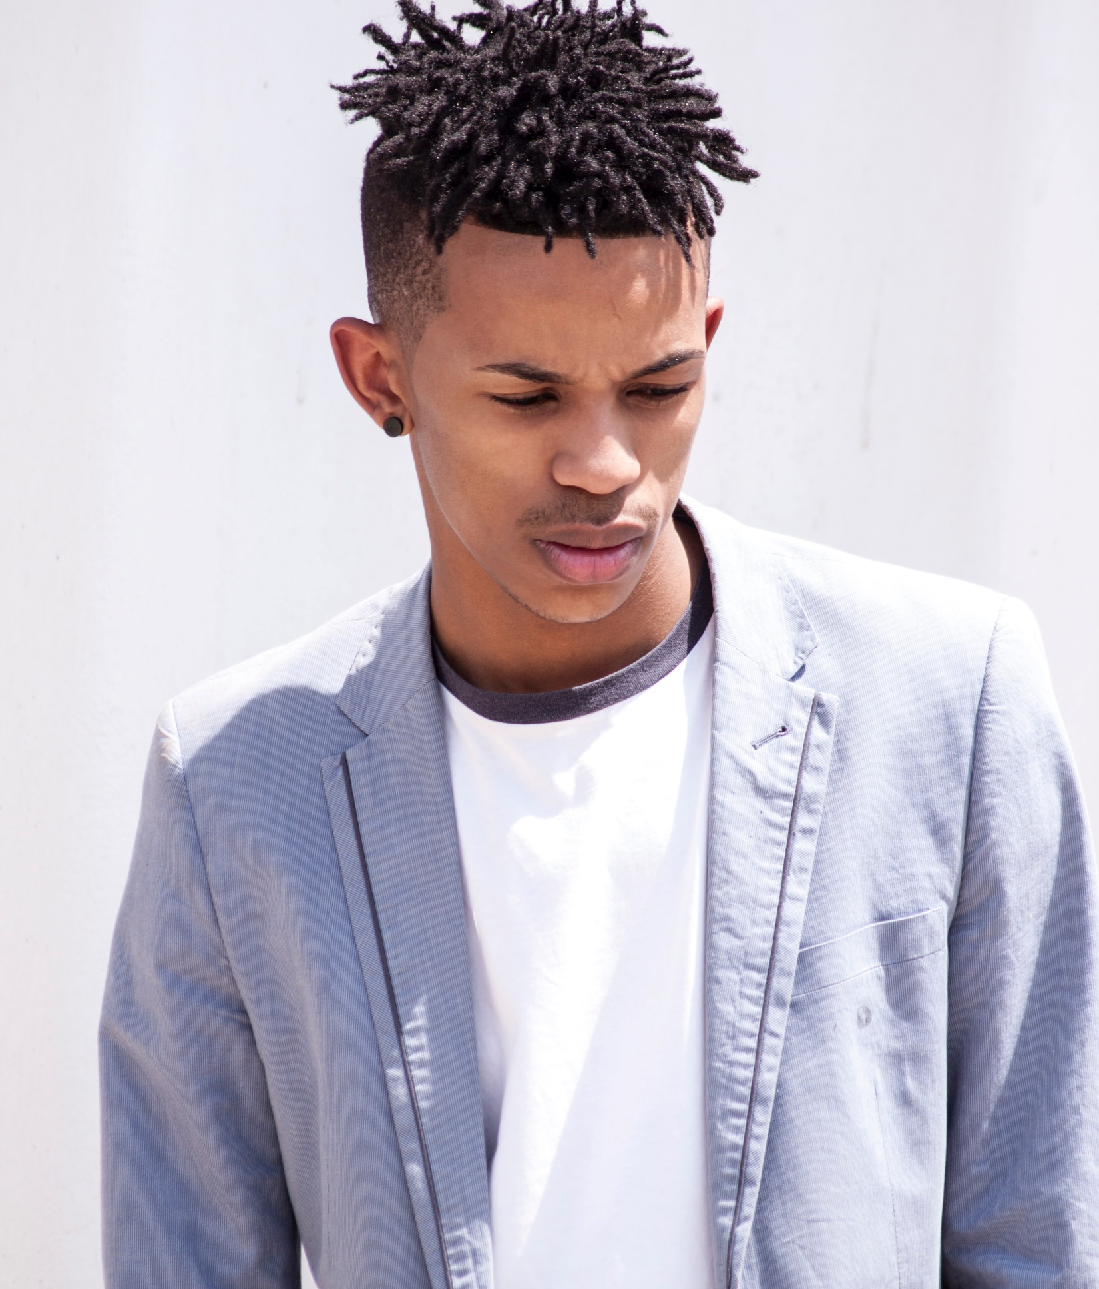
Building a Better you.
Design to enhance everyday life.
The image of the ‘tortured artist’ is a familiar characterization that asserts that the most creative among us are bound to be touched by mental affliction.

Slide 15
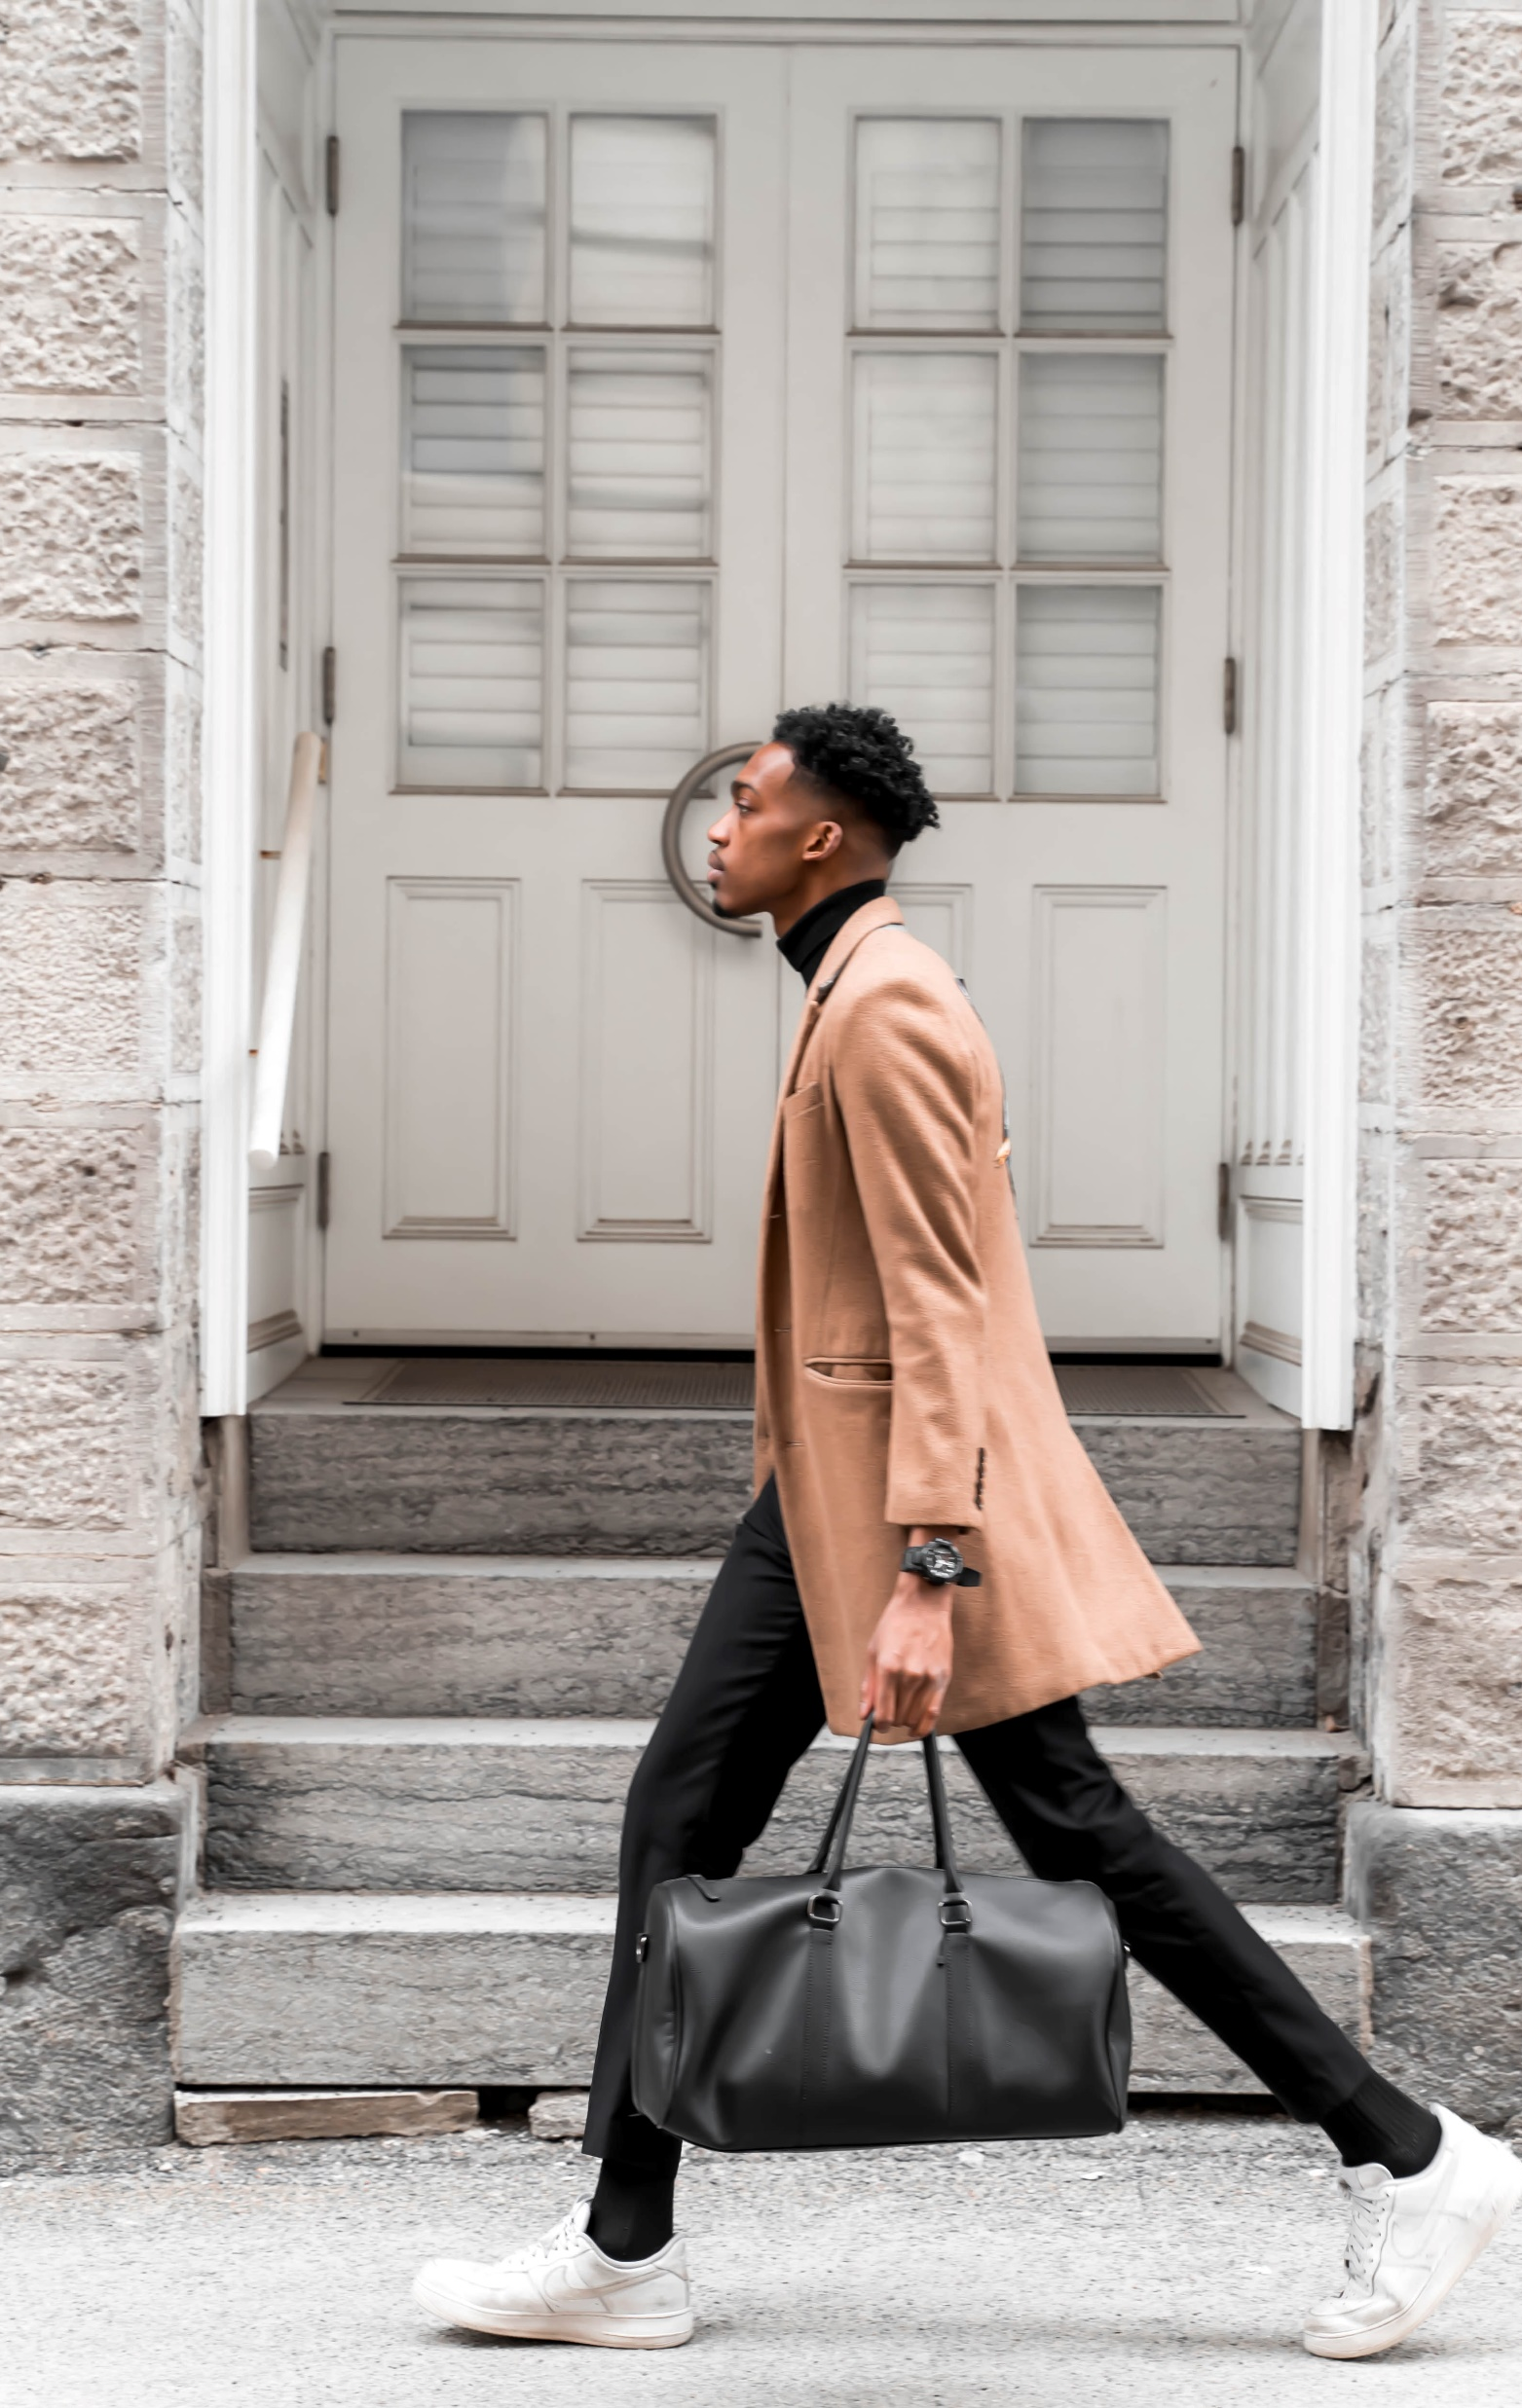
A Store that Sells Style.
The image of the ‘tortured artist’ is a familiar characterization that asserts that the most creative among us are bound to be touched by mental affliction.

Slide 16
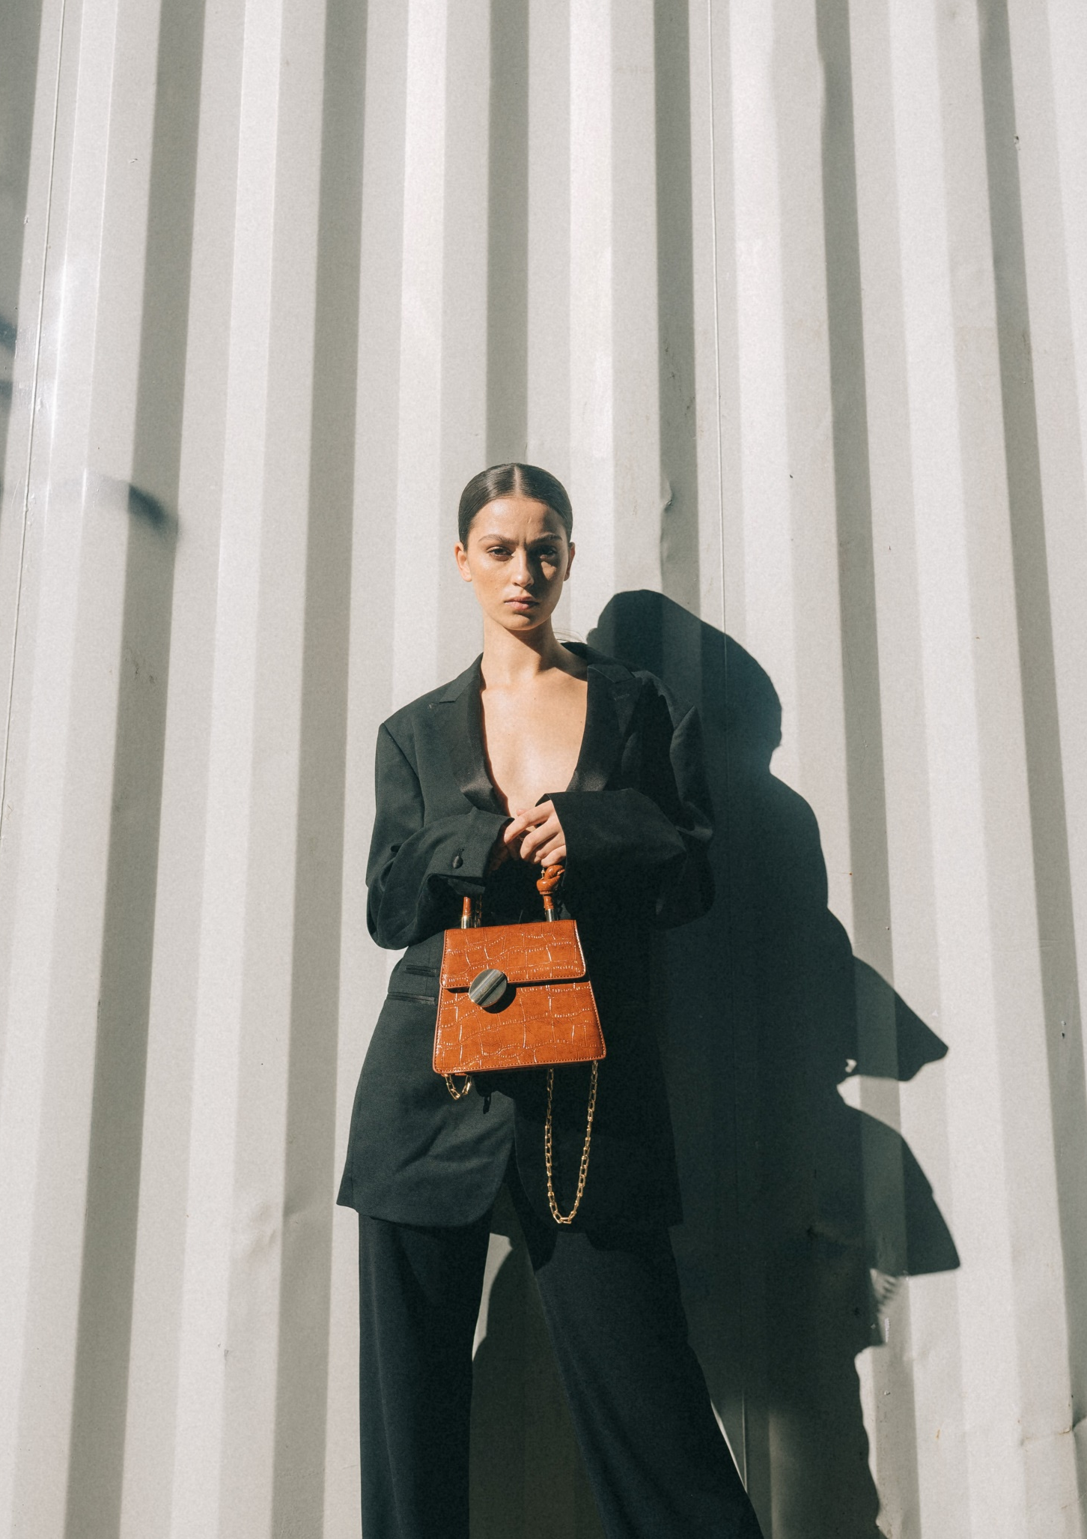
Feel Pretty, Feel Shine
Dress
Fashion
Market
Design

Slide 17

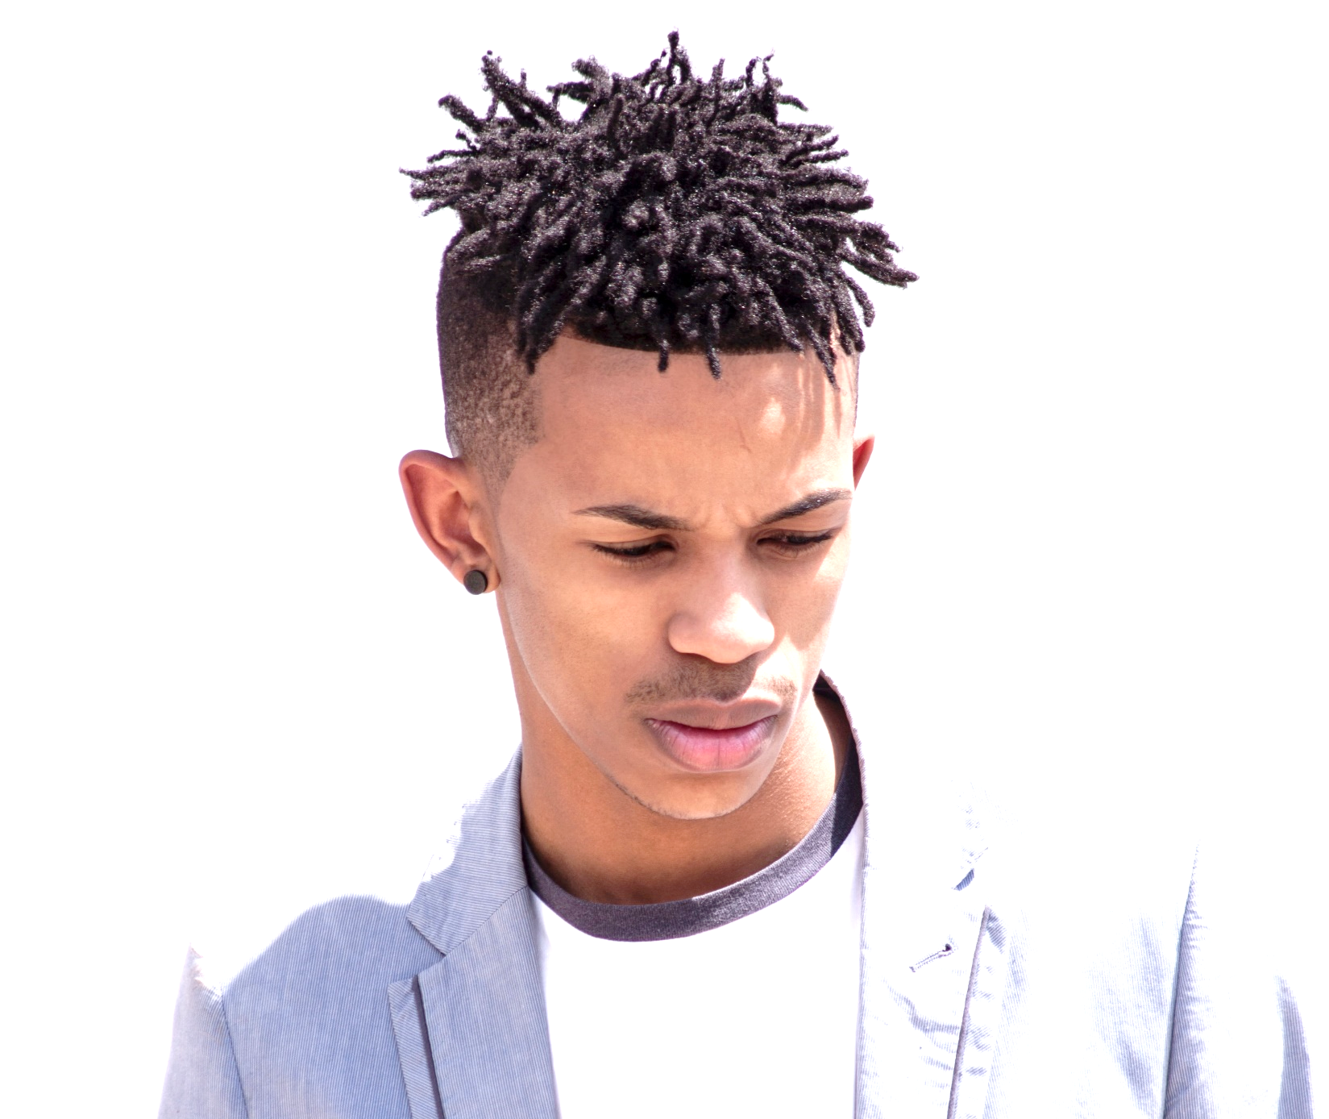

Yes! Fashion Is What We Are!
The image of the ‘tortured artist’ is a familiar characterization that asserts that the most creative among us are bound to be touched by mental affliction.

Slide 18
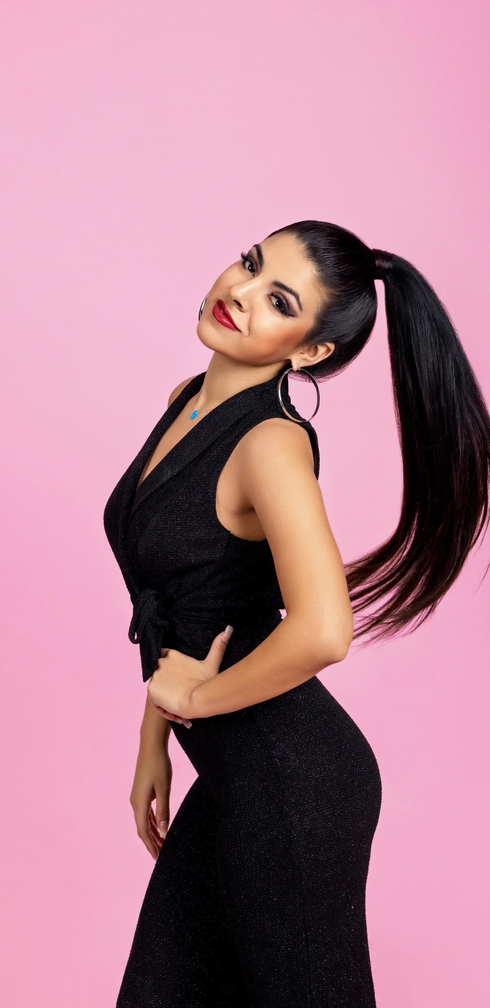

Fashion is Trending.
Design to enhance everyday life.
The image of the ‘tortured artist’ is a familiar characterization that asserts that the most creative among us are bound to be touched by mental affliction.

Slide 19
Building a Better you.
Design to enhance everyday life.
The image of the ‘tortured artist’ is a familiar characterization that asserts that the most creative among us are bound to be touched by mental affliction.

Slide 20
A Planet Of Style.
Planet Of Style
Design to enhance everyday life.
The image of the ‘tortured artist’ is a familiar characterization that asserts that the most creative among us are bound to be touched by mental affliction.

Slide 21
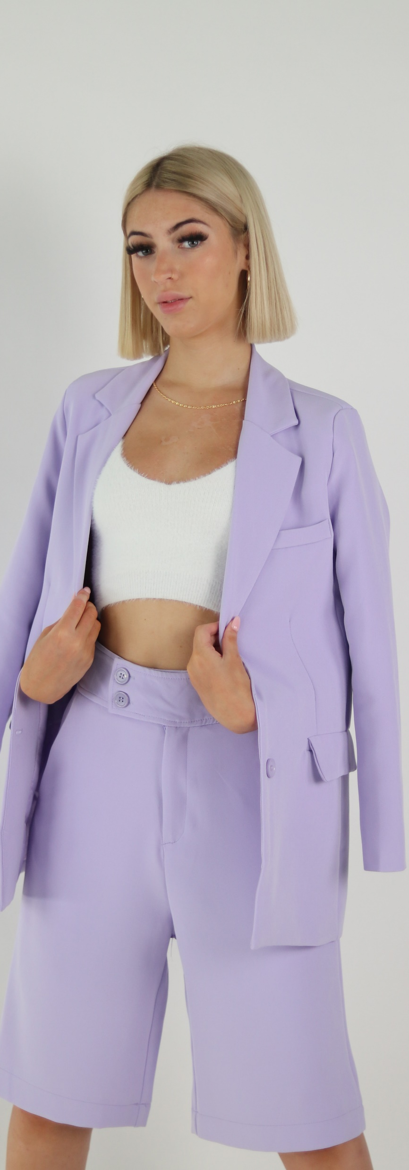
Fashion is Trending.
Design to enhance everyday life.
The image of the ‘tortured artist’ is a familiar characterization that asserts that the most creative among us are bound to be touched by mental affliction.

Slide 22
Design to enhance everyday life.
In a research project I conducted on the meaning of the clothes associated with a high street brand, one of the participants described herself as being a clone of the brand, referring to the fact that she was very much aware of her likeness to other customers, who also bought the brand.
Dresses To
Be Noticed

Slide 23

A Planet Of Style.
Design to enhance everyday life.
The image of the ‘tortured artist’ is a familiar characterization that asserts that the most creative among us are bound to be touched by mental affliction.

Slide 24


Building a Better you.
Design to enhance everyday life.
The image of the ‘tortured artist’ is a familiar characterization that asserts that the most creative among us are bound to be touched by mental affliction.

Slide 25

Thanks.

