Slide 1
Exercise & Fitness

Slide 2
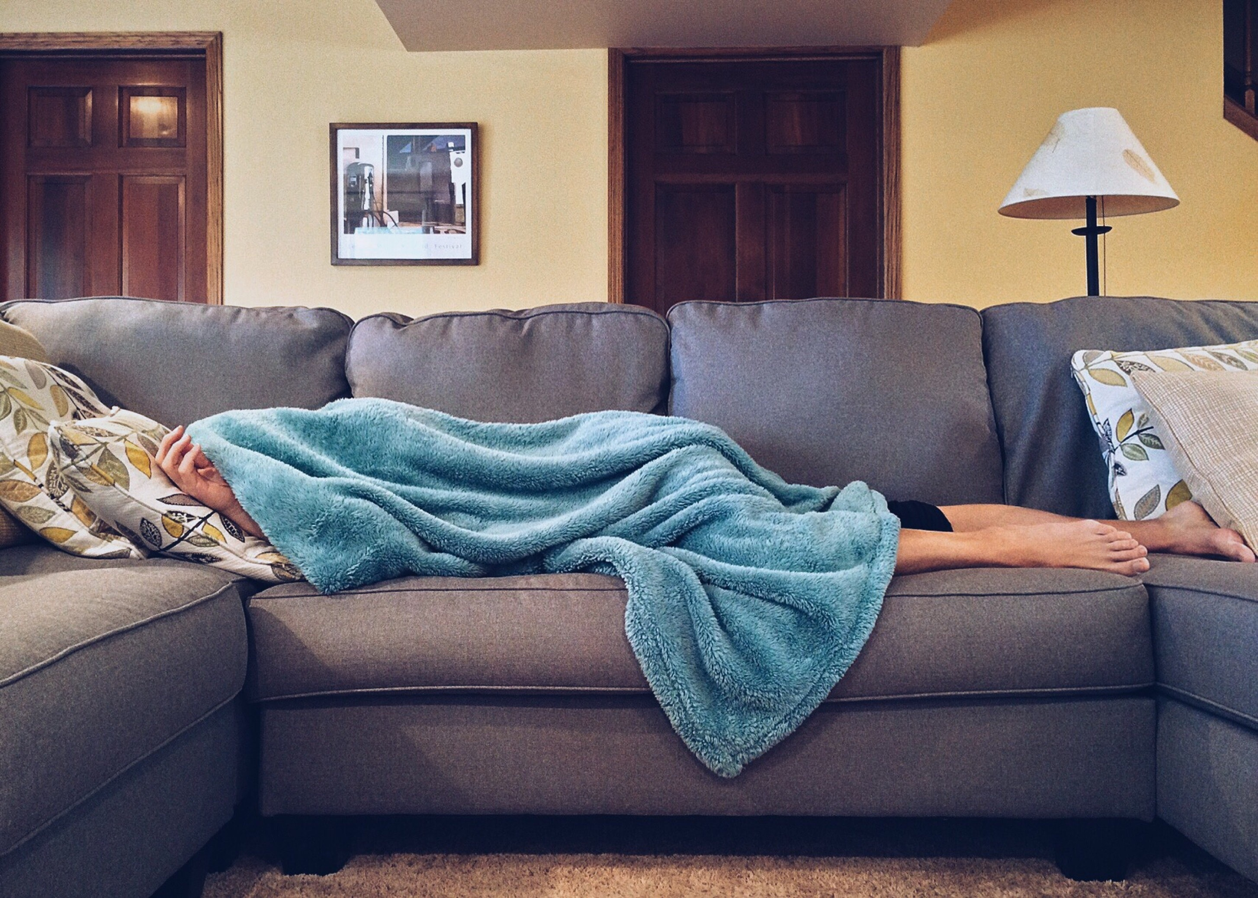
Did you know?
According to the National Center for Health Statistics, and the Office of the Surgeon General of The United States: Adults aged 18 and older need an average of 30 minutes 5 or more days a week of physical activity to be healthy. But only 3 in every 10 adults actually do the recommended amount of exercise.

Slide 3
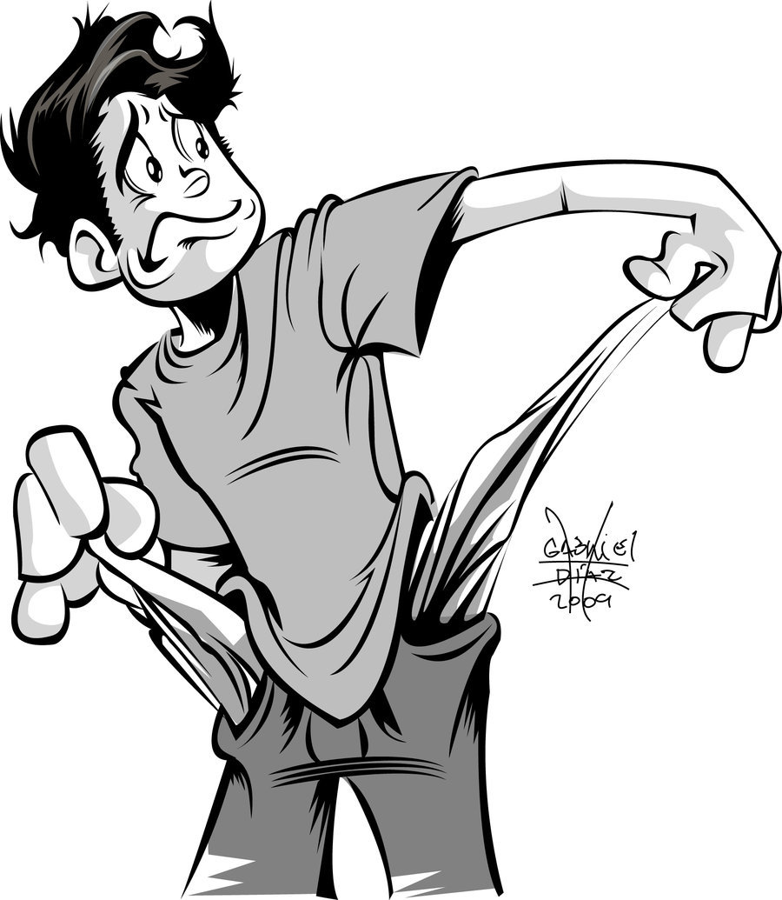
What some people believe
A lot of people believe that exercising can be:
Time consuming
Expensive
Unenjoyable
Today I came here to change your mind about exercising ,show you away to include exercising in your daily life, and try to make you enjoy it a little too

Slide 4

Why do we need exercise
Exercise isn’t only meant for people to control your weight Exercise actually helps your body to prevent or delay the onset of chronic diseases, heart disease, high blood pressure, and strokes. It also increases your stamina and gives you more energy to do your daily routines

Slide 5
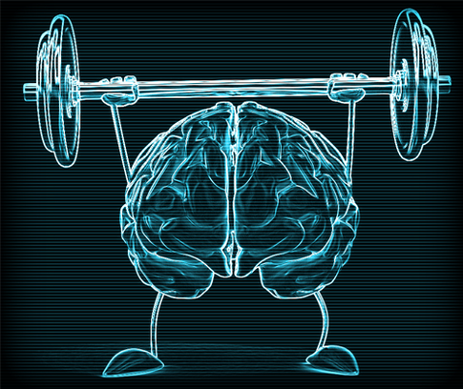
Not only does exercise help you physically it also treats you mentally. According to The National Center for Health Statistics “Daily physical activity helps reduce symptoms of anxiety and depression.”
Exercise has direct stress-reducing benefits
Releases endorphins
Calming effects
Improves your mood
Boosts energy
Boosts self-esteem
Improves sleep
Increase self confidence

Slide 6
Now let’s see how we can add exercise into our daily life

Slide 7
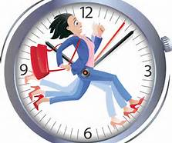
Don’t have time?
Did you know that according to a recent study an average person in the united states spends about 4 hours a day watching TV, this is a huge amount of time wasted that can actually be used to benefit your health
Wake up half an hour earlier, schedule lunchtime workouts, take an evening fitness class
Make family time physically active
Build physical activity into your routine chores
Squeeze in short walks throughout the day.
Drive less, walk more.

Slide 8

Change your perspective of exercise
View exercise as a necessity not a chore
View your workout time as “me time.”
Your workout time may be the only quiet time you get
Think of exercise as your energy source
Exercise can actually give you more energy and focus

Slide 9
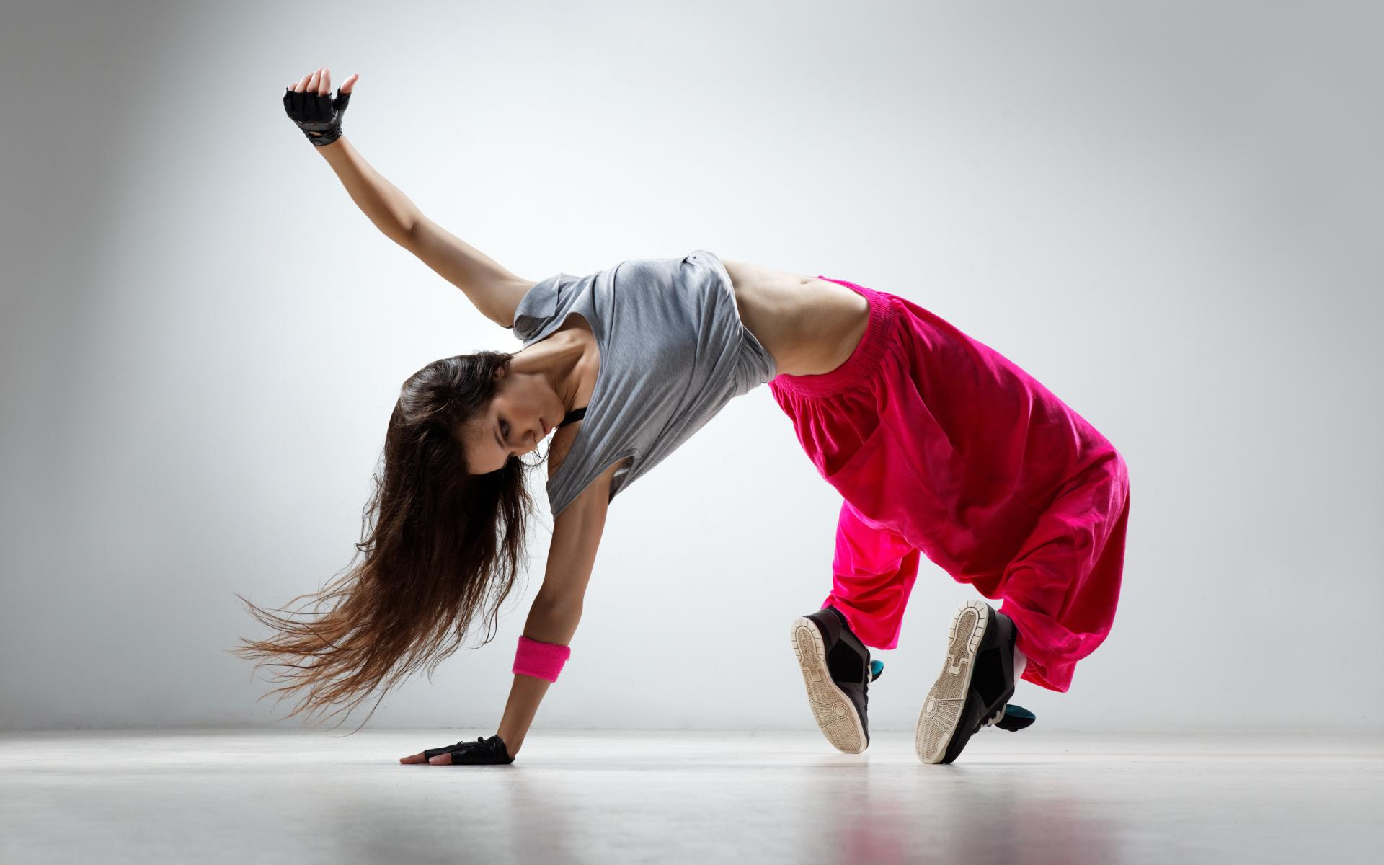
Alternative for exercise:
Dance Classes
Run a Marathon for a good cause
Swimming
Group sports
Clubs
Bike Riding
Hiking
Jump Rope

Slide 10
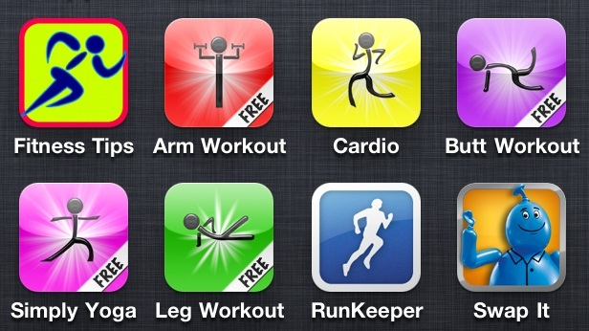
Fitness resources
There is a lot of websites and apps to use that can help your with your exercises these apps are totally free to use and a lot of them don’t require you to buy anything extra so there no money consuming at all

Slide 11
Conclusion:
You can make time for physical activity.
You can find a way you will enjoy exercising.
There are many resources available to help you stay fit

Slide 12

Remember:
Physical fitness is key to helping you live a long healthy life both physically and mentally.

Slide 13
Any questions?
Thank you for your time

