Slide 1
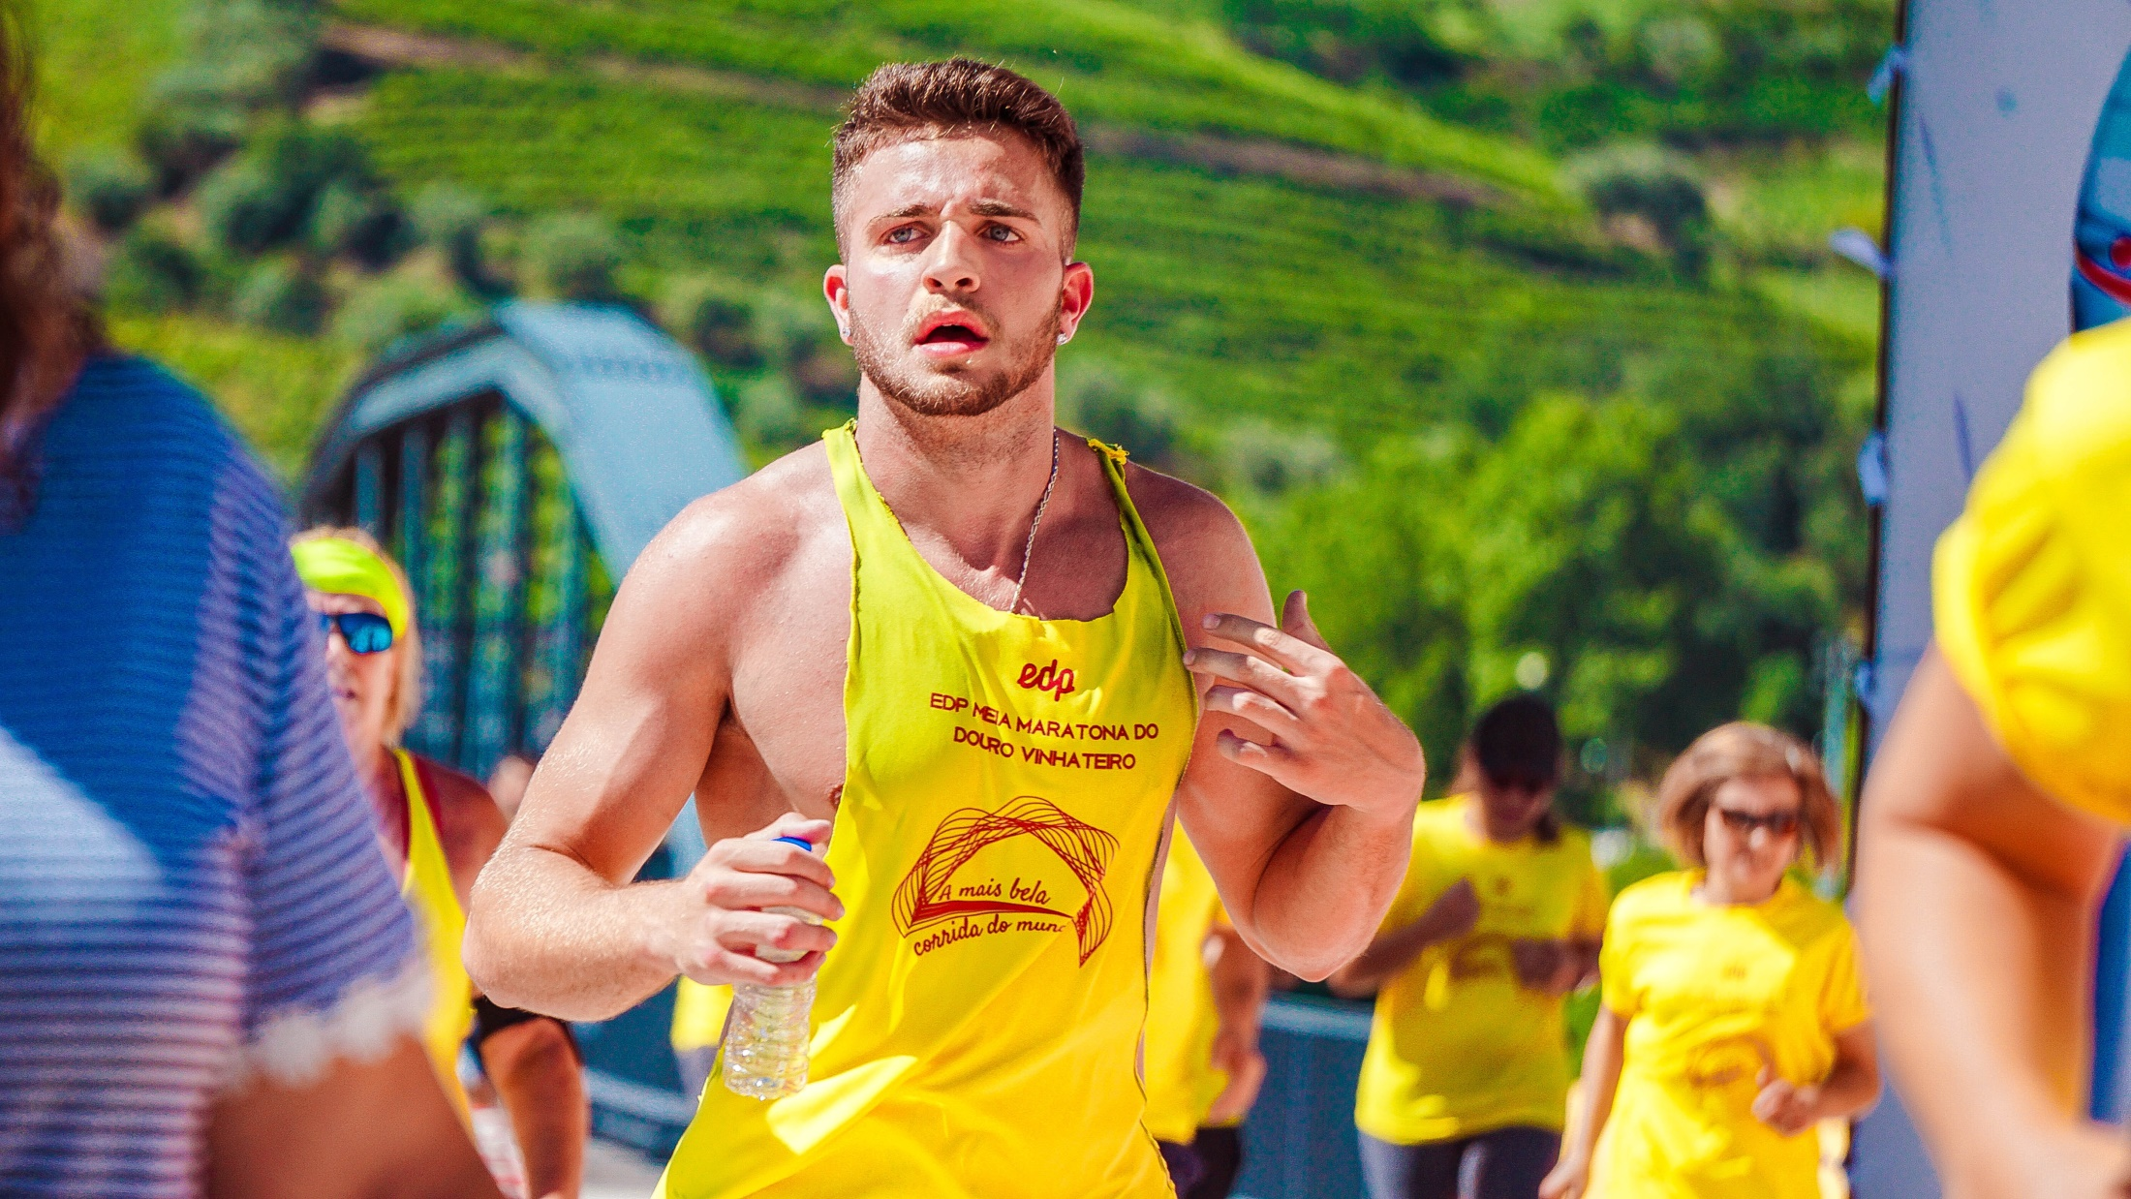
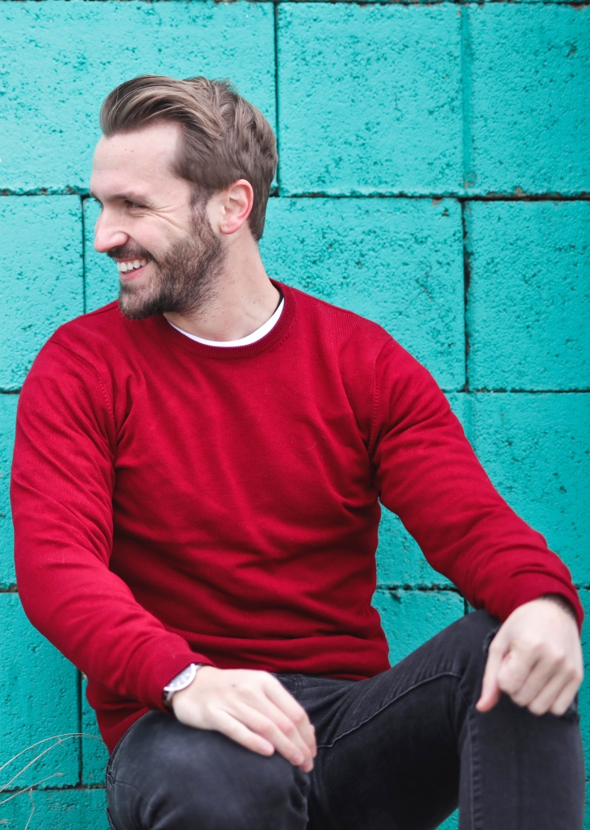
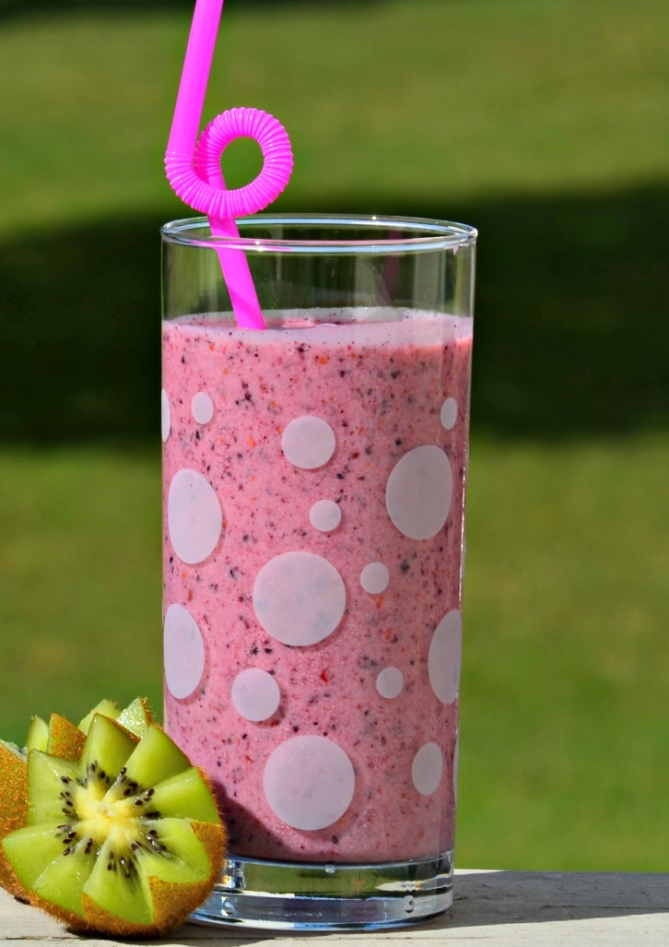
FITNESS TEMPLATE

Slide 2
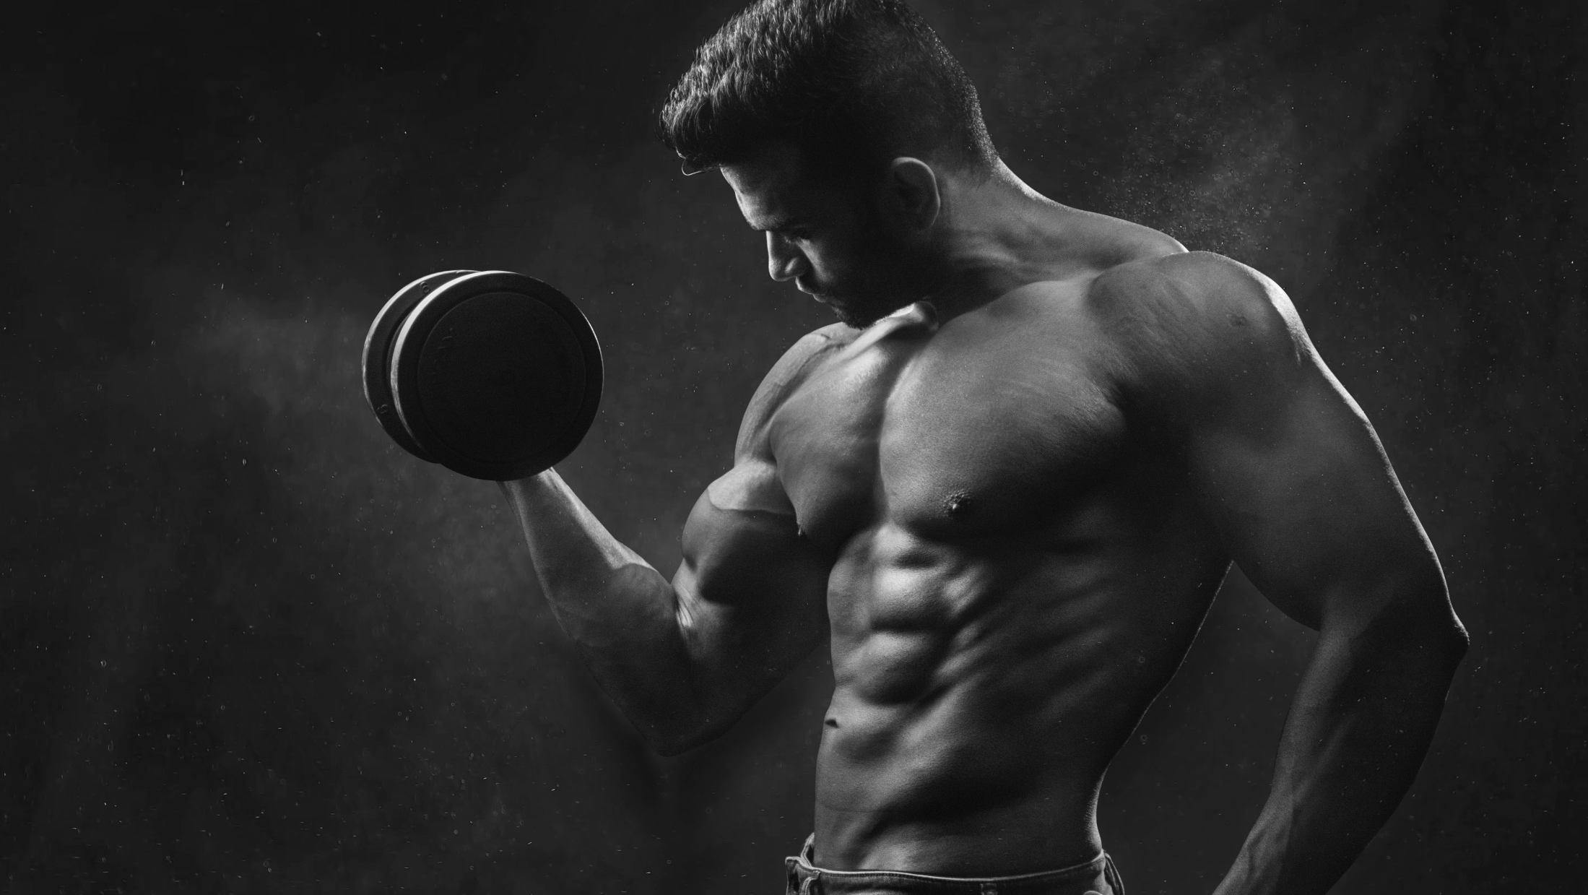
Exercise is any bodily activity that enhances physical fitness and overall health and wellness. It is performed for various reasons, to aid growth and improve strength, developing muscles, weight loss or improving health and also for enjoyment.

Slide 3
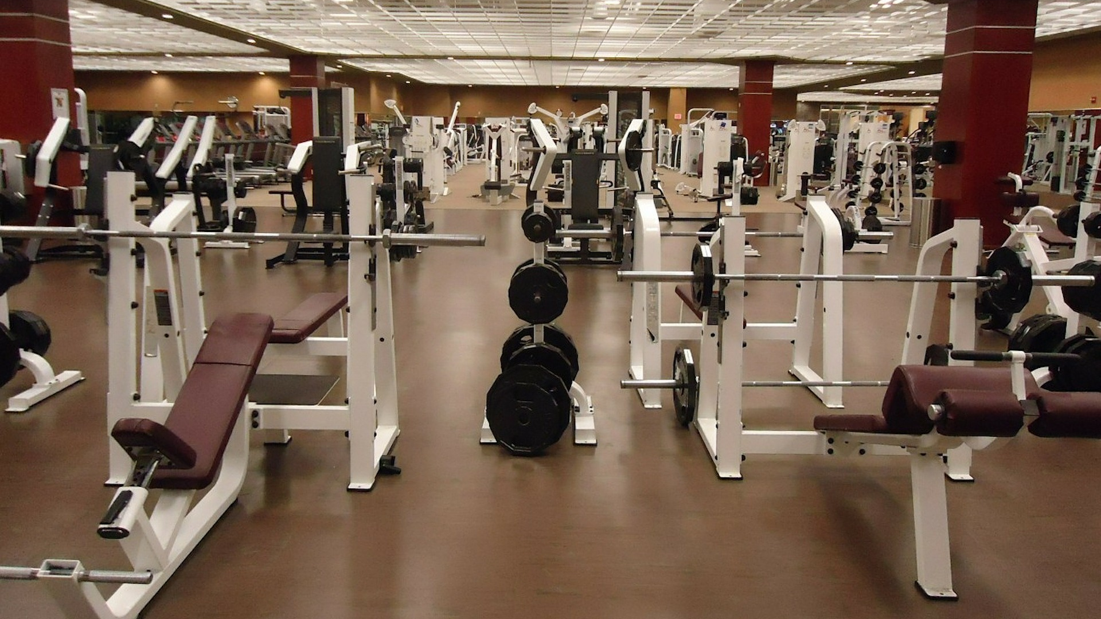
Gym is a covered location for gymnastics, athletics and gymnastic services. The word is derived from the ancient Greek gymnasium They are commonly found in athletic and fitness centers, and as activity and learning spaces in educational institutions.

Slide 4
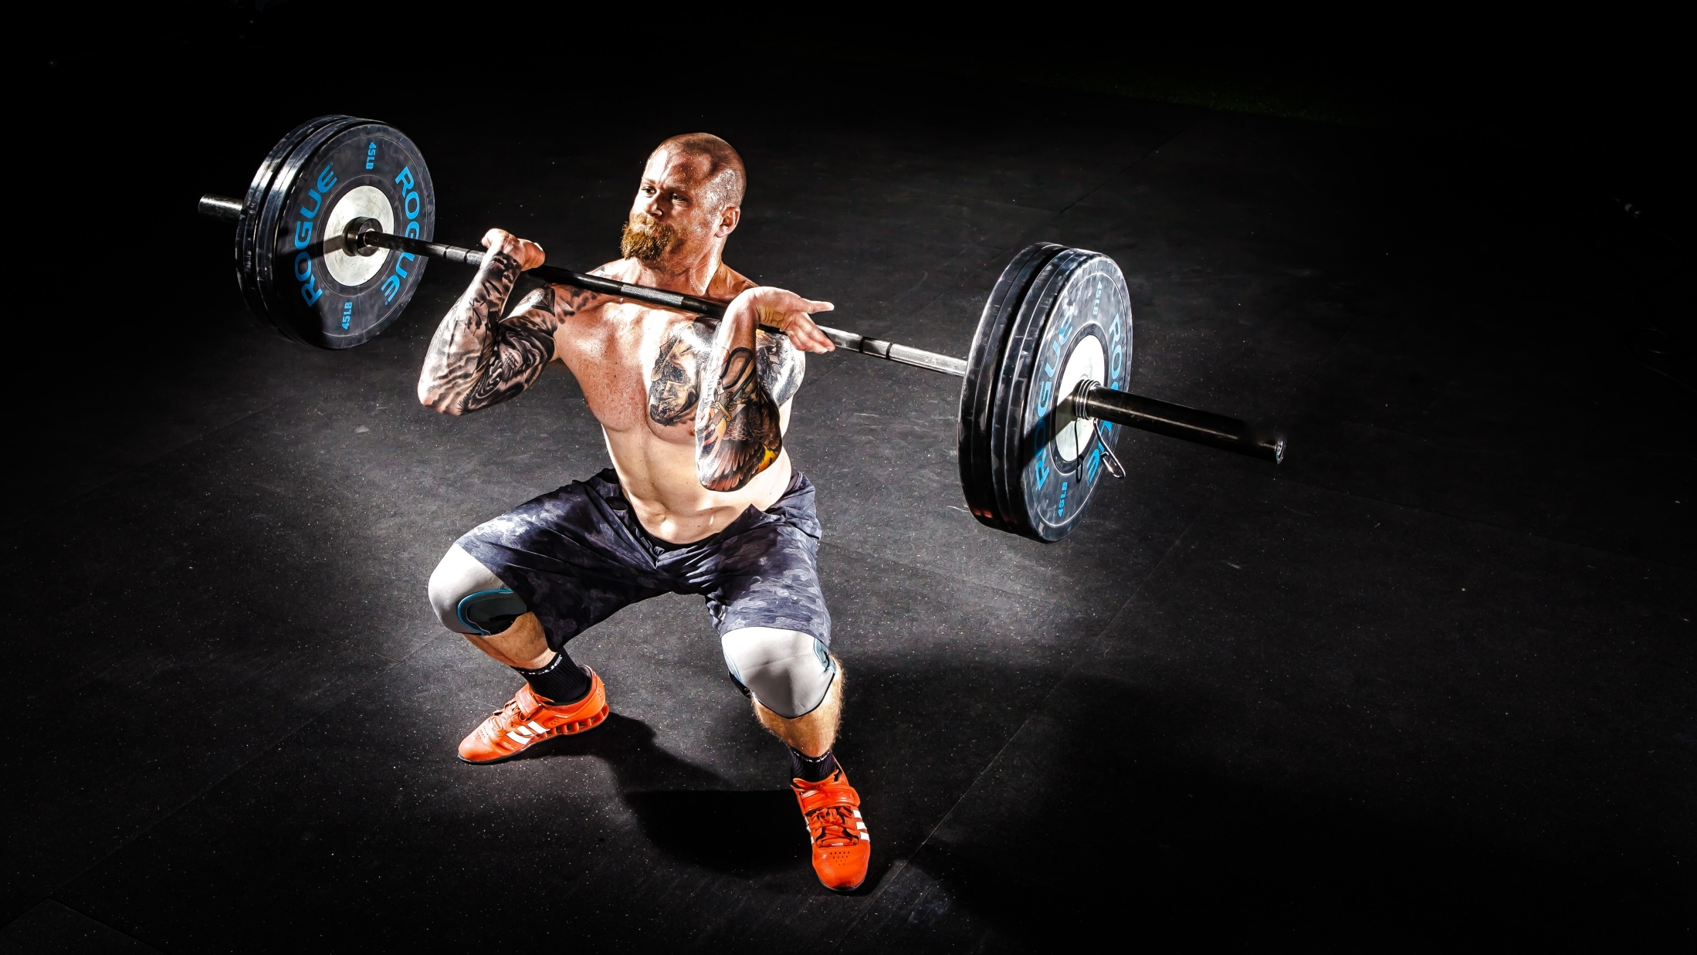
Physical exercise is important for maintaining physical fitness and can contribute to maintaining a healthy weight, regulating the digestive system, building and maintaining healthy bone density, muscle strength, and joint mobility, promoting physiological well-being, reducing surgical risks, and strengthening the immune system,

Slide 5
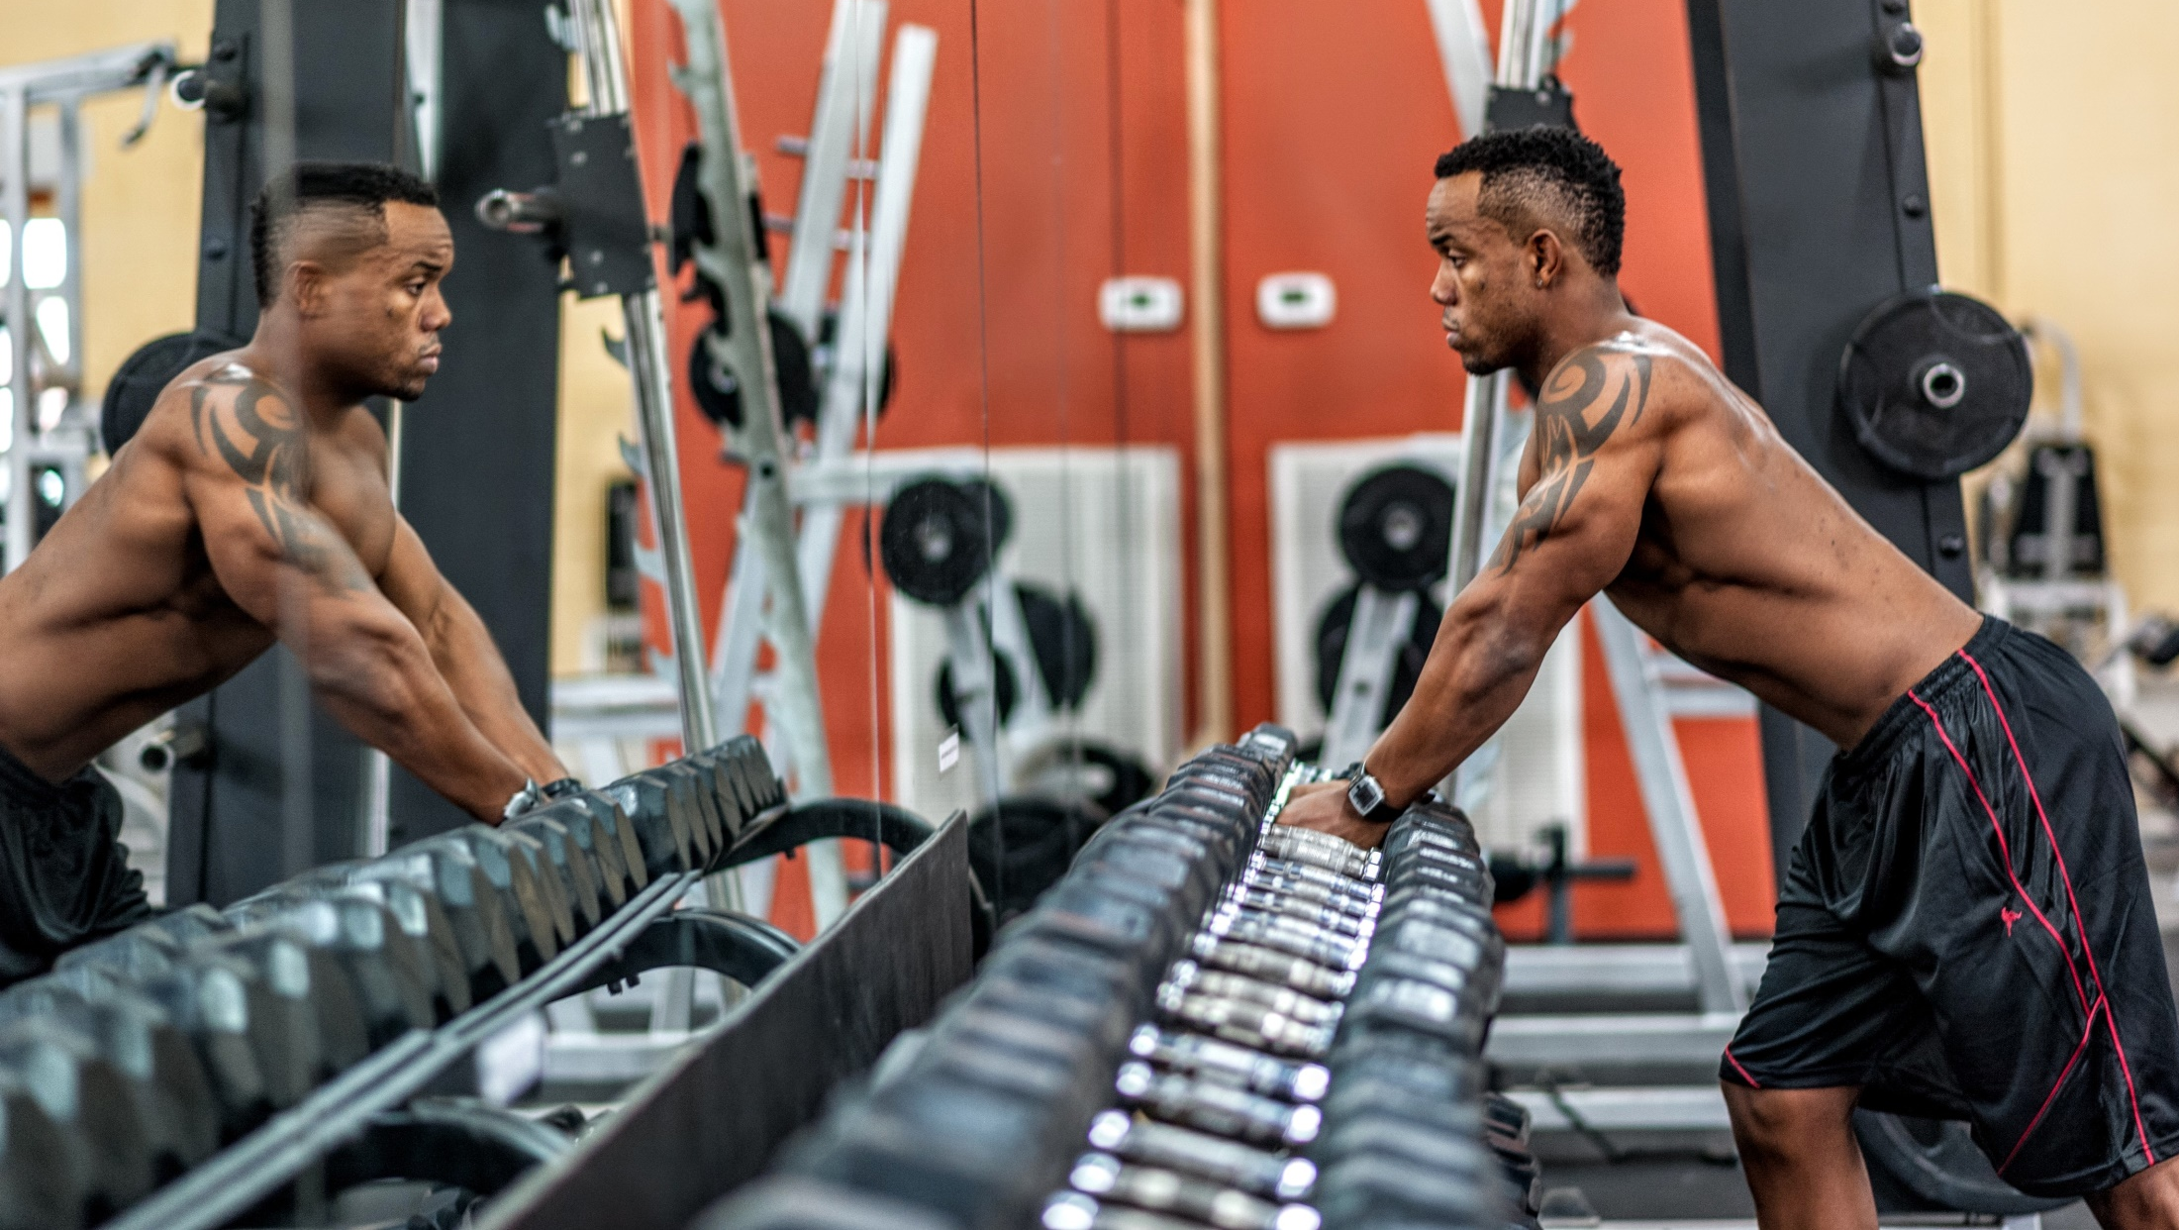
Gym is not only makes you physically fit but also mentally. In this current busy life schedule people are neglecting the most important asset of their life i.e. their own health. Doing gym on routine basis enforces you to eat clean and avoid fast foods, alcohol, smoking etc.

Slide 6

When you work out and stay active on a regular basis, it's not just a coincidence that you feel less stressed out, less anxious, and generally happier.

Slide 7
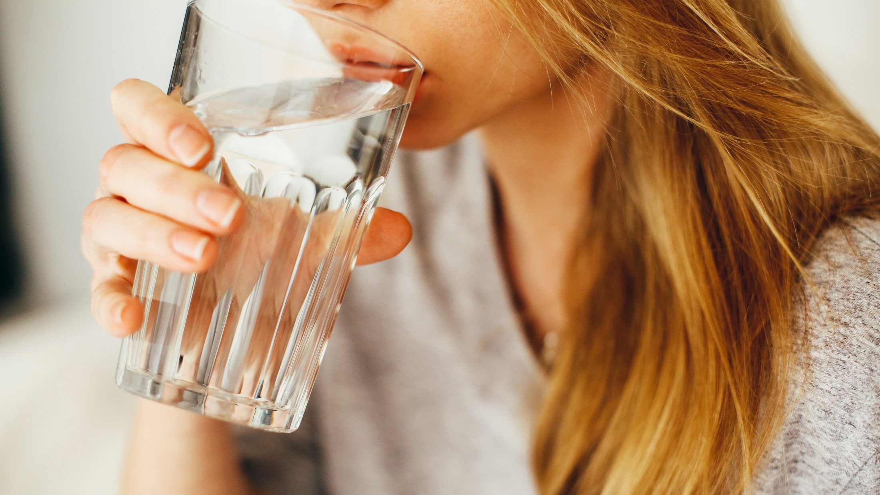
Water is an essential nutrient our body depends upon for optimal health and fitness. It keeps us hydrated and assists with other vital processes at every level of human function.

Slide 8

Smoothie is a thick and creamy beverage made from pureed raw fruit, vegetables, and sometimes dairy products (e.g. milk, yogurt, ice-cream etc.) typically using a blender. And this is very useful for fitness.

Slide 9
Running even five to 10 minutes a day, at slow speeds is associated with a drastically reduced risk of dying from cardiovascular disease, and it make you fell pleasant and active your whole day.

Slide 10
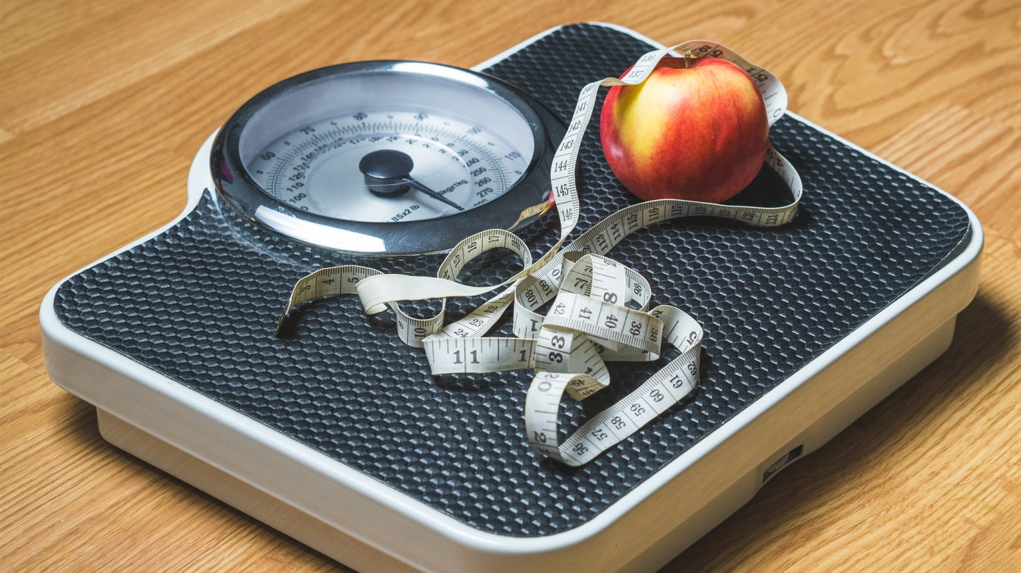
For people who are healthy, a healthy diet is not complicated and contains mostly fruits, vegetables, and whole grains, and includes little to no processed food and sweetened beverages. Fruits also help them in weight lose.

