Slide 1
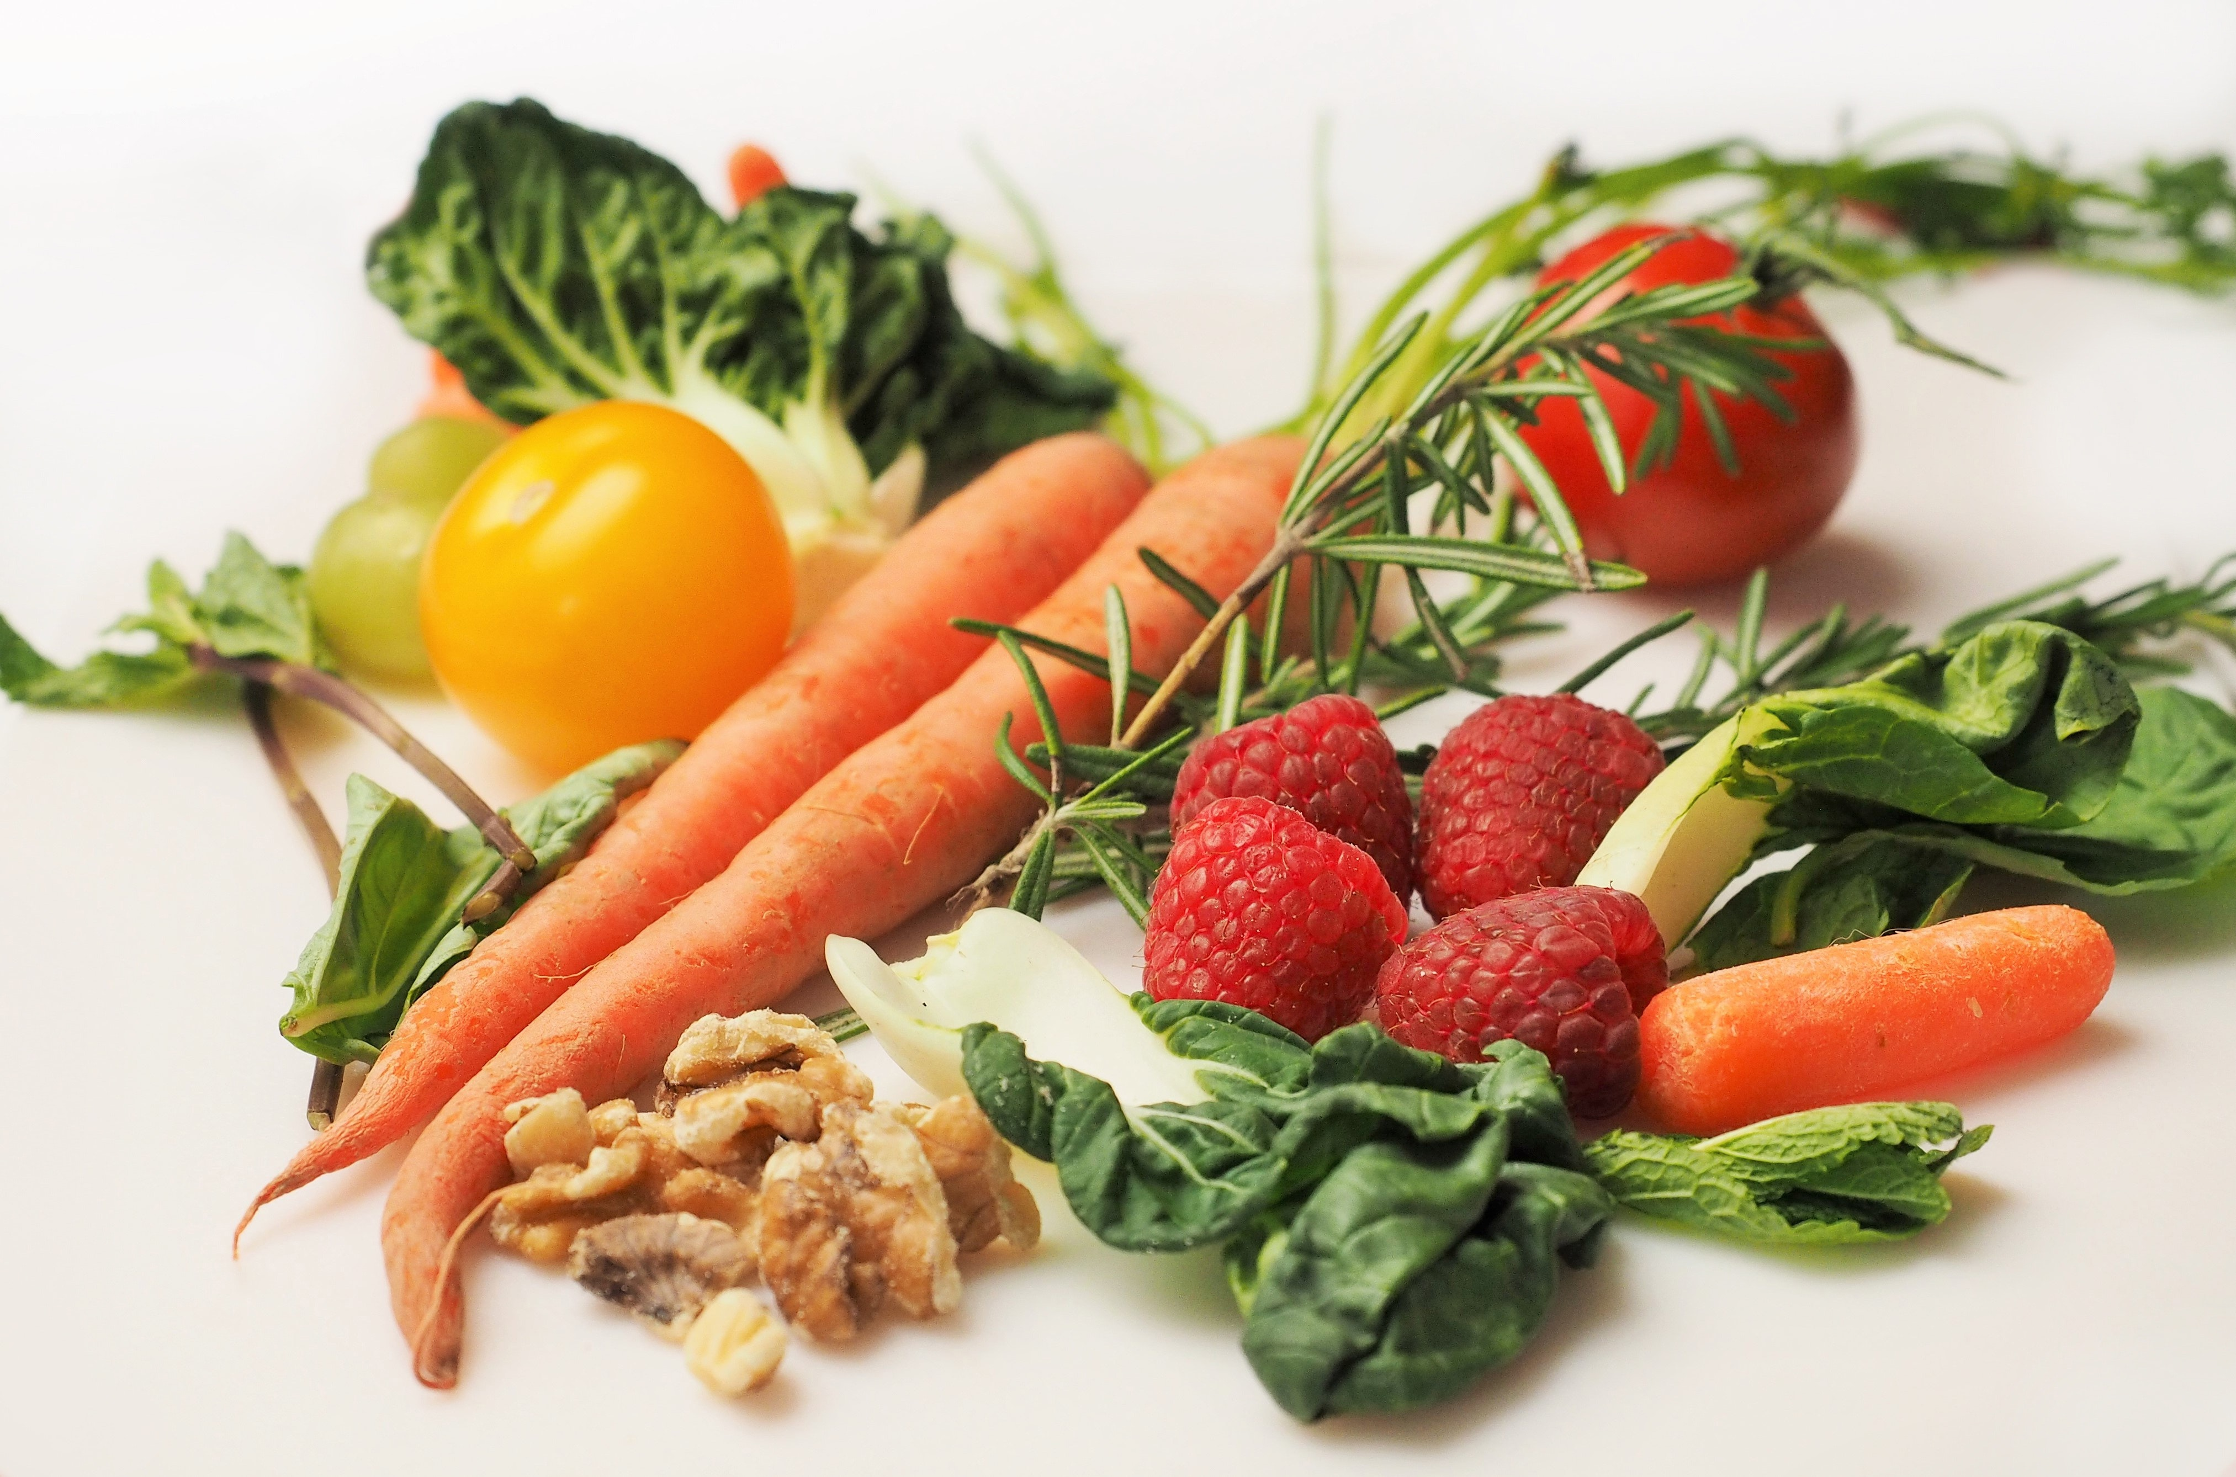
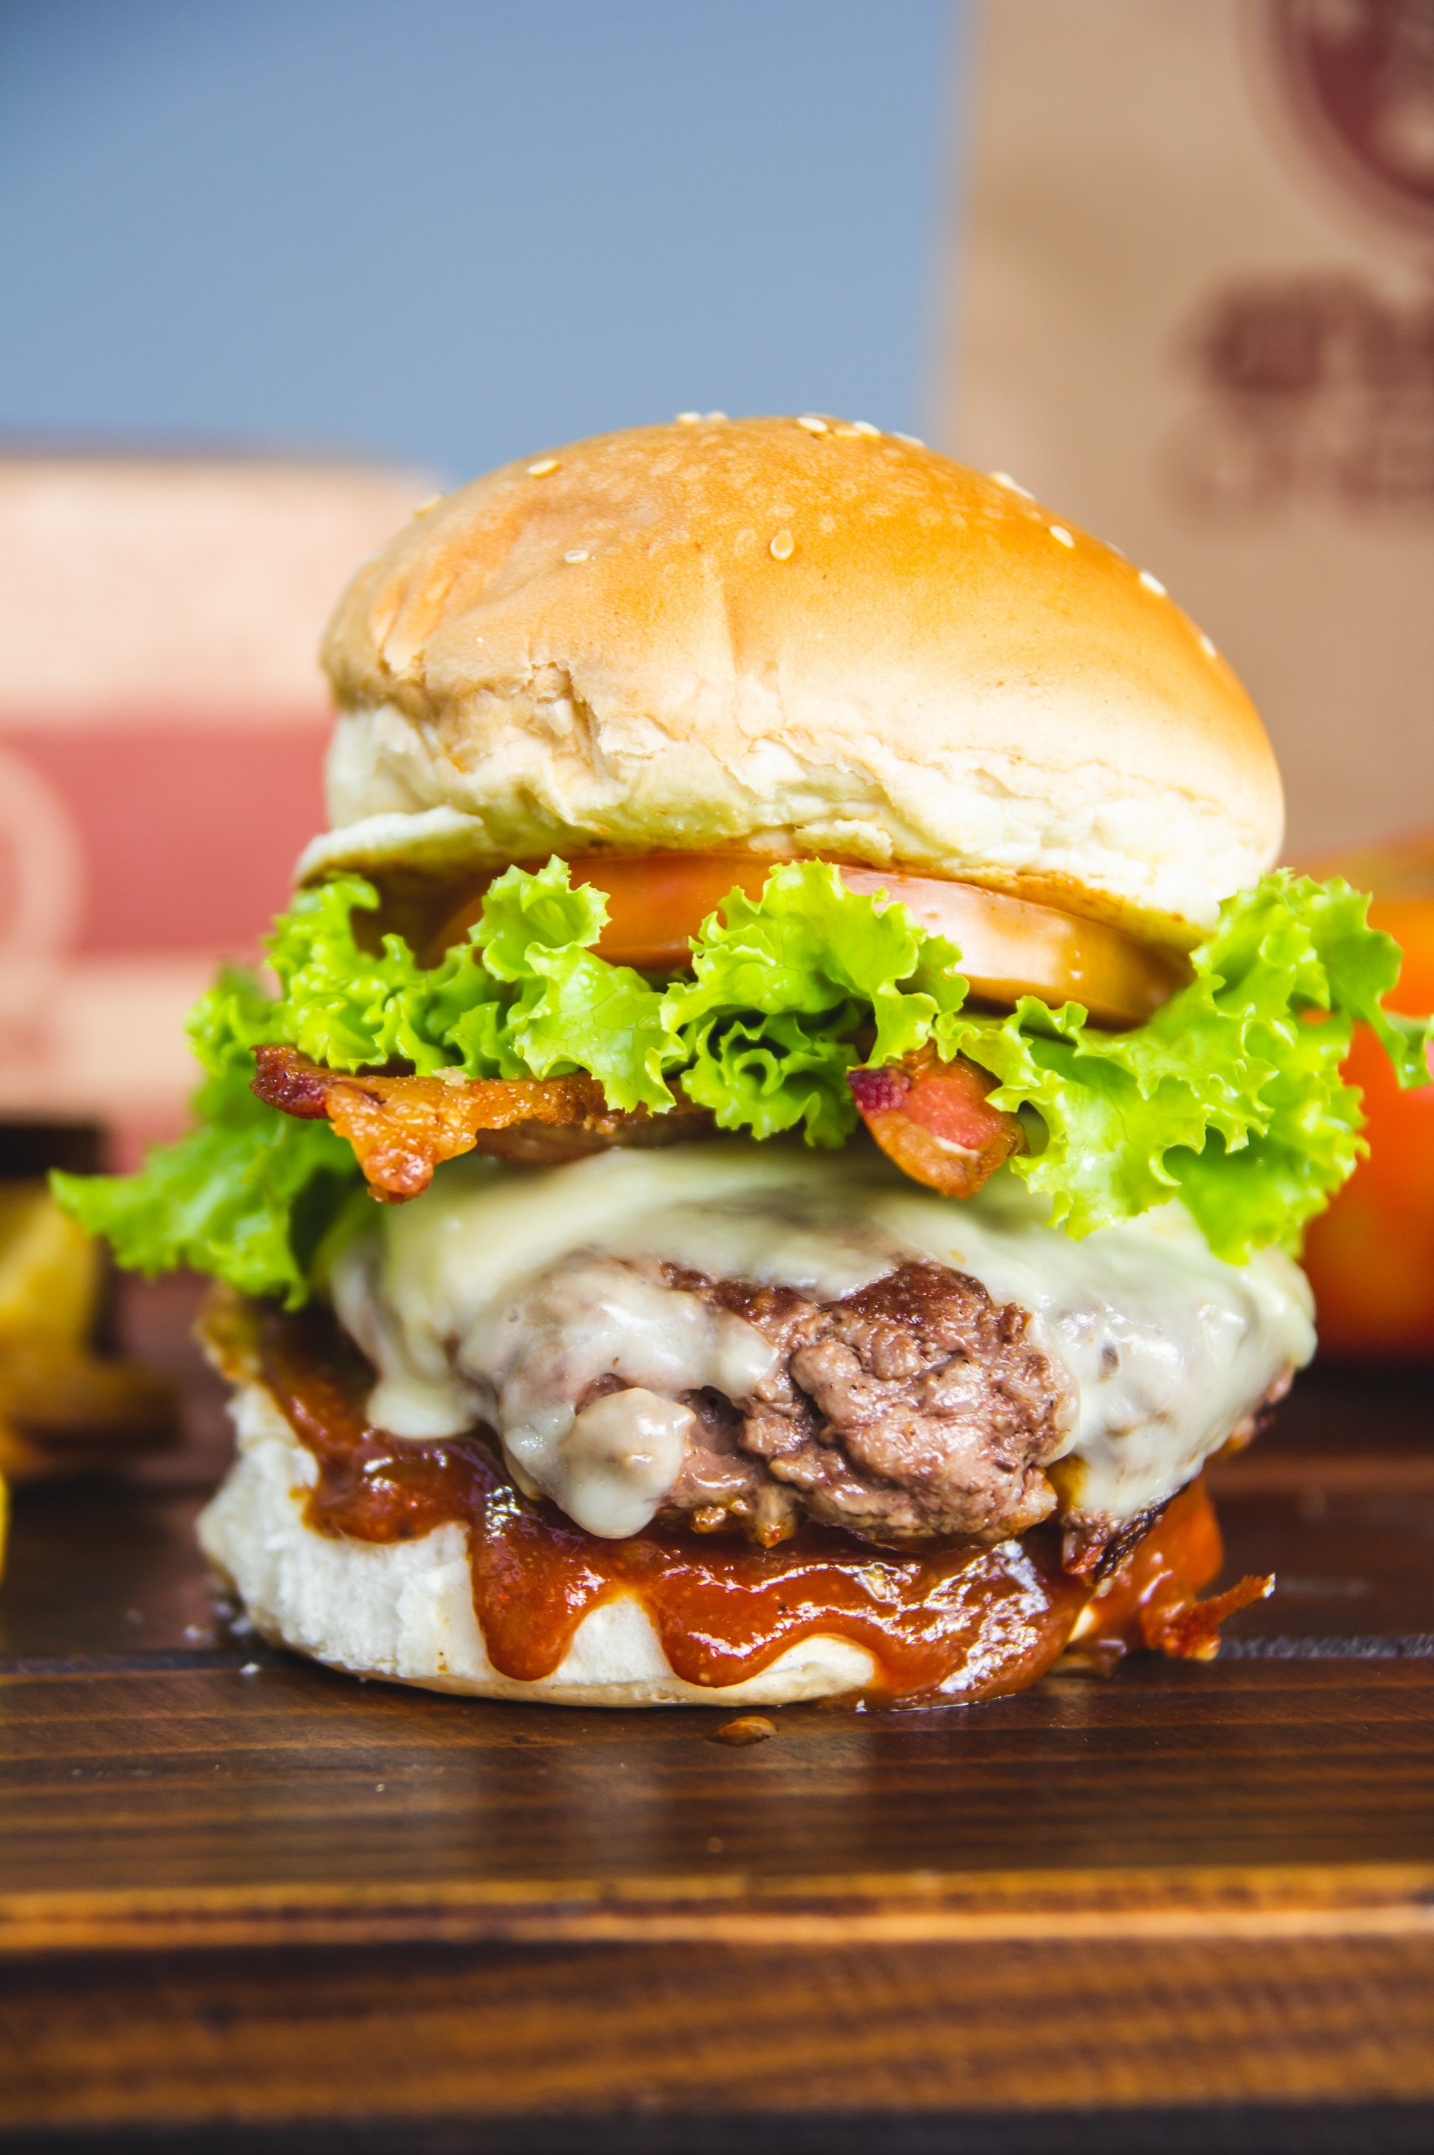
HEALTHY VS FAST FOOD

Slide 2
BALANCED DIET
Diet that helps to maintain or improve overall health.
It must contain all types of food :
Carbohydrates
Fats
Fibers
Proteins
Water

Slide 3
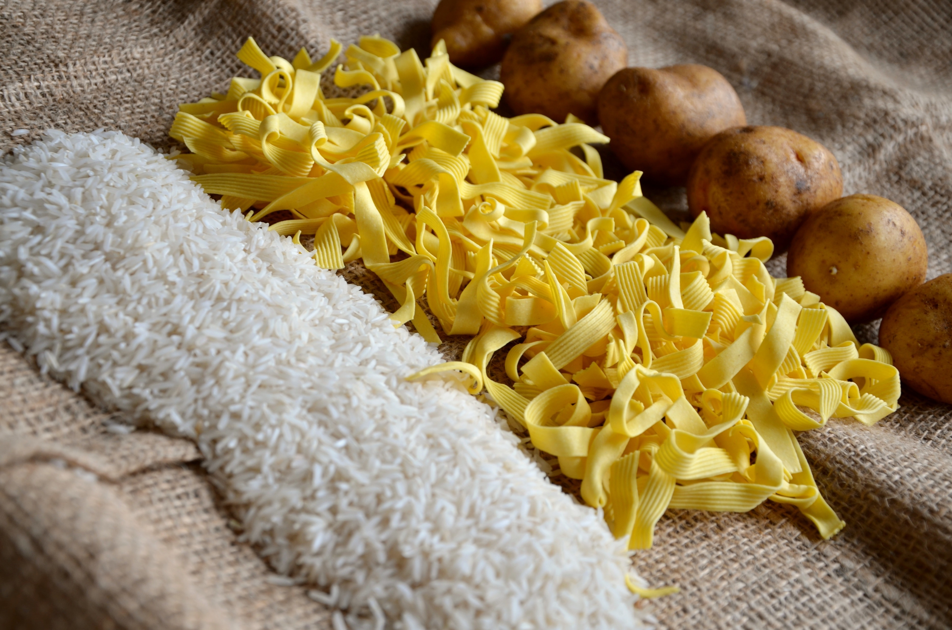
Carbohydrates
Carbohydrates are the sugars, starches and fibers found in fruits, grains, vegetables and milk products
Carbohydrates are often used as a source of energy for the body and are the easiest food parts that are broken down by the body .
Examples :
Rice
Potatoes
Pasta
Bread

Slide 4
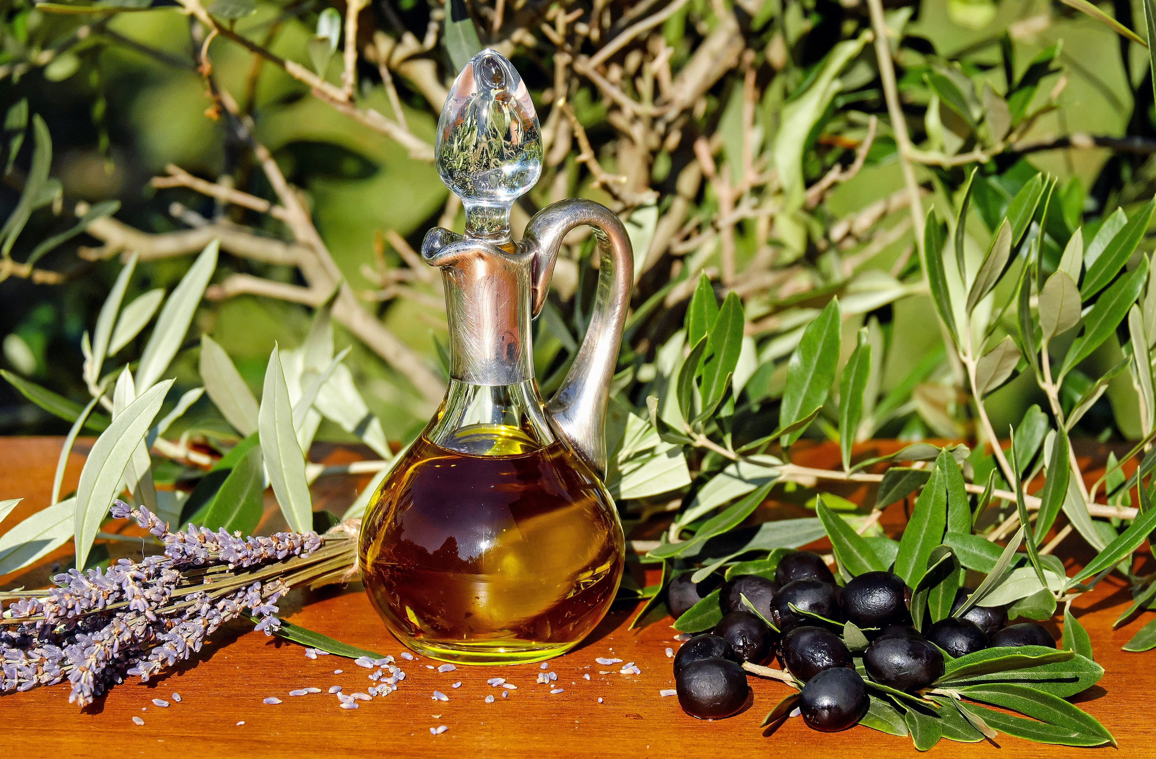
FATS
The body uses fat as a fuel source, and fat is the major storage form of energy in the body
Fats are the hardest substance to be digested by the body
Too much intake of fats always leads to weight gain and most probably may lead to obesity
Examples
Dairy Products
Oil
Avocado
Cheese
Butter

Slide 5
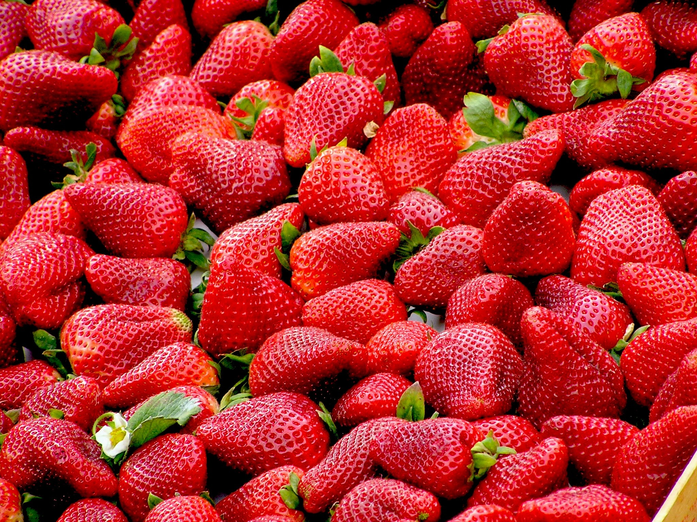

FIBERS
Normalizes bowel movements.
Dietary fiber increases the weight and size of your stool and softens it.
Helps maintain bowel health.
Lowers cholesterol levels.
Helps control blood sugar levels.
Aids in achieving healthy weight.
Examples
Pears
Strawberries
Coconuts
Bananas
Berries

Slide 6
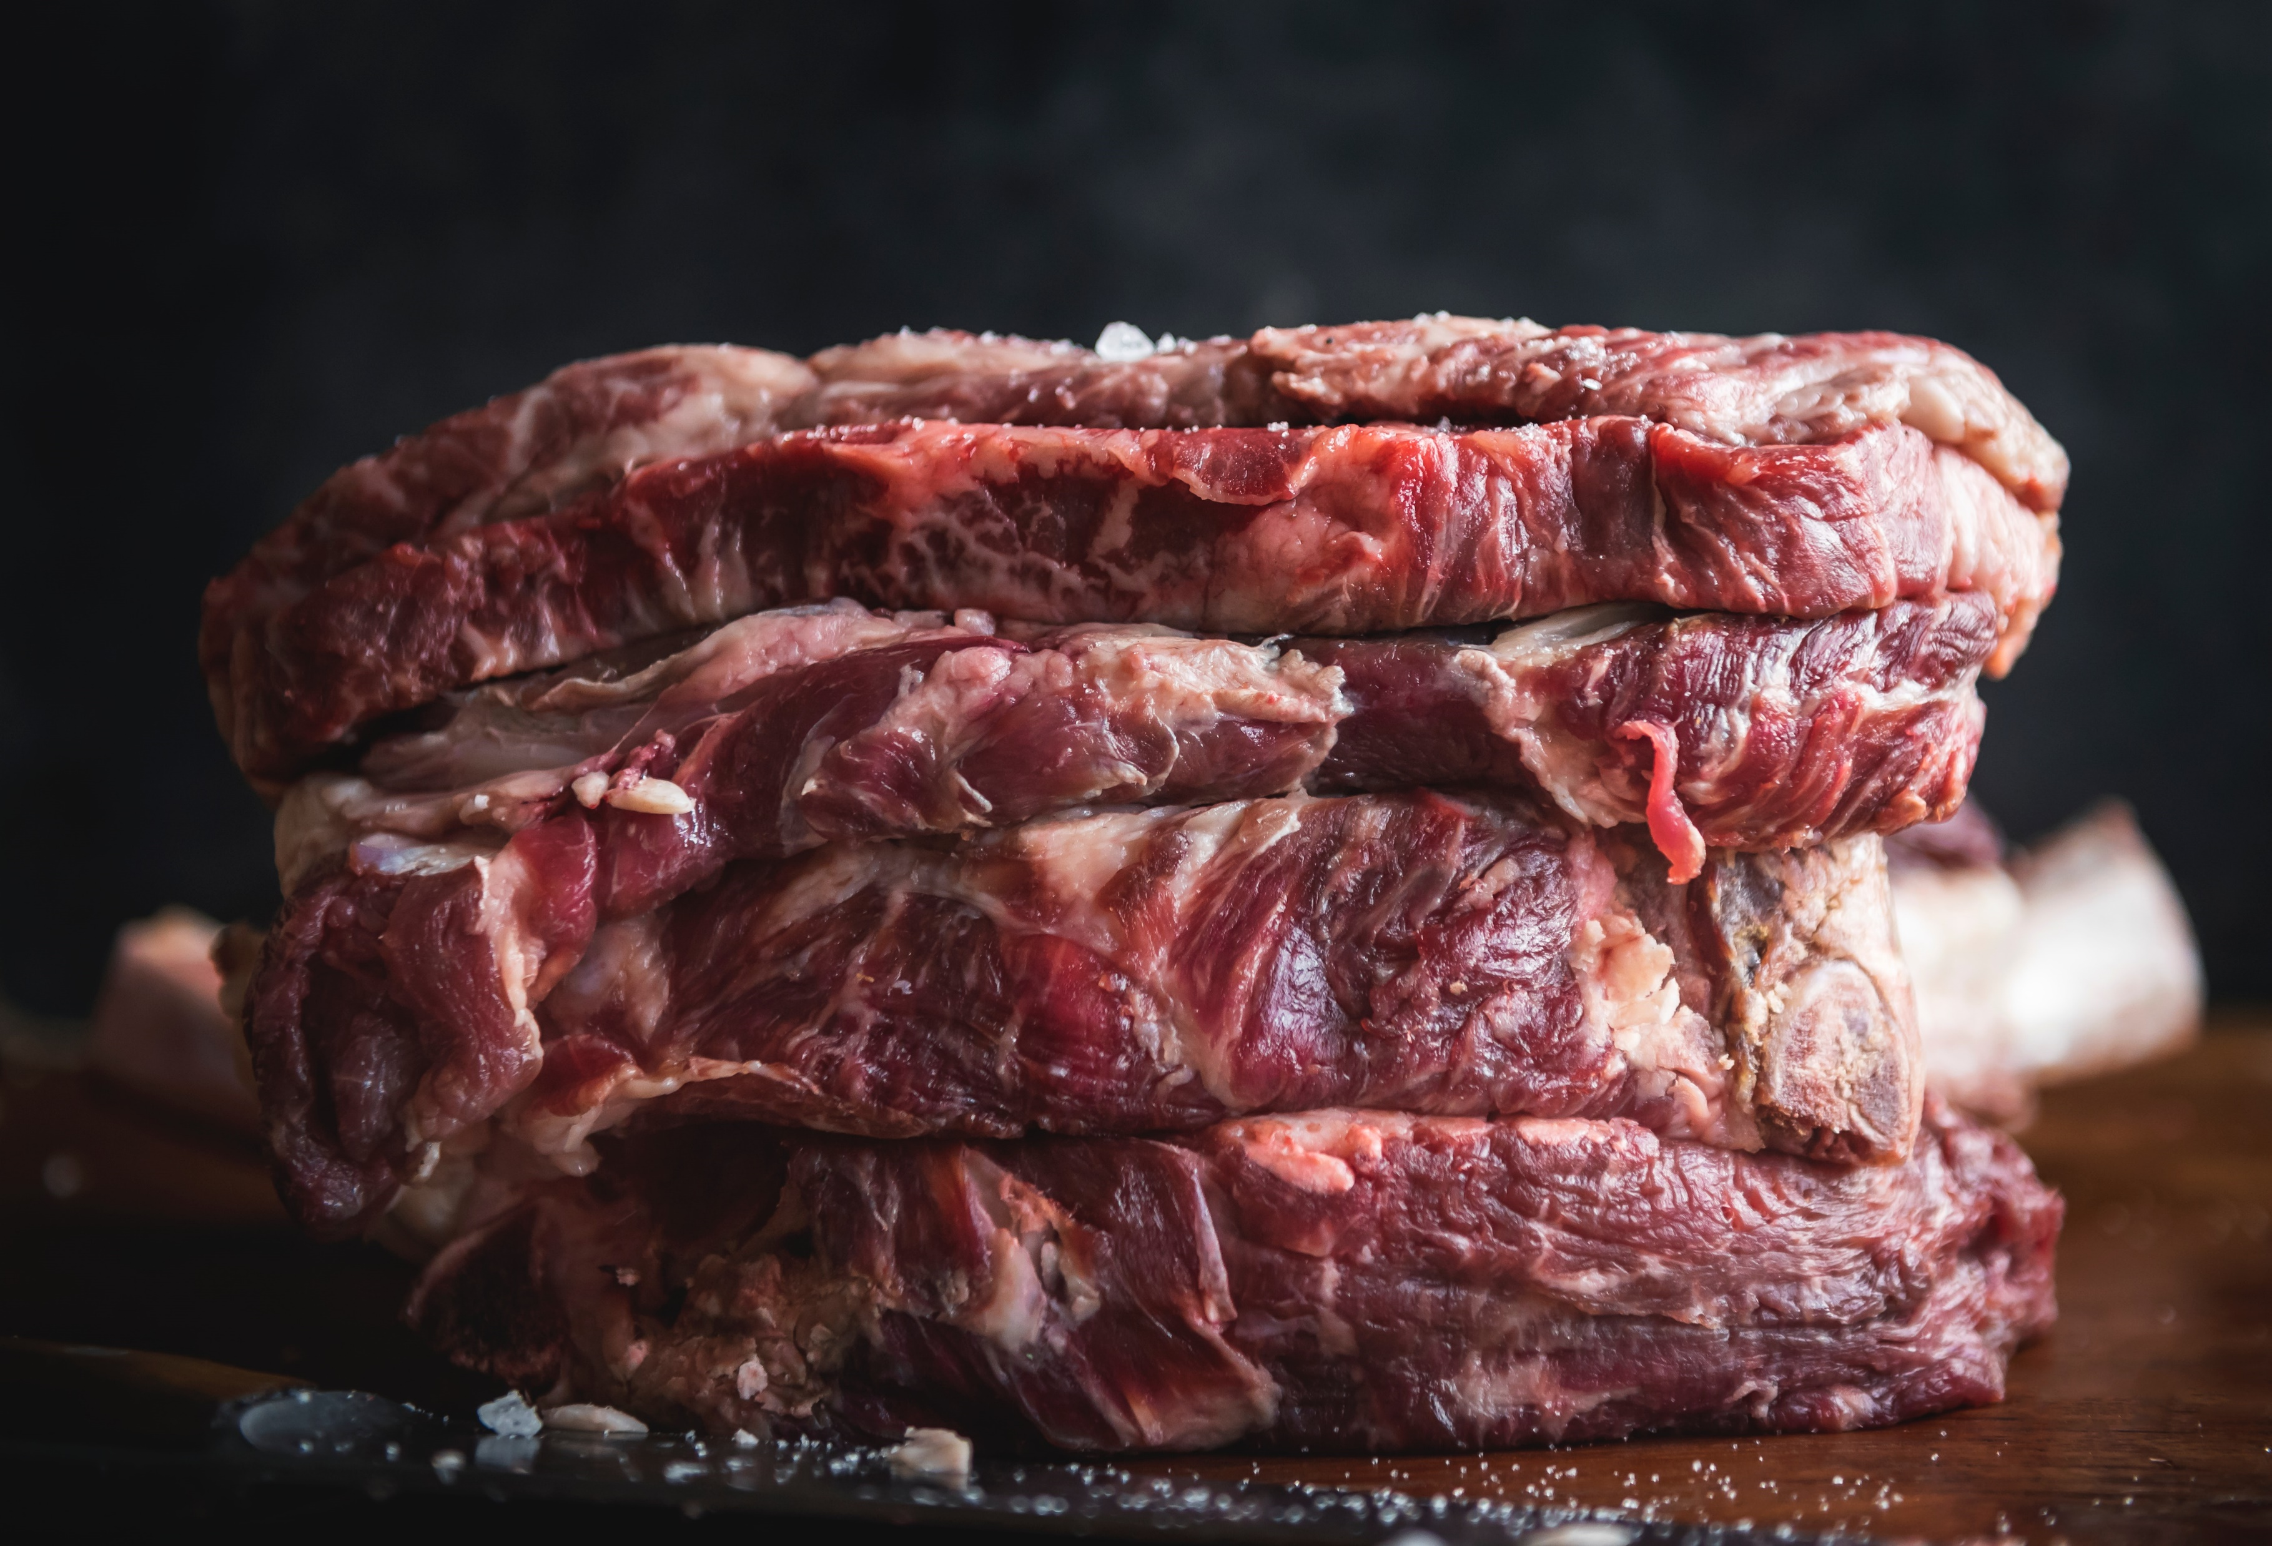
Proteins
Macronutrient that is essential to building muscle mass. It is commonly found in animal products
Composed of amino acids
Most important nutrient for maintaining the structure of the body
Excessive Protein is not healthy for the body because it will not be digest by the body and will lead to obesity
Examples
Chicken
Meat
Fish
Eggs
Seeds and Nuts

Slide 7
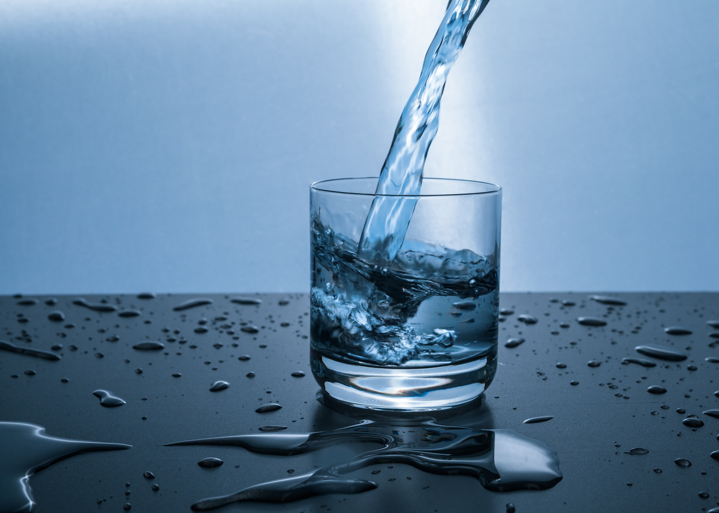
Water
Transparent, tasteless, odorless, and nearly colorless chemical substance,
Up to 70% of the body consists of water
Water is essential for the kidneys and other bodily functions.
In order to remain healthy a per son should drink from 2 to 4 liters of water daily this would cause :
Lubricates the joints
Forms saliva and mucus
Boost skin health
Regulates body temperature
Maintain blood pressure

Slide 8
Maintaining Weight
In order to maintain your weight you should eat a balanced diet which is a diet that contains all types of food that are explained in previous slides
The diet should contain
High carbohydrate and protein intake
Average Fats and Fibers
Drink from 2 to 3 liters of water daily minimum

Slide 9
Losing Weight
In order to loose Weight you to change the portions of the balanced Diet
The Diet should contain
High intake of protein
Average intake of carbohydrates and fibers
Low intakes of Fats
Drink water from 4- 6 liters daily
Cheat meal every 7 Days

Slide 10
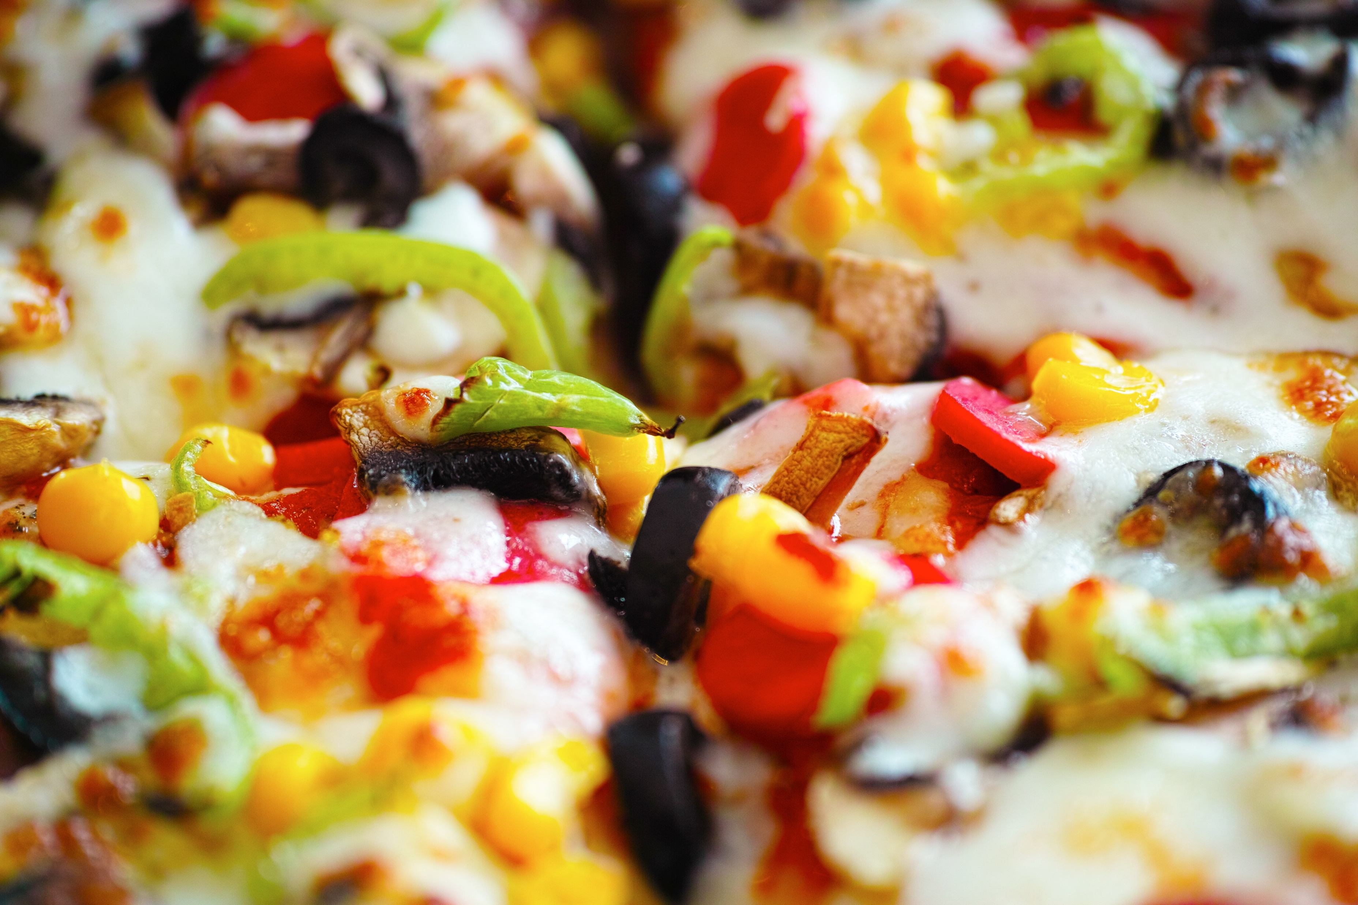
Cheat Meal
Cheat meal is a very important meal while dieting without it your body will stop losing weight because it the only meal that resets the metabolism of your body

Slide 11
THANK YOU

