Slide 1

IT IS VERY EXPENSIVE TO GIVE BAD MEDICAL CARE TO POOR PEOPLE IN A RICH COUNTRY.

Slide 2

ONE-STOP HOME
HEALTH CARE PROVIDER
DOCTORS | NURSES | MEDICAL ATTENDANT | PHYSIOTHERAPIST | ELDERLY CARETAKER

Slide 3

ABOUT SQUARE
01
02
WE PRACTICE MEDICINE
WE HELP PATIENTS
Watch this slideshow about fibromyalgia (fibrositis) with pictures about this chronic condition that causes pain and stiffness of the tendons, muscles, and joints. Watch this slideshow about. Watch this slideshow about fibromyalgia (fibrositis) with pictures about this chronic condition that causes pain and stiffness of the tendons, muscles, and joints. Watch this slideshow about.
Watch this slideshow about fibromyalgia (fibrositis) with pictures about this chronic condition that causes pain and stiffness of the tendons, muscles, and joints. Watch this slideshow about. Watch this slideshow about fibromyalgia (fibrositis) with pictures about this chronic condition that causes pain and stiffness of the tendons, muscles, and joints. Watch this slideshow about.

Slide 4

ABOUT OUR HOSPITAL
01
WE PRACTICE MEDICINE
THINK OF EXERCISE AS MEDICINE AND TAKE YOUR DAILY PRESCRIPTION.
Watch this slideshow about fibromyalgia (fibrositis) with pictures about this chronic condition that causes pain and stiffness of the tendons, muscles, and joints. Watch this slideshow about. Watch this slideshow about fibromyalgia (fibrositis) with pictures. Watch this slideshow about fibromyalgia (fibrositis) with pictures about this chronic condition.
02
WE HELP PATIENTS
Watch this slideshow about fibromyalgia (fibrositis) with pictures about this chronic condition that causes pain and stiffness of the tendons, muscles, and joints. Watch this slideshow about. Watch this slideshow about fibromyalgia (fibrositis) with pictures.

Slide 5
ISN'T IT A BIT UNNERVING THAT DOCTORS CALL WHAT THEY DO PRACTICE?

Slide 6

ISN'T IT A BIT UNNERVING THAT DOCTORS CALL WHAT THEY DO “PRACTICE”?

Slide 7


EVA STARK
DOCTOR
“THIS FRIEND OF HIS HAD FIRST ARRIVED ON THE
PLANET SOME FIFTEEN EARTH YEARS PREVIOUSLY, AND HE HAD WORKED HARD TO BLEND HIMSELF INTO”

Slide 8

THIS FRIEND OF HIS HAD FIRST ARRIVED ON THE
PLANET SOME FIFTEEN EARTH YEARS PREVIOUSLY, AND HE HAD WORKED HARD TO BLEND HIMSELF INTO”
EVA STARK
DOCTOR

Slide 9

ISN'T IT A BIT UNNERVING THAT DOCTORS CALL WHAT THEY DO PRACTICE?

Slide 10

THINK OF EXERCISE AS MEDICINE AND TAKE YOUR DAILY PRESCRIPTION.
MEDICAL ATTENDANT
MEDICAL ATTENDANT
MEDICAL ATTENDANT
Watch this slideshow about fibromyalgia (fibrositis) with pictures about this chronic condition that causes pain and stiffness of the tendons, muscles, and joints. Watch this slideshow about.
Watch this slideshow about fibromyalgia (fibrositis) with pictures about this chronic condition that causes pain and stiffness of the tendons, muscles, and joints. Watch this slideshow about.
Watch this slideshow about fibromyalgia (fibrositis) with pictures about this chronic condition that causes pain and stiffness of the tendons, muscles, and joints. Watch this slideshow about.

Slide 11

MEDICAL
PORTFOLIO
Watch this slideshow about fibromyalgia (fibrositis) with pictures about this chronic condition that causes pain and stiffness of the tendons, muscles, and joints. Watch this slideshow about. Watch this slideshow about fibromyalgia (fibrositis) with pictures about this chronic condition that causes pain and stiffness of the tendons, muscles, and joints. Watch this slideshow about.
MEDICAL ATTENDANT
MEDICAL ATTENDANT
MEDICAL ATTENDANT

Slide 12



MEDICAL
PORTFOLIO
MEDICAL ATTENDANT
Watch this slideshow about fibromyalgia (fibrositis) with pictures about this chronic condition that causes pain and stiffness of the tendons, muscles, and joints. Watch this slideshow about.
MEDICAL ATTENDANT
Watch this slideshow about fibromyalgia (fibrositis) with pictures about this chronic condition that causes pain and stiffness of the tendons, muscles, and joints. Watch this slideshow about.
MEDICAL TREATMENT
Watch this slideshow about fibromyalgia (fibrositis) with pictures about this chronic condition that causes pain and stiffness of the tendons, muscles, and joints. Watch this slideshow about.

Slide 13

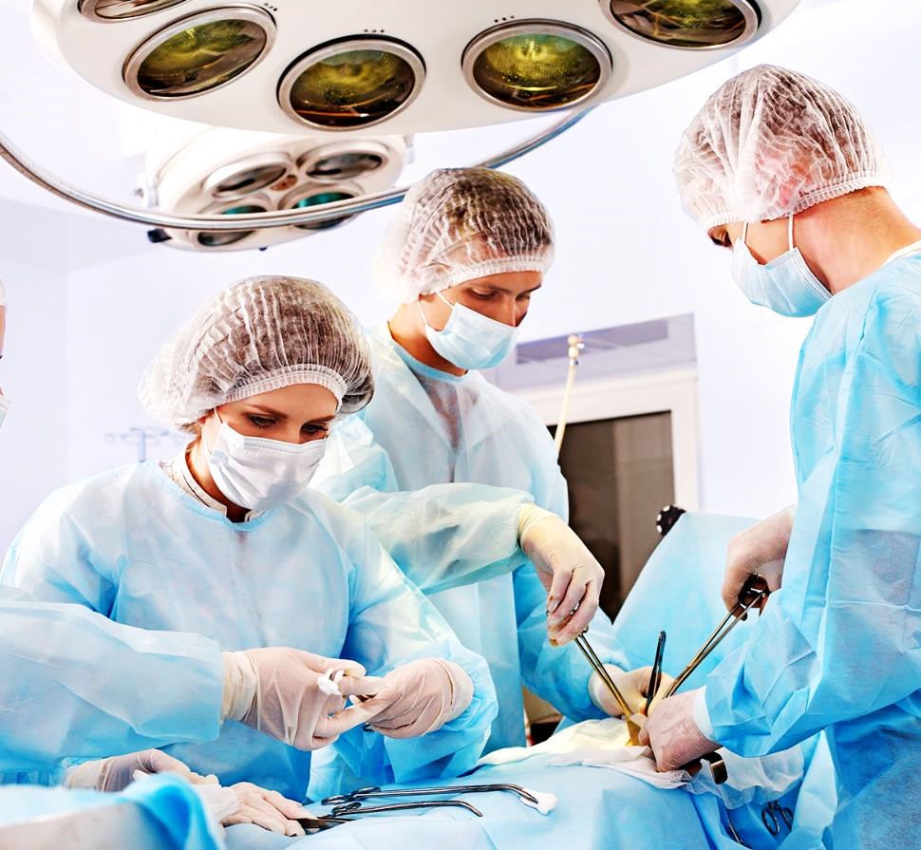



MEDICAL PORTFOLIO
01
02
WE PRACTICE MEDICINE
WE HELP PATIENTS
Watch this slideshow about fibromyalgia (fibrositis) with pictures about this chronic condition that causes pain and stiffness of the tendons, muscles, and joints. Watch this slideshow about. Watch this slideshow about fibromyalgia (fibrositis) with pictures about this chronic condition that causes pain and stiffness of the tendons, muscles, and joints. Watch this slideshow about.
Watch this slideshow about fibromyalgia (fibrositis) with pictures about this chronic condition that causes pain and stiffness of the tendons, muscles, and joints. Watch this slideshow about. Watch this slideshow about fibromyalgia (fibrositis) with pictures about this chronic condition that causes pain and stiffness of the tendons, muscles, and joints. Watch this slideshow about.

Slide 14

MEDICAL
PORTFOLIO
MEDICAL ATTENDANT
Watch this slideshow about fibromyalgia (fibrositis) with pictures about this chronic condition that causes pain and stiffness of the tendons, muscles, and joints. Watch this slideshow about.
MEDICAL TREATMENT
Watch this slideshow about fibromyalgia (fibrositis) with pictures about this chronic condition that causes pain and stiffness of the tendons, muscles, and joints. Watch this slideshow about.

Slide 15



CHRONIC PAIN CENTER
MEDICAL ATTENDANT
MEDICAL ATTENDANT
MEDICAL ATTENDANT
Watch this slideshow about fibromyalgia (fibrositis) with pictures about this chronic condition that causes pain and stiffness of the tendons, muscles, and joints. Watch this slideshow about.
Watch this slideshow about fibromyalgia (fibrositis) with pictures about this chronic condition that causes pain and stiffness of the tendons, muscles, and joints. Watch this slideshow about.
Watch this slideshow about fibromyalgia (fibrositis) with pictures about this chronic condition that causes pain and stiffness of the tendons, muscles, and joints. Watch this slideshow about.

Slide 16
CHRONIC PAIN HEALTH CENTER
MEDICAL ATTENDANT
Watch this slideshow about fibromyalgia (fibrositis) with pictures about this chronic condition that causes pain and stiffness of the tendons, muscles, and joints. Watch this slideshow about.
MEDICAL TREATMENT
Watch this slideshow about fibromyalgia (fibrositis) with pictures about this chronic condition that causes pain and stiffness of the tendons, muscles, and joints. Watch this slideshow about.

Slide 17

MEDICAL PORTFOLIO
MEDICAL ATTENDANT

Slide 18
MEDICAL PORTFOLIO
MEDICAL ATTENDANT
MEDICAL ATTENDANT

Slide 19
MEDICAL PORTFOLIO
MEDICAL ATTENDANT
Watch this slideshow about fibromyalgia (fibrositis) with pictures about this chronic condition that causes pain and stiffness of the tendons, muscles, and joints. Watch this slideshow about.
MEDICAL ATTENDANT
Watch this slideshow about fibromyalgia (fibrositis) with pictures about this chronic condition that causes pain and stiffness of the tendons, muscles, and joints. Watch this slideshow about.
MEDICAL TREATMENT
Watch this slideshow about fibromyalgia (fibrositis) with pictures about this chronic condition that causes pain and stiffness of the tendons, muscles, and joints. Watch this slideshow about.

Slide 20

DOUBLE HELIX
CHEST PAIN
SHORTNESS OF BREATH
FAINTING
Watch this slideshow about fibromyalgia (fibrositis) with pictures about this chronic condition that causes pain and stiffness of the tendons, muscles, and joints. Watch this slideshow about.
Watch this slideshow about fibromyalgia (fibrositis) with pictures about this chronic condition that causes pain and stiffness of the tendons, muscles, and joints. Watch this slideshow about.
Watch this slideshow about fibromyalgia (fibrositis) with pictures about this chronic condition that causes pain and stiffness of the tendons, muscles, and joints. Watch this slideshow about.

Slide 21


MEDICAL PORTFOLIO
MEDICAL ATTENDANT
Watch this slideshow about fibromyalgia (fibrositis) with pictures about this chronic condition that causes pain and stiffness of the tendons, muscles, and joints. Watch this slideshow about.

Slide 22
MEDICAL PORTFOLIO
MEDICAL ATTENDANT
MEDICAL ATTENDANT
MEDICAL ATTENDANT
MEDICAL ATTENDANT

Slide 23



CARING
ABOUT OUR
PATIENT
MEDICAL ATTENDANT
Watch this slideshow about fibromyalgia (fibrositis) with pictures about this chronic condition that causes pain and stiffness of the tendons, muscles, and joints. Watch this slideshow about.
MEDICAL TREATMENT
Watch this slideshow about fibromyalgia (fibrositis) with pictures about this chronic condition that causes pain and stiffness of the tendons, muscles, and joints. Watch this slideshow about.

Slide 24

DR. WALTON
CARDIOLOGIST
Watch this slideshow about fibromyalgia (fibrositis) with pictures about this chronic condition that causes pain and stiffness of the tendons, muscles, and joints. Watch this slideshow about. Watch this slideshow about fibromyalgia (fibrositis) with pictures. Watch this slideshow about fibromyalgia (fibrositis) with pictures about this chronic condition.
Experience
Expertise
Education
Success Rate

Slide 25



DOCTOR’S TEAM
DOMINICK NORMAN
PATTI HAMILTON
MELISSA SHAW
CARDIOLOGIST
CARDIOLOGIST
CARDIOLOGIST
Watch this slideshow about fibromyalgia (fibrositis) with pictures about this chronic condition that causes pain and stiffness of the tendons.
Watch this slideshow about fibromyalgia (fibrositis) with pictures about this chronic condition that causes pain and stiffness of the tendons.
Watch this slideshow about fibromyalgia (fibrositis) with pictures about this chronic condition that causes pain and stiffness of the tendons.

Slide 26
DOCTOR’S TEAM
DOMINICK NORMAN
PATTI HAMILTON
MELISSA SHAW
MELISSA SHAW
CARDIOLOGIST
CARDIOLOGIST
CARDIOLOGIST
CARDIOLOGIST
DOMINICK NORMAN
PATTI HAMILTON
MELISSA SHAW
MELISSA SHAW
CARDIOLOGIST
CARDIOLOGIST
CARDIOLOGIST
CARDIOLOGIST

Slide 27
HEART DISEASES
CHEST PAIN
Watch this slideshow about fibromyalgia (fibrositis) with pictures about this chronic condition that causes pain and stiffness of the tendons, muscles, and joints. Watch this slideshow about.
SHORTNESS OF BREATH
Watch this slideshow about fibromyalgia (fibrositis) with pictures about this chronic condition that causes pain and stiffness of the tendons, muscles, and joints. Watch this slideshow about.
FAINTING
Watch this slideshow about fibromyalgia (fibrositis) with pictures about this chronic condition that causes pain and stiffness of the tendons, muscles, and joints. Watch this slideshow about.

Slide 28



MEDICAL PORTFOLIO
MEDICAL
ATTENDANT
MEDICAL
ATTENDANT
MEDICAL
ATTENDANT
MEDICAL
ATTENDANT
Watch this slideshow for a about fibromyalgia with pictures about this chronic condition
Watch this slideshow for a about fibromyalgia with pictures about this chronic condition
Watch this slideshow for a about fibromyalgia with pictures about this chronic condition
Watch this slideshow for a about fibromyalgia with pictures about this chronic condition

Slide 29
HEART DISEASES
CHEST PAIN
Watch this slideshow about fibromyalgia (fibrositis) with pictures about this chronic condition that causes pain and stiffness of the tendons, muscles, and joints. Watch this slideshow about.
SHORTNESS OF BREATH
Watch this slideshow about fibromyalgia (fibrositis) with pictures about this chronic condition that causes pain and stiffness of the tendons, muscles, and joints. Watch this slideshow about.
FAINTING
Watch this slideshow about fibromyalgia (fibrositis) with pictures about this chronic condition that causes pain and stiffness of the tendons, muscles, and joints. Watch this slideshow about.

Slide 30
HEART DISEASES
YOUR TITLE HERE
YOUR TITLE HERE
Watch this slideshow about fibromyalgia (fibrositis) with pictures about this chronic condition that causes pain and stiffness of the tendons.
Watch this slideshow about fibromyalgia (fibrositis) with pictures about this chronic condition that causes pain and stiffness of the tendons.
YOUR TITLE HERE
YOUR TITLE HERE
Watch this slideshow about fibromyalgia (fibrositis) with pictures about this chronic condition that causes pain and stiffness of the tendons.
Watch this slideshow about fibromyalgia (fibrositis) with pictures about this chronic condition that causes pain and stiffness of the tendons.

Slide 31

GROWTH REPORT
SPECULATION
GROWTH
SAFETY AND INCOME
Watch this slideshow about fibromyalgia (fibrositis) with pictures about this chronic condition that causes pain and stiffness of the tendons, muscles, and joints. Watch this slideshow about.
SAFETY AND INCOME
FINANCIAL SECURITY

Slide 32
KEY FACTORS
YOUR TITLE HERE
YOUR TITLE HERE
DUMMY
Watch this slideshow about fibromyalgia (fibrositis) with pictures about this chronic condition that causes pain and stiffness of the tendons.
Watch this slideshow about fibromyalgia (fibrositis) with pictures about this chronic condition that causes pain and stiffness of the tendons.
DUMMY
YOUR TITLE HERE
YOUR TITLE HERE
DUMMY
Watch this slideshow about fibromyalgia (fibrositis) with pictures about this chronic condition that causes pain and stiffness of the tendons.
Watch this slideshow about fibromyalgia (fibrositis) with pictures about this chronic condition that causes pain and stiffness of the tendons.
DUMMY

Slide 33
HEART DISEASES
CHEST PAIN
SHORTNESS OF BREATH
Watch this slideshow about fibromyalgia (fibrositis) with pictures about this chronic condition that causes pain and stiffness of the tendons, muscles, and joints. Watch this slideshow about.
Watch this slideshow about fibromyalgia (fibrositis) with pictures about this chronic condition that causes pain and stiffness of the tendons, muscles, and joints. Watch this slideshow about.
FAINTING
FAINTING
Watch this slideshow about fibromyalgia (fibrositis) with pictures about this chronic condition that causes pain and stiffness of the tendons, muscles, and joints. Watch this slideshow about.
Watch this slideshow about fibromyalgia (fibrositis) with pictures about this chronic condition that causes pain and stiffness of the tendons, muscles, and joints. Watch this slideshow about.

Slide 34
KEY FACTORS
KEYWORD
KEYWORD
KEYWORD
KEYWORD
KEYWORD
WE PRACTICE MEDICINE
Watch this slideshow about fibromyalgia (fibrositis) with pictures about this chronic condition that causes pain and stiffness of the tendons, muscles, and joints. Watch this slideshow about. Watch this slideshow about fibromyalgia (fibrositis) with pictures about this chronic condition that causes pain and stiffness of the tendons, muscles, and joints. Watch this slideshow about.

Slide 35
MEDICAL PORTFOLIO
MEDICAL
ATTENDANT
MEDICAL
ATTENDANT
MEDICAL
ATTENDANT
MEDICAL
ATTENDANT
Watch this slideshow for a about fibromyalgia with pictures about this chronic condition
Watch this slideshow for a about fibromyalgia with pictures about this chronic condition
Watch this slideshow for a about fibromyalgia with pictures about this chronic condition
Watch this slideshow for a about fibromyalgia with pictures about this chronic condition

Slide 36
KEY FACTORS
YOUR TITLE HERE
Watch this slideshow about fibromyalgia (fibrositis) with pictures about this chronic condition that causes pain and stiffness of the tendons.
YOUR TITLE HERE
Watch this slideshow about fibromyalgia (fibrositis) with pictures about this chronic condition that causes pain and stiffness of the tendons.
YOUR TITLE HERE
Watch this slideshow about fibromyalgia (fibrositis) with pictures about this chronic condition that causes pain and stiffness of the tendons. Watch this slideshow about fibromyalgia.
WE PRACTICE MEDICINE

Slide 37
DOUBLE HELIX
CHEST PAIN
SHORTNESS OF BREATH
FAINTING
Watch this slideshow about fibromyalgia (fibrositis) with pictures about this chronic condition that causes pain and stiffness of the tendons, muscles, and joints. Watch this slideshow about.
Watch this slideshow about fibromyalgia (fibrositis) with pictures about this chronic condition that causes pain and stiffness of the tendons, muscles, and joints. Watch this slideshow about.
Watch this slideshow about fibromyalgia (fibrositis) with pictures about this chronic condition that causes pain and stiffness of the tendons, muscles, and joints. Watch this slideshow about.

Slide 38
SURGERY SERVICES
YOUR TITLE HERE
YOUR TITLE HERE
Watch this slideshow about fibromyalgia (fibrositis) with pictures about this chronic condition that causes pain and stiffness of the tendons.
Watch this slideshow about fibromyalgia (fibrositis) with pictures about this chronic condition that causes pain and stiffness of the tendons.
YOUR TITLE HERE
YOUR TITLE HERE
Watch this slideshow about fibromyalgia (fibrositis) with pictures about this chronic condition that causes pain and stiffness of the tendons.
Watch this slideshow about fibromyalgia (fibrositis) with pictures about this chronic condition that causes pain and stiffness of the tendons.

Slide 39
PRICING CHART
ECONOMIC
POPULAR
BUSINESS
BRILLAND
$99
$199
$299
$399
First Feature
Second Feature
Third Feature
Fourth Feature
First Feature
Second Feature
Third Feature
Fourth Feature
Fifth Feature
First Feature
Second Feature
Third Feature
Fourth Feature
Fifth Feature
First Feature
Second Feature
Third Feature
Fourth Feature
Fifth Feature
REQUEST OFFER
REQUEST OFFER
REQUEST OFFER
REQUEST OFFER

Slide 40
FINANCIAL PROJECTIONS
Medical Cost | $13,000.00 | $13,000.00 | $13,000.00
Medical Cost | $13,000.00 | $13,000.00 | $13,000.00
Medical Cost | $13,000.00 | $13,000.00 | $13,000.00
Medical Cost | $13,000.00 | $13,000.00 | $13,000.00
Medical Cost | $13,000.00 | $13,000.00 | $13,000.00
TOTAL | $13,000.00 | $13,000.00 | $13,000.00

Slide 41
FINANCIAL PROJECTIONS

Slide 42
INVESTMENT REQUIRED
208,010
147,810
HOSPITAL
MARKETING
TOTAL ASK
1,412,176
268,858
787,498
PREVIOUS LOAN
OPERATIONAL

Slide 43
WORLD MAP
$38.1B
EUROPE
$26.6B
USA

Slide 44
UNITED STATES MAP
CHEST PAIN
Watch this slideshow about fibromyalgia (fibrositis) with pictures about this chronic condition that causes pain and stiffness of the tendons, muscles, and joints. Watch this slideshow about.
$26.6B
USA
SHORTNESS OF BREATH
Watch this slideshow about fibromyalgia (fibrositis) with pictures about this chronic condition that causes pain and stiffness of the tendons, muscles, and joints. Watch this slideshow about.
FAINTING
Watch this slideshow about fibromyalgia (fibrositis) with pictures about this chronic condition that causes pain and stiffness of the tendons, muscles, and joints. Watch this slideshow about.

Slide 45
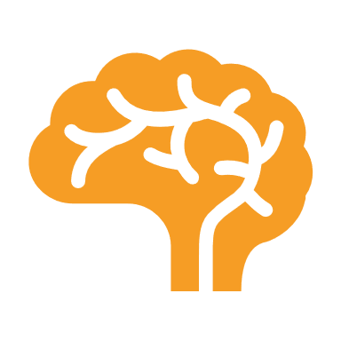

EUROPE MAP
SHORTNESS OF BREATH
Watch this slideshow about fibromyalgia (fibrositis) with pictures about this chronic condition that causes pain and stiffness of the tendons, muscles, and joints. Watch this slideshow about.
FAINTING
Watch this slideshow about fibromyalgia (fibrositis) with pictures about this chronic condition that causes pain and stiffness of the tendons, muscles, and joints. Watch this slideshow about.

Slide 46

TRY NOW
OR INVEST
+8801824989751
youremail@gmail.com
square.com
4383 Greenridge Ln, Kannapolis, NC, 28081

Slide 47


TALK TO US
+8801824989751
youremail@gmail.com
square.com
4383 Greenridge Ln, Kannapolis, NC, 28081

