Slide 1
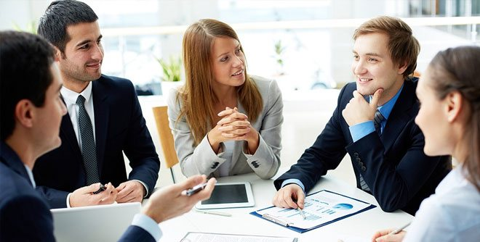
MEETING
“That's the ideal meeting...once upon a time, only once, unexpectedly, then never again.”

Slide 2
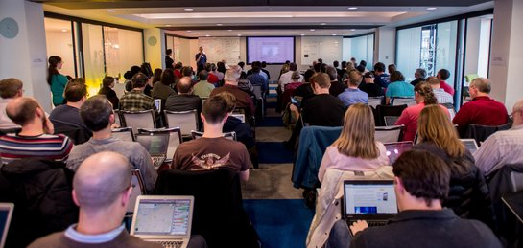
WHAT IS MEETING?
when someone has "had a meeting," it means that they attended an actual meeting, either scheduled or called, of a group to which that person belongs, either at work or as a social or recreational group, and thus, comparable to a "business meeting."

Slide 3

WHAT IS THE PURPOSE OF THE MEETING?
A meeting is where a group of people come together to discuss issues, to improve communication, to promote coordination or to deal with any matters that are put on the agenda and to help get any jobs done.

Slide 4
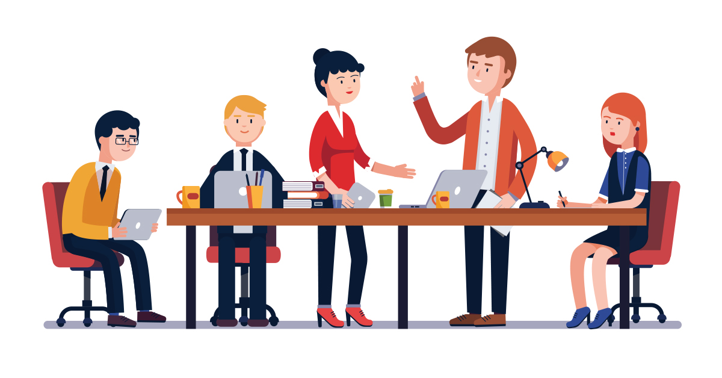
WHAT ARE TYPES OF MEETINGS?
Status Update Meetings.
Information Sharing Meetings.
Decision Making Meetings.
Problem Solving Meetings.
Innovation Meetings.
Team Building Meetings.

Slide 5
VISION & ROADMAP OF MEETING
80%
75%
72%
70%
40%
30%
2019
2020
2021
2022
2023
2024
END TITLE
TEXTS…
START TITLE
TEXTS….

Slide 6




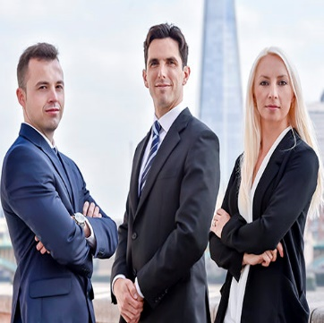
HYBRID PACKAGE OF MEETING
Texts about hybrid packages

Slide 7
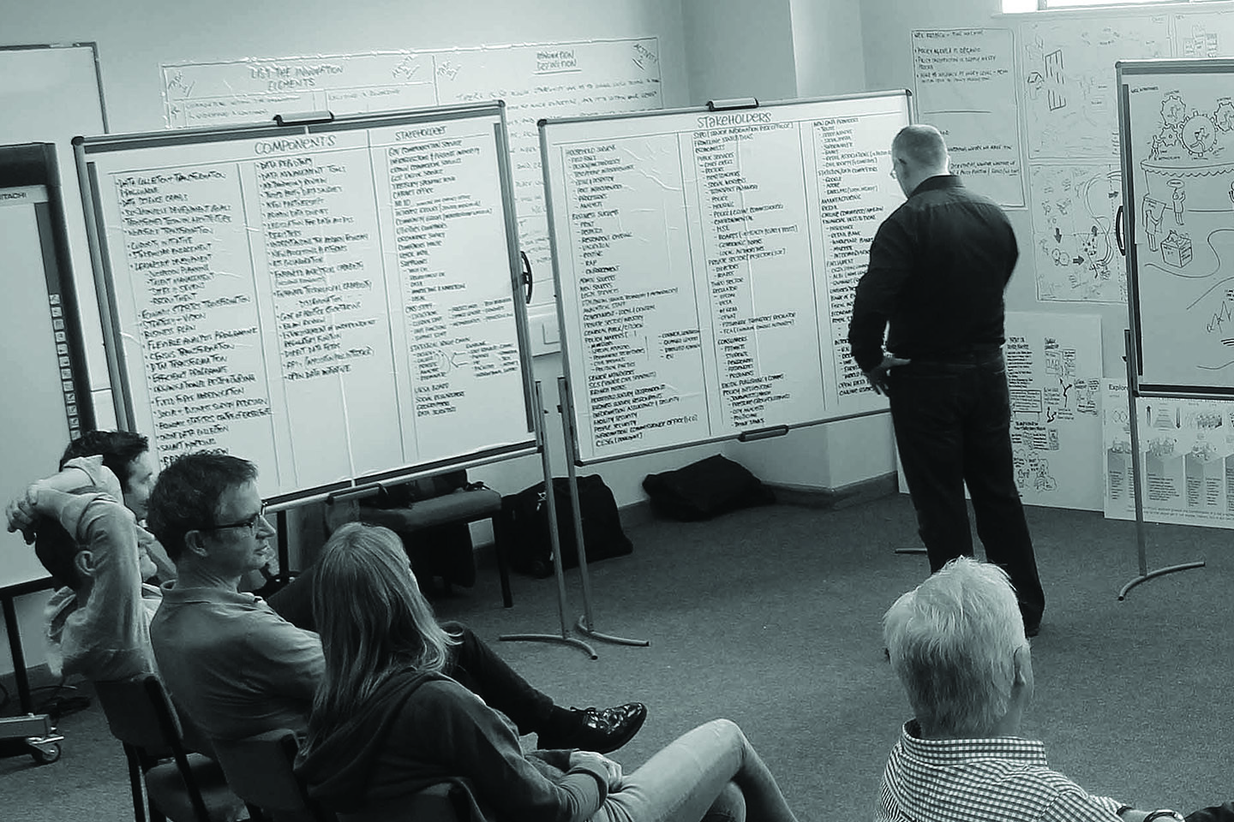

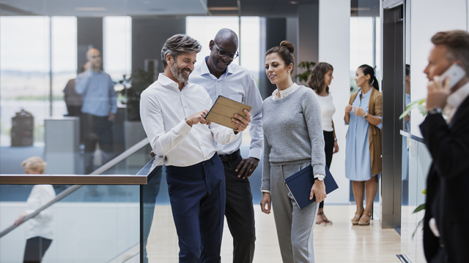
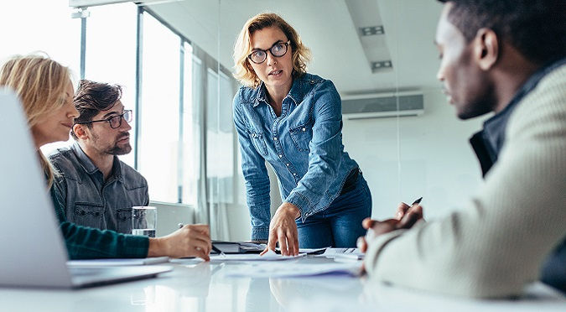
RESULTS OF MEETING
Texts about results
Texts about results
Texts about results

Slide 8

WHY IS IT IMPORTANT TO ATTEND STAFF MEETINGS?
Because their staff work different rosters, it's important to get their team together. Verge is constantly growing, so meetings are important for discussing future plans and goals. Management make it a point to express appreciation, and make sure their staff stay happy and motivated.

Slide 9

ARE MEETINGS NECESSARY?
Only people who're needed to achieve meeting goals should attend it. If you're attending a meeting without really having a role in it, your presence shouldn't be required.

Slide 10
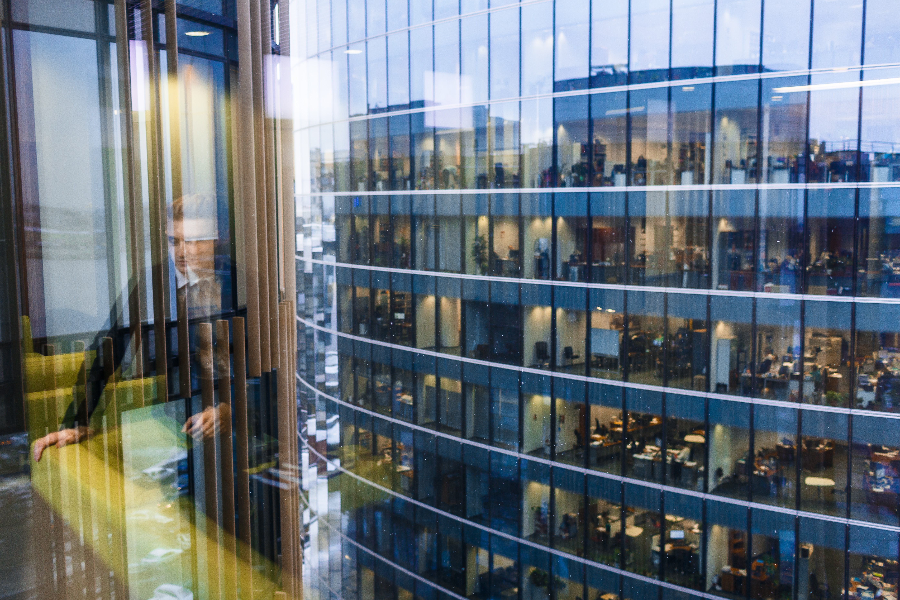
JOIN US OF MEETING
Website link
Address of the company

