Slide 1
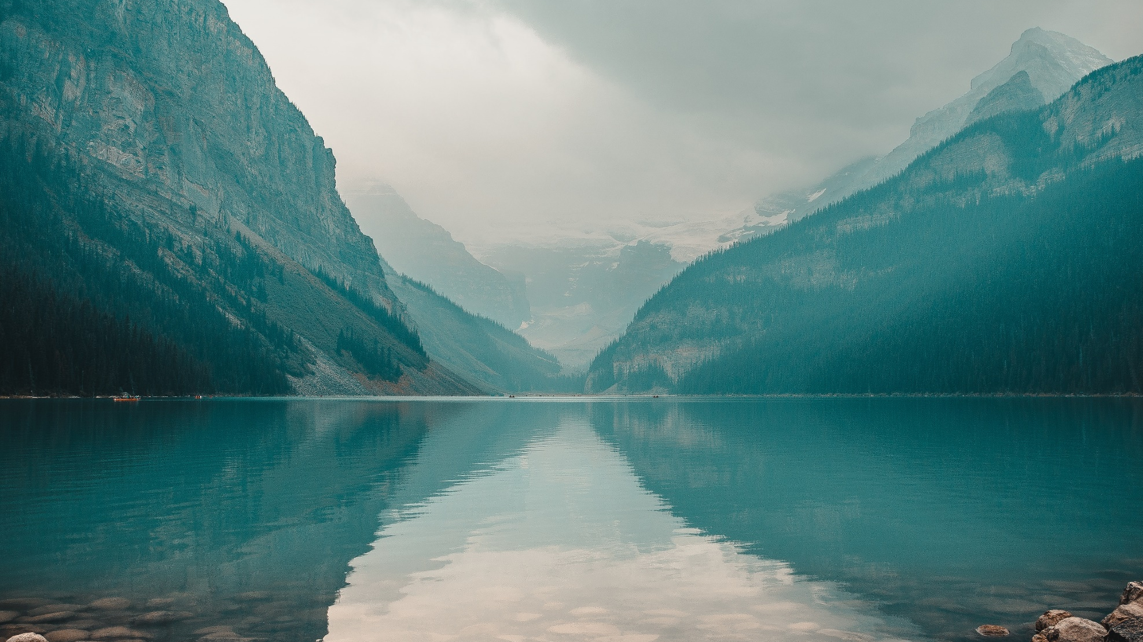
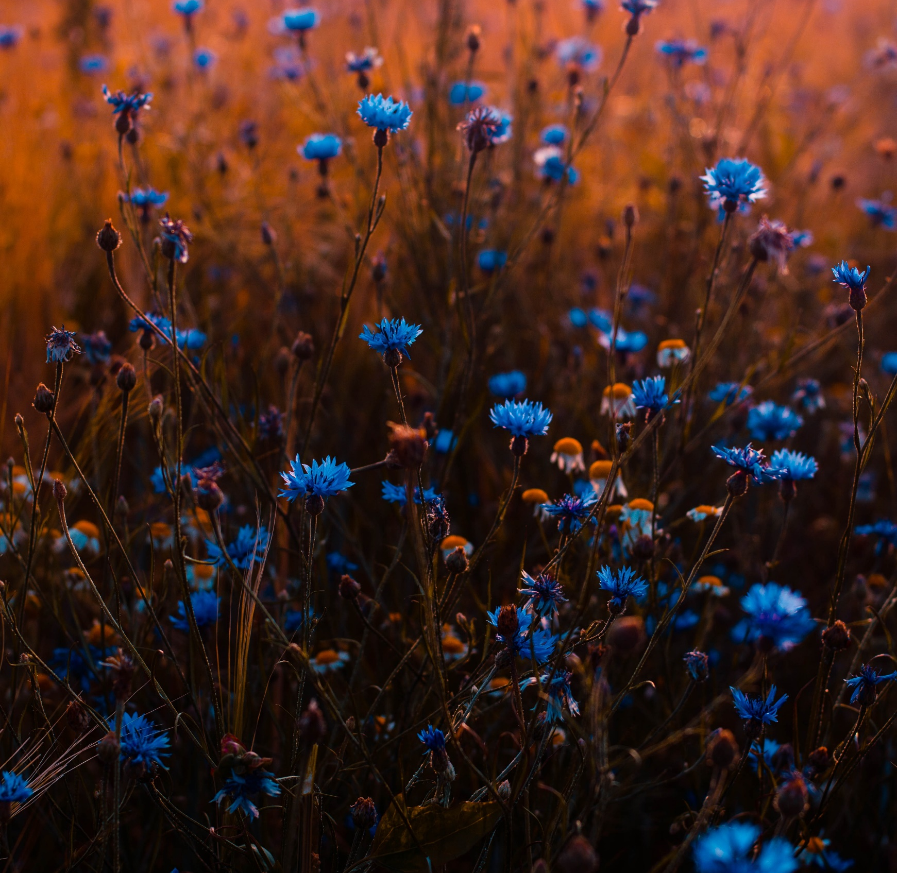
Logo Here
Investment generally results in acquiring an asset, also called an investment. If the asset is available at a price worth investing, it is normally expected either to generate income, or to appreciate in value

Slide 2
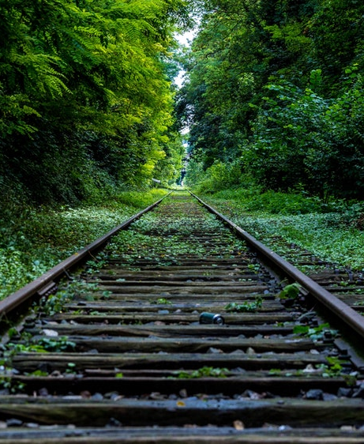
AWESOME SLIDE
CREATIVE IN HERE
Investment generally results in acquiring an asset, also called an investment. If the asset is available at a price worth investing, it is normally expected either to generate income, or to appreciate in value,

Slide 3

AWESOME SLIDE
CREATIVE IN HERE
Investment generally results in acquiring an asset, also called an investment. If the asset is available at a price worth investing, it is normally expected either to generate income, or to appreciate in value,

Slide 4

AWESOME SLIDE
CREATIVE IN HERE
Investment generally results in acquiring an asset, also called an investment. If the asset is available at a price worth investing, it is normally expected either to generate income, or to appreciate in value,

Slide 5

AWESOME SLIDE
CREATIVE IN HERE
Investment generally results in acquiring an asset, also called an investment. If the asset is available at a price worth investing, it is normally expected either to generate income, or to appreciate in value,

Slide 6
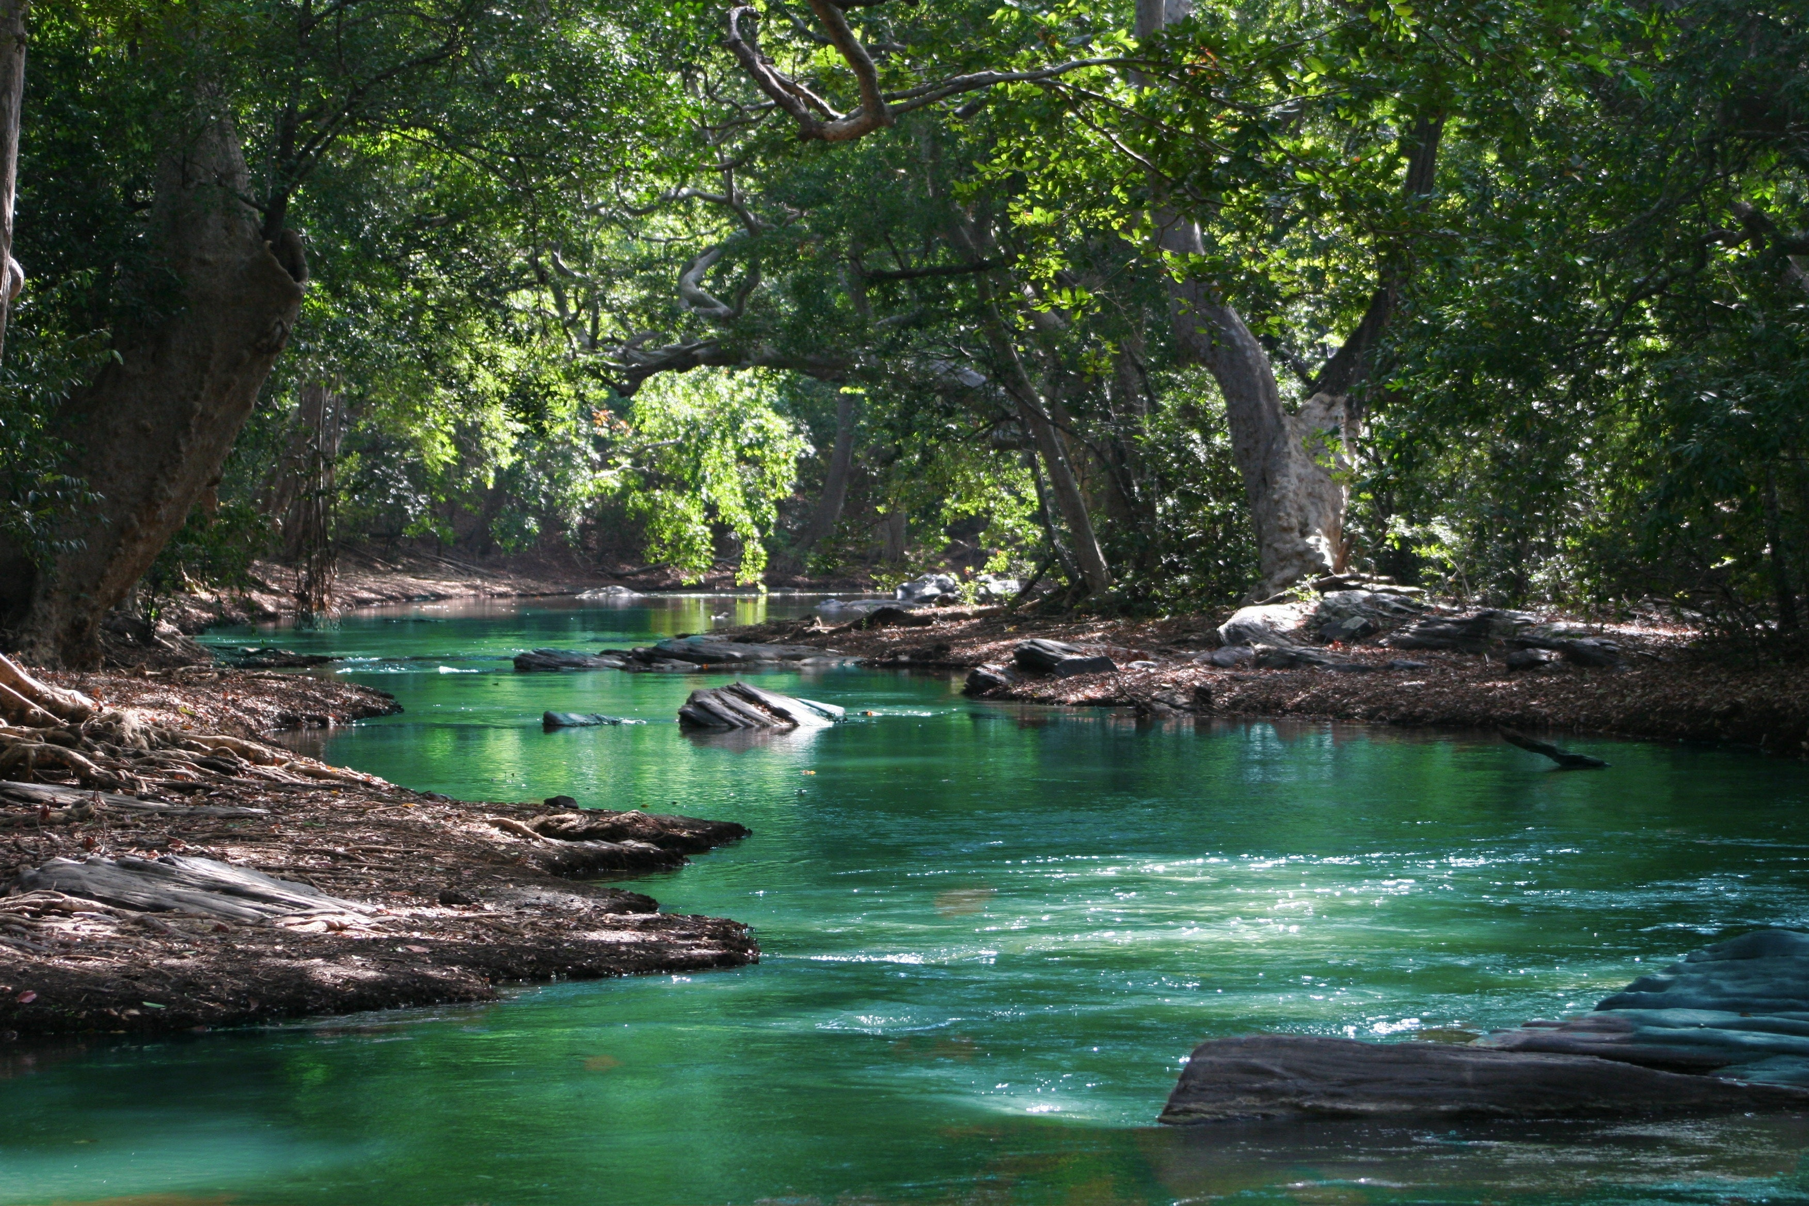
AWESOME SLIDE
CREATIVE IN HERE
Investment generally results in acquiring an asset, also called an investment. If the asset is available at a price worth investing, it is normally expected either to generate income, or to appreciate in value,

Slide 7

NATURE SLIDE SAMPLE
CREATIVE AWESOME

Slide 8
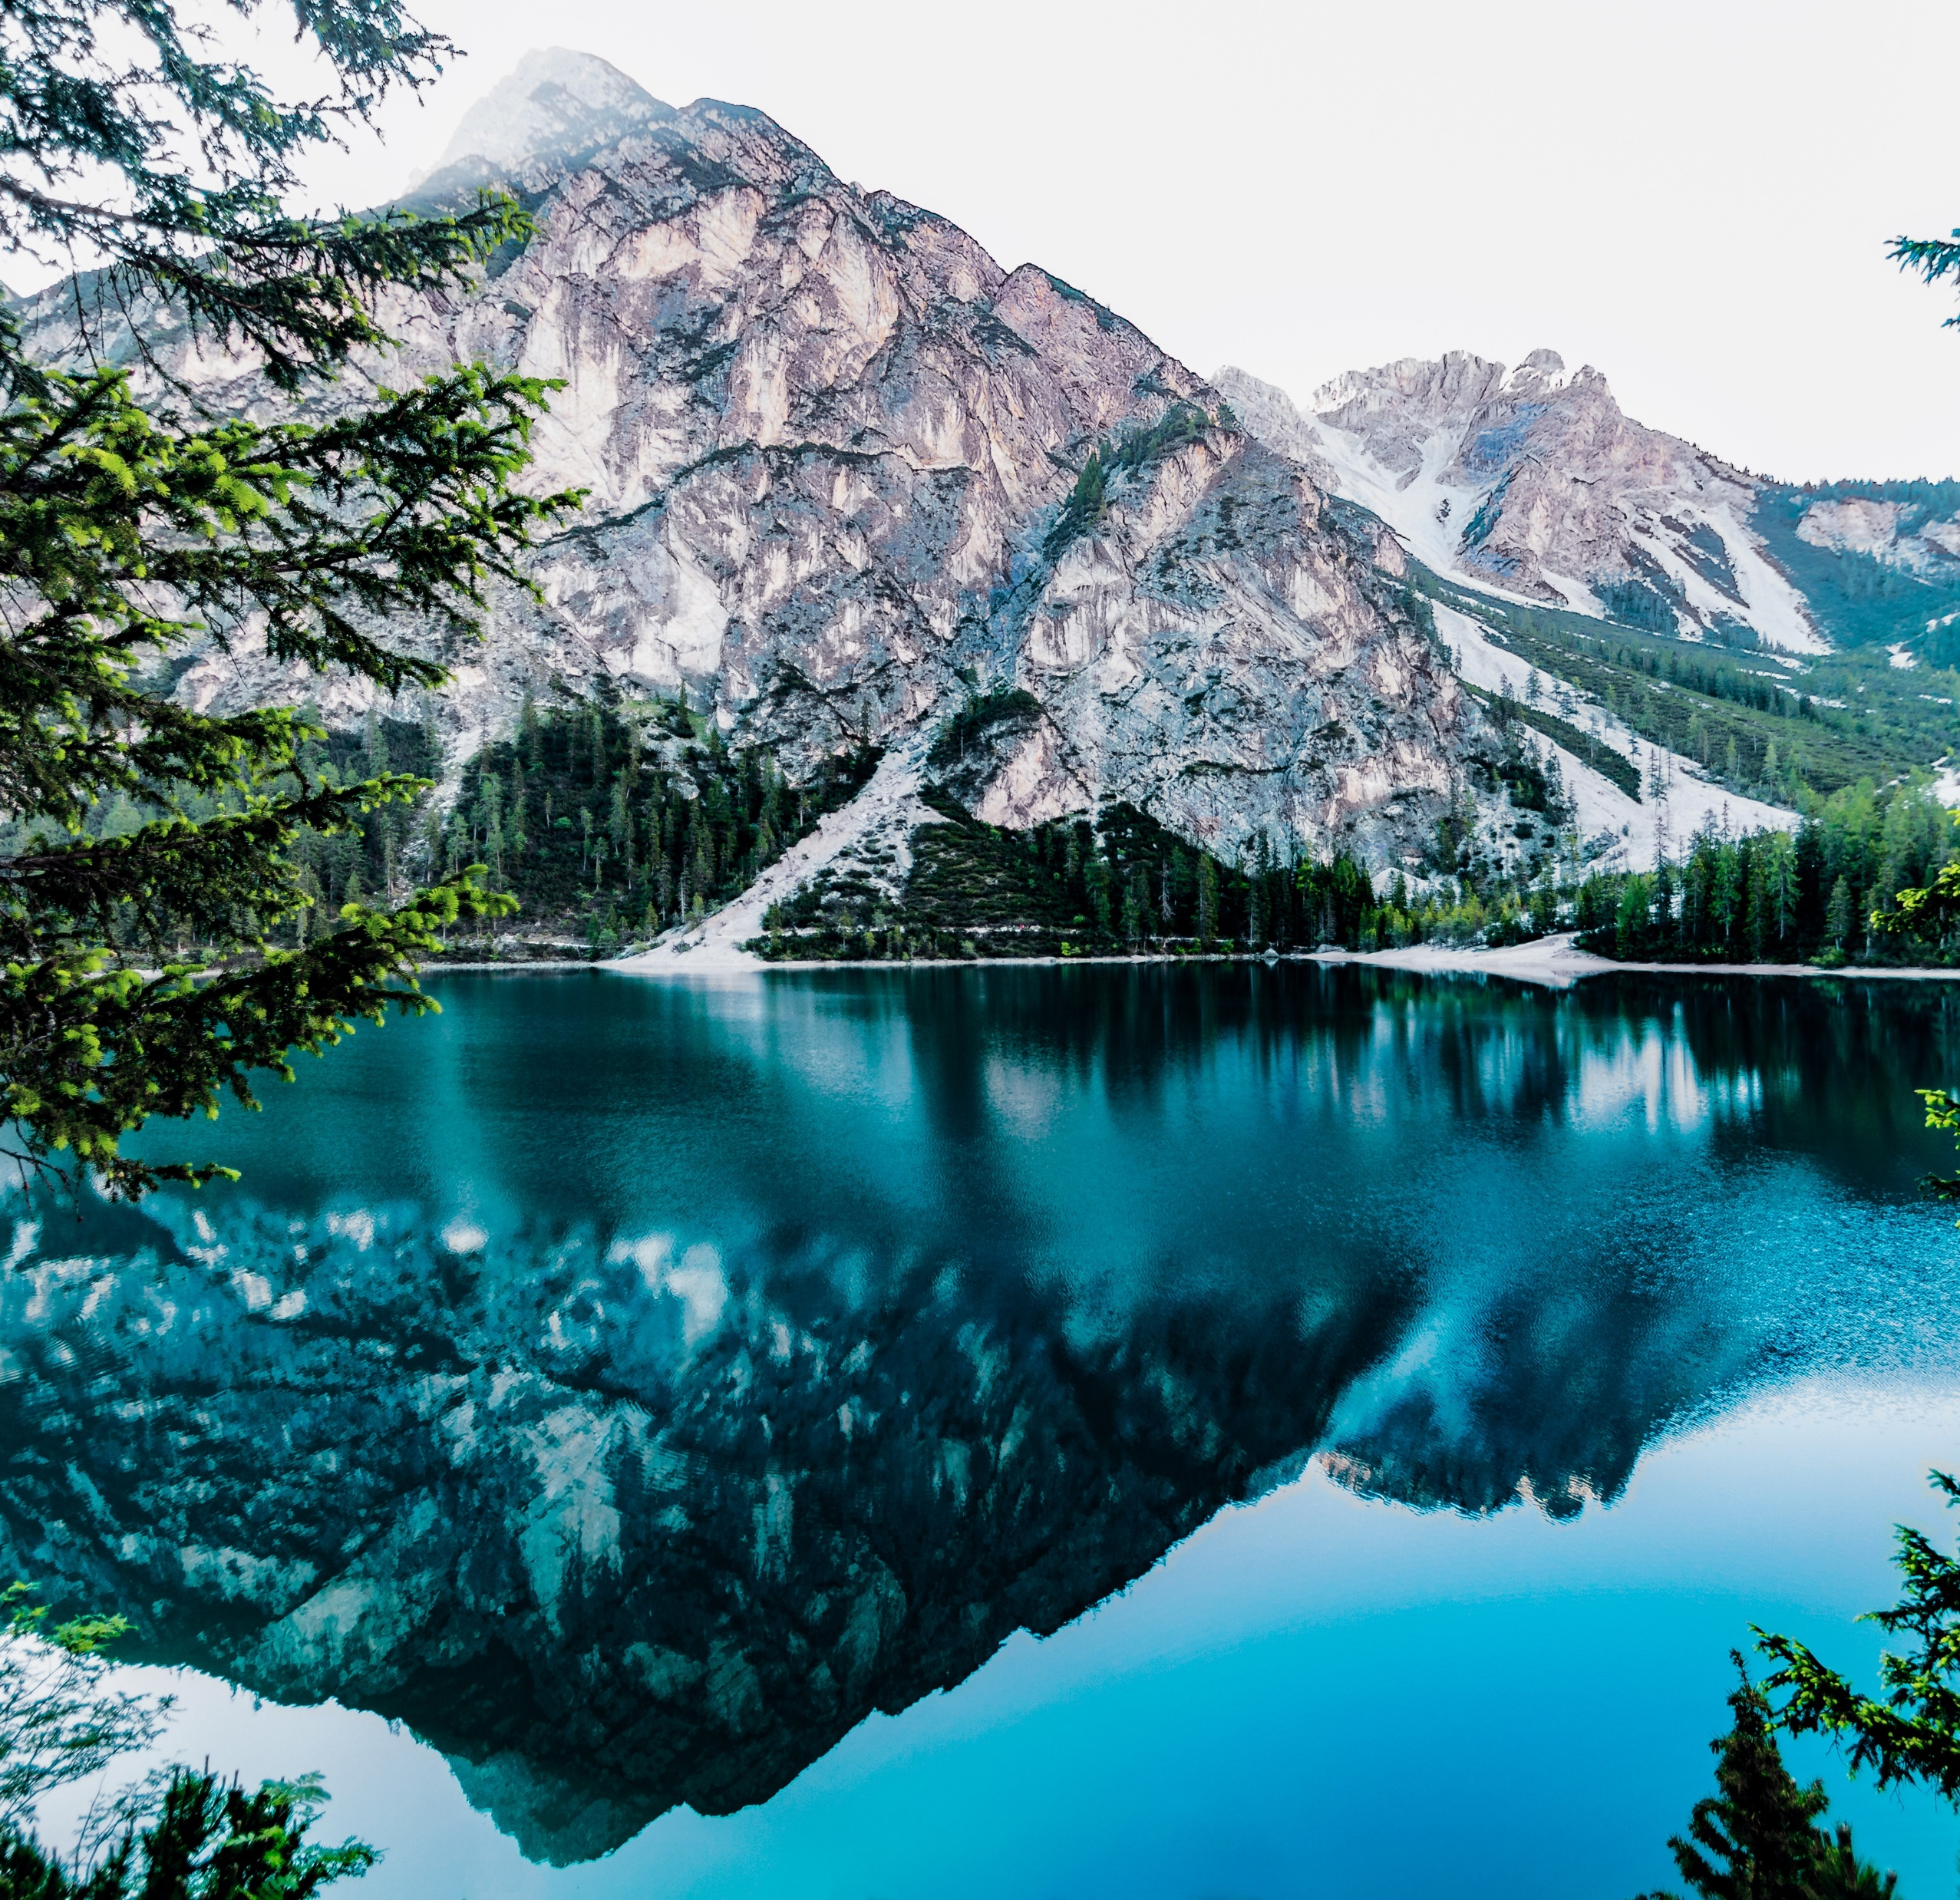
AWESOME SLIDE
CREATIVE IN HERE
Investment generally results in acquiring an asset, also called an investment. If the asset is available at a price worth investing, it is normally expected either to generate income, or to appreciate in value,

Slide 9

AWESOME SLIDE
CREATIVE IN HERE
Investment generally results in acquiring an asset, also called an investment. If the asset is available at a price worth investing, it is normally expected either to generate income, or to appreciate in value,

Slide 10
THANK YOU

