Slide 1
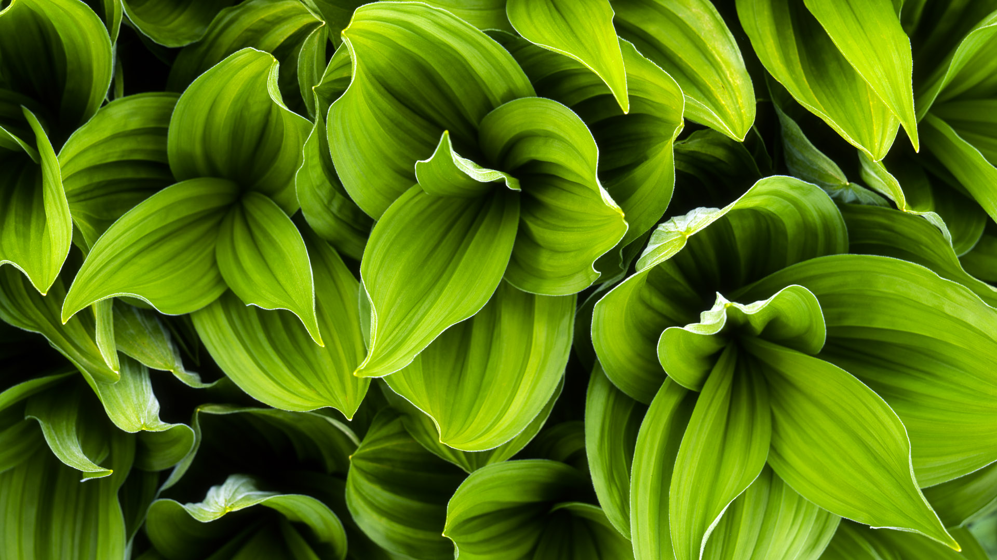

NATURE
One touch of naturae makes the whole world kin

Slide 2
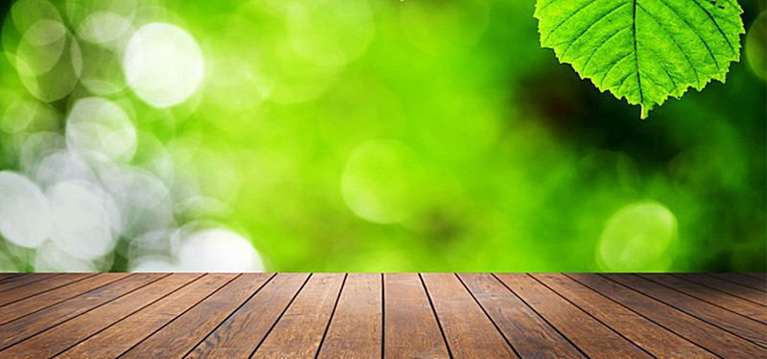

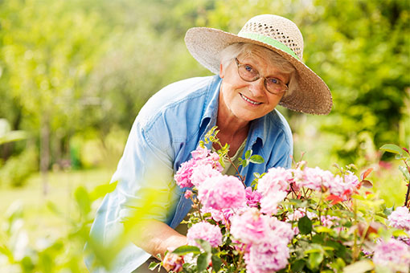
NATURE
WELCOME
Adopt the pace of nature : her secret is patience.
Come join nature and enjoy- designed to help local United Ways engage, impact, and grow in their community, donors, and United Way network connections. Immerse yourself in two days of sharing best practices, meeting new faces, and celebrating the good work being done today.

Slide 3

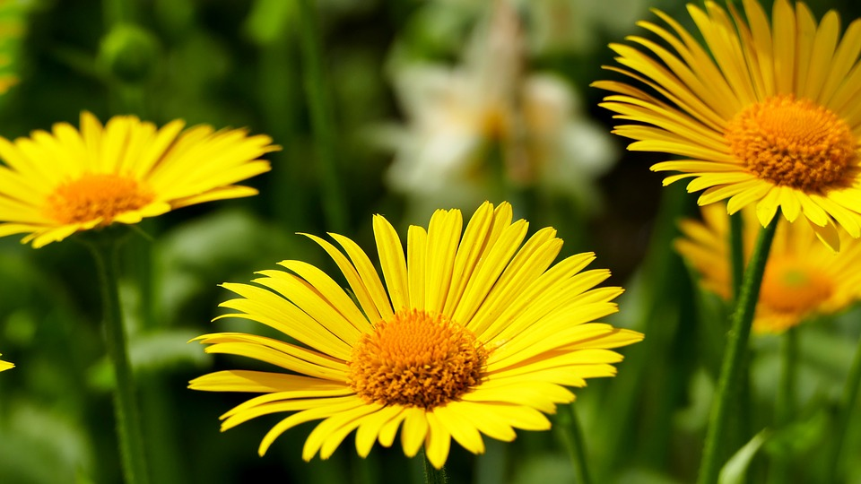
02
NATURE
About Nature
Come join nature and enjoy- designed to help local United Ways engage, impact, and grow in their community, donors, and United Way network connections. Immerse yourself in two days of sharing best practices, meeting new faces, and celebrating the good work being done today.

Slide 4
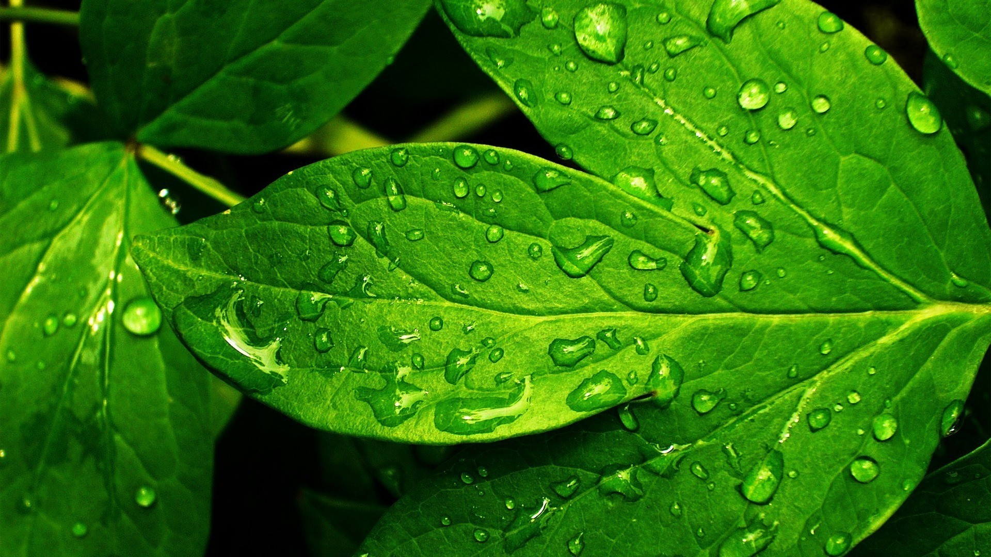
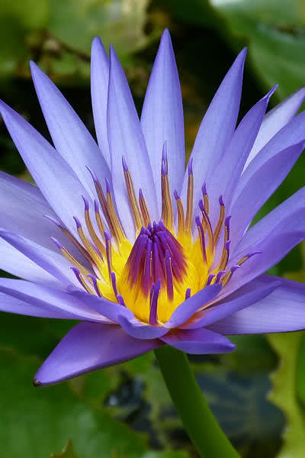
02
NATURE
Creativity Of Nature
Come join nature and enjoy- designed to help local United Ways engage, impact, and grow in their community.
Beautiness Of Nature
Come join nature and enjoy- designed to help local United Ways engage, impact, and grow in their community.

Slide 5
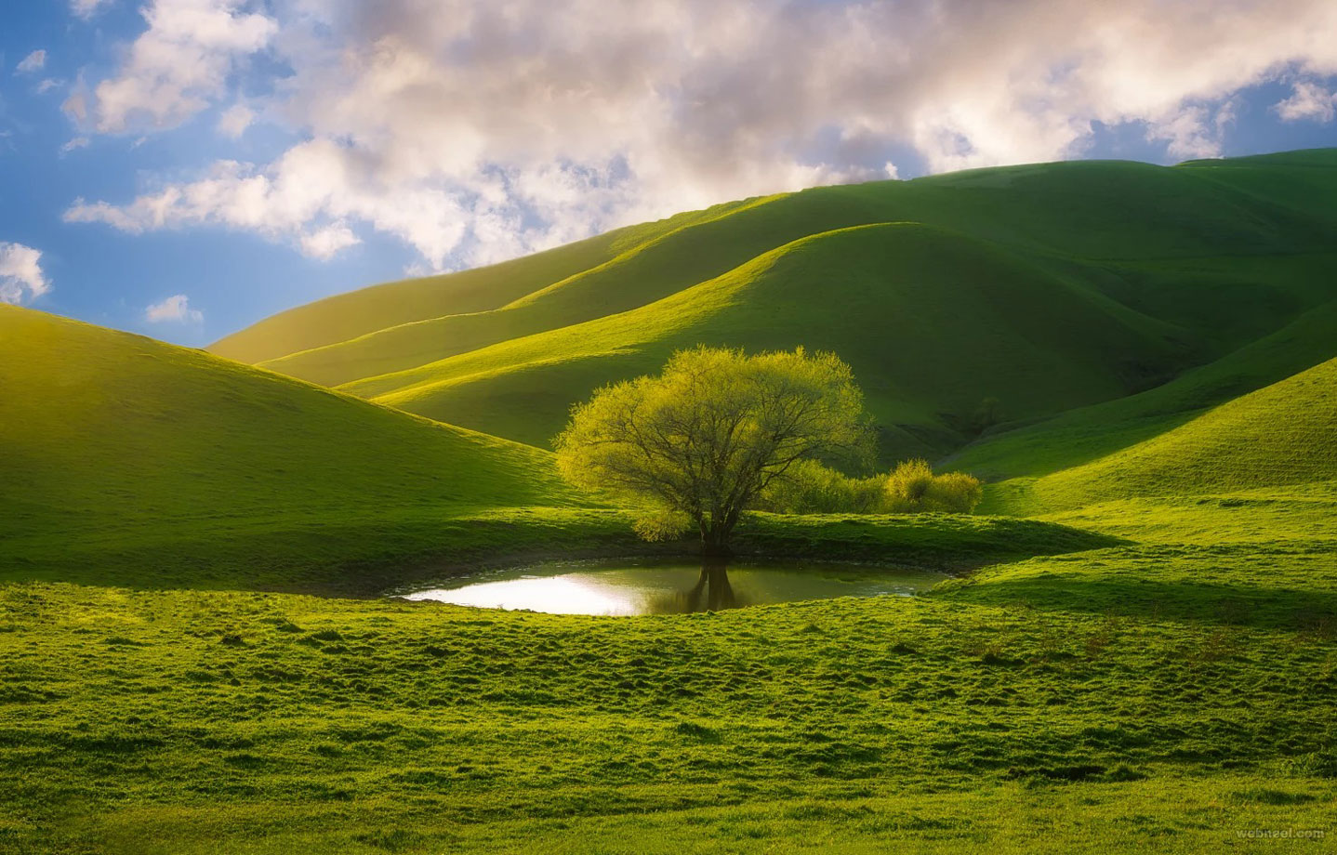
03
NATURE
A BASKET OF RIPE FRUIT IS HOLIER
Come join nature and enjoy- designed to help local United Ways engage, impact, and grow in their community, donors, and United Way network connections. Immerse yourself in two days of sharing best practices, meeting new faces, and celebrating the good work being done today.

Slide 6
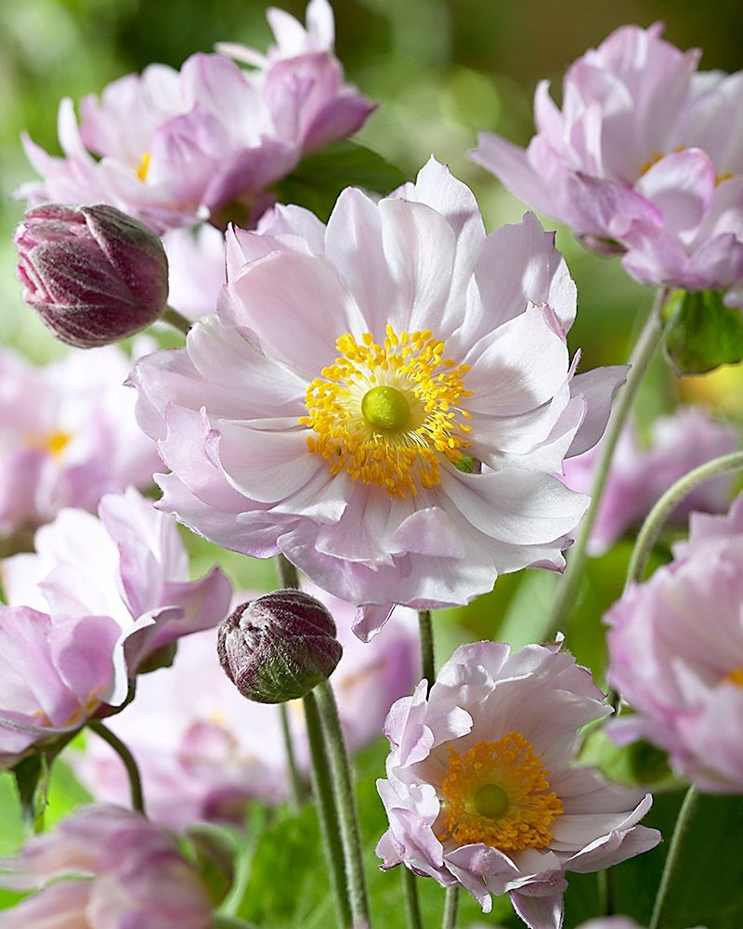
NATURE
A BASKET OF RIPE FRUIT IS HOLIER
Come join nature and enjoy- designed to help local United Ways engage, impact, and grow in their community, donors, and United Way network connections. Immerse yourself in two days of sharing best practices, meeting new faces, and celebrating the good work being done today.

Slide 7

NATURE
Content
Come join nature and enjoy- designed to help local United Ways engage, impact, and grow in their community, donors, and United Way network connections. Immerse yourself in two days of sharing best practices, meeting new faces, and celebrating the good work being done today.
Content
Content
Come join nature and enjoy- designed to help local United Ways engage, impact, and grow in their lands.
Come join nature and enjoy- designed to help local United Ways engage, impact, and grow in their lands.

Slide 8
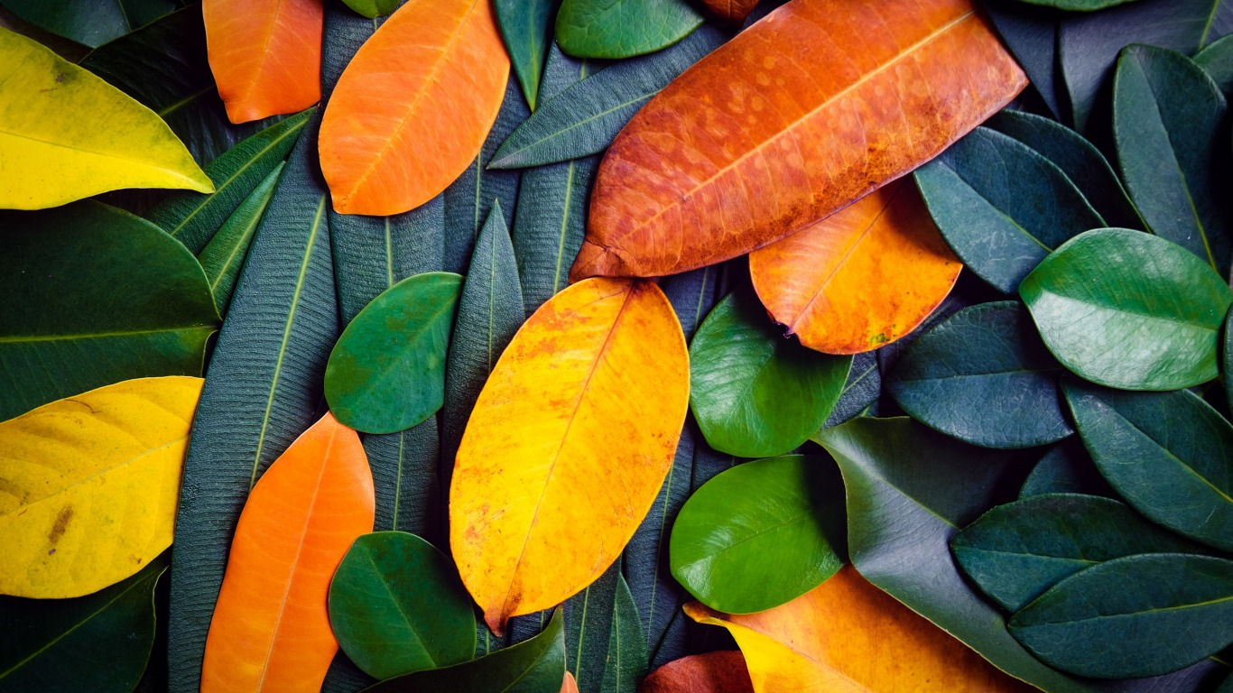
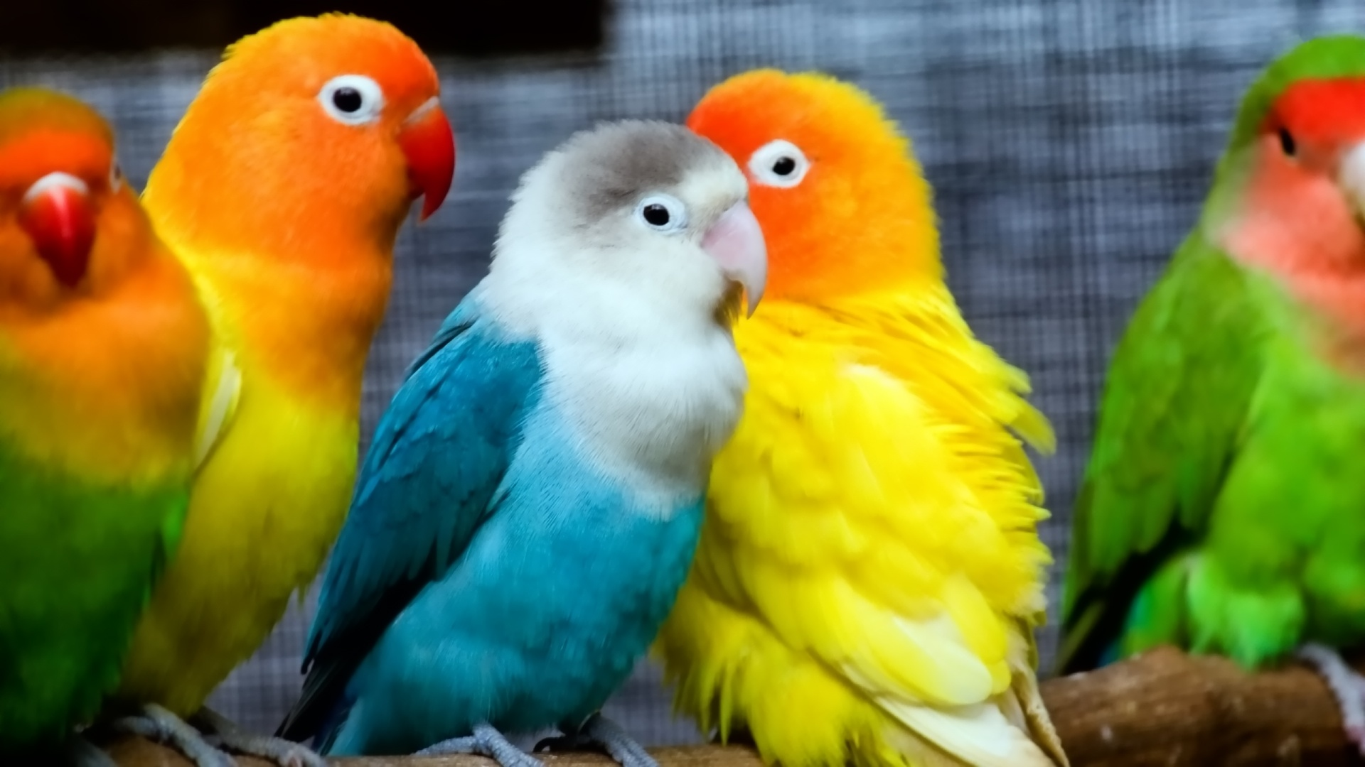
NATURE
Come join nature and enjoy- designed to help local United Ways engage, impact, and grow in their community, donors, and United Way network connections. Immerse yourself in two days of sharing best practices .
Gallery
Slide

Slide 9

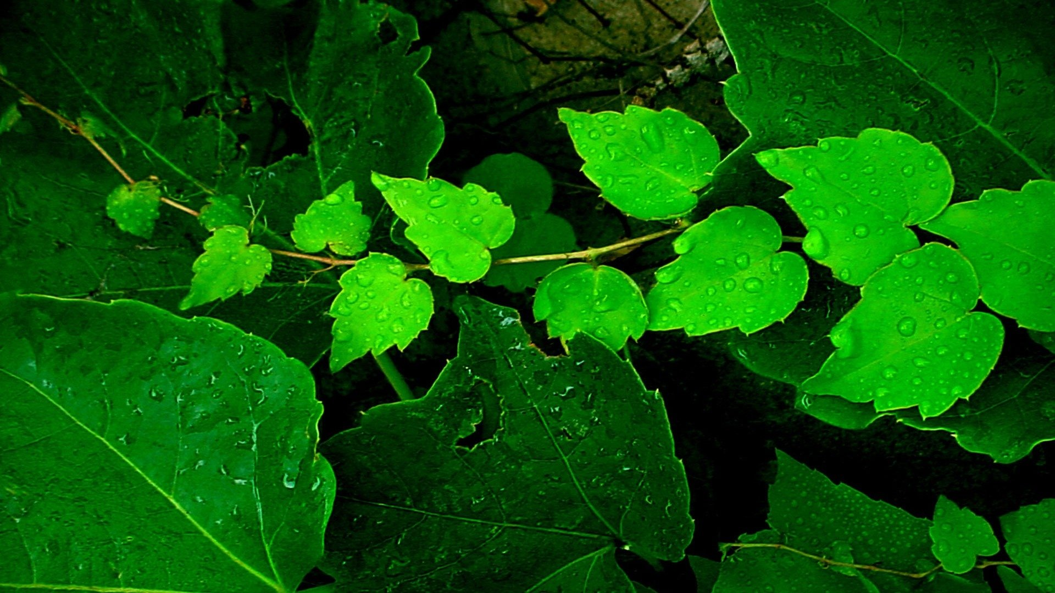

NATURE
01.
01 . Gallery Slide
Gallery 01 is in charge of menu creation, staff management, plating design and cost control.
02 . Gallery Slide
02.
Gallery
Slide
Gallery 01 is in charge of menu creation, staff management, plating design and cost control.

Slide 10
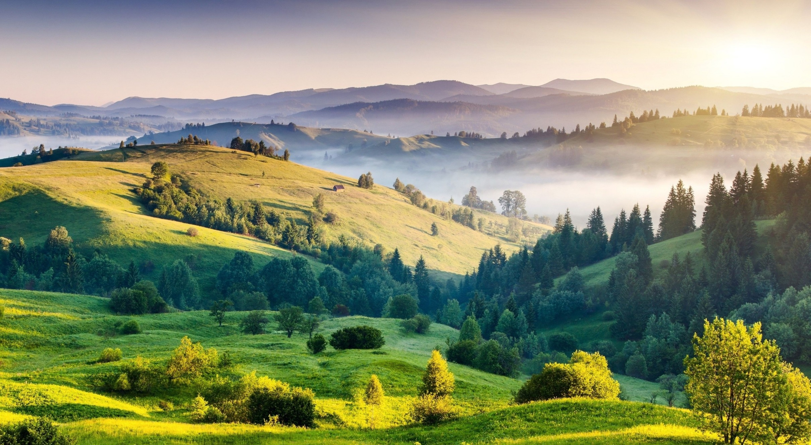

NATURE
Vision
Come join nature and enjoy- designed to help local United Ways engage, impact, and grow in their community, donors, and United Way network connections. Immerse yourself in two days of sharing best practices, meeting new faces, and celebrating the good work being done today.
Wind Power
Wind Power
Come join nature and enjoy- designed to help local United Ways engage, impact .
Come join nature and enjoy- designed to help local United Ways engage, impact .

Slide 11
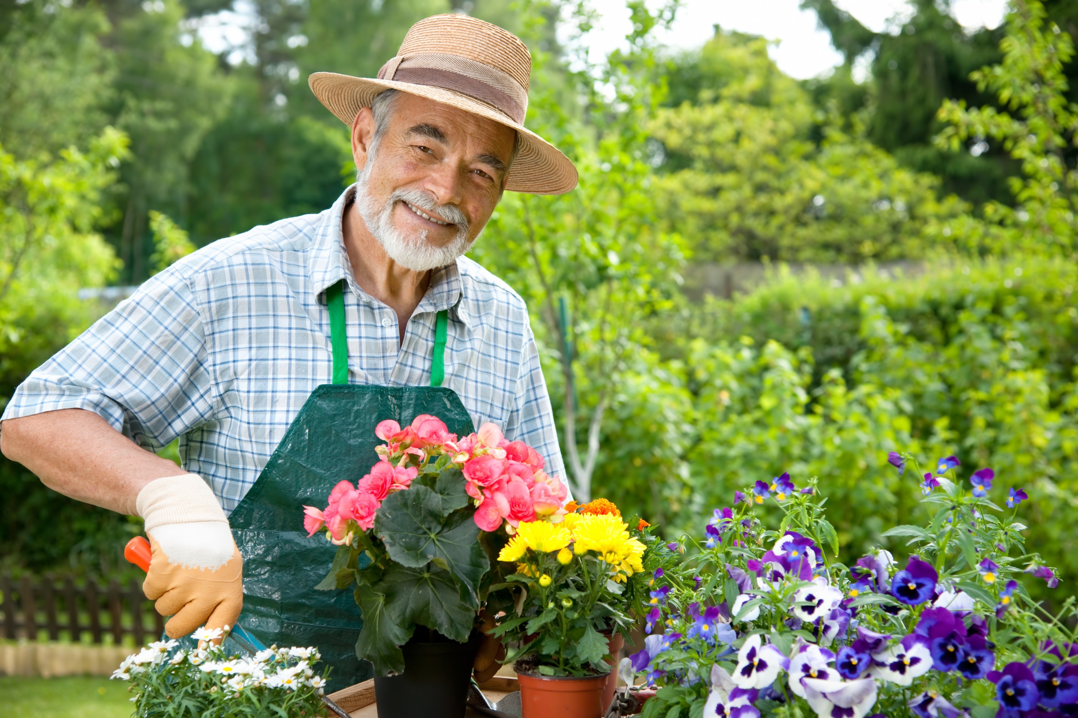

NATURE
Jack Bright
Chief Gardener
Jack Bright is in charge of menu creation, staff management, plating design and cost control.
Ecosystem
95%
Biotic and Abiotic
65%
Hydroponics
75%
jackbright@gmail.com

Slide 12
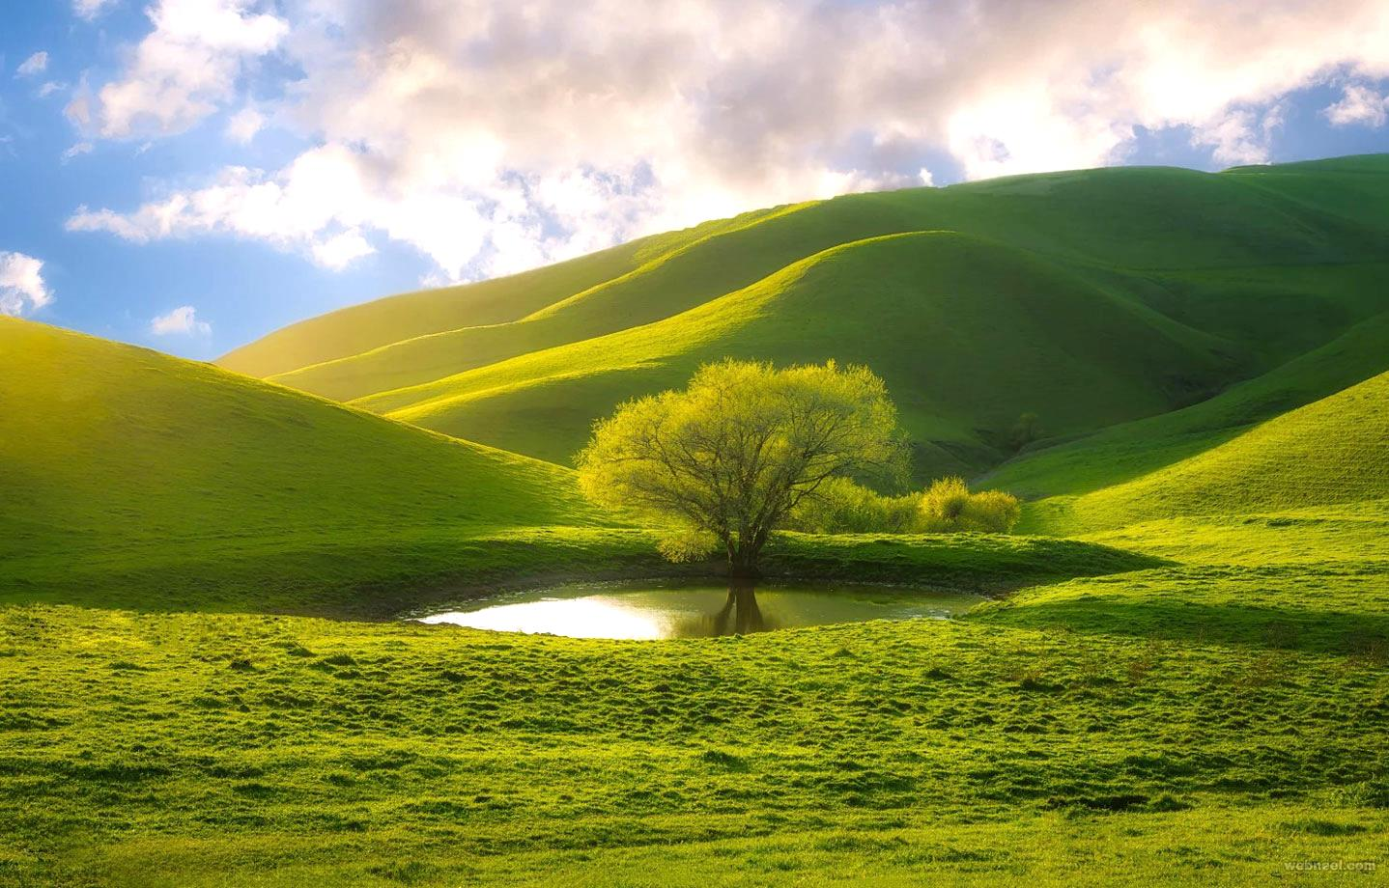
NATURE
Get In Touch
+41 4555 665 4545
+41 4545 555 4646
123 Main Street, SR Building, New York City, USA. 12345
123 Main Street, SR Building, New York City, USA. 12345

