Slide 1
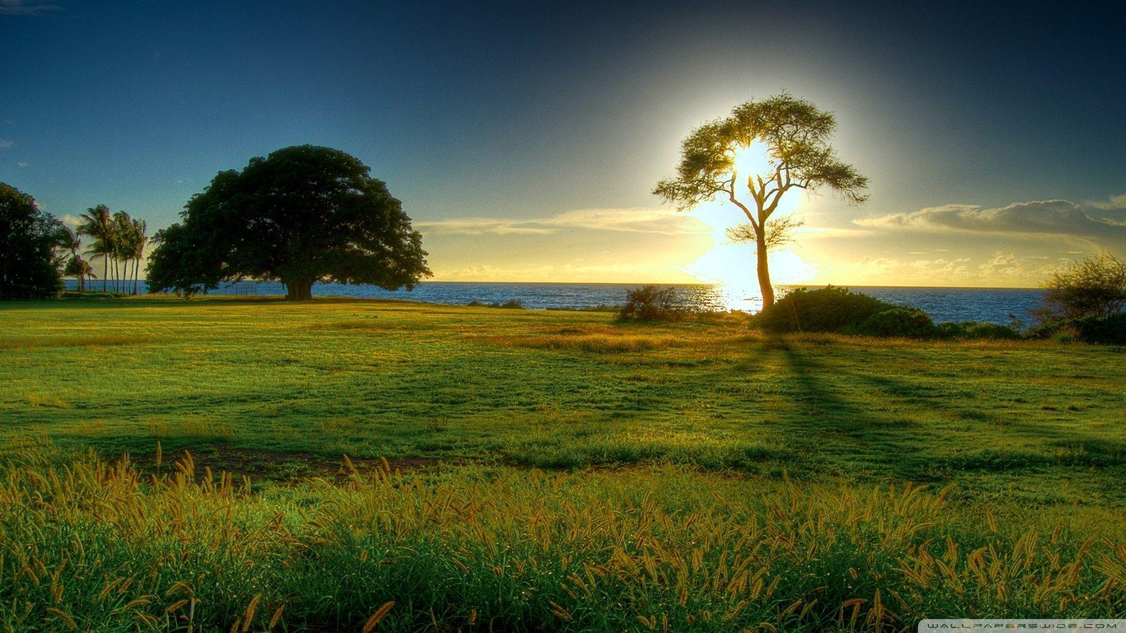
NATURE
Adopt the pace of nature: her secret is patience.

Slide 2
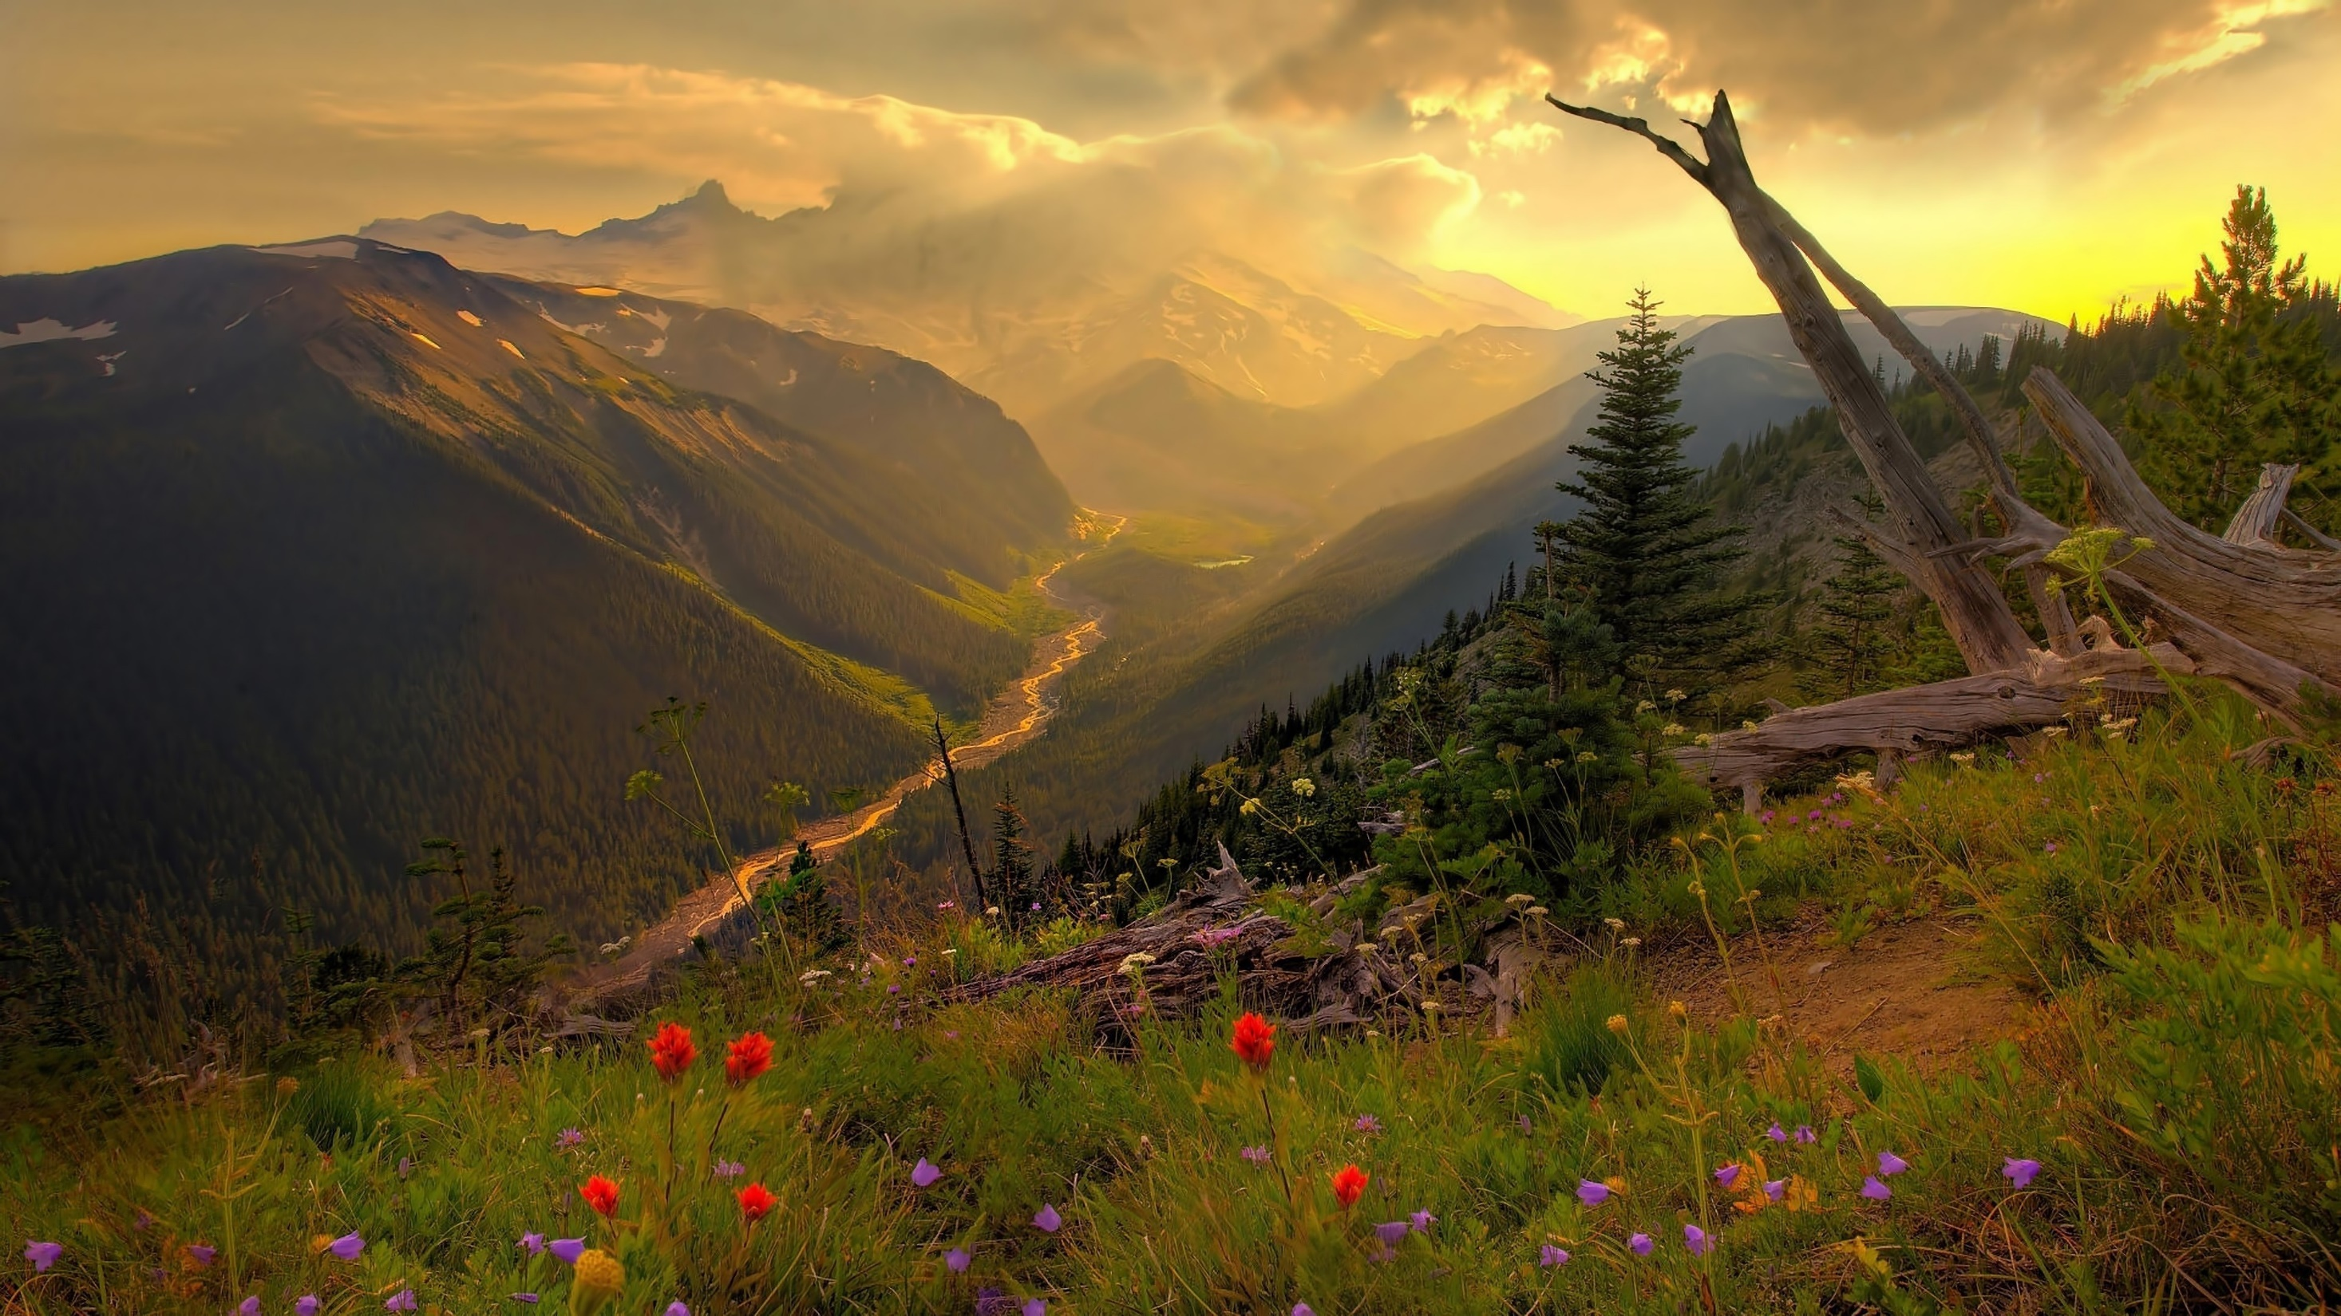
Things like weather, organisms, landforms, celestial bodies and much more are part of nature
INTRODUCTION
Nature, in the broadest sense, is the natural, physical, or material world or universe. "Nature" can refer to the phenomena of the physical world, and also to life in general

Slide 3
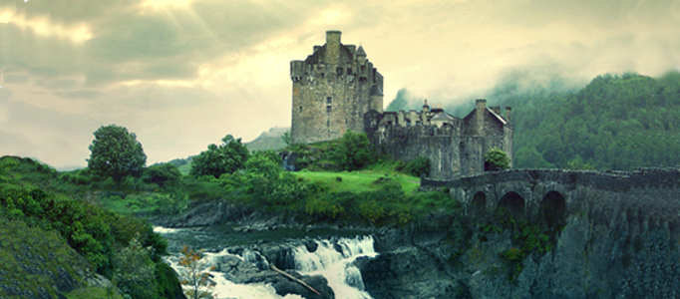
7 CLASSIFICATIONS OF LIVING THINGS IN NATURE
There are seven major levels of classification: Kingdom, Phylum, Class, Order, Family, Genus, and Species. The two main kingdoms we think about are plants and animals. Scientists also list four other kingdoms including bacteria, archaebacterial, fungi, and protozoa.

Slide 4
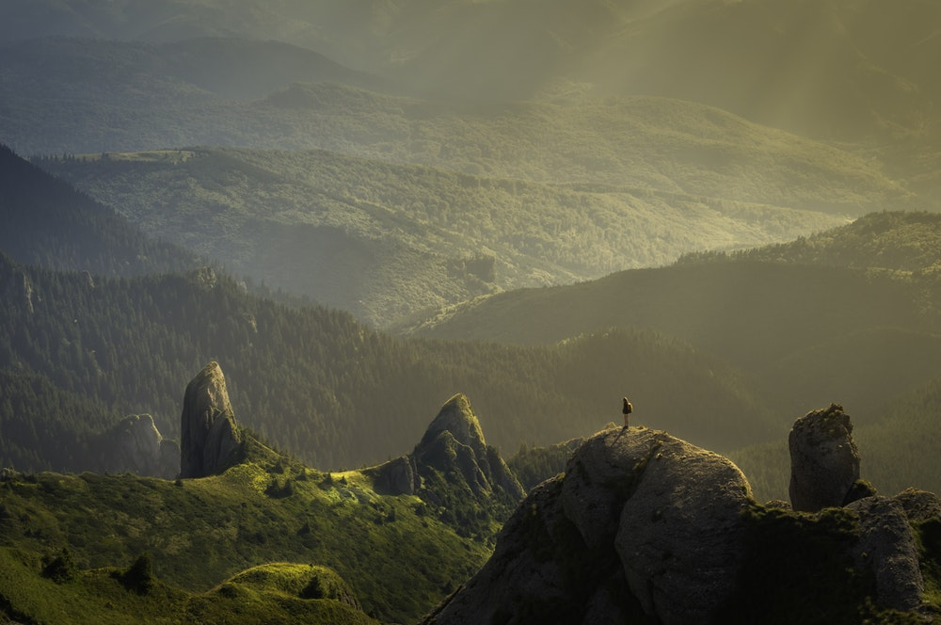
THE NATURAL CLASSIFICATION SYSTEM
A biological classification based upon morphological and anatomical relationships and affinities considered in the light of phylogeny and embryology specifically : a system in botany other than the artificial or sexual system established by Linnaeus.

Slide 5
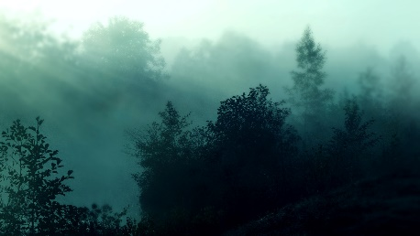
HOW DO HUMAN BEINGS HELP IN THE BALANCE OF NATURE?
The balance of nature is a concept which describes the state of equilibrium between living organisms like human beings, plants and animals and also their environment.

Slide 6
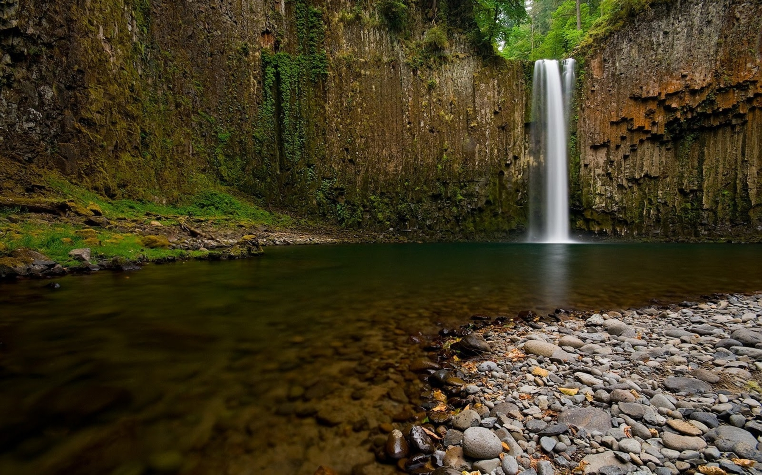
HOW DOES NATURE AFFECT OUR HEALTH?
Exposure to nature not only makes you feel better emotionally, it contributes to your physical wellbeing, reducing blood pressure, heart rate, muscle tension, and the production of stress hormones.

Slide 7
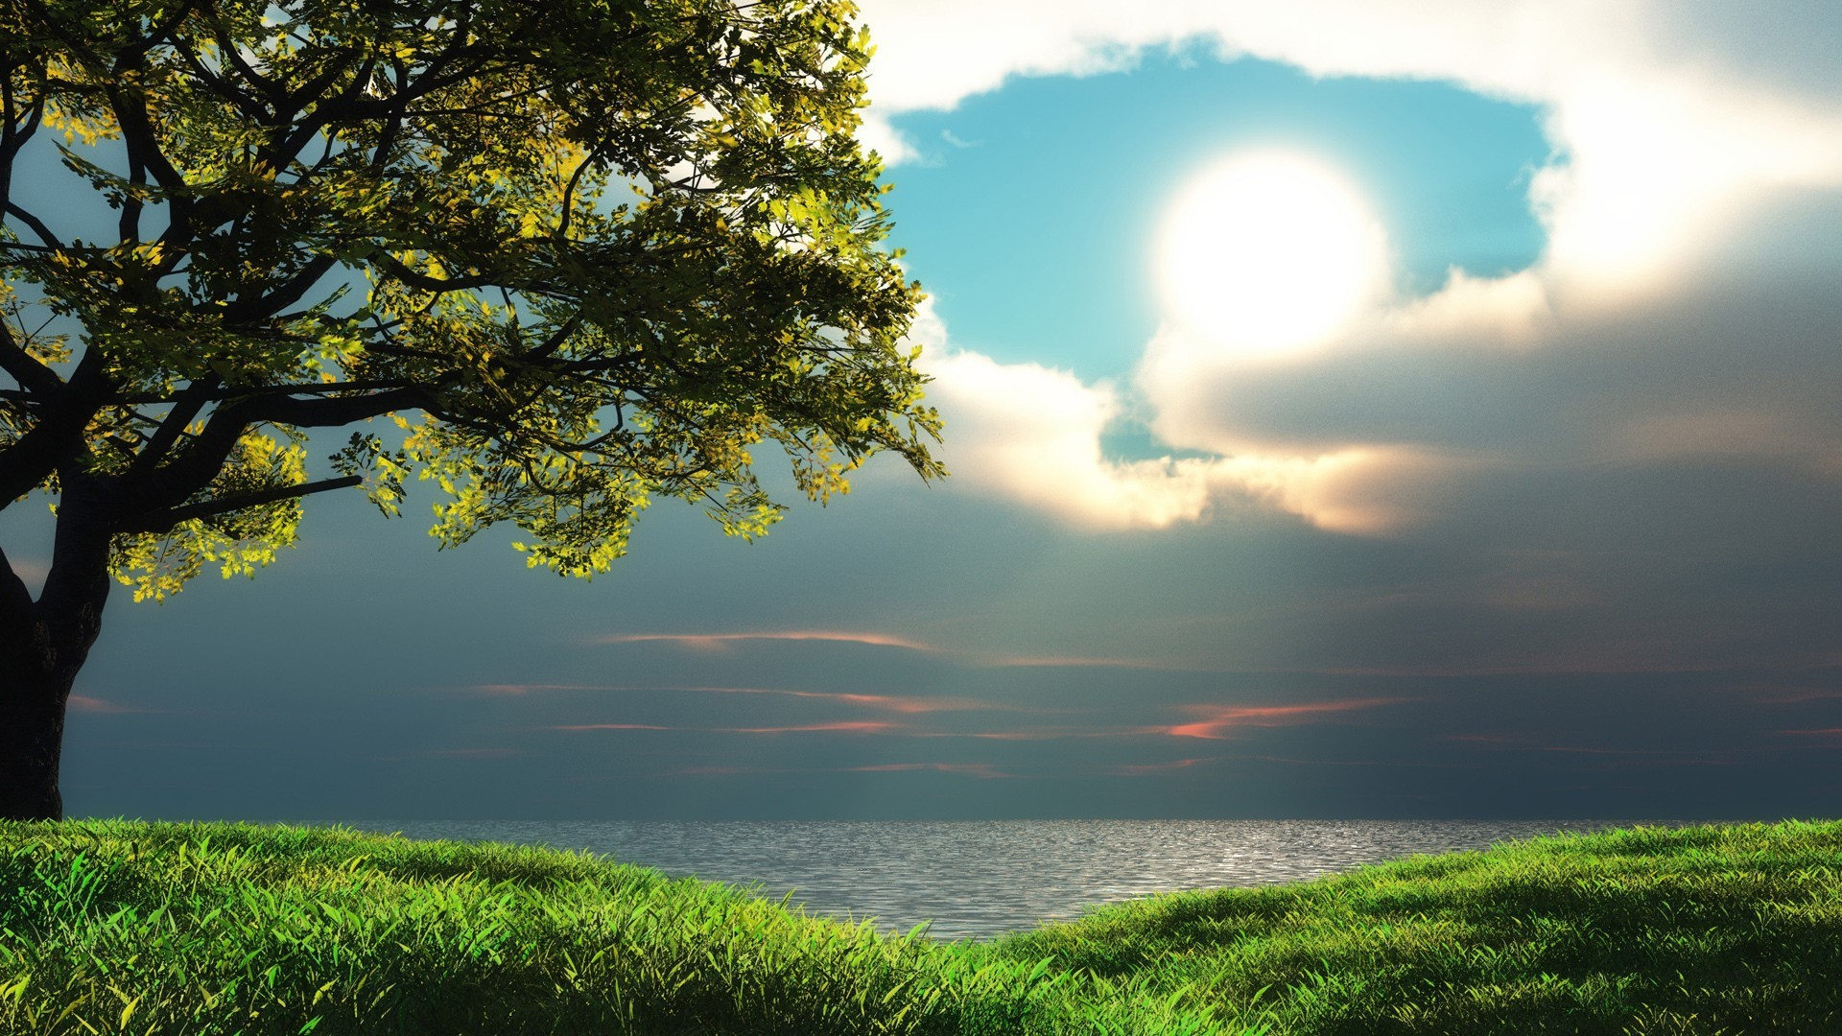
HOW DOES NATURE AFFECT THE BRAIN?
Scientists are beginning to find evidence that being in nature has a profound impact on our brains and our behaviour, helping us to reduce anxiety, brooding, and stress, and increase our attention capacity, creativity, and our ability to connect with other people.

Slide 8
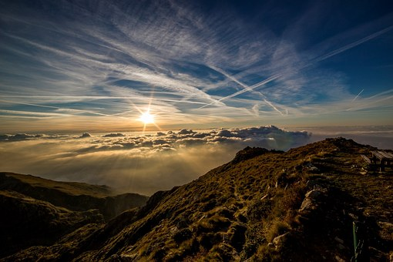
HOW DOES NATURE AFFECT PERSONALITY?
Genetics has more influence than parents do on shaping our personality. Molecular genetics is the study of which genes are associated with which personality traits. The largely unknown environmental influences, known as the no shared environmental effects, have the largest impact on personality.

Slide 9
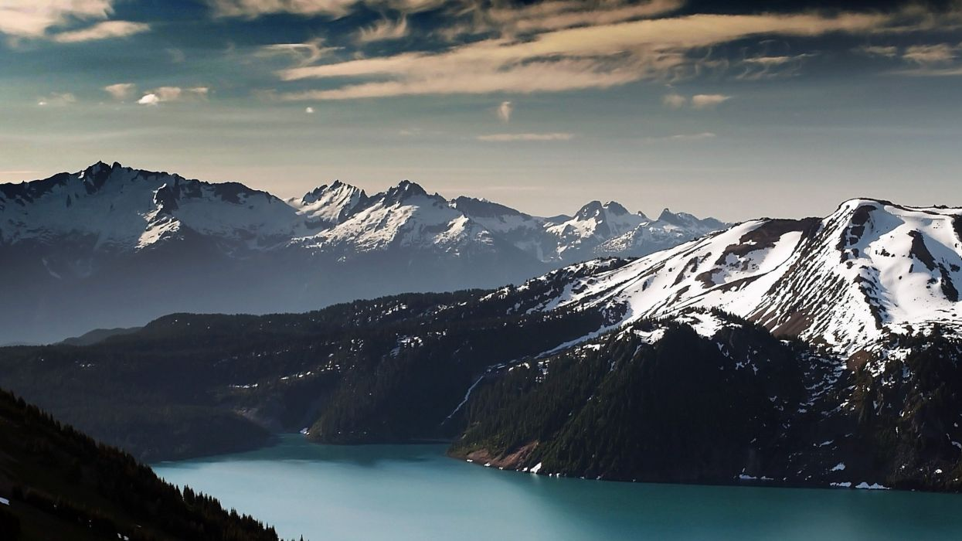
HOW DOES NATURE REDUCE STRESS?
A pleasant walk in the woods, a 'nature pill,' measurably reduces stress hormone levels.

Slide 10
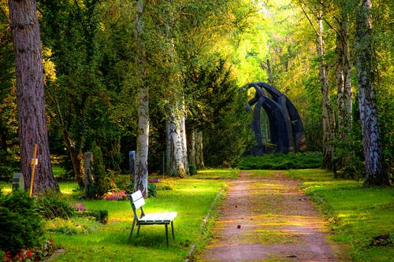
SLOGANS
Save plants, save the nature

