Slide 1


Slide 2

Electron Flow
The lamp in a circuit lights up because there are electrons moving from one terminal of the battery to the other terminal
There must be a conducting path between the lamp and the battery
Although the free electrons flow from the negative terminal to the positive terminal of the battery
We use the conventional current direction (from positive to negative terminal of the battery).

Slide 3
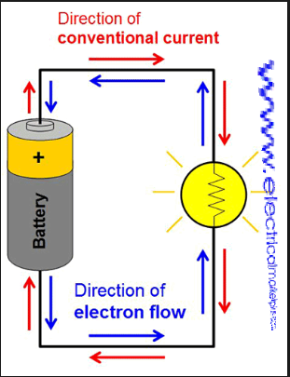
Electron Flow

Slide 4
Electric current
Electric current is the rate of flow of charge. In wires ,these changes are electrons.
The charge is measured in Coulombs(C) therefore current is measured in C/S or Amperes(A).
Current(I)=Charge(Q)/Time(t)

Slide 5
Potential Difference
It is the energy transferred per unit and it is measured in Volt(V) where 1 Volt is 1 J/C (joule per coulomb)
Voltage(V)=energy transferred(J)/Charge(Q)

Slide 6
Resistance
The resistance of a component is what causes a voltage drop (potential difference ) across the component.
If there is a P.D across a conductor , a current flows through it.
Resistance is measured in Ohms .
The resistance of a conductor is the ratio of the P>D applied across it , to current passing through it .
Resistance(R)=Volts(V)/Current(I)

Slide 7
Resistance of a Wire
The Resistance of a wire :
Increases with the length(L)
Increase as the cross-section area(A) decreases
Depends on the Resistivity(p) of the material (which varies from one to another )
Depends on the temperature such that :
1. Metallic conductors show increase in resistance as
temperature increases.
2.Non-Metalic is vice-versa

Slide 8
How Resistance s measured
To find the resistance of a wire you must place it in a circuit .
The voltmeter tells you the P.D across the wire .
The Ammeter tell you he current across it .
Calculate the resistance using R=V/I .

Slide 9
Series and Parallel circuits
Series Circuits:
The same current flows through all parts of the circuit.
The size of the current is determined by the P.D of the cells and the total resistance of the circuit(I=V/R)
The bigger the resistance of a component , the bigger its share of the total P.D
The total P.D of the supply is shared between the various components , so the voltages round a series circuit always add up to equal the total voltage of supply.

Slide 10
Series and Parallel circuits
Parallel Circuits:
The voltage is the same across all components.
The current through each component depends on the resistance
The total current flowing around the circuit is equal to the total of all currents in the separate branches.

Slide 11


