Slide 1

Introduction to Electricity

Slide 2

Static electricity
Rule 1# : There is positive charges and negative charges
Rule 2#:Like charges repel and unlike charges attract
+
+
-
+
-
-
Repel
Attract
Repel

Slide 3
Conductors and Insulators
Materials which allow electrons to flow through them are called Conductors .Metals are the best conductors.(They have free electrons )
Materials which do not allow electrons to flow them are called Insulators .Their electrons not free to move . Most non-metals conduct charge poorly.(graphite and silicon are exceptions )
When you switch on a light , the electricity passing through the cable is actually a flow of electrons.

Slide 4
Charging an insulator caused by friction
Normally , atoms have equal numbers of electrons and protons so the net (overall) charge on a substance is zero. However , when two insulators are rubbed together, electrons may be transferred from one to another , so that each is left with a net negative or positive charge.
An atom becomes negatively charged when it gains an excess of electrons. similarly, when an object has some electrons removed, it becomes positively charged.

Slide 5
Earthing
The Earth is considered to be a huge , neutral (it has a balance of positive and negative charges )conductor.
When there is a conducting path between a charged object and the Earth, electrons will flow to the discharged object.
In figure (a) electrons flow to earth .
In figure (b) electrons
flow from the earth
(a)
(b)
-
+

Slide 6
Charging metal sphere by induction
Consider the following steps to charge a metal :
When a charged rod is brought near a metal sphere without touching it , the charge on the sphere becomes redistributed
If the sphere is earthed from the other side by a metal wire , some electrons travel through the wire to the earth .
When the wire is removed , the sphere is has an excess of positive charge ,which then
Become evenly distributed on the surface of the sphere when the rod is removed.

Slide 7
Charged or Neutral
Uncharged ball is attracted to both positive and negative charged balls .
If a negatively charged ball is put next to another negatively charged ball they will repel each other as explained before and same goes for the positively charged balls
Only repulsion can confirm that an object is charged.

Slide 8
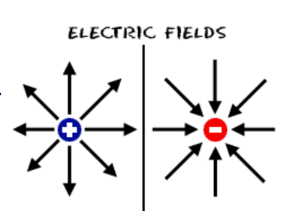
Electric Fields
An electric filed I a region of space where an electric charge experiences a force , just as a gravitational field is a region where a mass experiences a force .
The arrows on the field lines tell us the direction on the field .
Defined as the direction of force on a positive charge
The spacing between the lines tells us about
The strength .

Slide 9
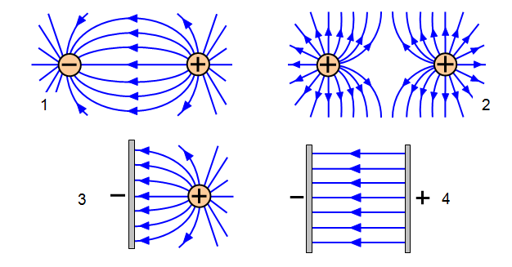
Electric Fields
The filed lines caused by parallel electrodes are parallel to each other and equally spaced .
This field is uniform
It has the same strength at all points.

Slide 10
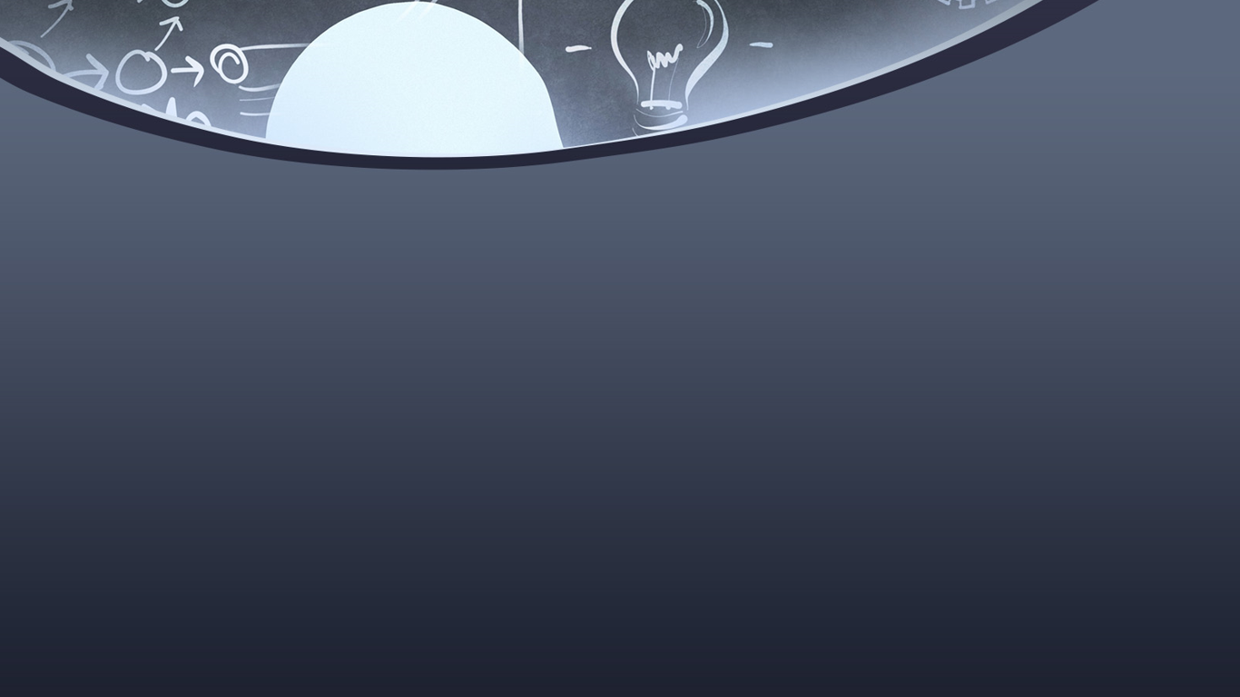
THANK YOU
ANY QUESTIONS ?

