Slide 1


Introduction to Forces

Slide 2

Force
The force is a pull or push exerted by an object on another.
Measured in newton (N)
It is a vector quantity therefor it can be represented by lines and arrows
Note:
Vector quantity : Is a quantity that has both magnitude and direction .
Scalar quantity : Is a quantity that has only a magnitude without direction

Slide 3
Resultant of Two Forces
The combined effect of the two Forces is called (Resultant of Two Forces )
Forces acting in the same direction are added together (R1 + R2)
Forces acting in the opposite directions are subtracted from each other (R1 –R2)

Slide 4
Driving & Resisting Forces
Driving Force : Forces that are acting in the direction of motion of the object
Resisting Force : Forces that are acting against the direction of motion of the object
DRIVING FORCE
RESISTING FORCE

Slide 5
Types of Forces
Gravitational Forces
Normal contact Forces
Up thrust Forces
Frictional Forces
Air Resistance
Tension

Slide 6
Gravitational Force
The gravitational pull of the Earth on an object that are within the Earth’s Gravitational Field .
These forces are always drawn as if they act at the centre of gravity ,or centre of mass of the object
Always vertically downwards
Equation :w=mg
w:weight , m :mass , g:gravitational pull (9.8)

Slide 7
Normal Contact Force
The force that exist whenever two solid surfaces are in contact .
It is exerted by a solid surface on an object which pushes against this surface.
Normal contact force is always perpendicular to surface that produces it

Slide 8
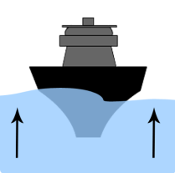
Up Thrust Force
Any object placed in a fluid such as water or air experiences an upward force whether the object is partially or completely submerged in the liquid.
This is what makes it possible for things to float in water

Slide 9
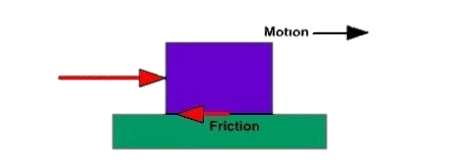
Frictional Forces
Force that arises when two Surfaces are sliding or trying to slide over one another
Frictional force is a resisting force
Always acts along a surface
Always against Sliding

Slide 10
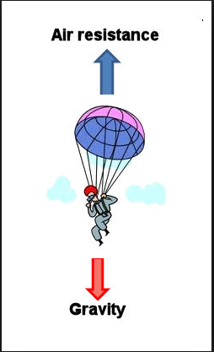
Air Resistance
Air resistance or drag is a force that occurs when an object is moving through air.
This due to air having to be pushed out of the way
Air Resistance is also a resisting force
Air resistance increases with:
The speed of the object
The are of cutting through the air

Slide 11
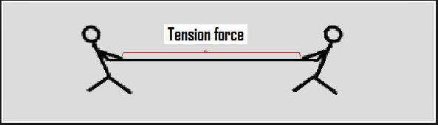
Tension
This is the force in a rope or a string when it is stretched
If you stretch a string the tension tends to pull it back
If you squash a string the tension tends to expand it back

Slide 12
THANK YOU

