Slide 1
Energy resources

Slide 2

Energy resources
Types of energy resources
Solar energy
Geothermal energy
Hydroelectric energy
Wind energy
Nuclear energy
Chemical energy

Slide 3
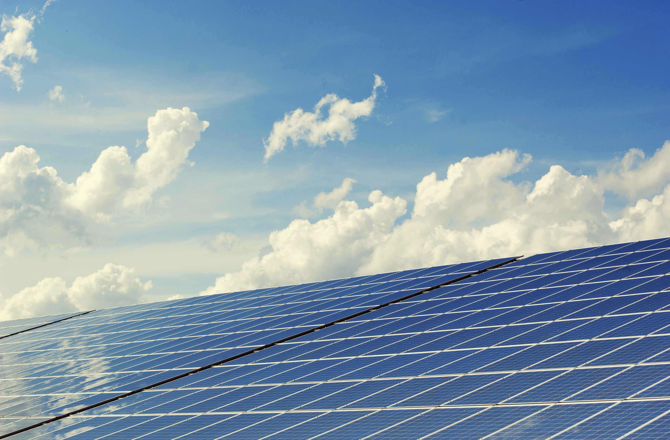
Solar energy
The solar panels are used to make use of energy from the sun as they capture heat .
This heat is used to heat water which can be later used for domestic purposes in the house .

Slide 4
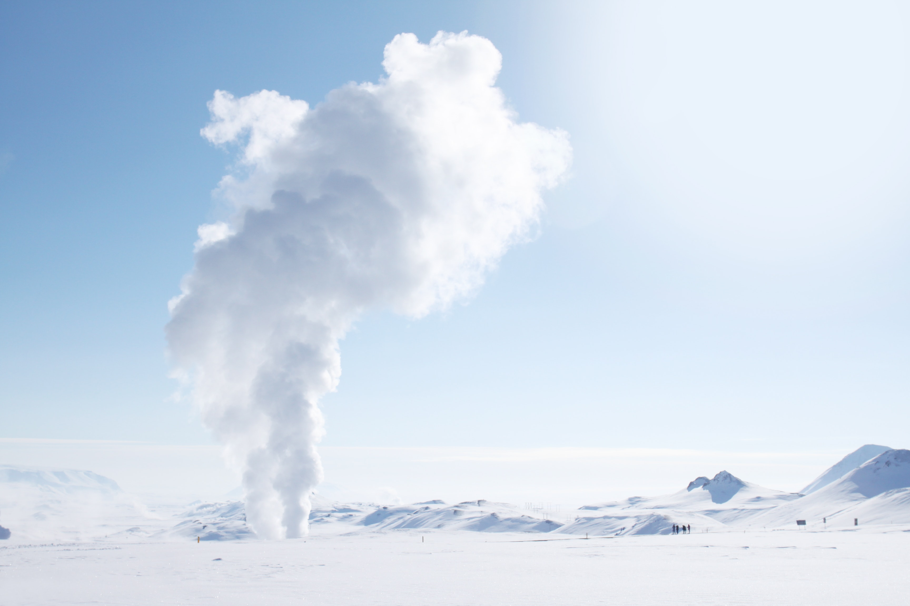
Geothermal Energy
the earth buries under its surface areas of hot rocks .
If cold water is pumped through pipes , the heat of the rocks is released to the water which is pumped again to drive the generators or to warm houses.

Slide 5
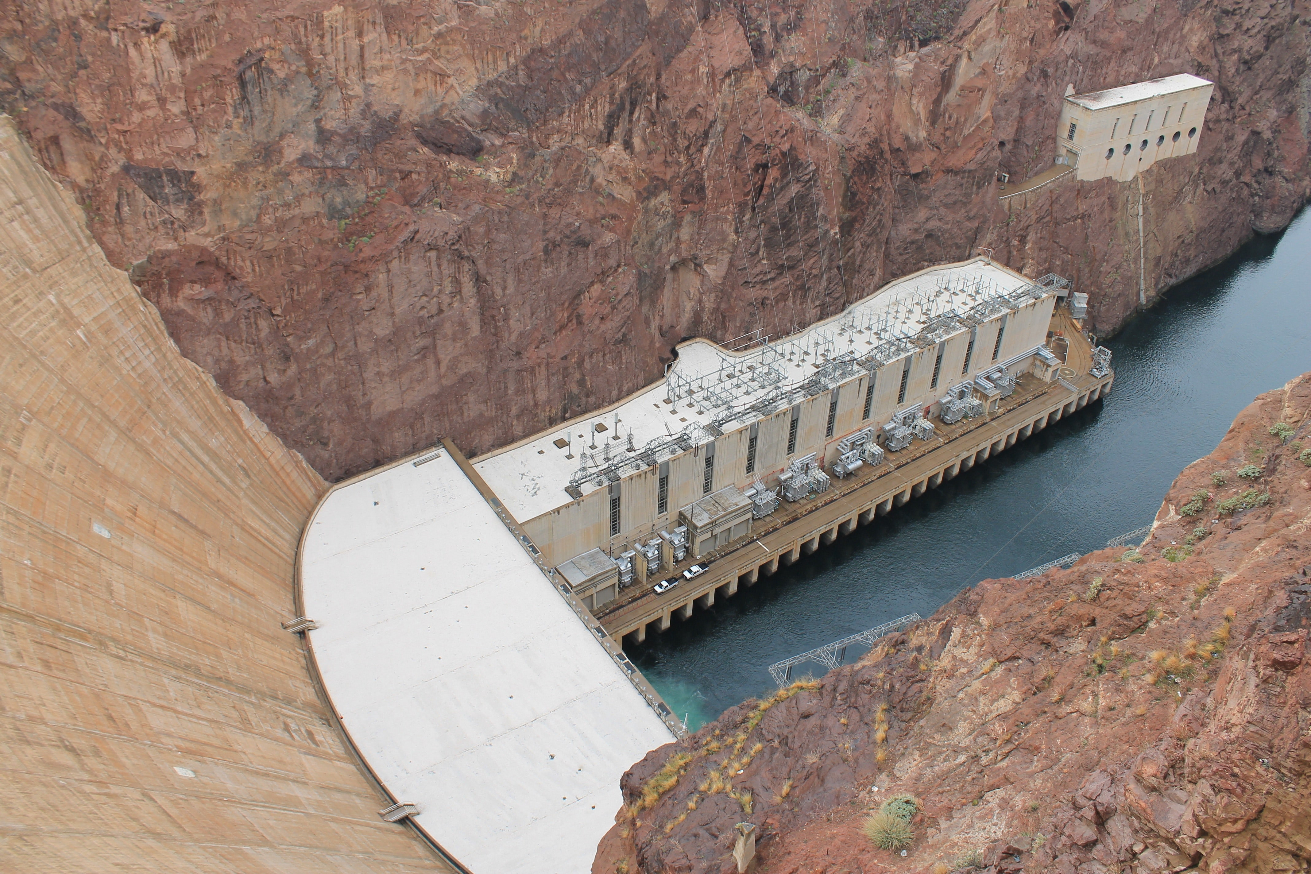
Hydroelectric Energy
Also known as energy from water
Waterfalls, tidal energy and wave energy
These movements of water can be used to turn turbines and drive generators .

Slide 6
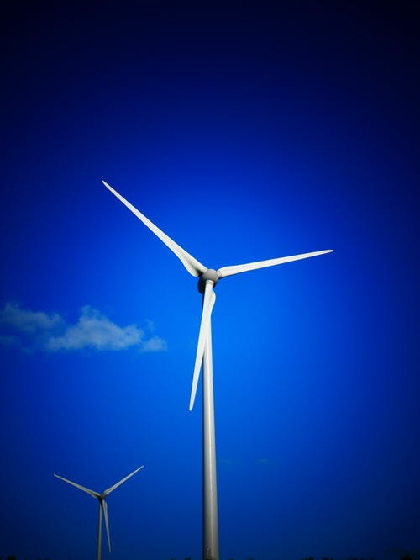
Wind energy
The energy of moving air can be used in :
Sailing ships
Operating large windmills
The operating large windmills turn turbines and generates electricity

Slide 7
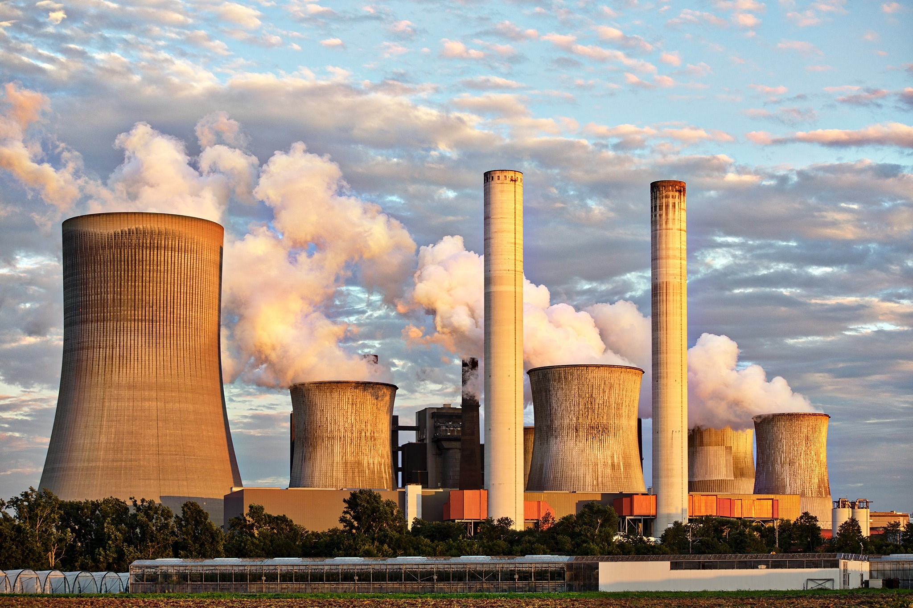
Nuclear Energy
Nuclear fussion takes place in an nuclear reactor and large amount of heat energy is released which is also used to heat water , turn turbines and drive generators

Slide 8
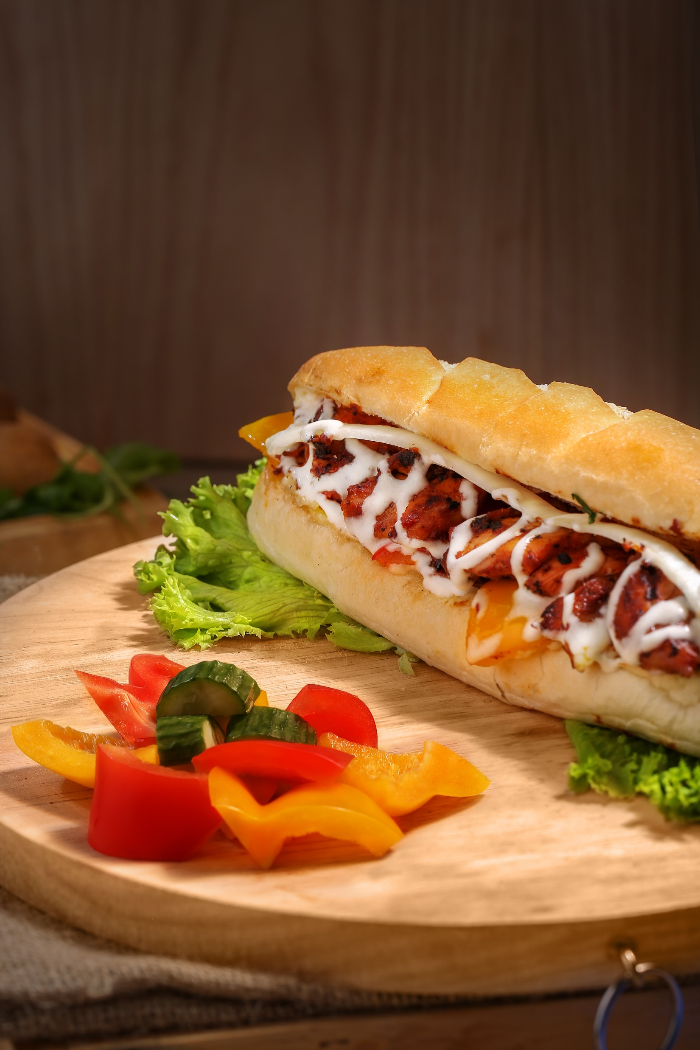
Chemical Energy
The chemical energy is stored in fossil fuels (coal , oil and natural gas) is converted to heat energy when these fuels are burnt.
Chemical energy is also stored in the food we eat .

Slide 9
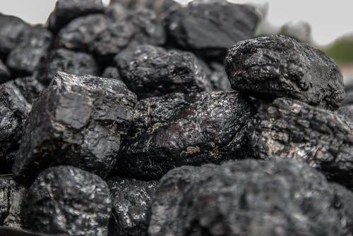
Renewable & Non-Renewable
Renewable sources of energy are sources that will not run out and are continuously replaced such as solar energy , wind energy , waver energy , tidal energy , hydroelectric energy and geothermal energy .
The trouble is that many of them are unreliable because hey depend on the weather.

Slide 10

Advantages
No air pollution
They will never run out
Don’t damage the environment (except visually)
No fuel costs , although the initial costs are high

Slide 11

Disadvantages
Limited number of suitable sites
They are non-reliable (they don’t always deliver when needed – if the weather isn’t right for example).
Require large areas of land or water , so in case of wind power stations for example because large numbers of wind mills are needed, large space is needed which may lead to the damage of natural habitat and visual pollution.

Slide 12

Thank You

