Slide 1
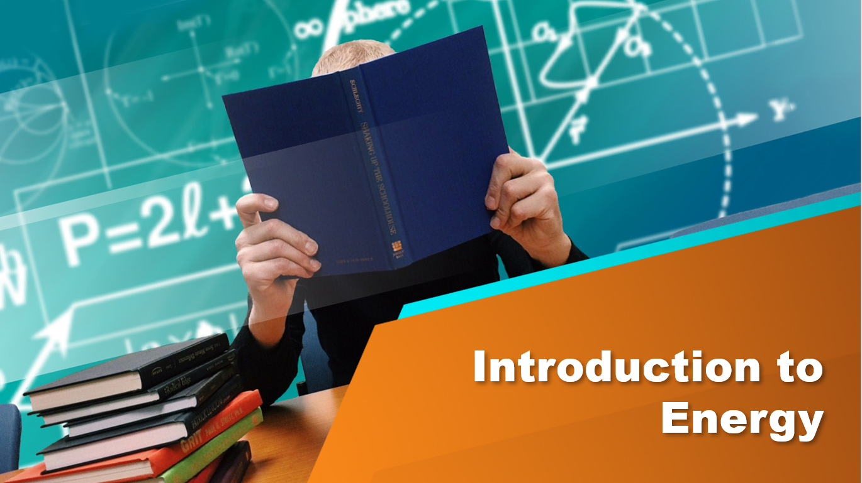
Introduction to Energy

Slide 2

Energy
Energy is the ability to do work .
It’s a scalar quantity .
Measured in Joules (J)
Note:
Vector quantity : Is a quantity that has both magnitude and direction .
Scalar quantity : Is a quantity that has only a magnitude without direction

Slide 3
Kinetic Energy
Is the energy of n object due to its motion .
The faster an object is the more kinetic energy it has.
If an object accelerates , its kinetic energy increases.
If a object decelerates , its kinetic energy decreases.
If an object travels at a constant speed , its kinetic energy remains constant .
If an object is at rest , its kinetic energy is zero.
Rule : EK=1/2 mv^2 where m = mass & v = velocity

Slide 4
Potential Energy
Is the type of energy that is stored in a body and available to do work
We will compare only four kinds of potential energies.

Slide 5
Types of Potential Energy
Gravitational Potential Energy
Chemical Potential Energy
Elastic Potential Energy Forces
Nuclear Potential Forces

Slide 6
Gravitational Potential energy
It is the energy of an object due to its position or height .
If an object is raised its potential energy increases .
If an object is lowered its potential energy decreases .
Rule : EP= mg* h1-h2 where m = mass , g=9.8 & h = height . h1 is the initial height
h2 is the final height.

Slide 7
Chemical Potential Energy
This is a stored form of energy that is released by chemical reactions .
Examples:
Energy of food is released by chemical reactions in our bodies .
Chemical energy in the batteries which when in use is transferred to electrical energy
Energy released in burning fules

Slide 8
Elastic Potential Energy
This is the energy stored in a body when it experiences elastic deformation by stretching , compressing or twisting it .
It may be also called Strain energy
It very important type of energy to study
One of the important uses of is are the spring used in the cars .(it must be calculated the amount of energy it can with hold without a permanent deformation)

Slide 9
Nuclear Potential Energy
This is the energy stored in the nucleus of an atom .
This nuclear energy can be released from certain elements by two methods:
Nuclear Fission: the splitting of heavy nucleus into lighter nuclei.
Nuclear Fusion: the union of light nuclei into heavier ones.(Energy is released by nuclear fusion in the sun )

Slide 10
Conservation of Energy
Energy cannot be created or destroyed , it can only be transformed from one form to another. (principle of conservation of energy)
Examples :
Person lifting a load (chemical energy form the person transfers to gravitational potential energy gained by the load + heat energy released from the muscles)
Person stretching a spring (chemical energy transformed to elastic potential energy + heat energy)

Slide 11

THANK YOU

