Slide 1
Physics and Measurements

Slide 2
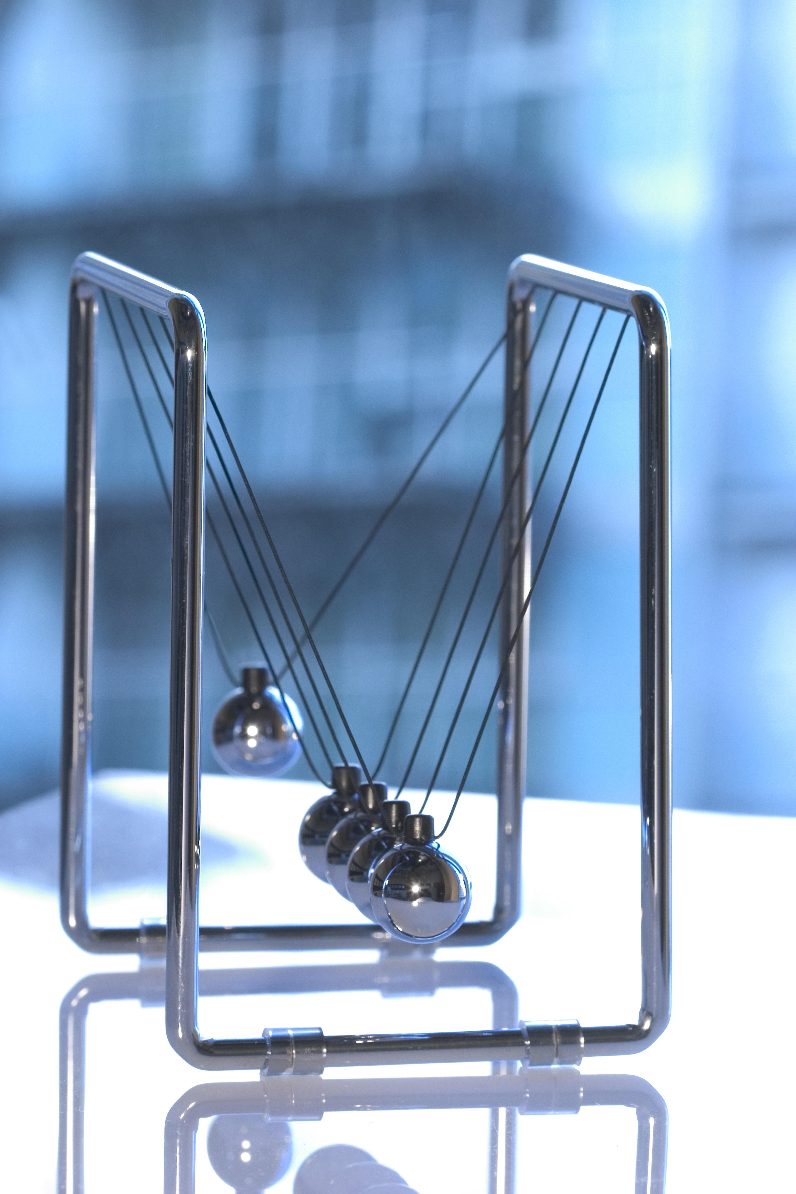
Physics
Physics is the science of measurement .
Physical quantity is any quantity that can be measured .

Slide 3
Units of Measurement

Slide 4
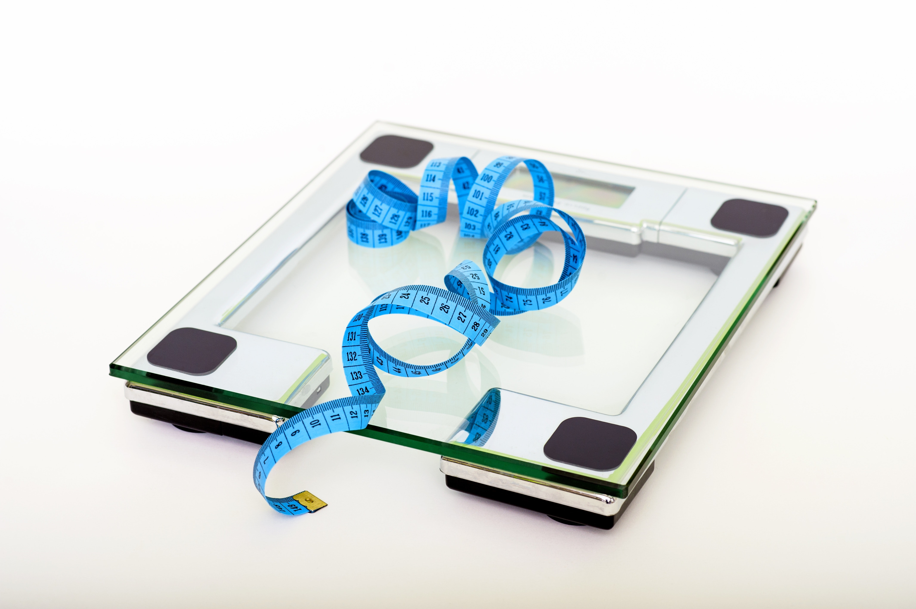
Mass
The mass of an object is the mount of matter contained in this object .
The mass is usually measured in kilograms but in USA it measured in pounds
Examples
Balance
Top-Pan Balance
Beam Balance

Slide 5
Volume
Volume of an object is the amount of space occupied by the object.
Volume is usually measured in cubic meter (m^3)
There is two method to measure volumes
Regular solids : can be calculated using ruler measurements (Width , Height, Length )
Irregular solids : displacement method

Slide 6
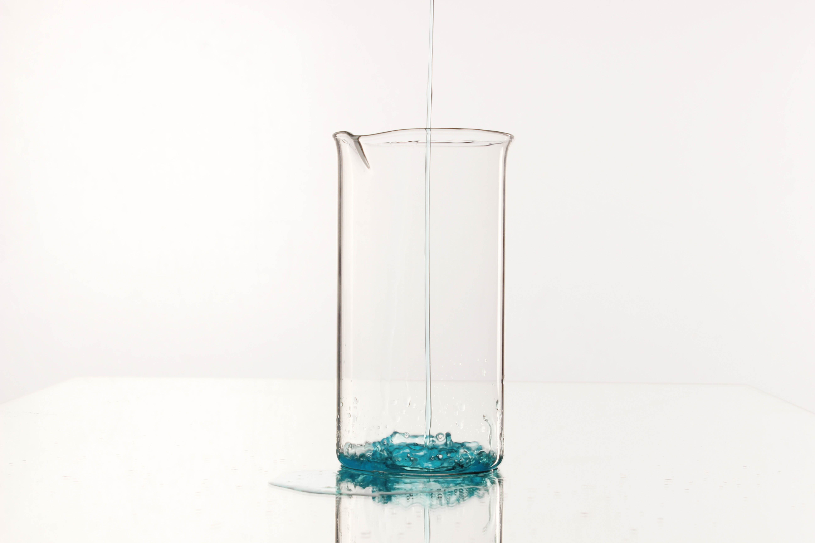
Displacement method
Steps for measuring volume :
Fill a measuring cylinder with water
Take reading of the level of the water
Wrap the irregular shaped solid with a wire
Put in the cylinder
Take the readings of the water
Subtract the new reading from the old reading

Slide 7
Precautions for displacement methods
The measuring cylinder should be placed on a flat horizontal table.
You must take the reading while looking perpendicular to the cylinder to avoid parallax error
Use a string to lower the irregular shape being measured gently
The object must be completely submerged in water before taking the reading

Slide 8

Density
Is the mass per unit volume of substance
Density is a microscopic property of matter and it tells sus about how concentrated the matter is
It measures how closely packed the particles are.

Slide 9
S.I system of Units
Scientists have worked out to measure any quantity in nature in terms of small number of base units.
Name of Quantity | Unit of measurement | Symbol for quantity | Symbol for unit
Length | Meter |  | m
Time | Second | t | s
Temperature | Kelvin | T | K
Mass | Kilogram | m | Kg
Electric Current | Ampere | I | A

Slide 10
Powers of Ten
 |  | Prefix | Symbol | Example
Multiple | 10^9 | Giga | G | Gigawatt | GW
 | 10^6 | Mega | M | Megajoule | MJ
 | 10^3 | Kilo | K | Kilogram | Kg
Submultiple | 10^-3 | milli | m | milliampere | mA
 | 10^-6 | micro | m | microcoulomb | mC
 | 10^9 | nano | n | nanosecond | ns
 | 10^-12 | Pico | P | picosecond | ps

Slide 11
THANK YOU
Any Questions ?

