Slide 1
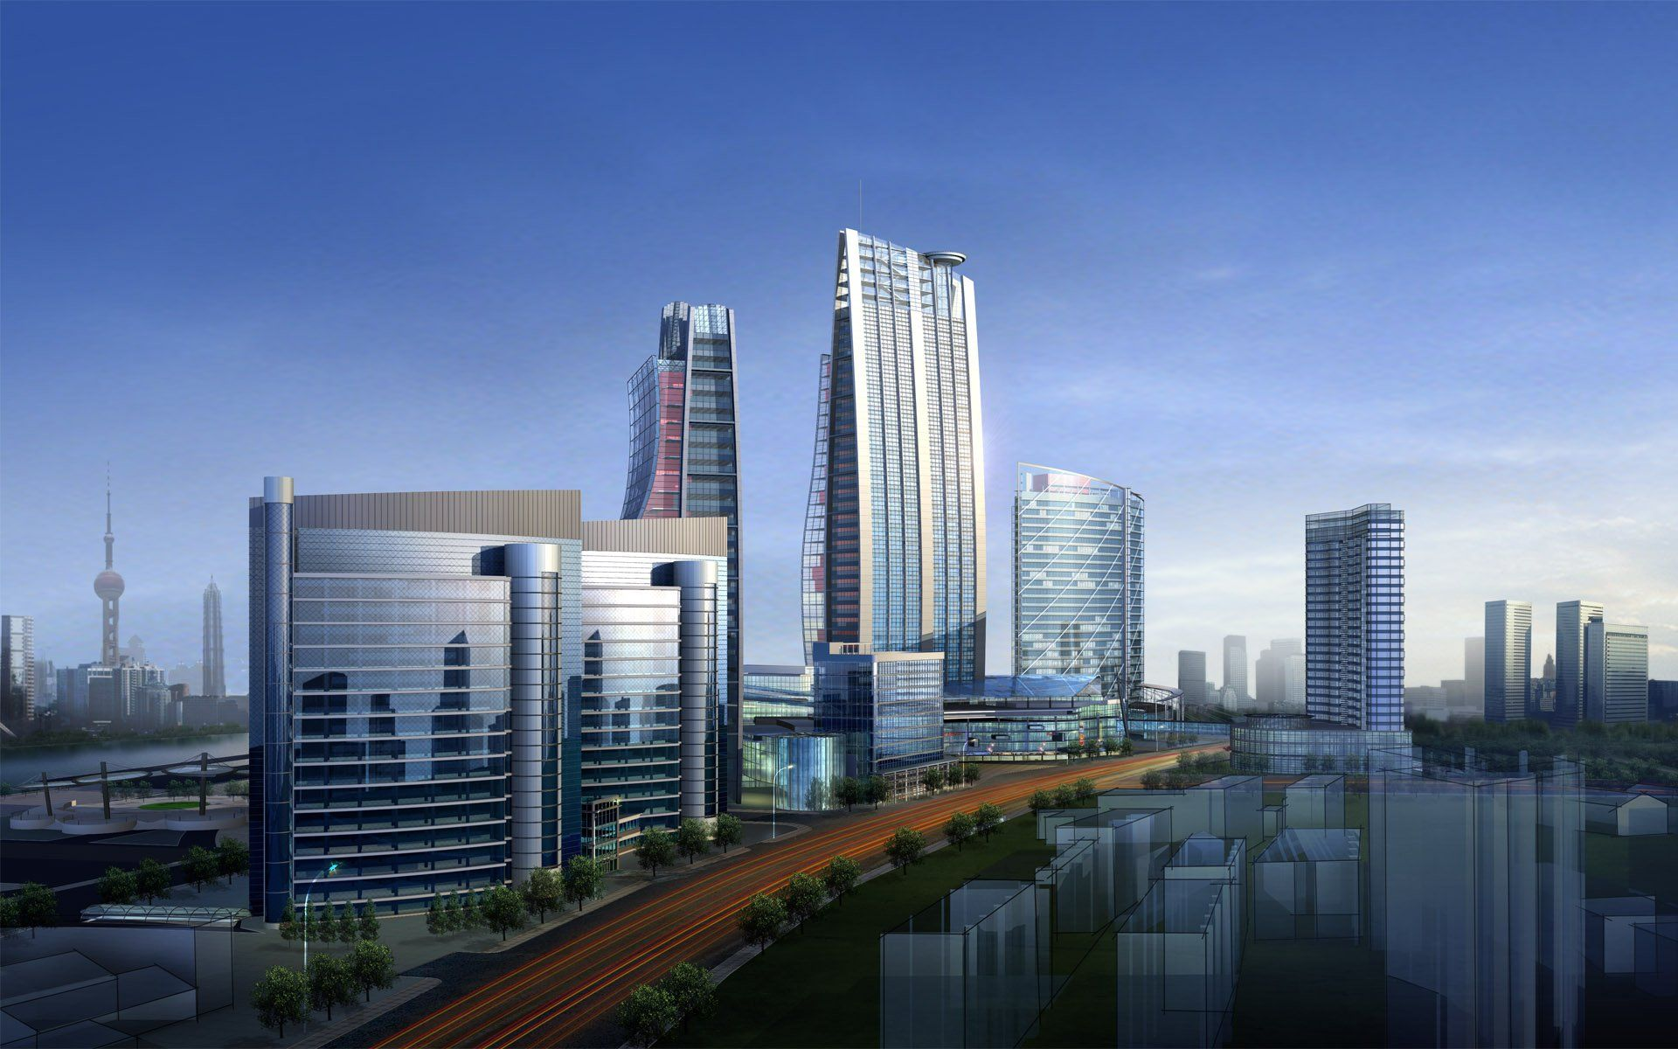
REAL ESTATE
“This is a real-estate-driven economy from top to bottom.”

Slide 2
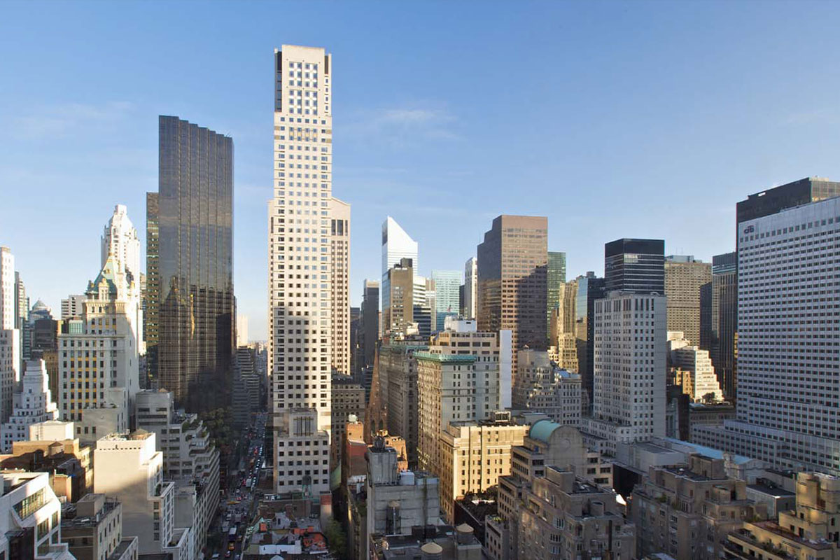
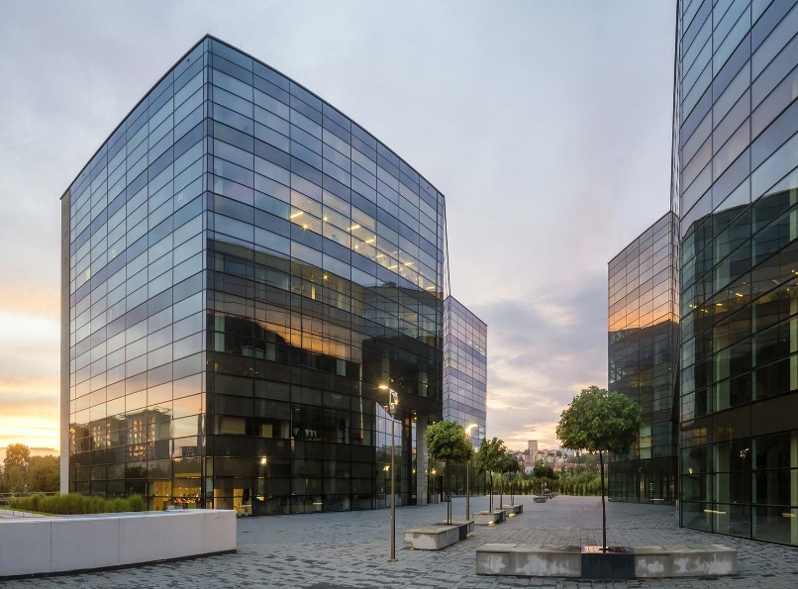

HISTORY
The early human dwellings as pointed by archaeological evidences started in caves.
Zhoukbodian caves system near Beijing, China, dates at 500,000 years.
Easily inhabitants of Australia, the middle east and the perusian Andes have also left remains in caves.
Gradually as agriculture became important to people, some 4500 years ago, people established villages of permanent houses and found new uses for hunting and herding activities.

Slide 3

KEY FEATURES
The term ‘Real Estate’ is defined as land, including the air above it and the ground below
it, and any buildings or structures on it. It is also referred to as realty
Real estate involves the purchase, sale, and development of land, residential and non-residential buildings

Slide 4
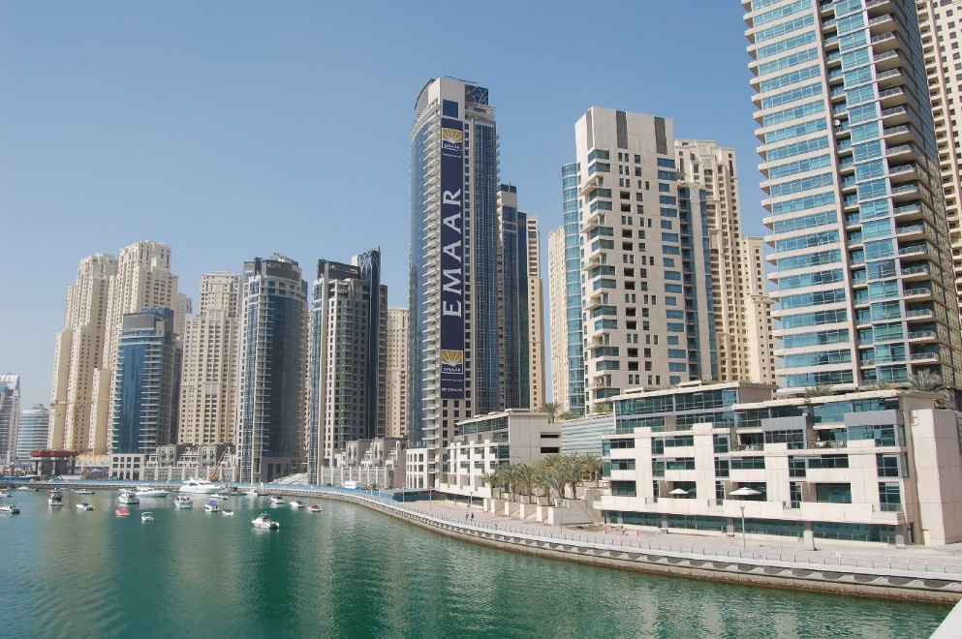
KEY FEATURES
The activities of the real estate sector encompass the housing and construction sectors also
The real estate sector is a major employment driver, being the second largest employer
PRESENTATIONS

Slide 5
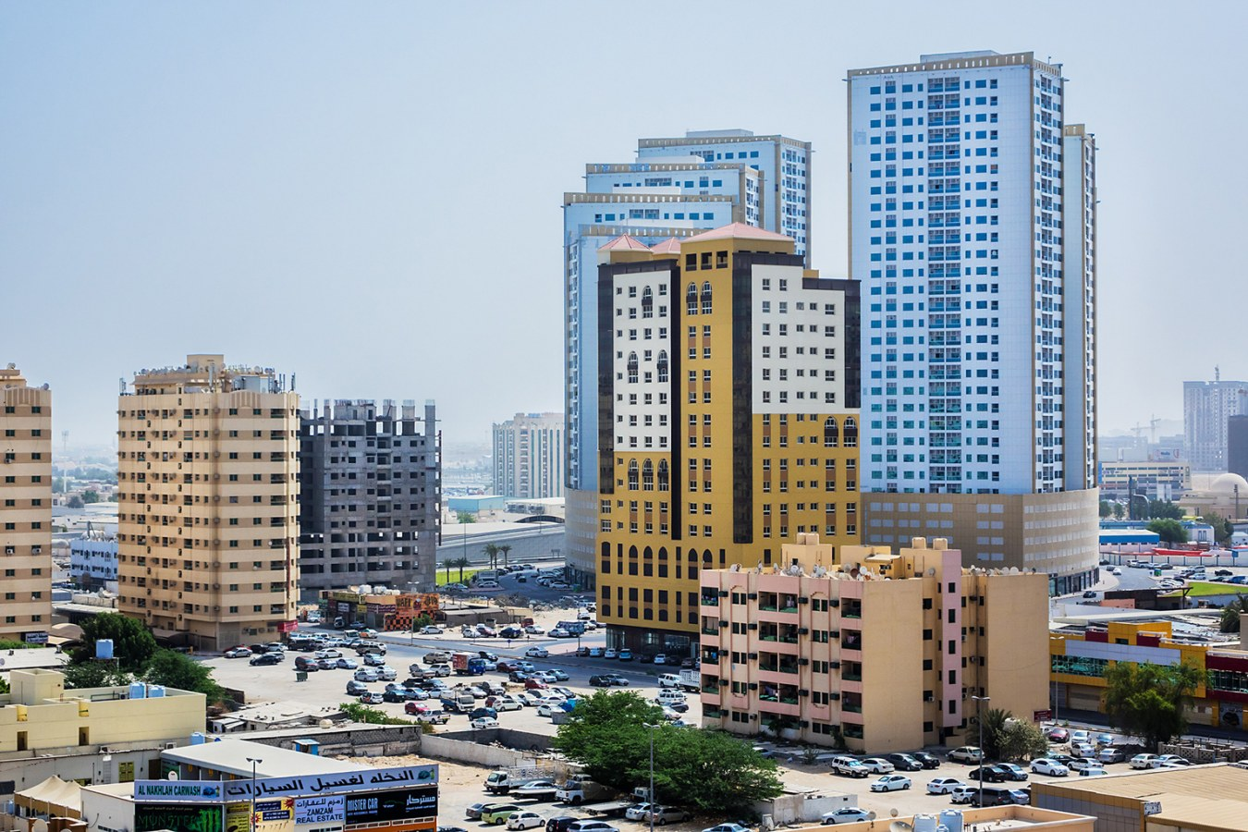
KEY FEATURES
Next only to agriculture
About 250 ancillary industries such as cement, brick, steel, timber, building materials etc. are dependent on the real estate industry
India Still has a shortfall of 2.47 crores as on 2007
PRESENTATIONS

Slide 6

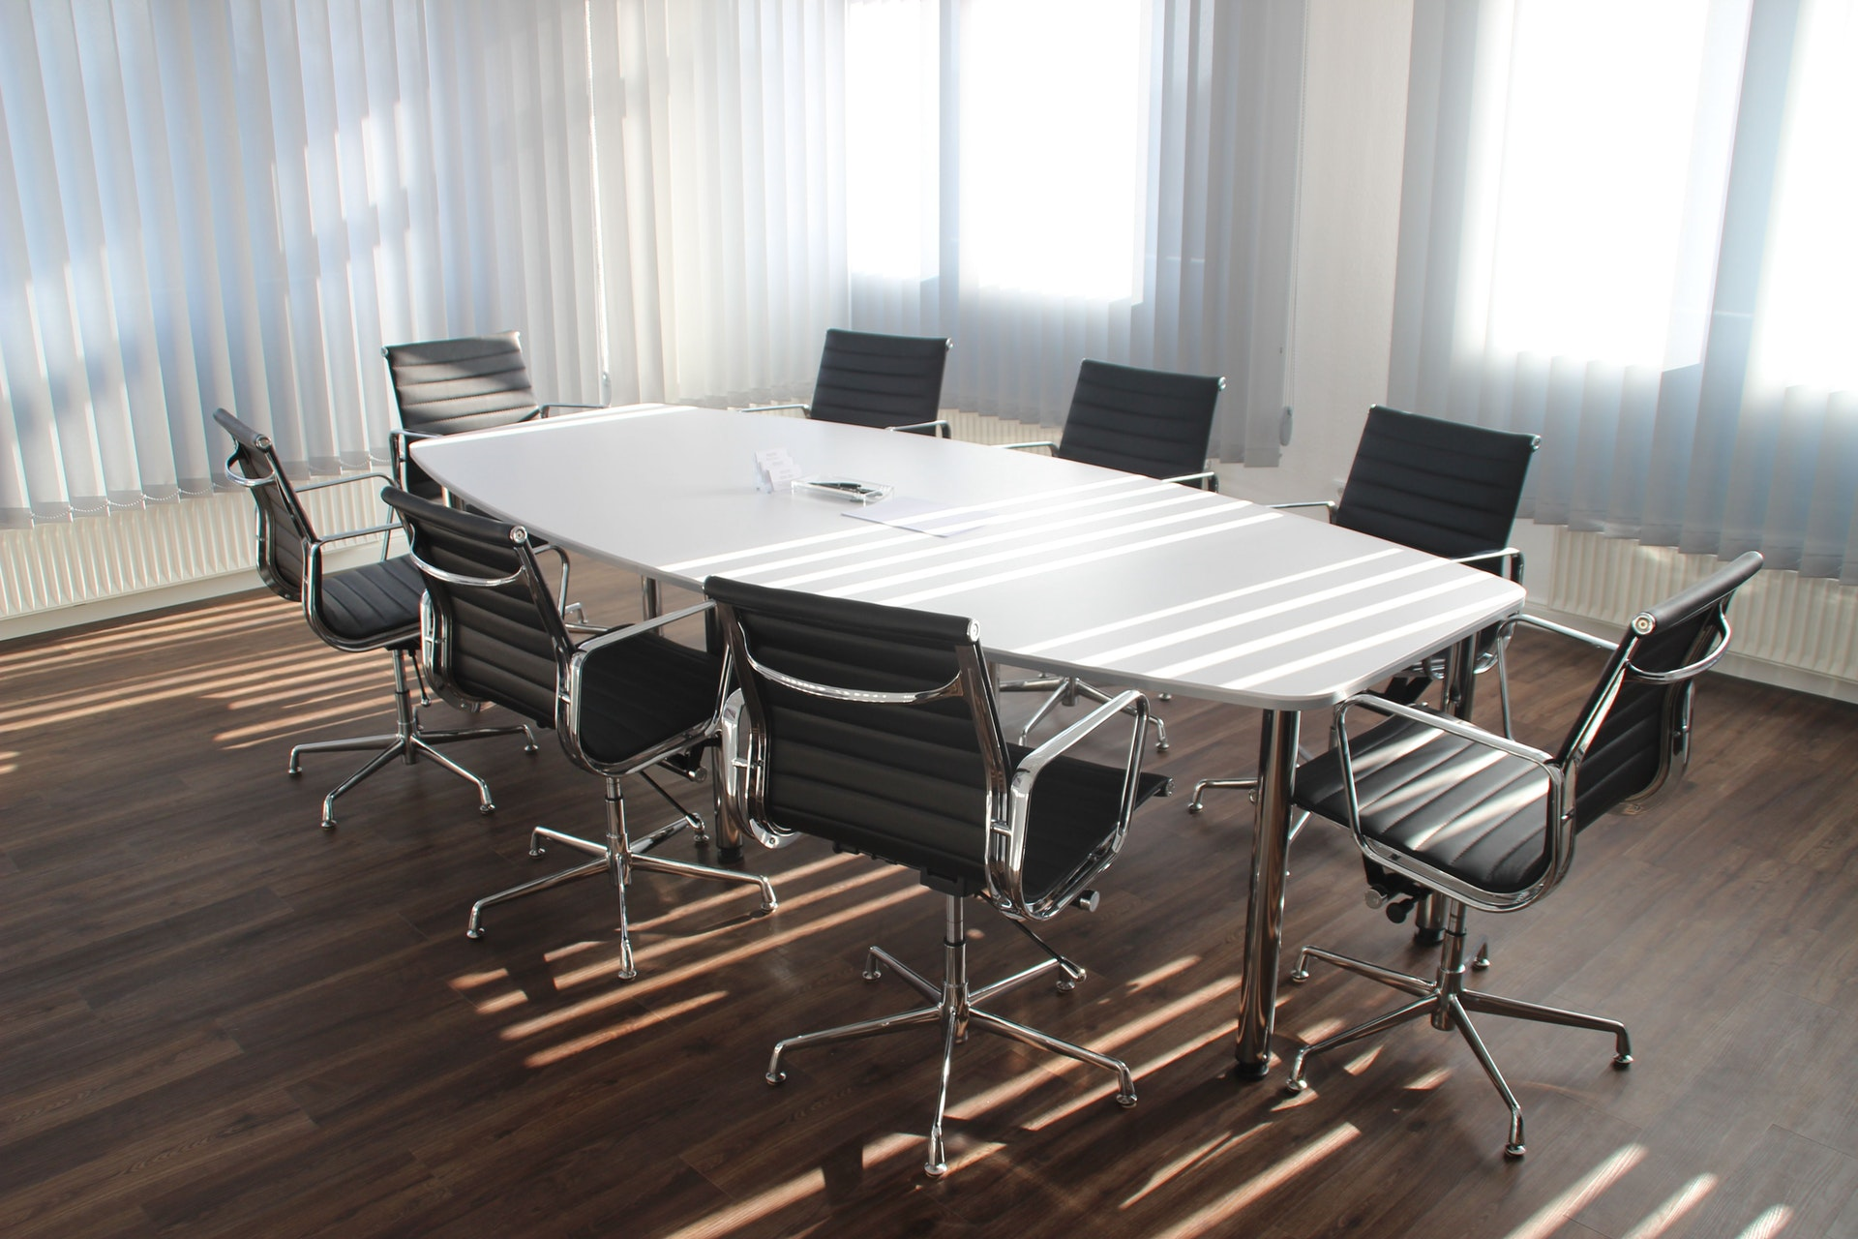
Retail(Malls)
Hospitality (Resorts, hotels, lodges, spa, inns)
Entertainment Industries(Multiplexes, Theatres, Recreation centres )
Economic Services( Hospitals, school)
Information technology(IT) Enabled companies( call centres)
Impact of Real Estate Industry
PRESENTATION

Slide 7

MAJOR CHALLENGES FACED
Land availability and acquisition issue
Lack of Transparency
High stamp duty charges
Variable prices of raw materials
Absence of a centralized regulatory authority
Constraints of funds

Slide 8
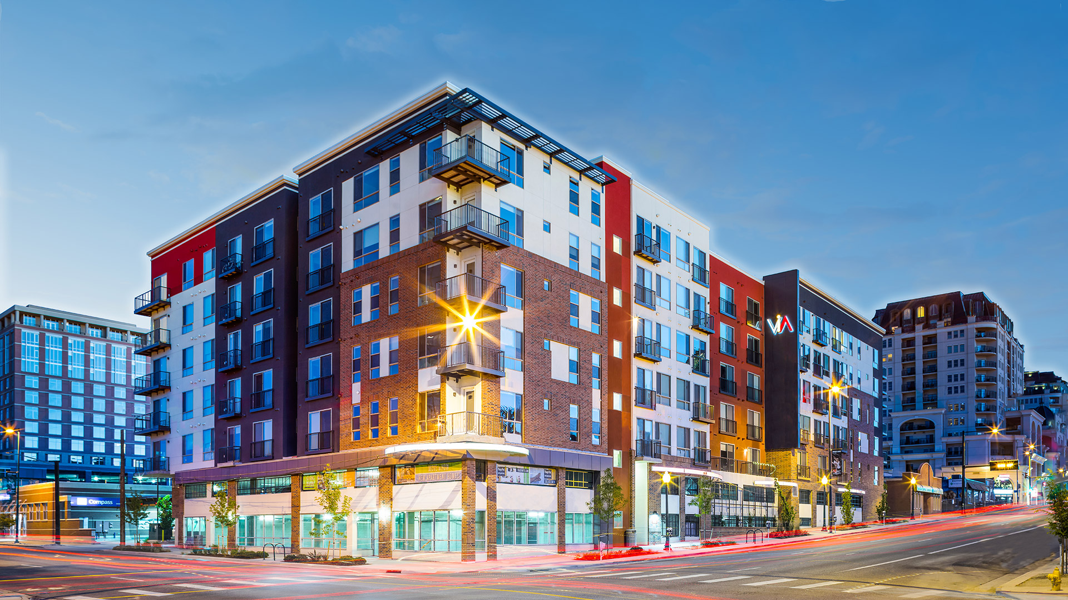
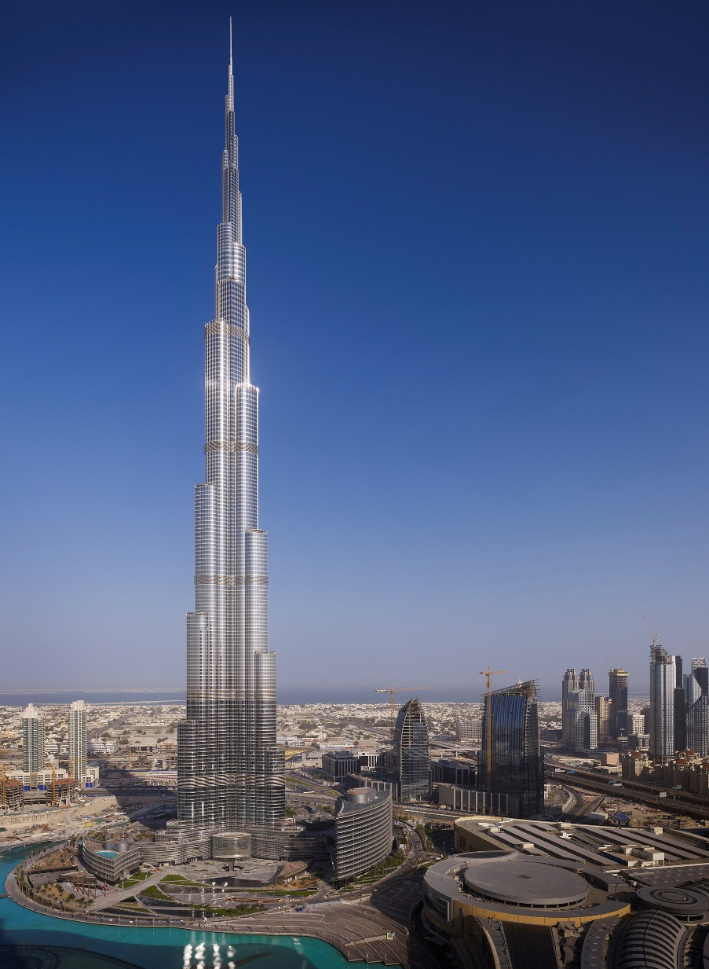
BURJ DUBAI
Highest number of floors in a building – 160, breaking 110 of World Trade Centre buildings
Tallest structure ever built, and freestanding
Highest elevators ever installed
World’s fastest elevators at 64 km/hr.
Worlds highest installation of an aluminium and glass facade at a height of 512 meters

Slide 9

TYPES OF END USERS
Investments
Organizations
Type of occupation
On the basis of size of
family
Budget

Slide 10





Constructing companies
Developers
Engineers
Technicians
Design consultants
Landlords
Foremen
Clerical staff
Skilled workers
Unskilled workers
Banks
Insurance companies
Tenants
Suppliers of material( Electrical, Material, etc.)
Buyers
Government
Licensing/ Registration offices( e.g. BMC)
STAKEHOLDERS

