Slide 1
Vacation Ideas

Slide 2
What will you do this summer?

Slide 3
Cruise
Positive
Negative
One price includes transportation, accommodation, and meals
Visit many locations without having to unpack and repack
High quality food and personal service
Not good if you suffer from seasickness

Slide 4
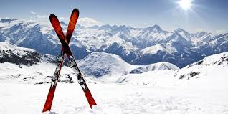
Ski Trip
Enjoy snow-capped mountain peaks and scenic views
Comfortable lodgings directly on the ski slopes
Good way to get exercise

Slide 5
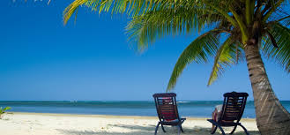
Beach Trip
Play in the ocean
Build sand castles
Participate in water sports including sailing, snorkeling, and SCUBA diving

