Slide 1
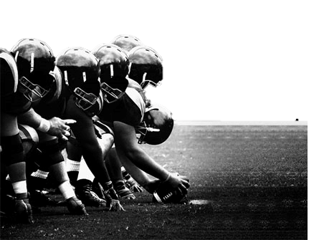
Football

Slide 2
Basics
FORMATIONS
GAME CLOCK
Positions

Slide 3
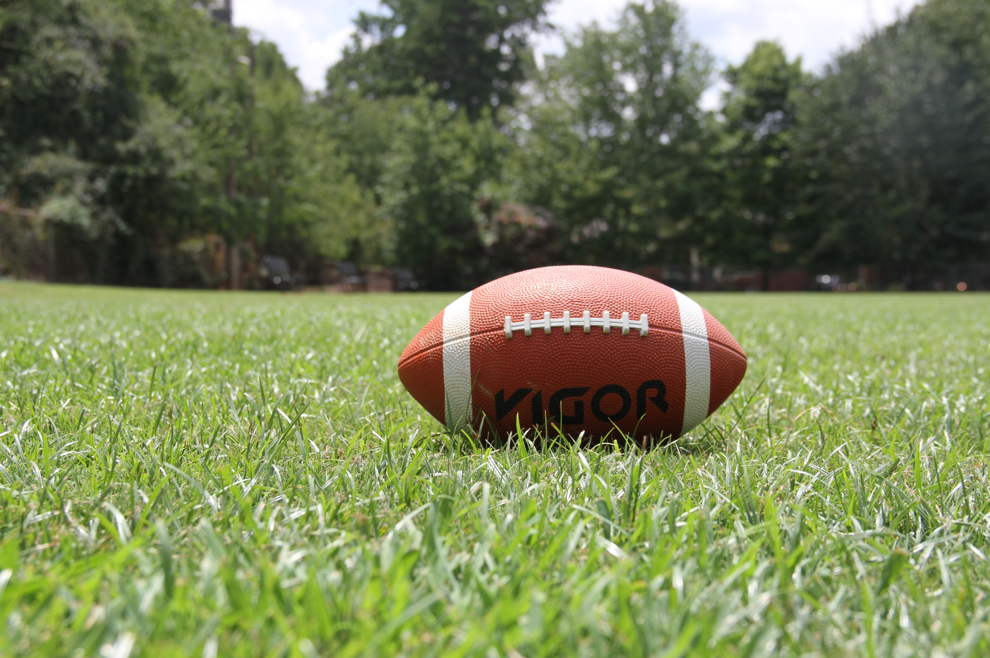
Formations
The kicking and receiving Teams are decided upon a coin toss in the beginning of the game
Special Teams: 11 players from each team ,Team A is the kicking Team and Team B is the Receiving team . After this play ends
Offensive unit : (the Receiving Team )
Defensive Unit :(The kicking Team )

Slide 4
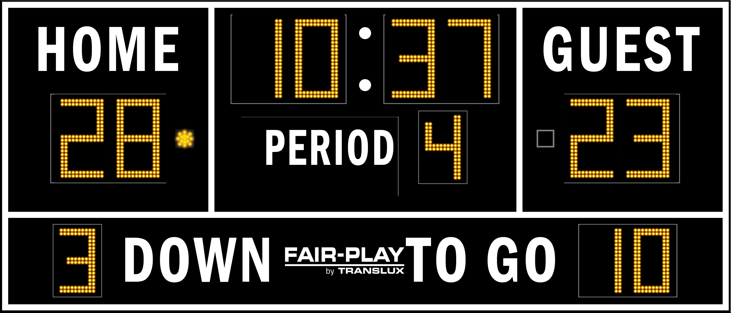
Game Clock
In an American football game, the game clock, which is operated by a timekeeper in the press box, doesn’t run continuously throughout the game’s 15-minute quarters.
The clock stops for the following reasons:
Either team calls a timeout..
The quarterback throws an incomplete pass.
The ball carrier goes out of bounds.
A player from either team is injured during a play.
An official signals a penalty by throwing a flag.
A wet ball needs to be replaced with a dry one.

Slide 5
Offensive Unit

Slide 6
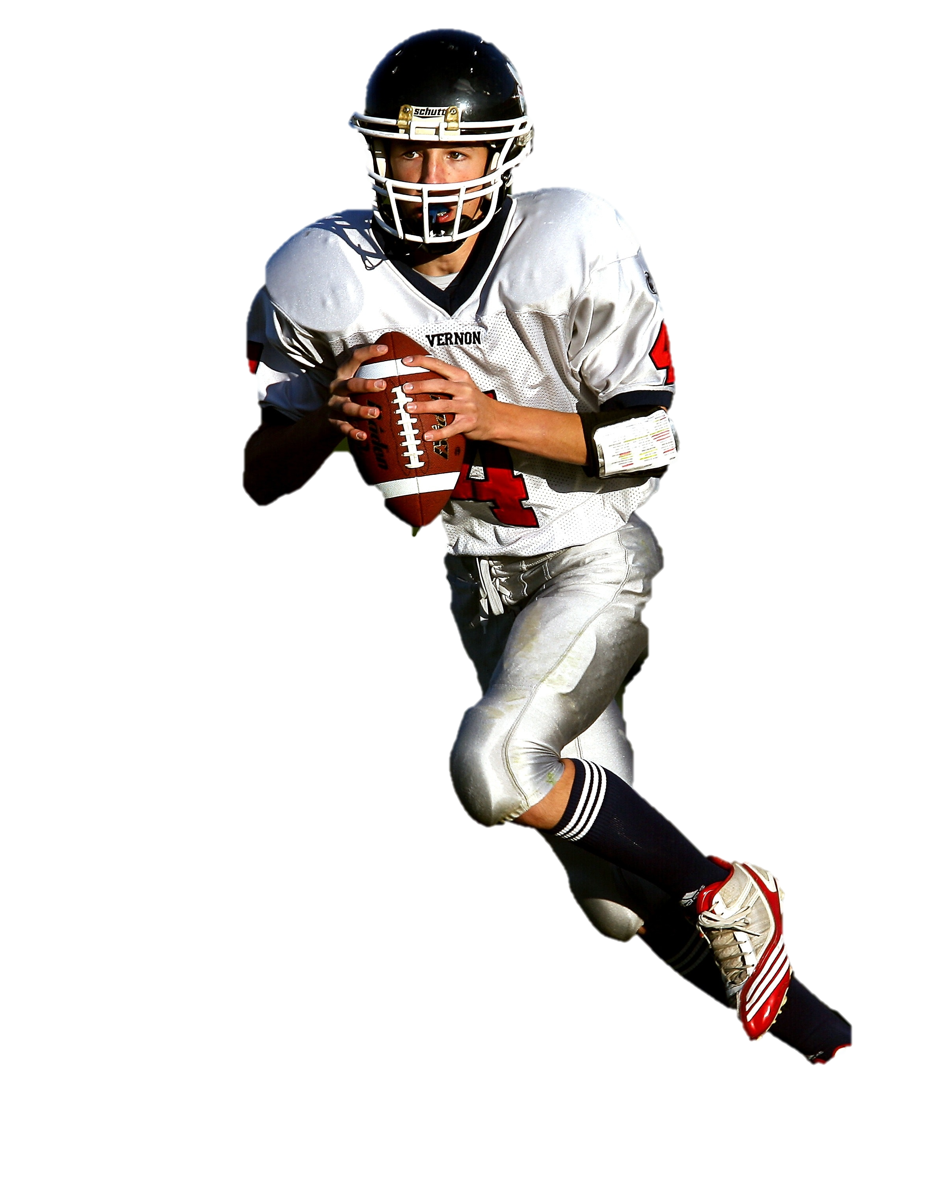
Quarter Backs
Leadership
Arm Strength
Intelligence
vision
Mobility

Slide 7
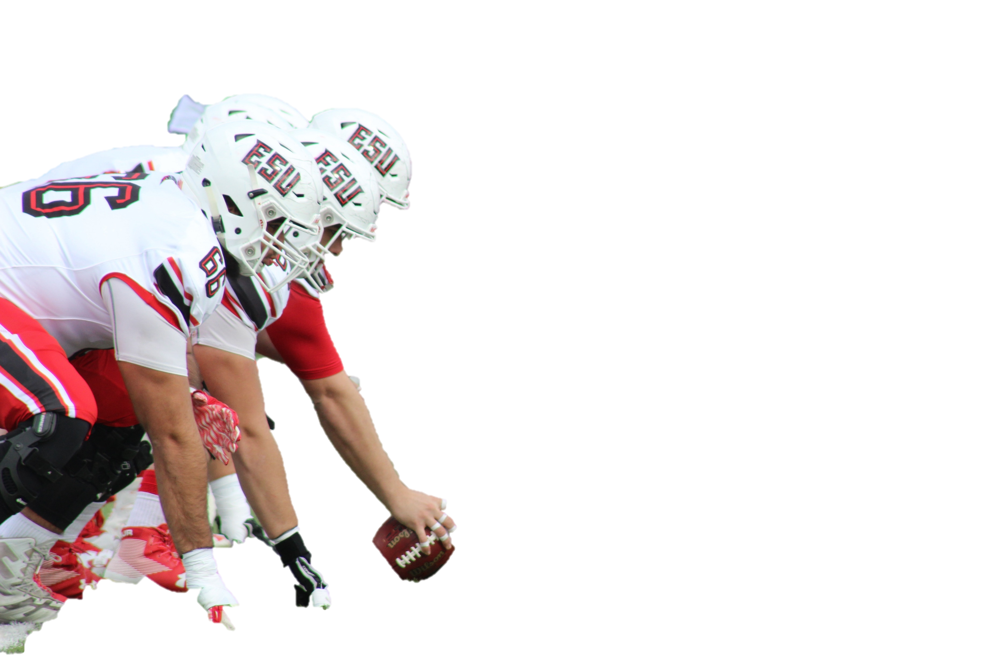
Offensive Linemen
Physical Strength
Strong Feet
Blocking
Heavy Weight

Slide 8
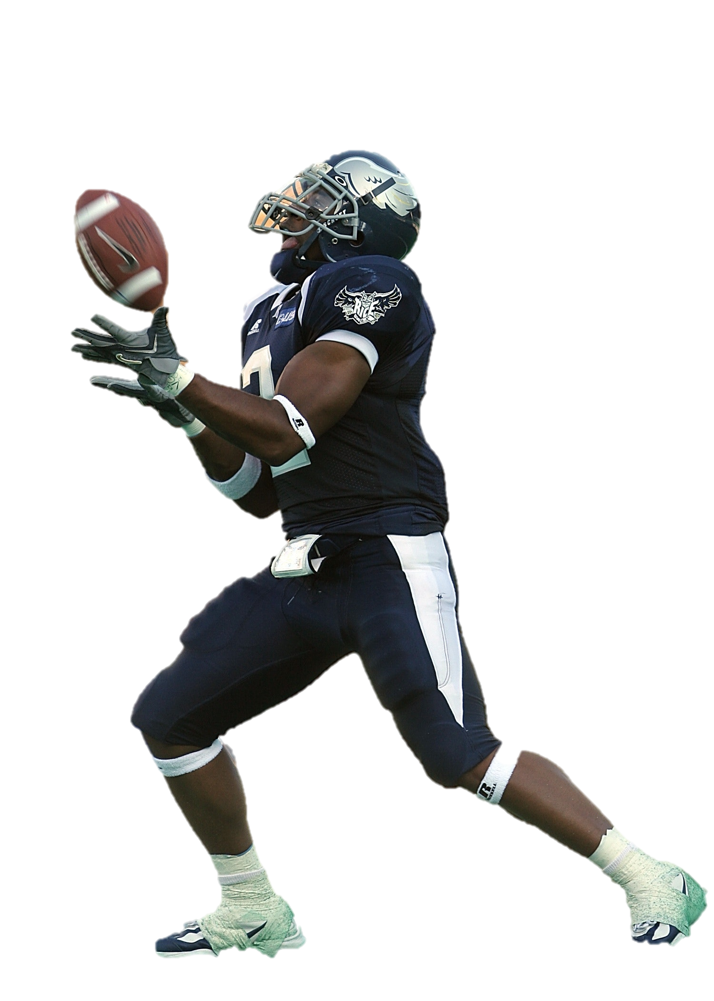
Receivers
Route Running
Catching
Blocking
Speed

Slide 9
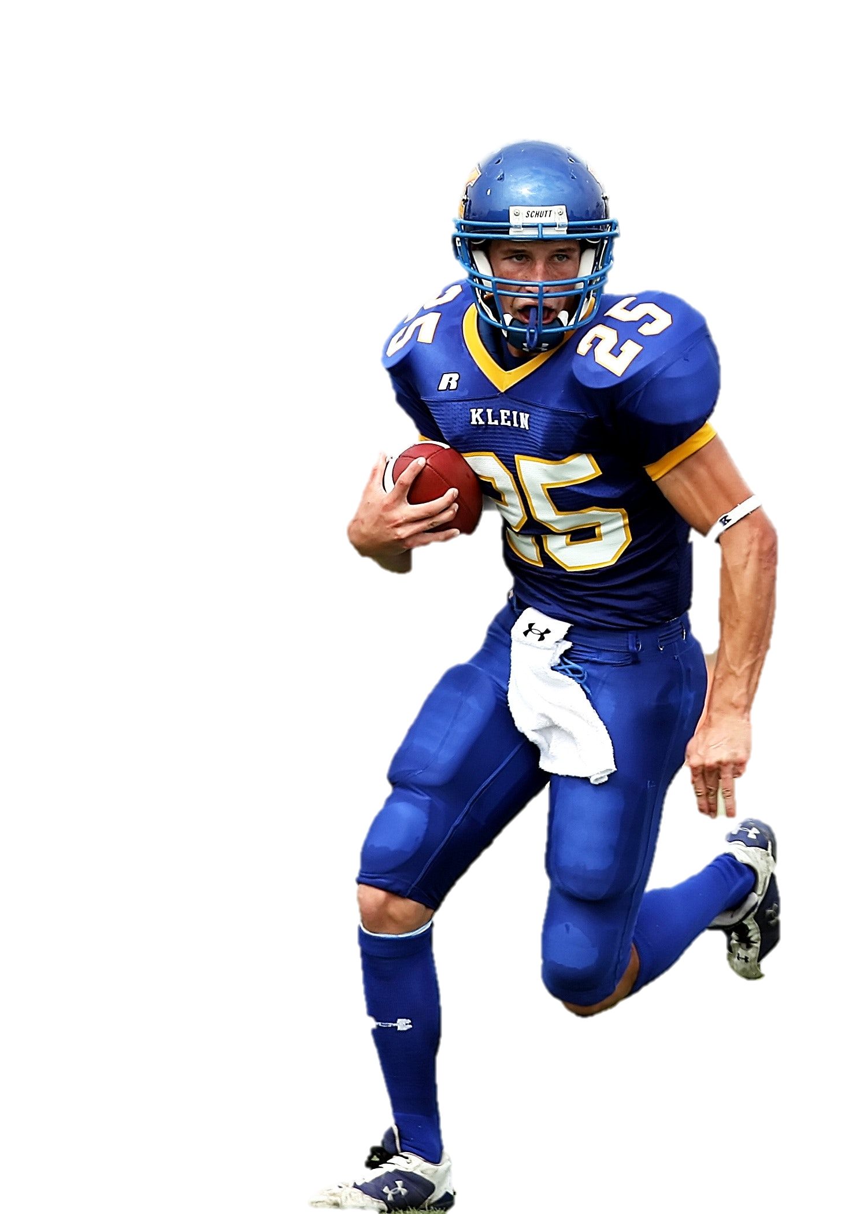
Running backs
Change direction
Elude Defenders
Tough
Speed

Slide 10
Defensive Unit

Slide 11
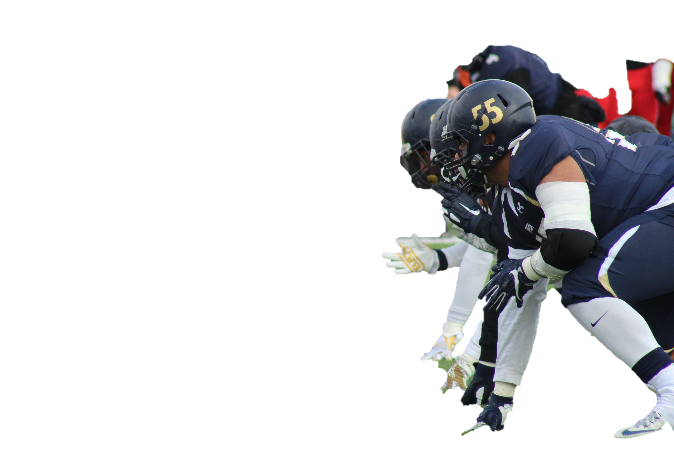
Defensive Linemen
Arm & Hand Strength
Quickness
Durability
Size

Slide 12
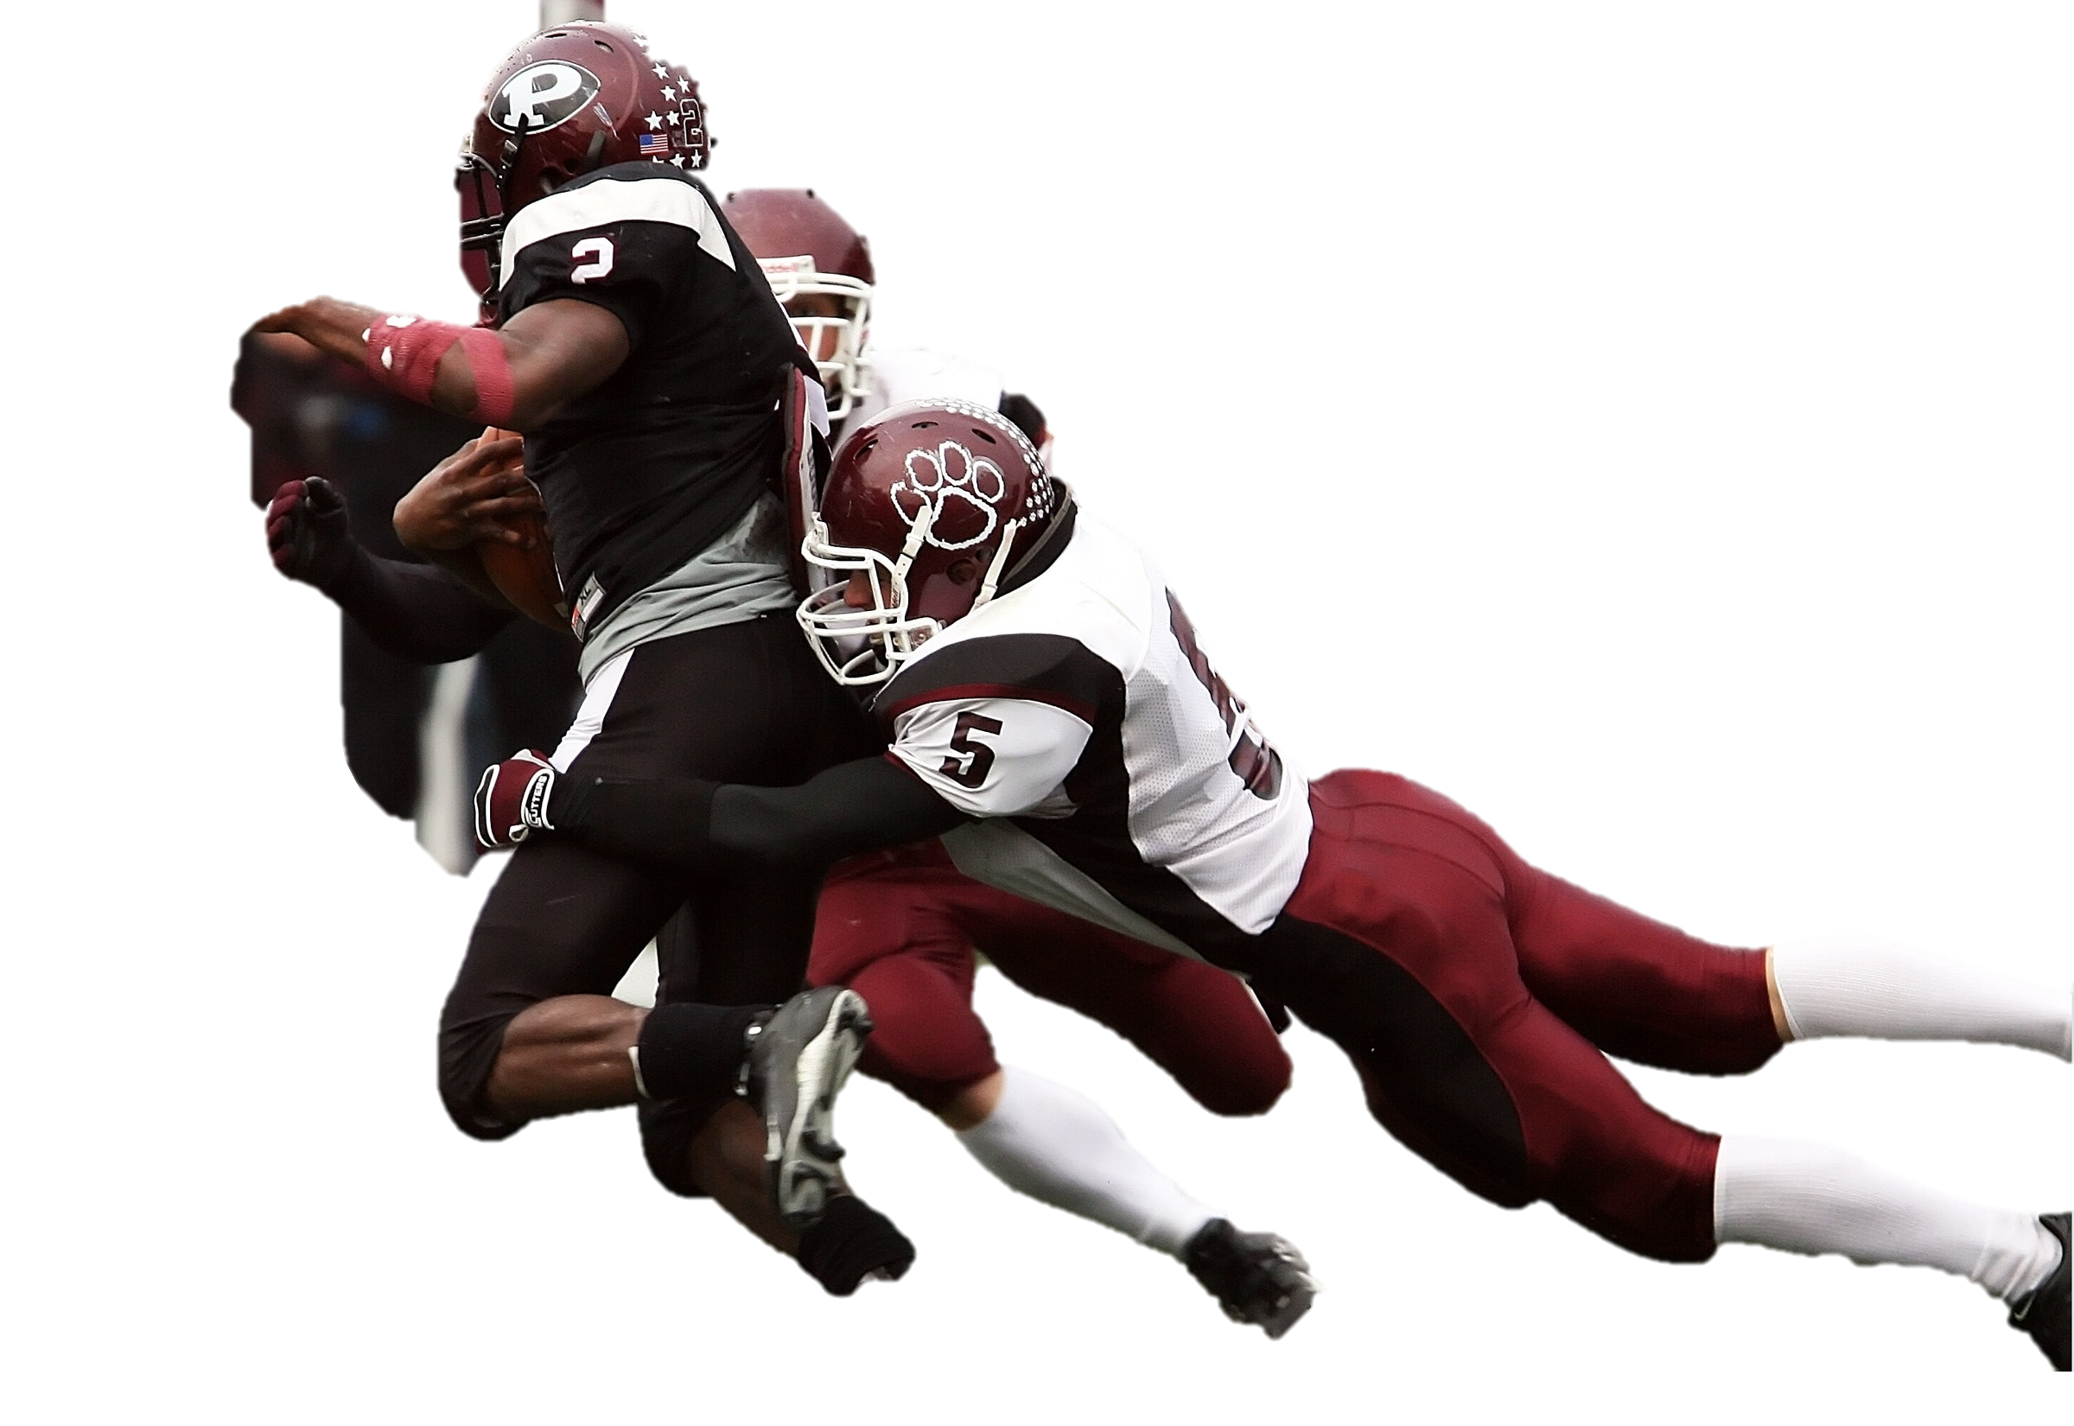
Linebackers
Physical Strength
Strong Feet
Intelligence
Vision

Slide 13
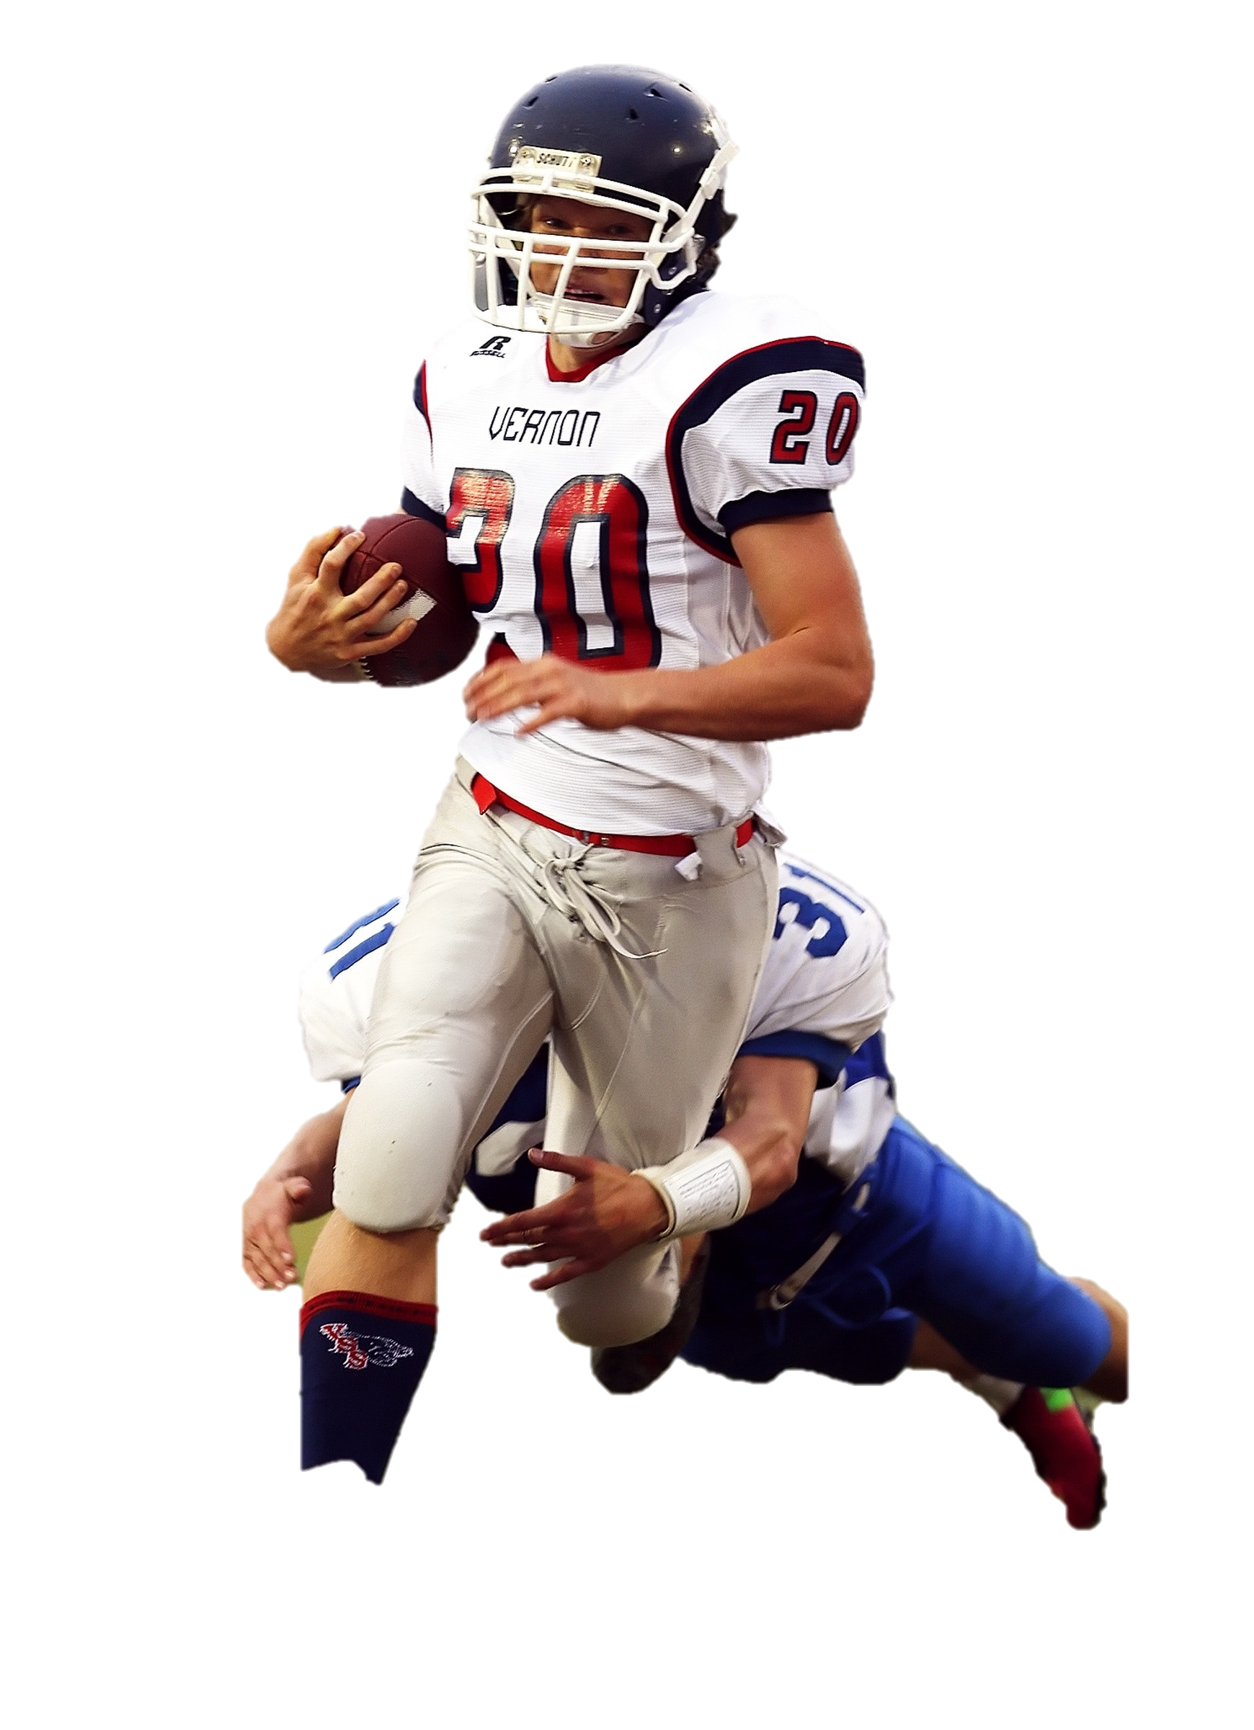
Cornerbacks and Safety
Strong Feet
Intelligence
Chemistry
Ball Hawk

