Slide 1
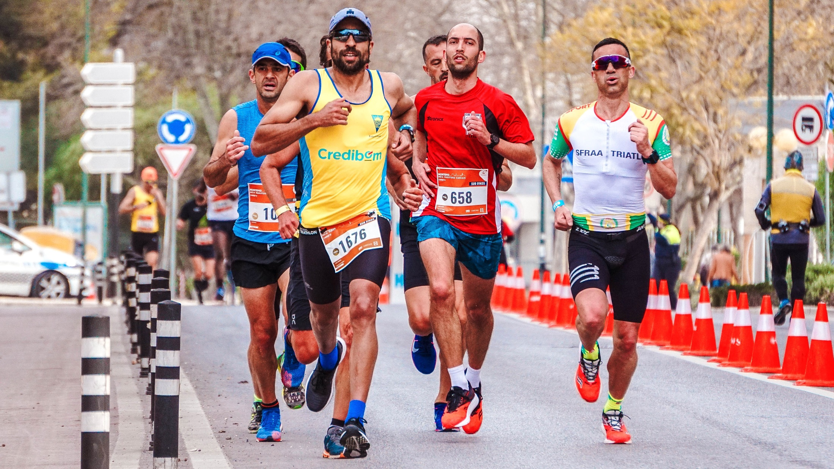
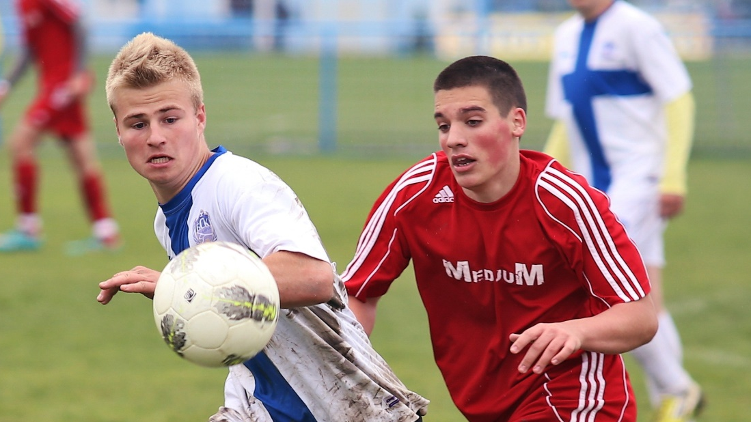
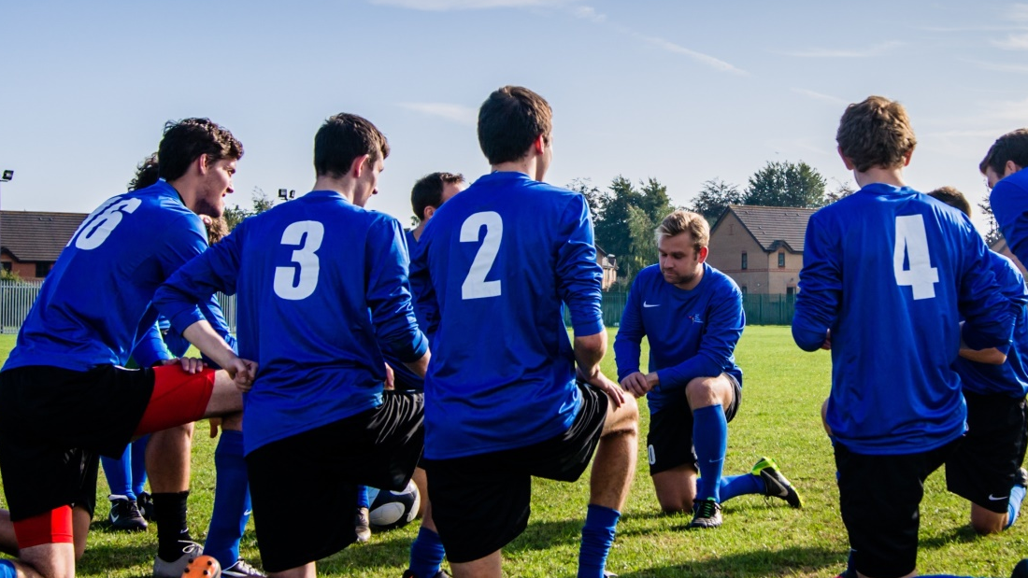
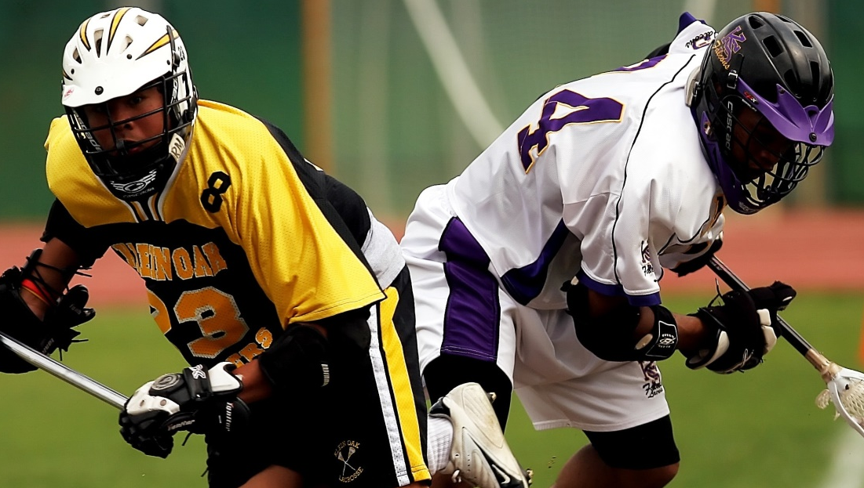
Sports.
Sport includes all forms of competitive physical activity or games which, through casual or organized participation, aim to use, maintain or improve physical ability and skills while providing enjoyment to participants, and in some cases, entertainment for spectators.

Slide 2

Team.
Team is a group of people who are interdependent with respect to information, resources, and skills and who seek to combine their efforts to achieve a common goal.

Slide 3

Lacrosse.
Lacrosse is a team sport played with a lacrosse stick and a lacrosse ball. Players use the head of the lacrosse stick to carry, pass, catch, and shoot the ball into the goal.

Slide 4
Marathon.
The marathon is a long-distance race, completed by running, walking, or a run/walk strategy. There are also wheelchair divisions. The marathon has an official distance of 42.195 kilometers, usually run as a road race.

Slide 5

Football.
Football is a family of team sports that involve, to varying degrees, kicking a ball to score a goal. Unqualified, the word football normally means the form of football that is the most popular where the word is used.

Slide 6

Playing Benefits.
the health benefits of playing sports include an increase in lean body mass, an increase in basal metabolic rate, and an increase in bone density, assisting in healthy body composition.

Slide 7
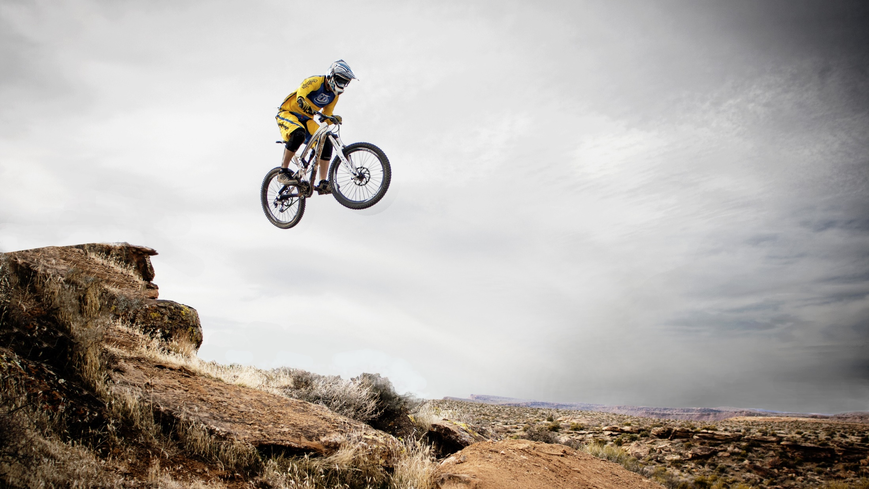
Mountain biking.
Mountain biking is a sport of riding bicycles off-road, often over rough terrain, using specially designed mountain bikes. Mountain bikes share similarities with other bikes but incorporate features designed to enhance durability and performance in rough terrain.

Slide 8
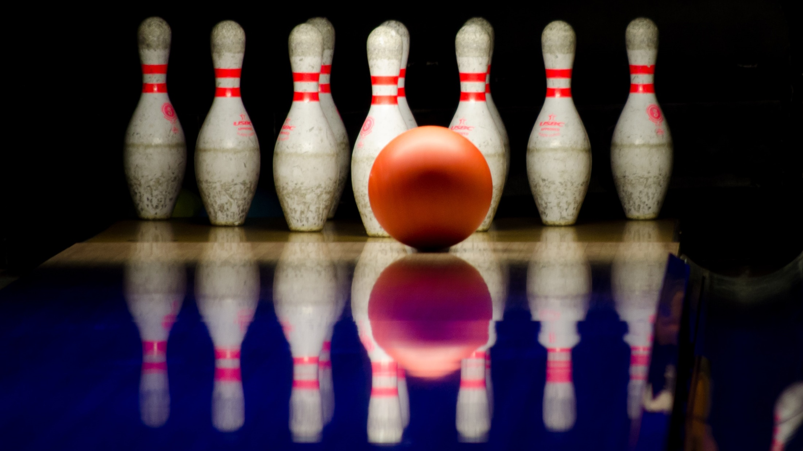
Bowling.
Bowling is a target sport and recreational activity in which a player rolls or throws a bowling ball toward pins (in pin bowling) or another target (in target bowling).

Slide 9
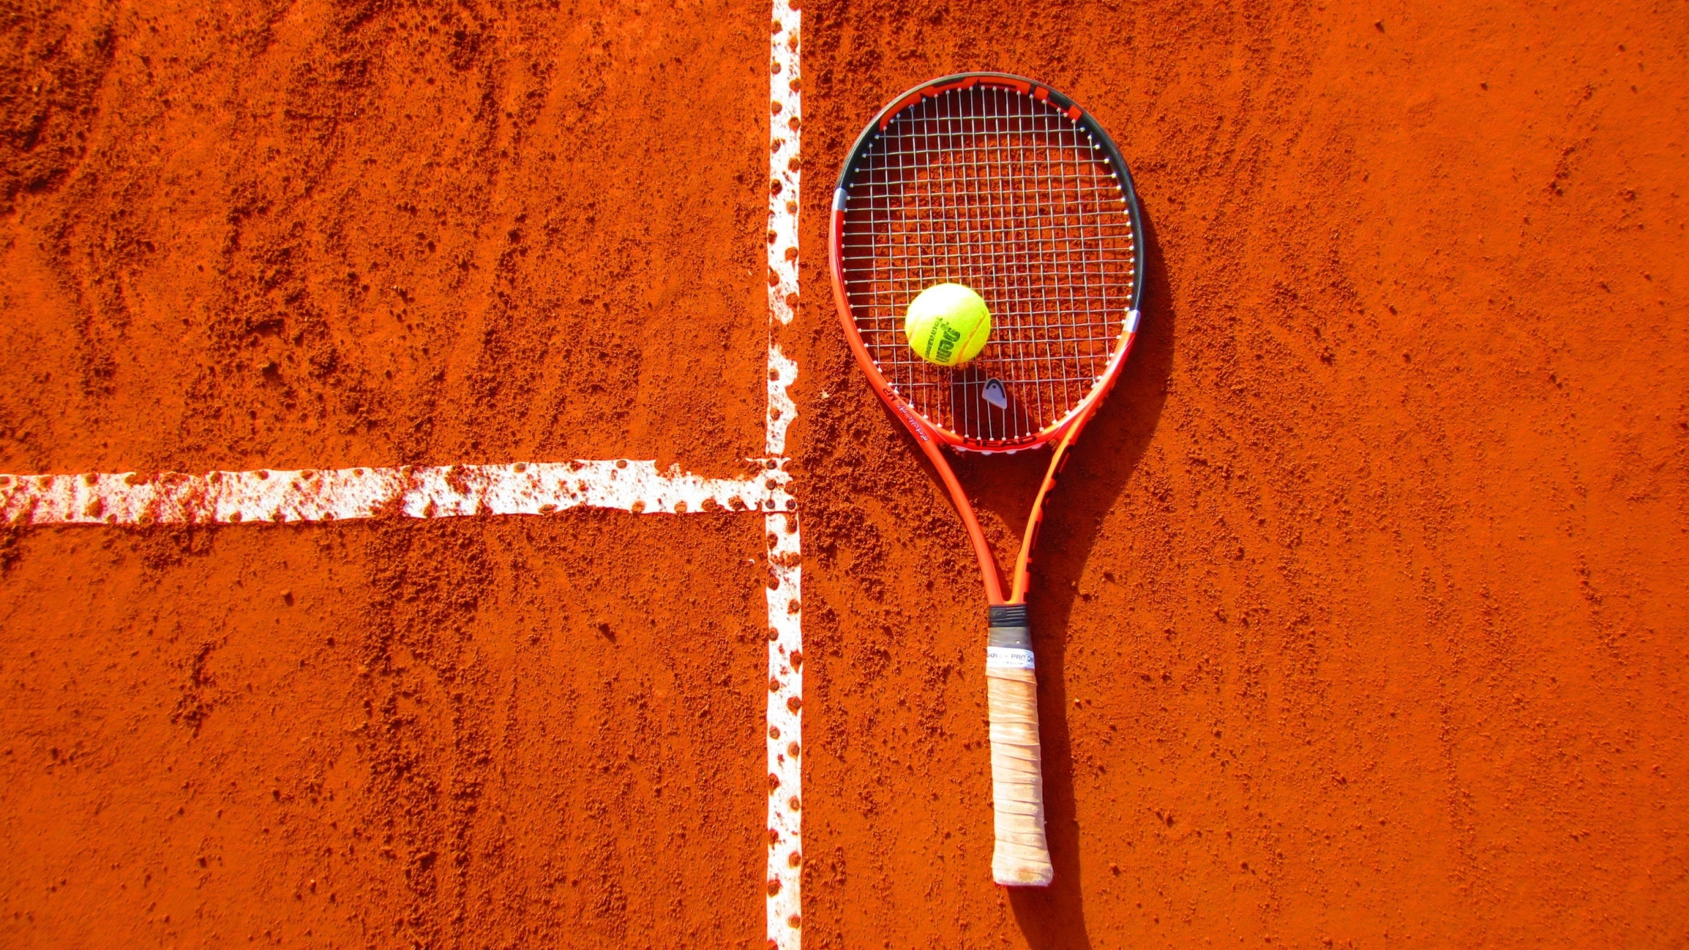
Tennis.
Tennis is a racket sport that can be played individually against a single opponent or between two teams of two players each. Each player uses a tennis racket that is strung with cord to strike a hollow rubber ball covered with felt over or around a net and into the opponent's court.

Slide 10
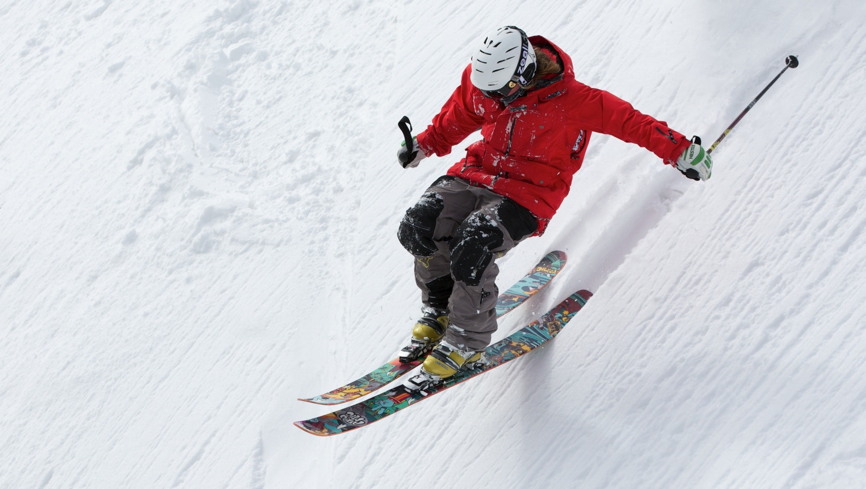
Backcountry skiing.
Backcountry skiing also called off-piste or out-of-area, is skiing in the backcountry on unmarked or unpatrolled areas either inside or outside a ski resort's boundaries. This contrasts with alpine skiing which is typically done on groomed trails benefiting from a ski patrol.

