Slide 1

FOOTBALL
“Once you learn to quit, it becomes a habit.”

Slide 2
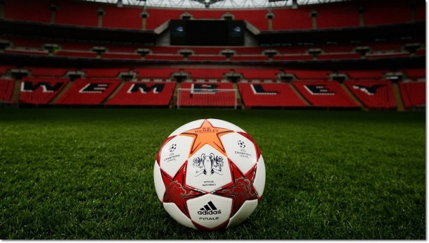
INTRODUCTION
Its played by 250 million players in over 200 countries.
The object of the game is to score by using any part of the body besides the arms and hands to get the football.
Its Played on a rectangular field.
SPORT
SPORT

Slide 3
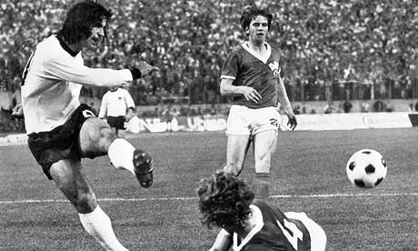
FOOTBALL
History
The contemporary history of the world's favourite game spans more than 100 years. It all began in 1863 in England, when rugby football and association football branched off on their different courses and the Football Association in England was formed - becoming the sport's first governing body.
01
Who invented it?
England invented a game of running around kicking a ball in the mid-19th century (although the Chinese claim to have played a version centuries earlier). They called it “football,” not because the ball is played with the feet, but because the game is played on foot rather on horseback.
02
How was football started?
The sport of American football itself was relatively new in 1892. Its roots stemmed from two sports, soccer and rugby, which had enjoyed long-time popularity in many nations of the world. On November 6, 1869, Rutgers and Princeton played what was billed as the first college football game.

Slide 4
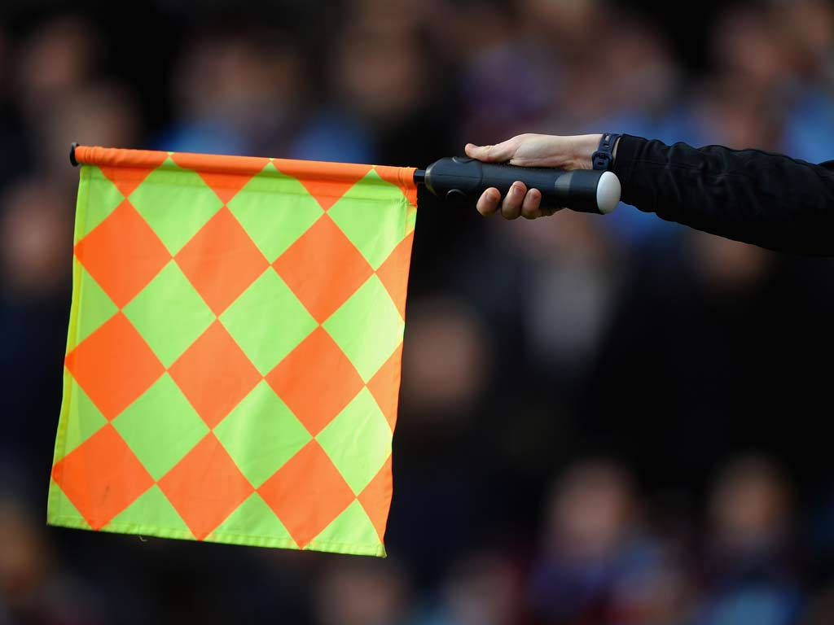
Basic Rules
Scoring.
Not getting 10 yards in four downs.
Fumbling or dropping the football and the defensive team recovers it.
“Pressure is something you feel when you don't know what the hell you're doing.”
Throwing the football to a defensive player for an interception.
Punting or kicking the football to the defensive team.
Missing a field goal.

Slide 5
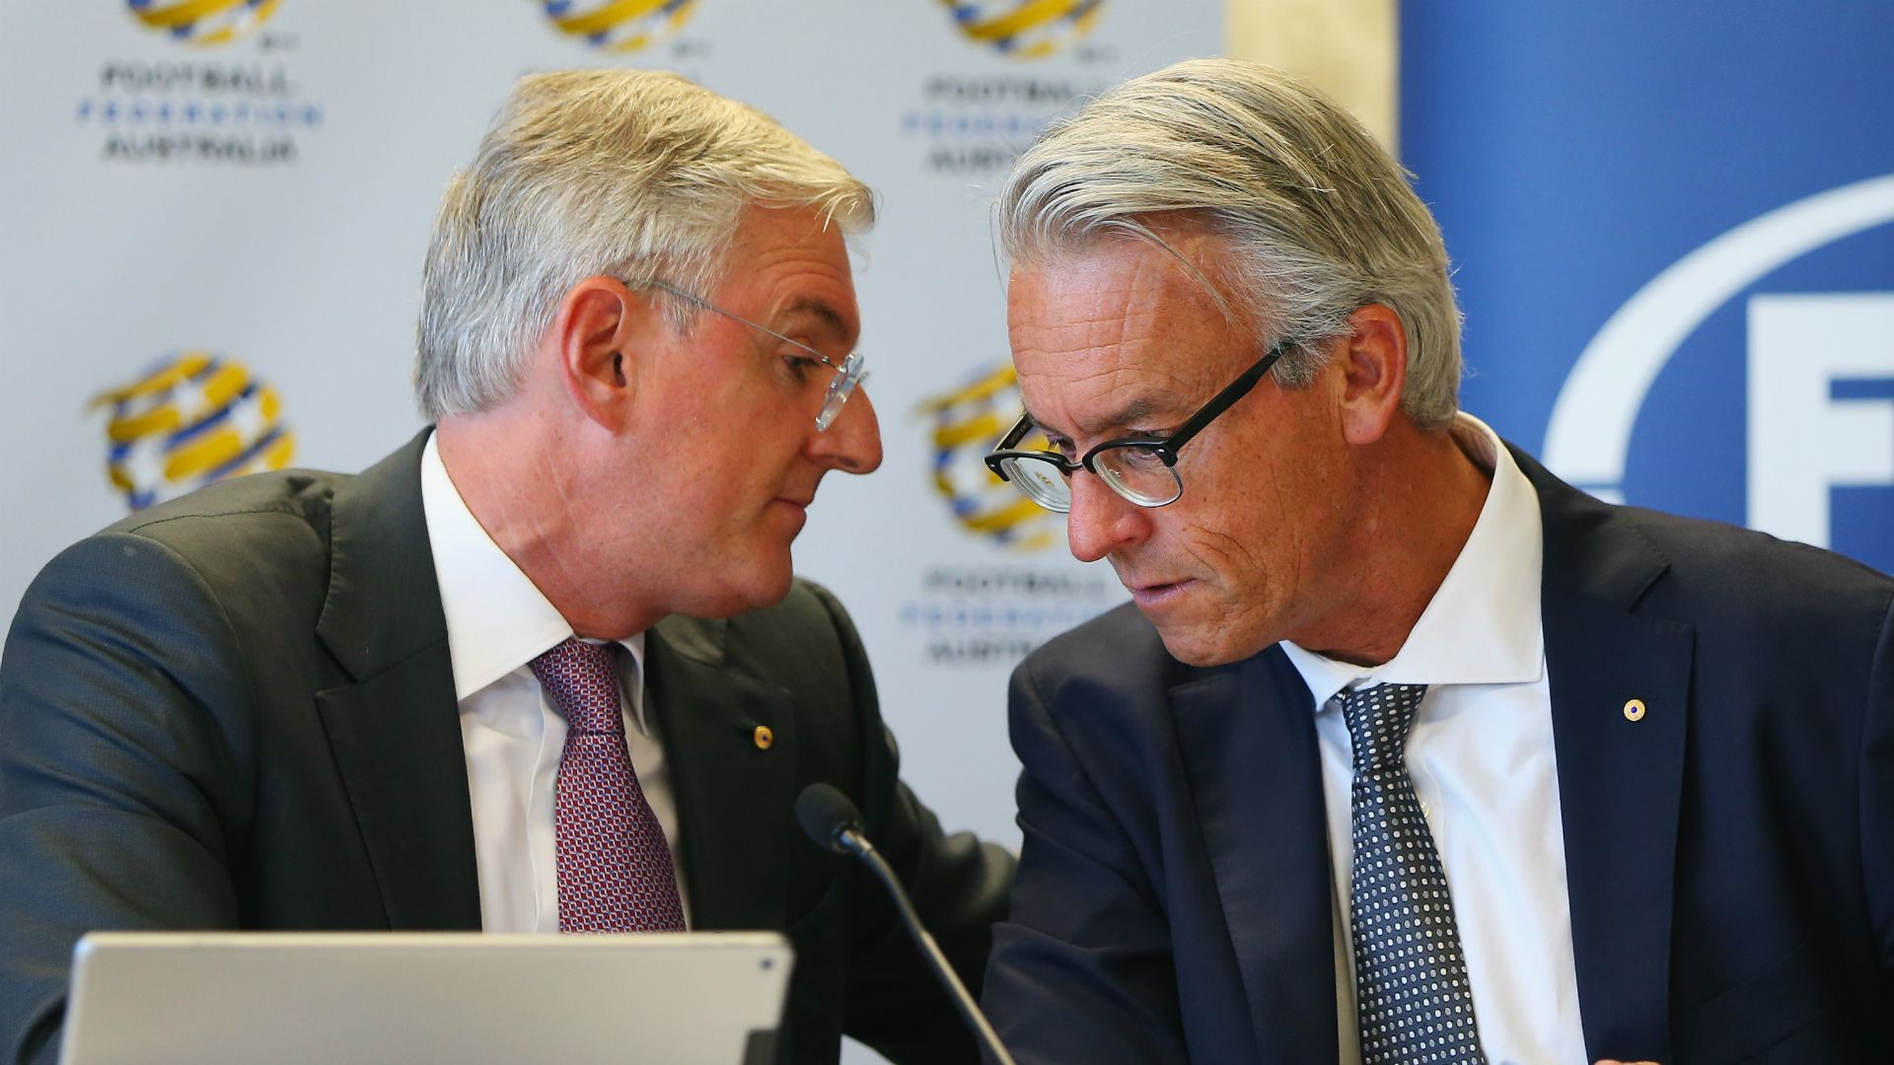





Governing Bodies
The Trinidad and Tobago Football Association (TTFA) is the governing body of football in Trinidad and Tobago. It is based in Port of Spain, Trinidad. It is a member of FIFA and is responsible for governing amateur and professional football and including the men's and women's national teams.
60%
50%
40%
30%
20%
AFC
CFA
CONCACAF
OFC
UEFA

Slide 6
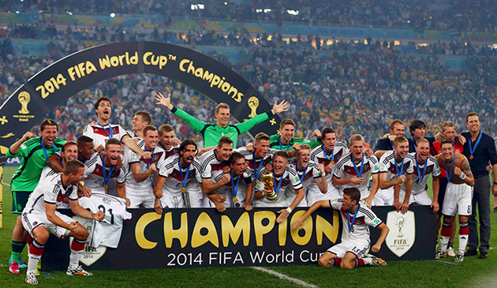
The UEFA Nations League is a new biennial international association football competition contested by the senior men's national teams of the member associations of UEFA
Football
INTERNATIONAL COMPETITIONS
There are several cup competitions for clubs at different levels of the football pyramid. The two major cup competitions are the FA Cup and the EFL Cup, with the winners of those competitions qualifying for the UEFA Europa League. The FA Cup, first held in 1872, is the oldest national cup competition in the world.
PRESENTATION

Slide 7
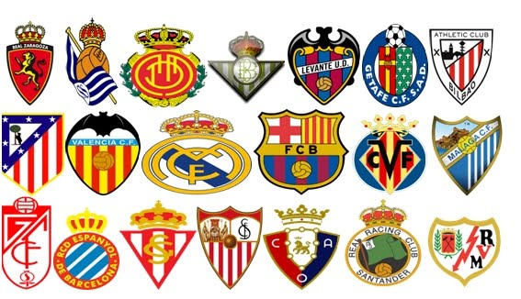
POPULAR FOOTBALL CLUBS

Slide 8

FOOTBALL LEGENDS

Slide 9
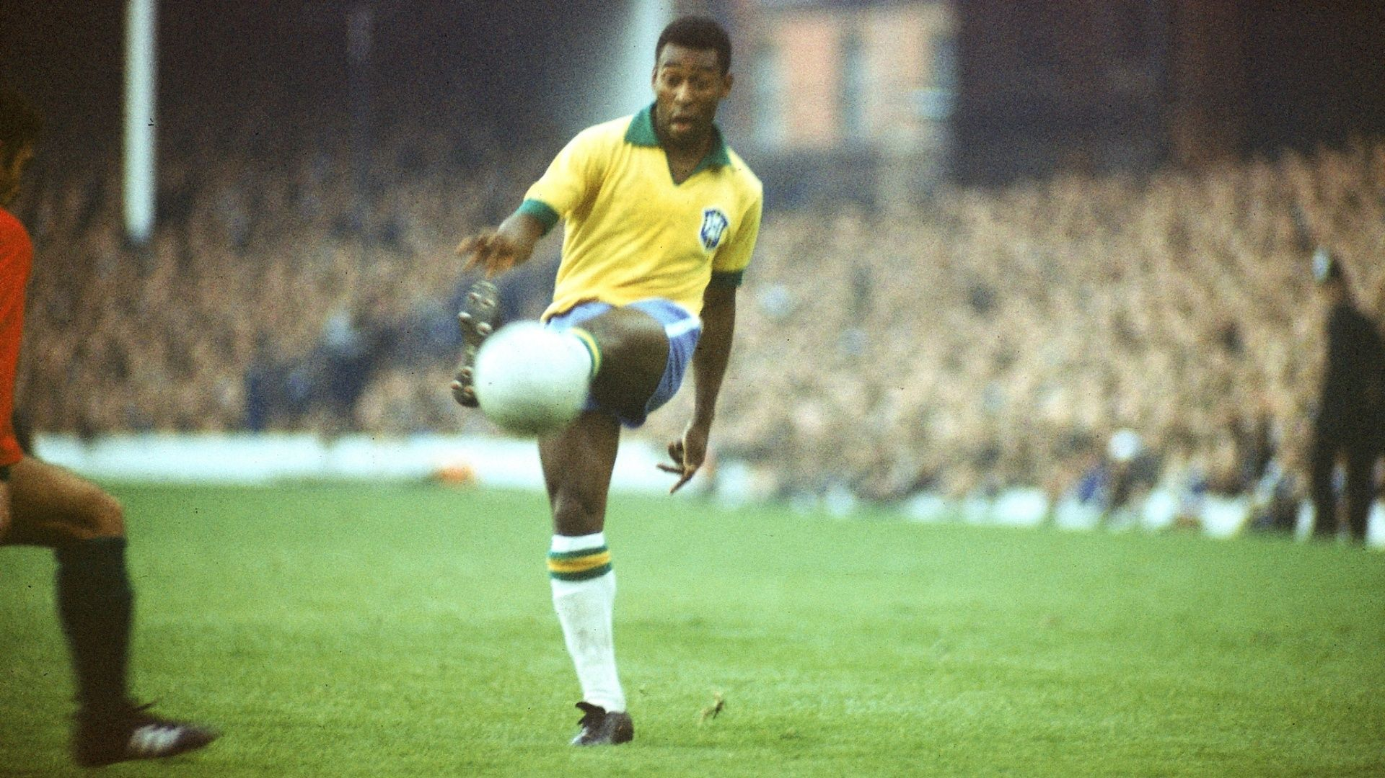
Pele-scoring 650 goals in 694 League matches, and in total 1281 goals in 1363 games

Slide 10
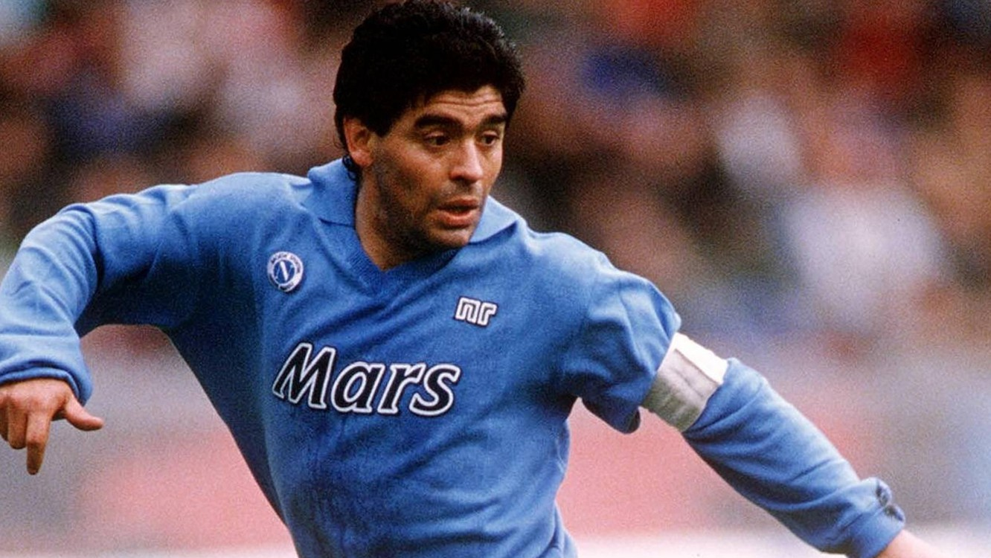
Maradona played 490 official club games during his 21-year professional career, scoring 259 goals

Slide 11
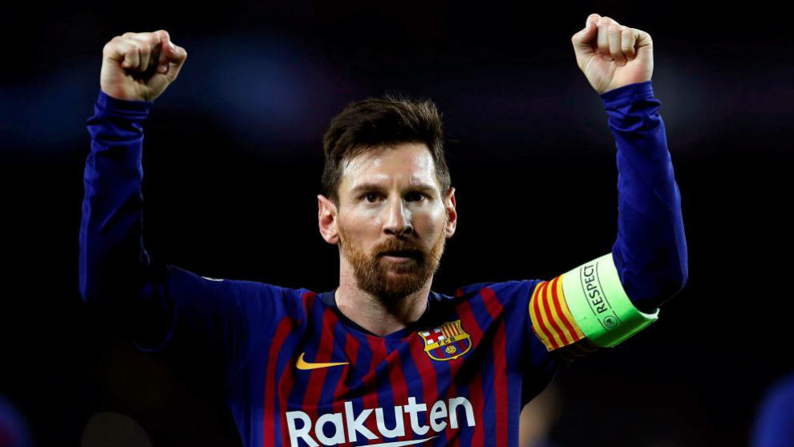
Messi has won a club-record 33 trophies, including 10 La Liga titles, four UEFA Champions League trophies and six Copas del Rey.

Slide 12
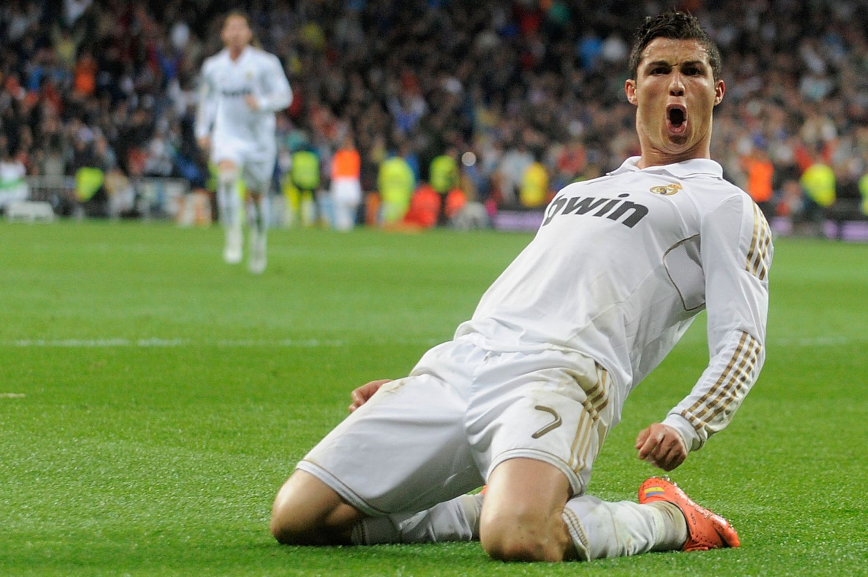
Ronaldo has won 29 trophies in his career, including six league titles, five European Cups and one European Championship.

