Slide 1
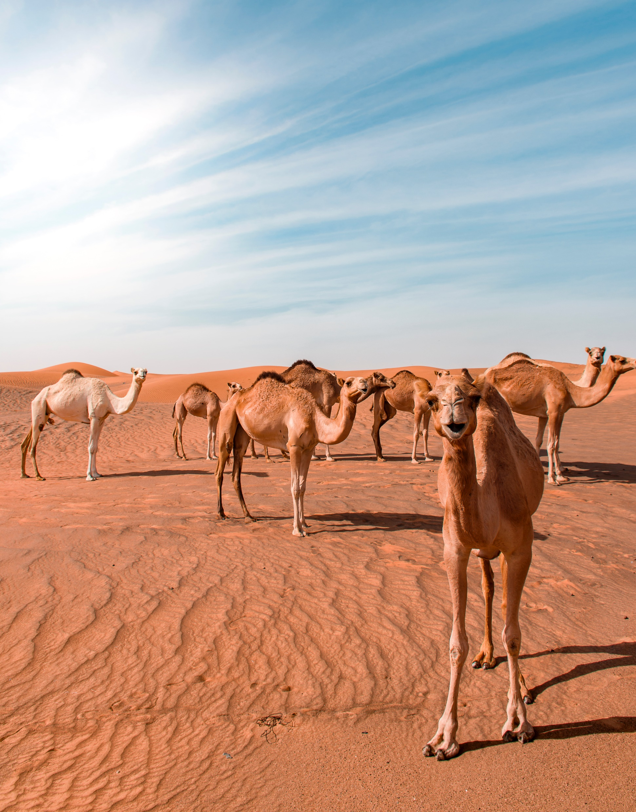
LET’S GET LOST!
WE’LL HANDLE THE
DETAILS ACCURATELY
FLIGHT
Maecenzs faucibus mollis interdum. Maecenas faucibus mollis interdumz
SUMMER TRIP
Maecenzs faucibus mollis Maecenas faucibus mollis interdumz

Slide 2
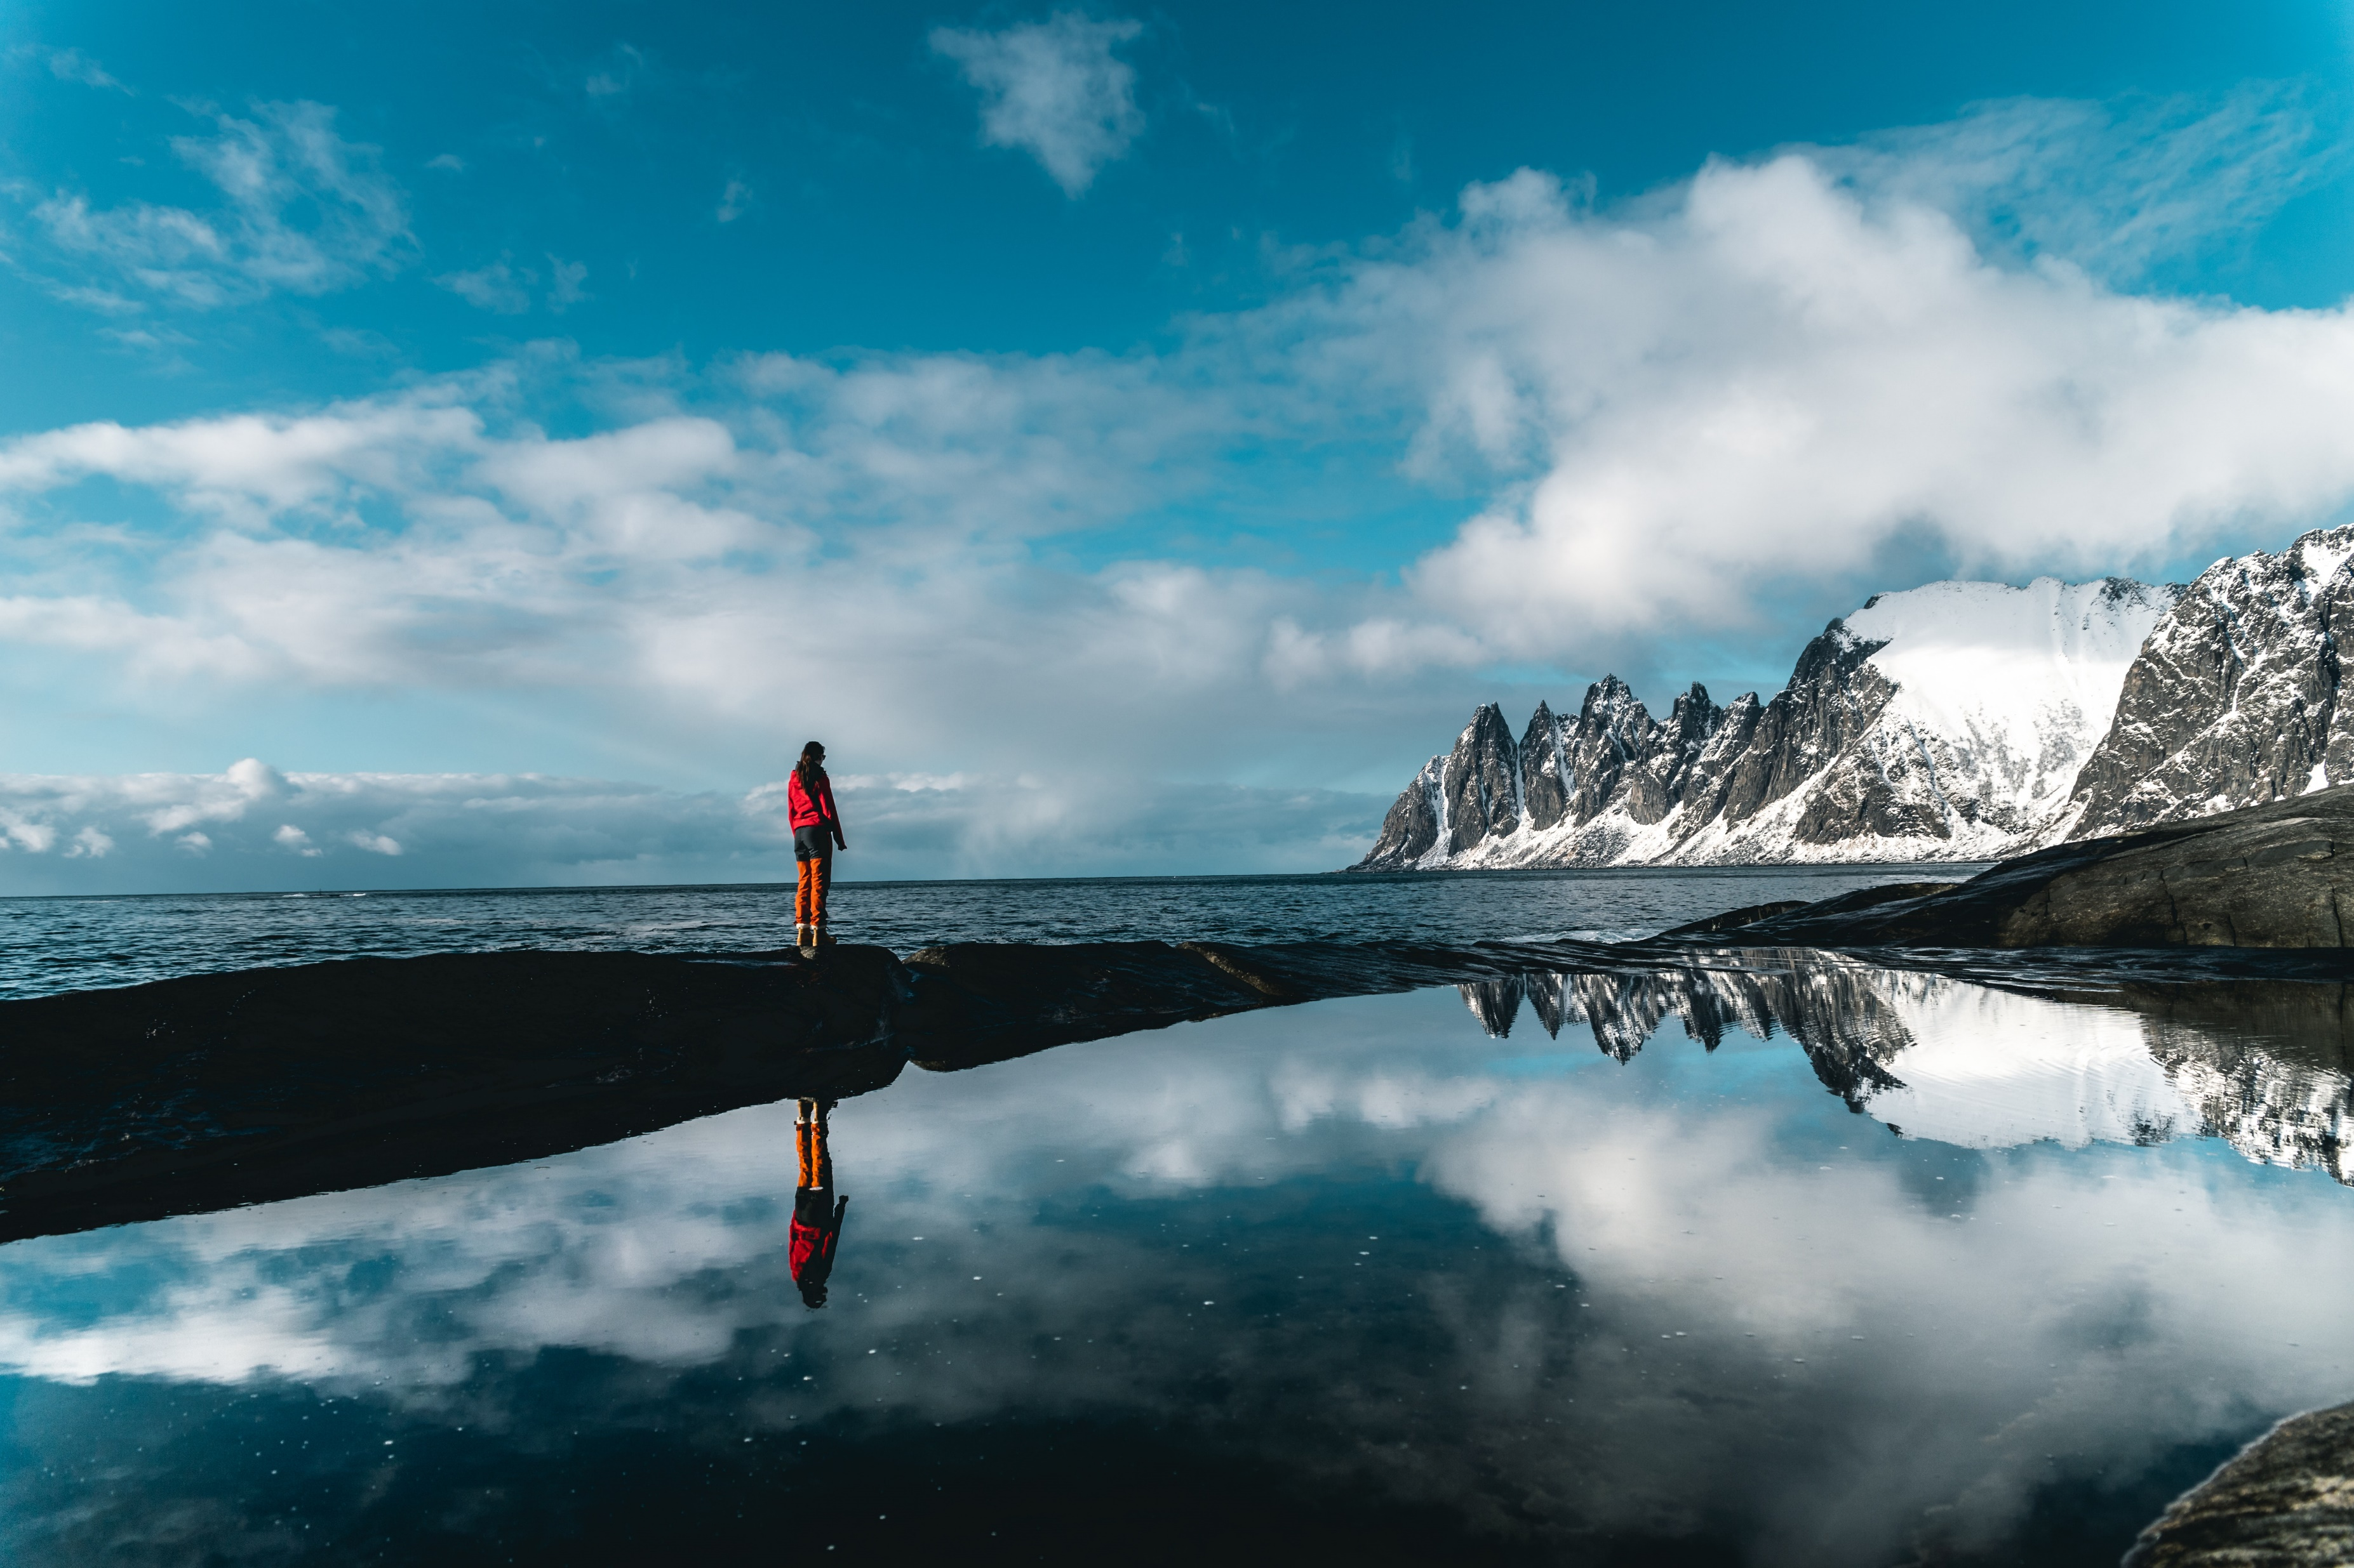
WE’LL HANDLE THE DETAILS ACCURATELY
Flight
Maecenzs faucibus mollis interdum. Maecenas faucibus mollis interdumz
Winter trip
Maecenzs faucibus mollis interdum. Maecenas faucibus mollis interdumz
Summer trip
Maecenzs faucibus mollis Maecenas faucibus mollis interdumz
Offroad
Maecenzs faucibus mollis Maecenas faucibus mollis interdumz
World wide
Maecenzs faucibus mollis interdum. interdumz
Mountaineer
Maecenzs faucibus mollis interdum. interdumz

Slide 3
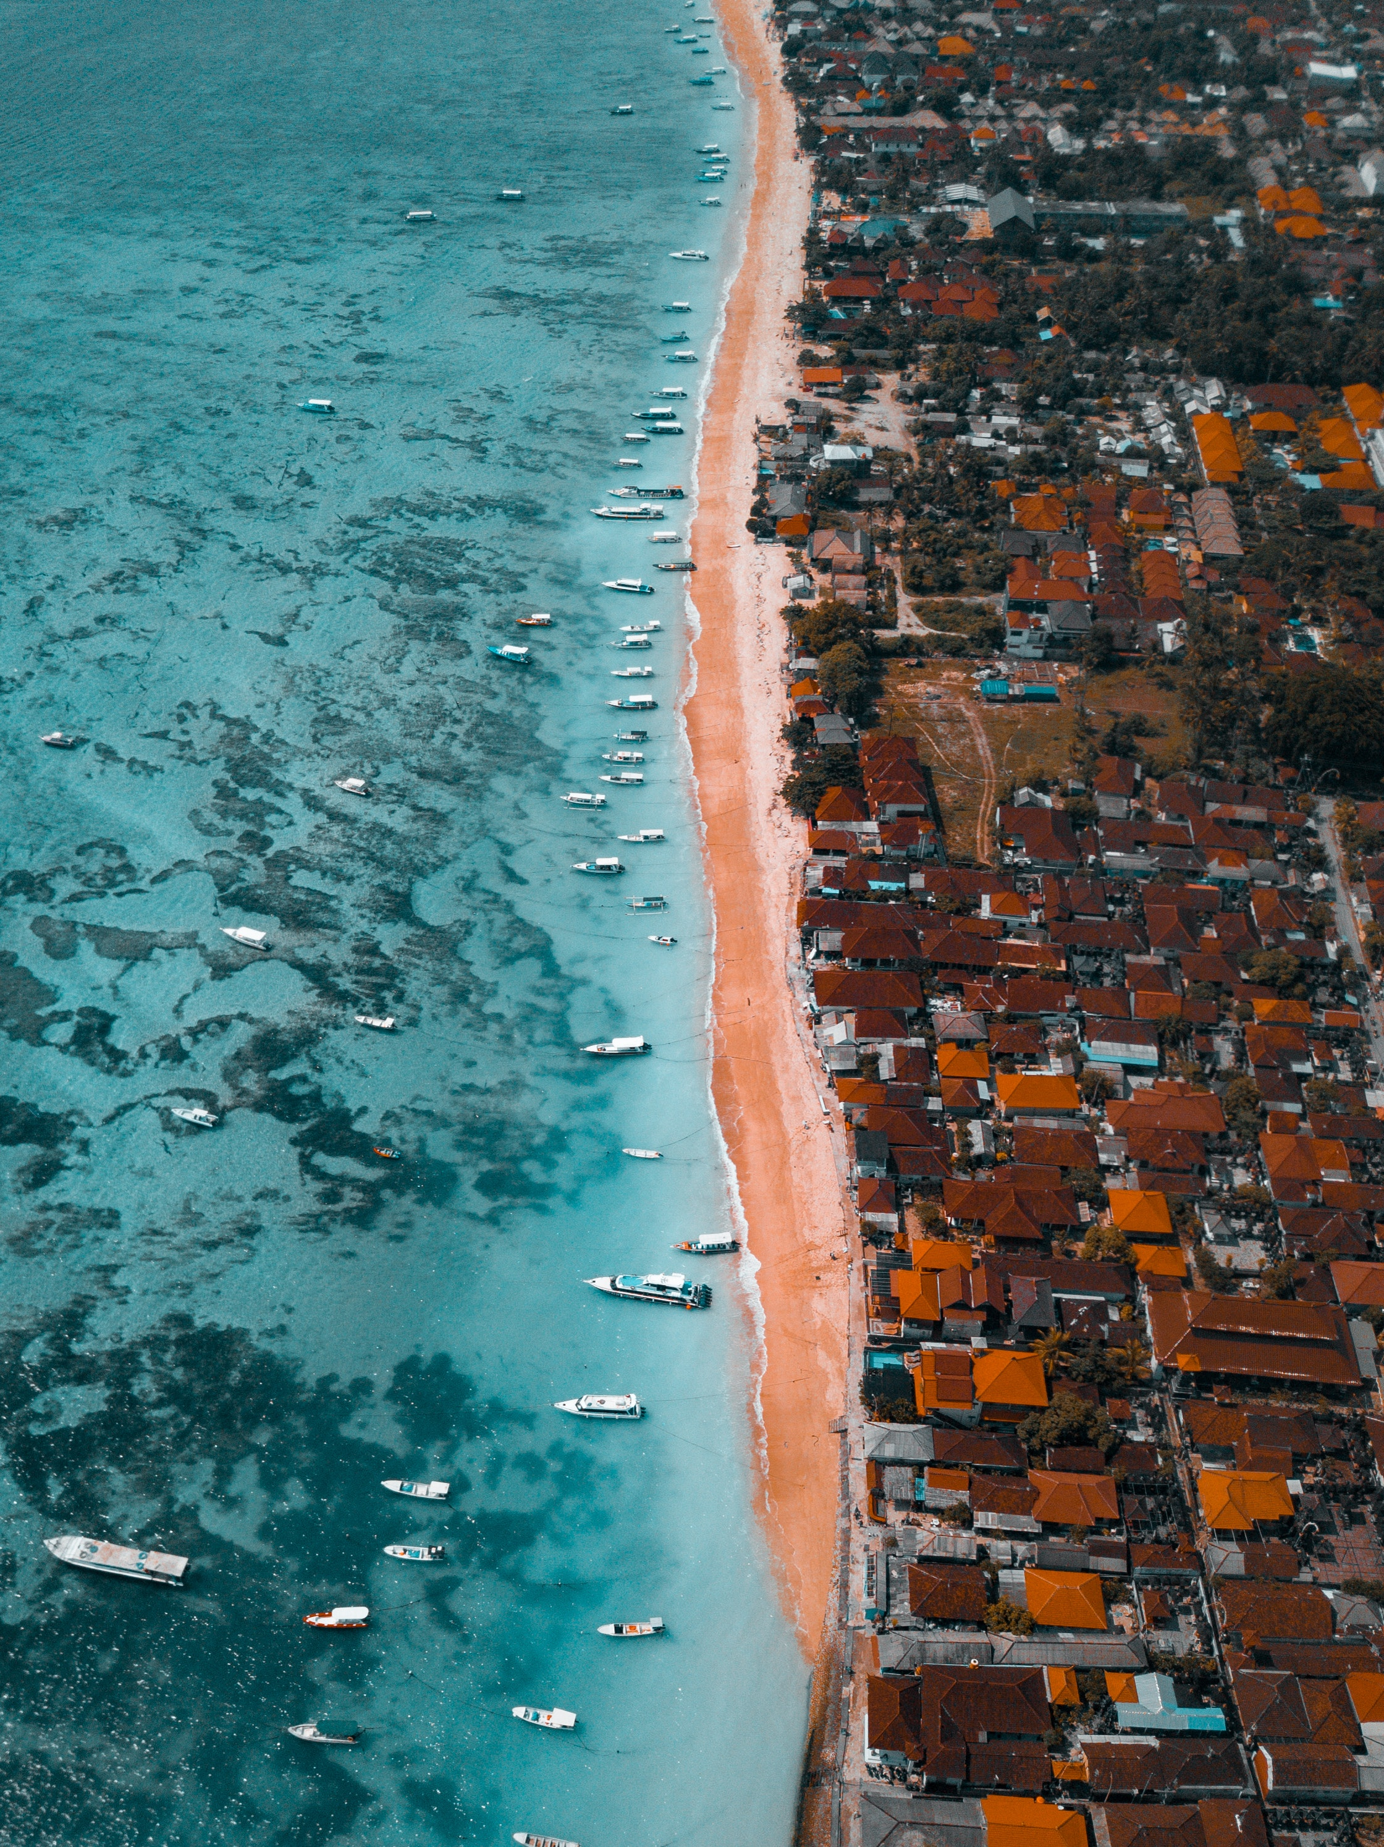
LET’S GET LOST!
WE’LL HANDLE THE
DETAILS ACCURATELY
flight
sail schedulle
Maecenas faucibus mollis interdum. Donec ullamcorper nulla non metus auctor fringilla.
Maecenas faucibus mollis interdum. Donec ullamcorper nulla non metus auctor fringilla.

Slide 4
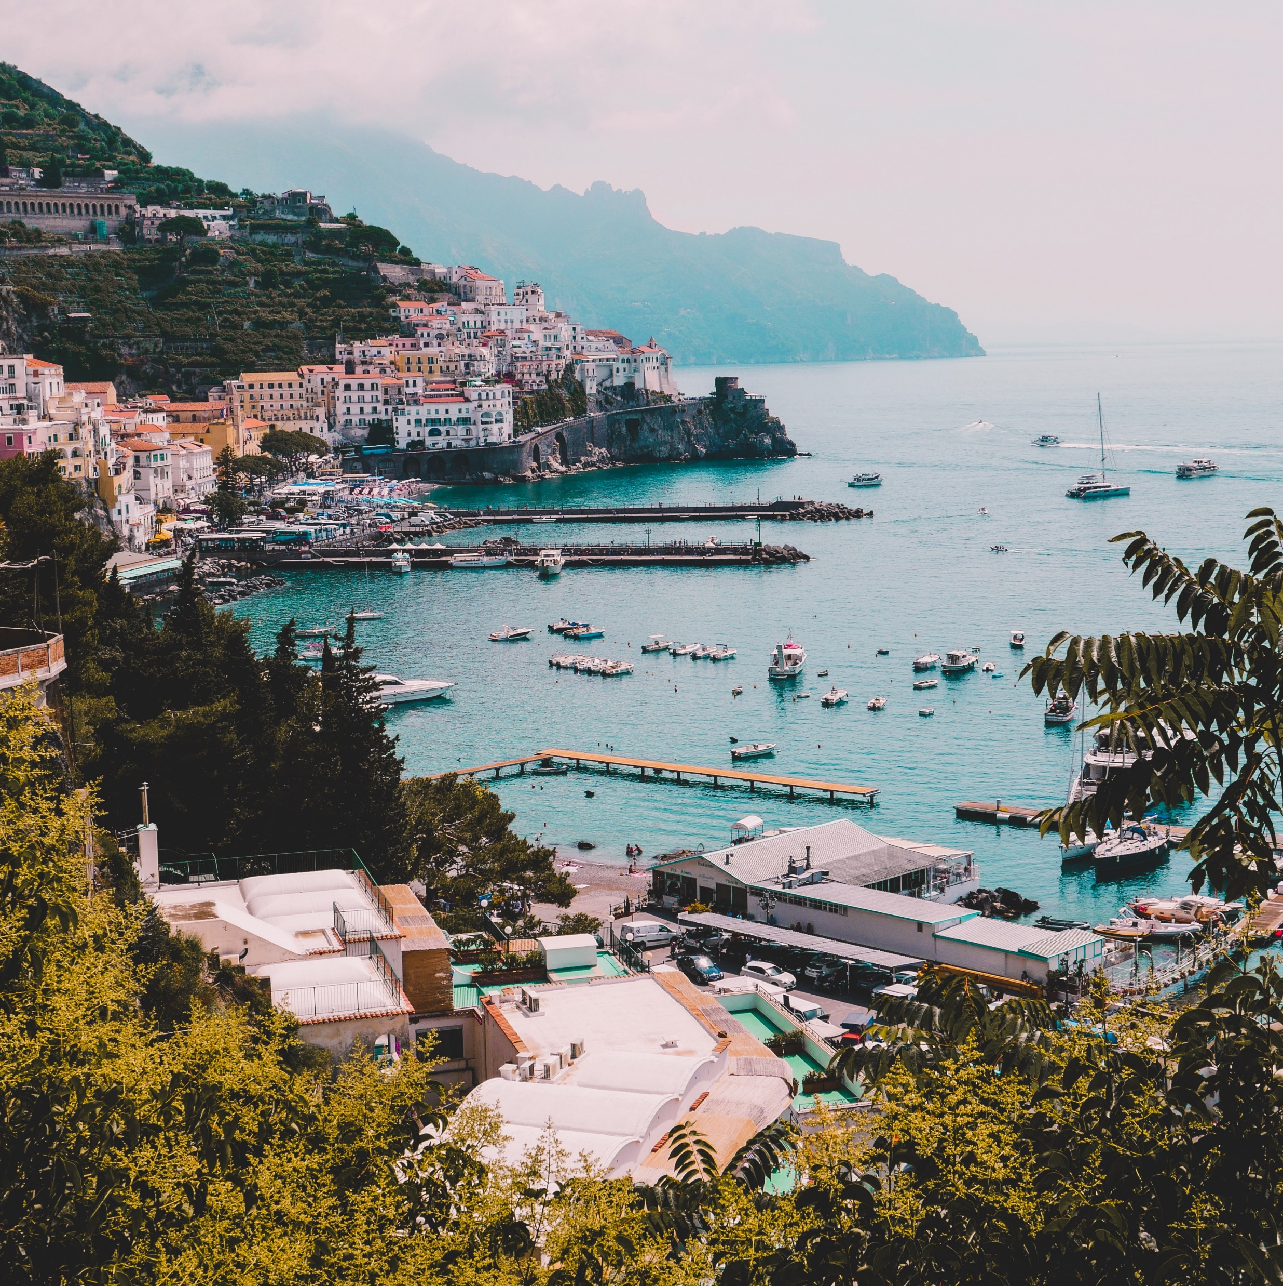
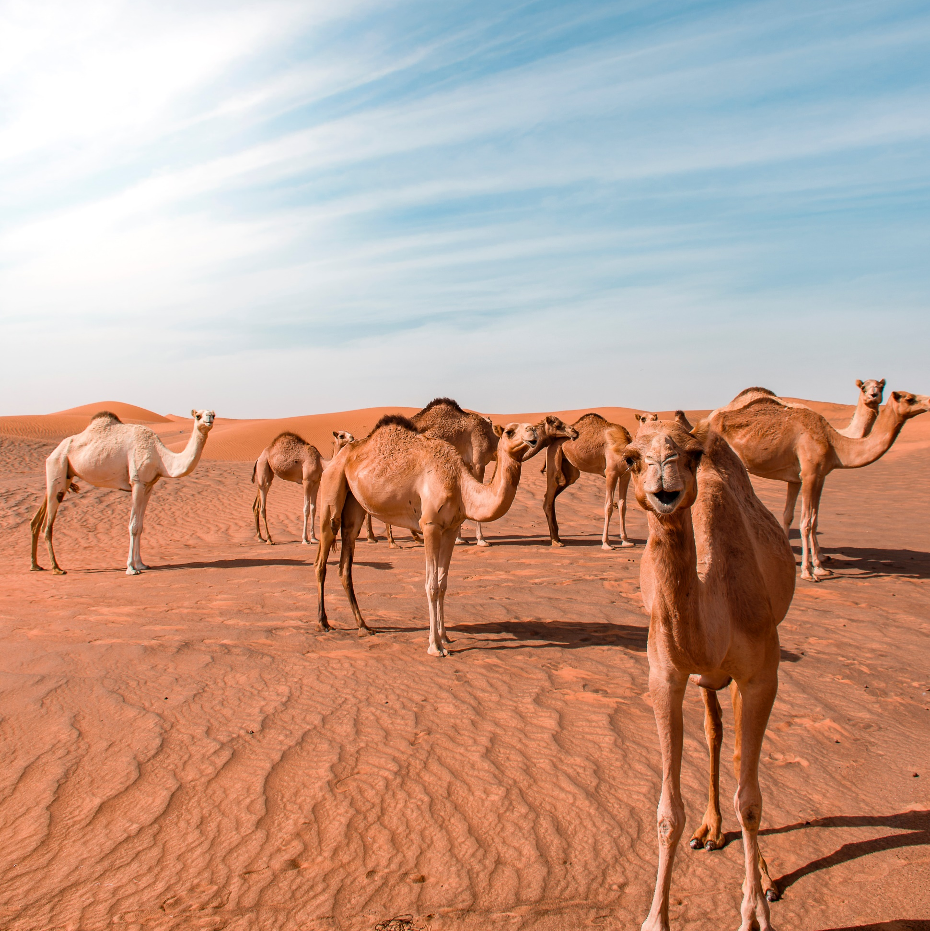

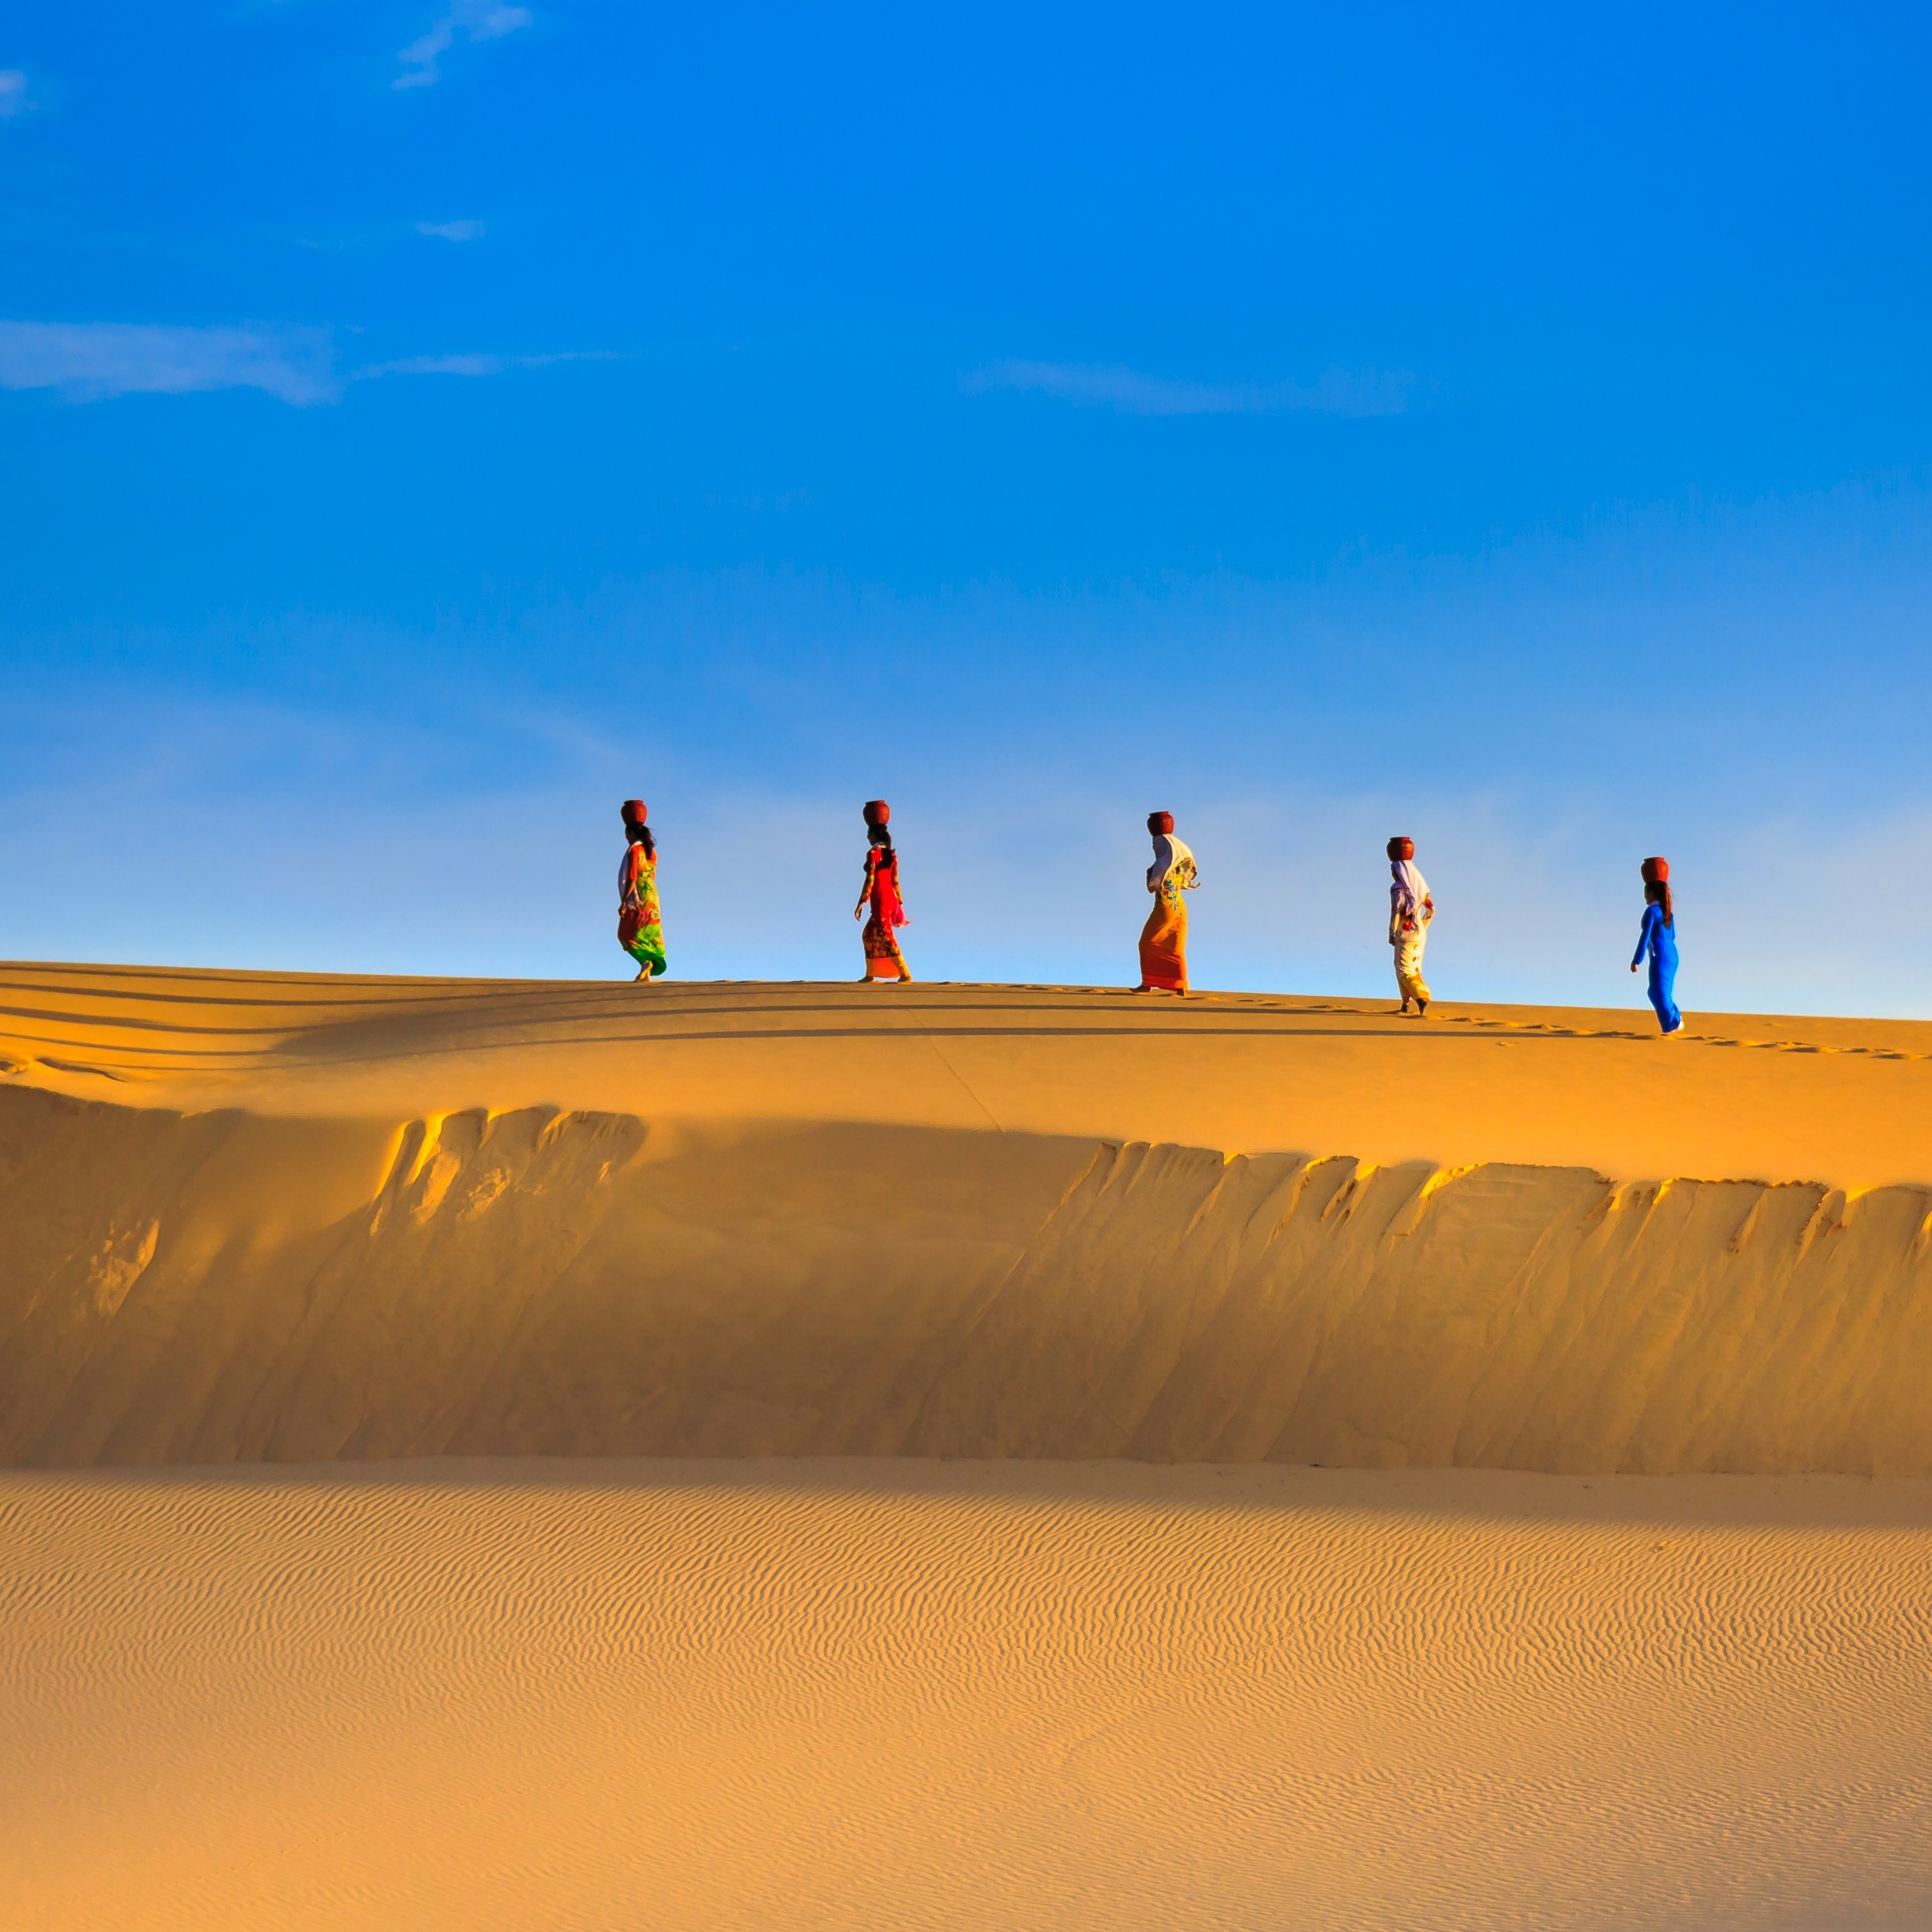

200,000 STRONG COMMUNITY WORLD WIDE
Maecenas faucibus mollis interdum. Donec ullamcorper nulla non metus auctor fringilla. Vivamus sagittis lacus vel augue laoreet rutrum faucibus dolor auctor. Etiam porta sem malesuada magna mollis

Slide 5
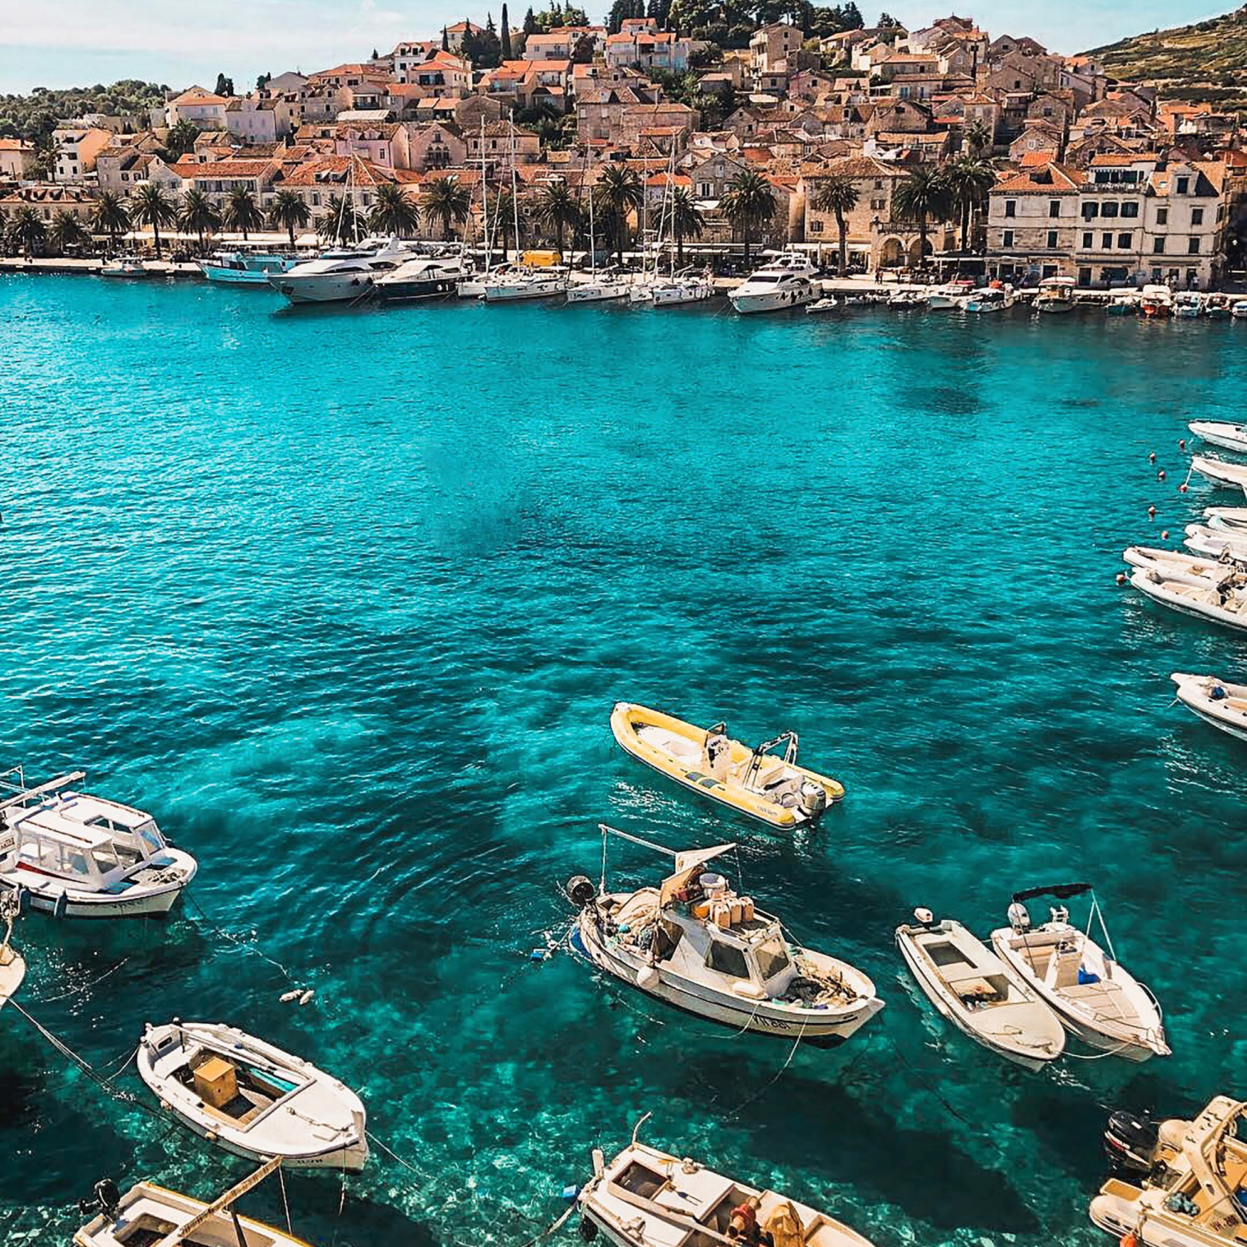
BUDGET TRIP,
SAVE MORE MONEY IN GROUP.
Maecenas faucibus mollis interdum. Donec ullamcorper nulla non metus auctor fringilla. Vivamus sagittis lacus vel augue laoreet rutrum faucibus dolor auctor. Etiam porta sem malesuada magna mollisMaecenas faucibus mollisMaecenas faucibus mollis interdum. Donec ullamcorper nulla non metus auctor fringilla. Vivamus sagittis lacus vel augue

Slide 6

BUDGET TRIP,
SAVE MORE MONEY IN GROUP.
14 DAYS TRIP!
ONLY $2827
Bali, Sulawesi, Papua
Maecenas faucibus mollis interdum. Donec ullamcorper nulla non metus auctor fringilla. Vivamus sagittis lacus vel augue laoreet rutrum faucibus dolor auctor. Etiam porta sem malesuada.

Slide 7
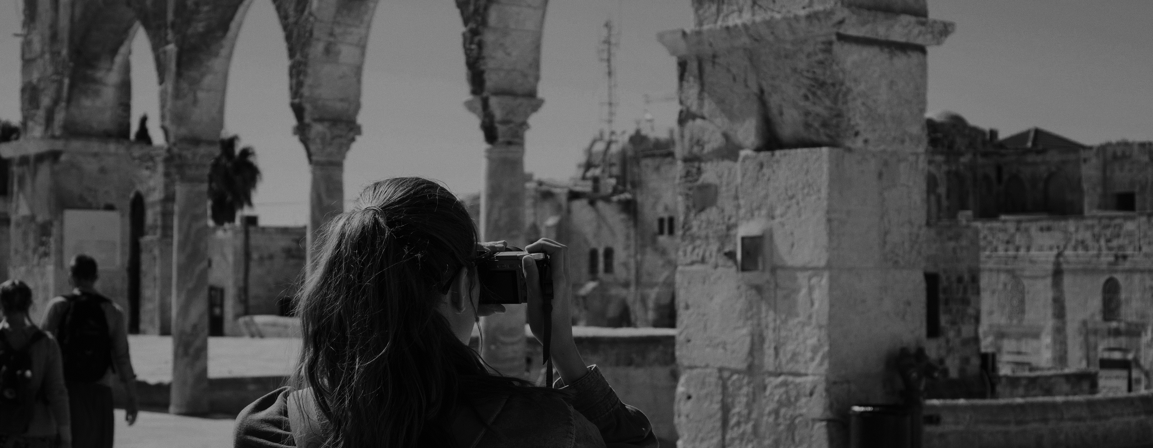
BUDGET TRIP,
SAVE MORE MONEY IN GROUP.
14 DAYS TRIP!
14 DAYS TRIP!
14 DAYS TRIP!
only $2827
only $2827
only $2827
Bali, Sulawesi, Papua
Bali, Sulawesi, Papua
Bali, Sulawesi, Papua

Slide 8


BUDGET TRIP,
SAVE MORE MONEY IN GROUP.
Maecenas faucibus mollis interdum. Donec ullamcorper nulla non metus auctor fringilla. Vivamus sagittis lacus vel augue laoreet rutrum faucibus dolor auctor. Etiam porta sem malesuada. Maecenas faucibus mollis interdum. Donec ullamcorper nulla non metus auctor fringilla. Vivamus sagittis lacus vel augue laoreet rutrum faucibus dolor auctor.
SCANDINAVIA TRIP

Slide 9

THE SEA IS CALLING
BALI + LOMBOK
Maecenas faucibus mollis interdum. Donec dos ullamcorper nulla non metus auctor fringilla. Bermantis
10 Destinations in 3 days
Maecenas faucibus mollis interdum. Donec ullamcorper nulla non metus auctor fringilla. Vivamus sagittis lacus vel augue laoreet rutrum faucibus dolor auctor.

Slide 10
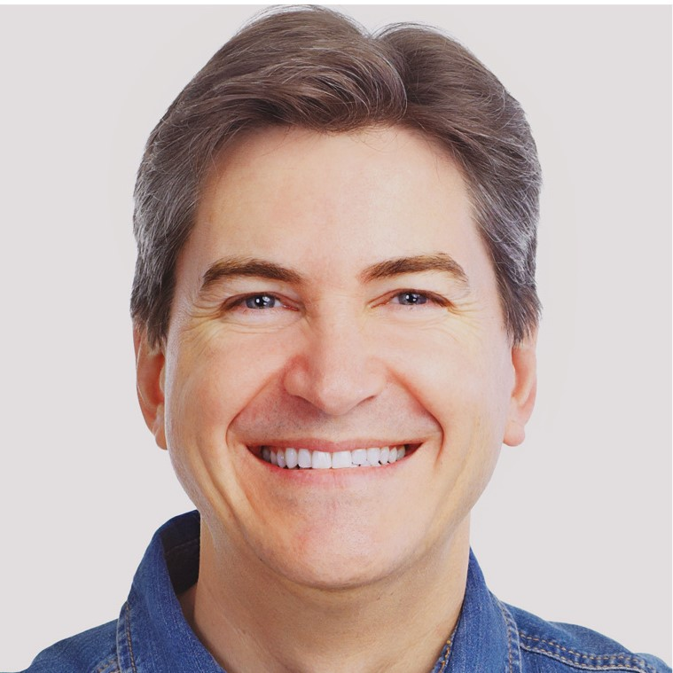

BACKPACKERS #1 FRIENDS
STAY WILD & ADVENTUROUS
Stay
Friends
Friendly environment
group trip and adventure
family package
best choice
10 Destinations in 3 days
free service during winter
marathon route flexible schd.
get more discount today
cheap rent and flexible schd.
$12.99/NIGHT
$12.99/NIGHT

Slide 11

BUDGET TRIP,
SAVE MORE MONEY IN GROUP.
Maecenas faucibus mollis interdum. Donec ullamcorper nulla non metus auctor fringilla
Stay
Logistics
sail & fishing
Maecenas faucibus mollis interdum. Donec ullamcorper nulla non metus auctor fringilla.
Maecenas faucibus mollis interdum. Donec ullamcorper nulla non metus auctor fringilla.
Maecenas faucibus mollis interdum. Donec ullamcorper nulla non metus auctor fringilla.

Slide 12
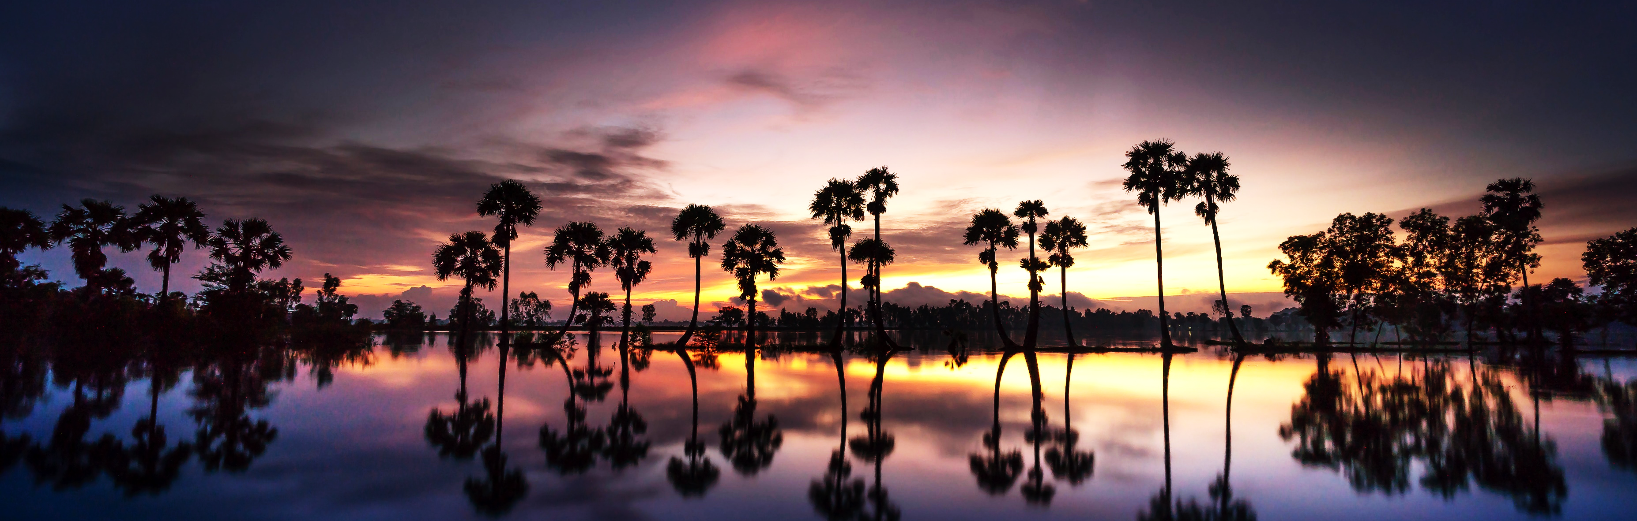
BUDGET TRIP,
SAVE MORE MONEY IN GROUP.
Maecenas faucibus mollis interdum. Donec ullamcorper nulla non metus auctor fringilla. Vivamus sagittis lacus vel augue laoreet rutrum faucibus dolor auctor. Etiam porta sem malesuada magna mollisMaecenas faucibus mollisMaecenas faucibus mollis interdum. Donec ullamcorper nulla non metus auctor fringilla. Vivamus sagittis lacus vel augue
SCANDINAVIA TRIP

Slide 13
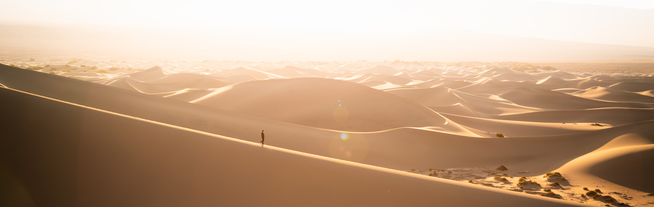
BUDGET TRIP,
SAVE MORE MONEY IN GROUP.
NATURE
SAIL
FAUNA
Maecenas faucibus mollis interdum. Donec ullamcorper nulla
Maecenas faucibus mollis interdum. Donec ullamcorper nulla
Maecenas faucibus mollis interdum. Donec ullamcorper nulla

Slide 14

BUDGET TRIP,
SAVE MORE MONEY IN GROUP.
complete pack
BALI + LOMBOK
Maecenas faucibus mollis doni interdum. Donec
Maecenas faucibus mollis interdum. Donec ullamcorper nulla non metus auctor fringilla. Vivamus sagittis lacus vel augue laoreet rutrum faucibus dolor auctor. Etiam porta sem malesuada magna mollisMaecenas faucibus mollisMaecenas faucibus mollis interdum. Donec ullamcorper nulla non metus auctor fringilla. Vivamus sagittis lacus vel augue
days
3 days, 2 night.
Hotels
5 stars

Slide 15
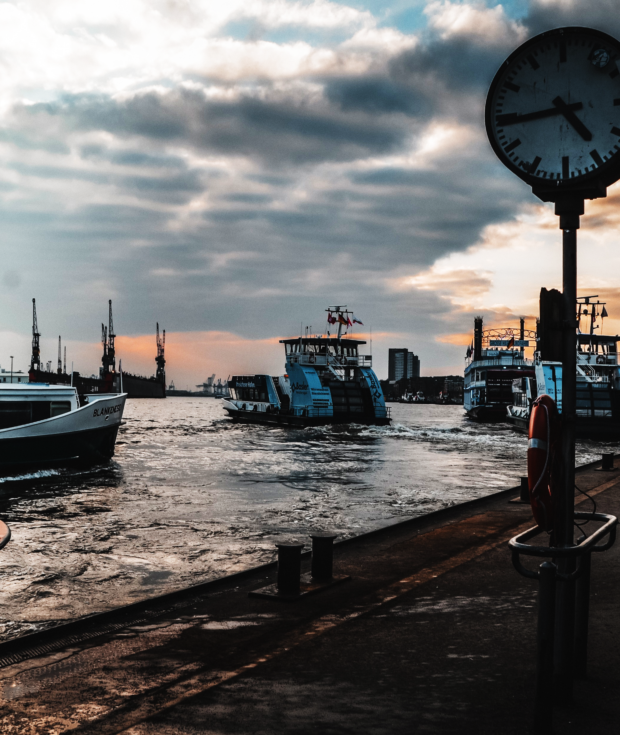
BUDGET TRIP,
SAVE MORE MONEY
IN GROUP.
3.5
budget flight
Group trip
near hotels
Maecenas faucibus mollis interdum. Donec ullamcorper nulla non metus auctor fringilla. Vivamus sagittis lacus vel augue laoreet rutrum faucibus dolor auctor. Etiam porta sem malesuada magna mollisMaecenas faucibus mollis
20% DISCOUNT DURING SUMMER

Slide 16

BUDGET TRIP,
SAVE MORE MONEY IN GROUP.
3.5
budget flight
Group trip
near hotels
Maecenas faucibus mollis interdum. Donec ullamcorper nulla non metus auctor fringilla. Vivamus sagittis lacus vel augue laoreet rutrum faucibus dolor auctor. Etiam porta sem malesuada magna mollisMaecenas faucibus mollis
20% DISCOUNT DURING SUMMER

Slide 17
BUDGET TRIP,
SAVE MORE MONEY IN GROUP.
3.5
budget flight
Group trip
near hotels
pro. guide
sail & fishing
Maecenas faucibus mollis interdum. Donec ullamcorper nulla non metus auctor fringilla. Vivamus sagittis lacus vel augue laoreet rutrum faucibus dolor auctor. Etiam porta sem malesuada magna mollisMaecenas faucibus mollis. Maecenas faucibus mollis interdum. Donec ullamcorper nulla non metus auctor fringilla. Vivamus sagittis lacus vel augue laoreet rutrum faucibus dolor auctor. Etiam porta sem malesuada magna mollisMaecenas faucibus mollis

Slide 18

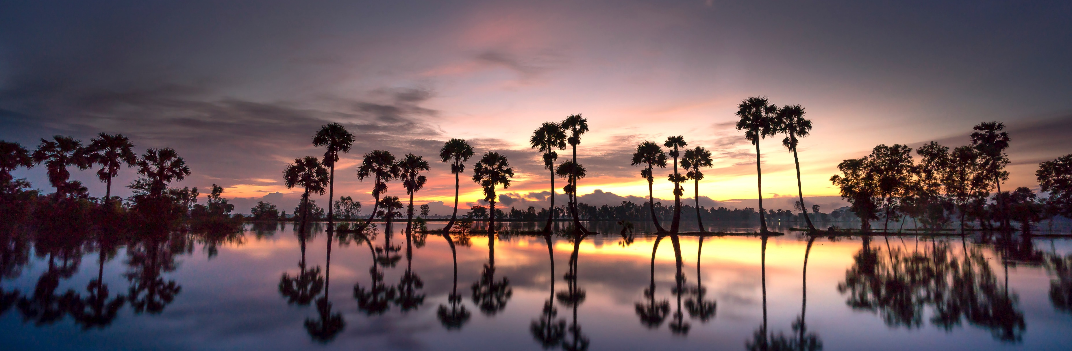
CHOOSE YOUR VACATION
Booking Free
Booking Free
Booking Free
SEPTEMBER 2019
SEPTEMBER 2019
SEPTEMBER 2019
Wild West Wave
Top Peak
Cliff Camp
Maecenas faucibus mollis interdum. Donec ullamcorper nulla non metus auctor fringilla. Vivamus sagittis lacus
Maecenas faucibus mollis interdum. Donec ullamcorper nulla non metus auctor fringilla. Vivamus sagittis lacus
Maecenas faucibus mollis interdum. Donec ullamcorper nulla non metus auctor fringilla. Vivamus sagittis lacus

Slide 19
CHECK OUR RATE & PACKAGES
SILVER TRIP
GOLD TRIP
VIP TRIP
$1920
$2666
$2199
$8728
Best services
Trusted since 1990
Low prices
Free booking fee
Best services
Trusted since 1990
Low prices
Free booking fee
Best services
Trusted since 1990
Low prices
Free booking fee

Slide 20
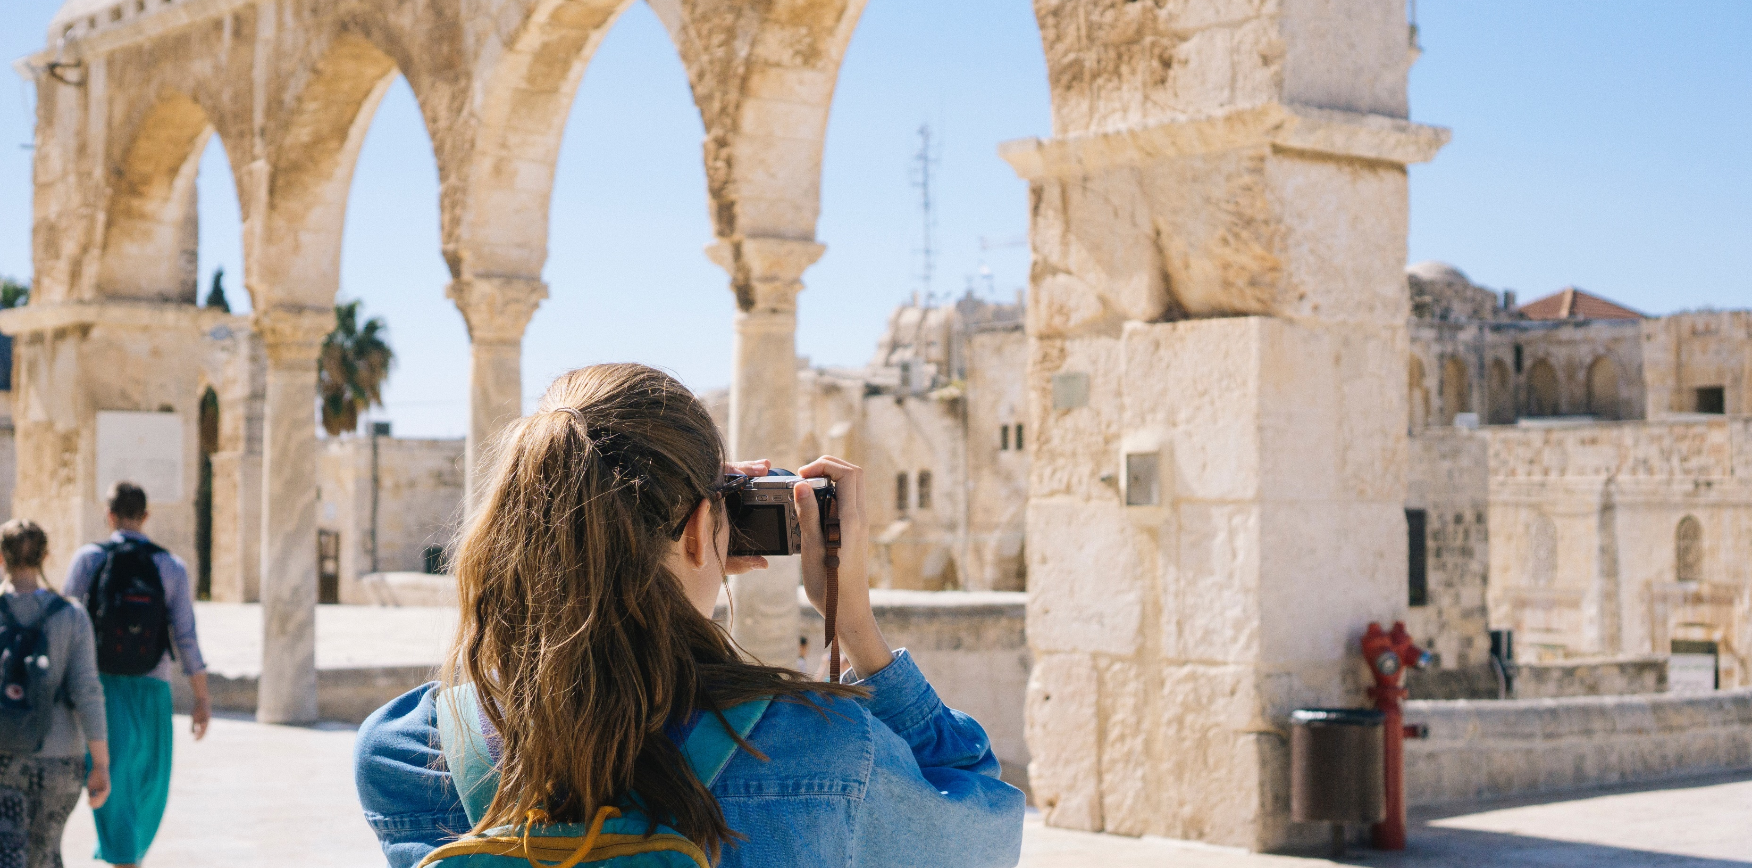

CHOOSE YOUR VACATION
Maecenas faucibus mollis interdum. Donec ullamcorper nulla non metus auctor fringilla. Maecenas faucibus mollis interdum. Donec ullamcorper nulla non metus auctor fringilla. Maecenas faucibus mollis interdum. Donec ullamcorper nulla non metus auctor fringilla. Maecenas faucibus mollis interdum. Donec ullamcorper nulla non metus auctor fringilla. Maecenas faucibus mollis interdum. Donec ullamcorper nulla non metus auctor
$35
for person
per night
$35
for person
per night
Maecenas faucibus mollis interdum. Donec ullamcorper nulla non metus auctor
Maecenas faucibus mollis interdum. Donec ullamcorper nulla non metus auctor
barmadang hotel
barmadang hotel

Slide 21
CHOOSE YOUR VACATION
Backpacker
city tour
sail & dive
Maecenas faucibus mollis interdum. Donec ullamcorper nulla non metus auctor fringilla.
Maecenas faucibus mollis interdum. Donec ullamcorper nulla non metus auctor fringilla.
Maecenas faucibus mollis interdum. Donec ullamcorper nulla non metus auctor fringilla.
group
honey moon
extreme
Maecenas faucibus mollis interdum. Donec ullamcorper nulla non metus auctor fringilla.
Maecenas faucibus mollis interdum. Donec ullamcorper nulla non metus auctor fringilla.
Maecenas faucibus mollis interdum. Donec ullamcorper nulla non metus auctor fringilla.

Slide 22

BUDGET TRIP, SAVE MORE MONEY IN GROUP.
family
Maecenas faucibus mollis interdum. Donec ullamcorper nulla non metus auctor fringilla. Vivamus sagittis lacus vel augue laoreet rutrum faucibus dolor auctor. Etiam porta sem malesuada magna mollisMaecenas faucibus mollis
Maecenas faucibus mollis interdum. Donec ullamcorper nulla non metus auctor fringilla. Vivamus sagittis lacusMaecenas

Slide 23
DESTINATION
SCHEDULE
LOCATION
Departure
LOCATION
Maecenas faucibus mollis interdum. Donec ullamcorper nulla non metus auctor fringilla.
Schedule
Maecenas faucibus mollis interdum. Donec ullamcorper nulla non metus auctor fringilla.

Slide 24
ç
DESTINATION
SCHEDULE
siren peak
siren peak
siren peak
Departure
siren peak
Maecenas faucibus mollis interdum. Donec ullamcorper nulla non metus auctor fringilla.
Schedule
siren peak
Maecenas faucibus mollis interdum. Donec ullamcorper nulla non metus auctor fringilla.

